Slide 2
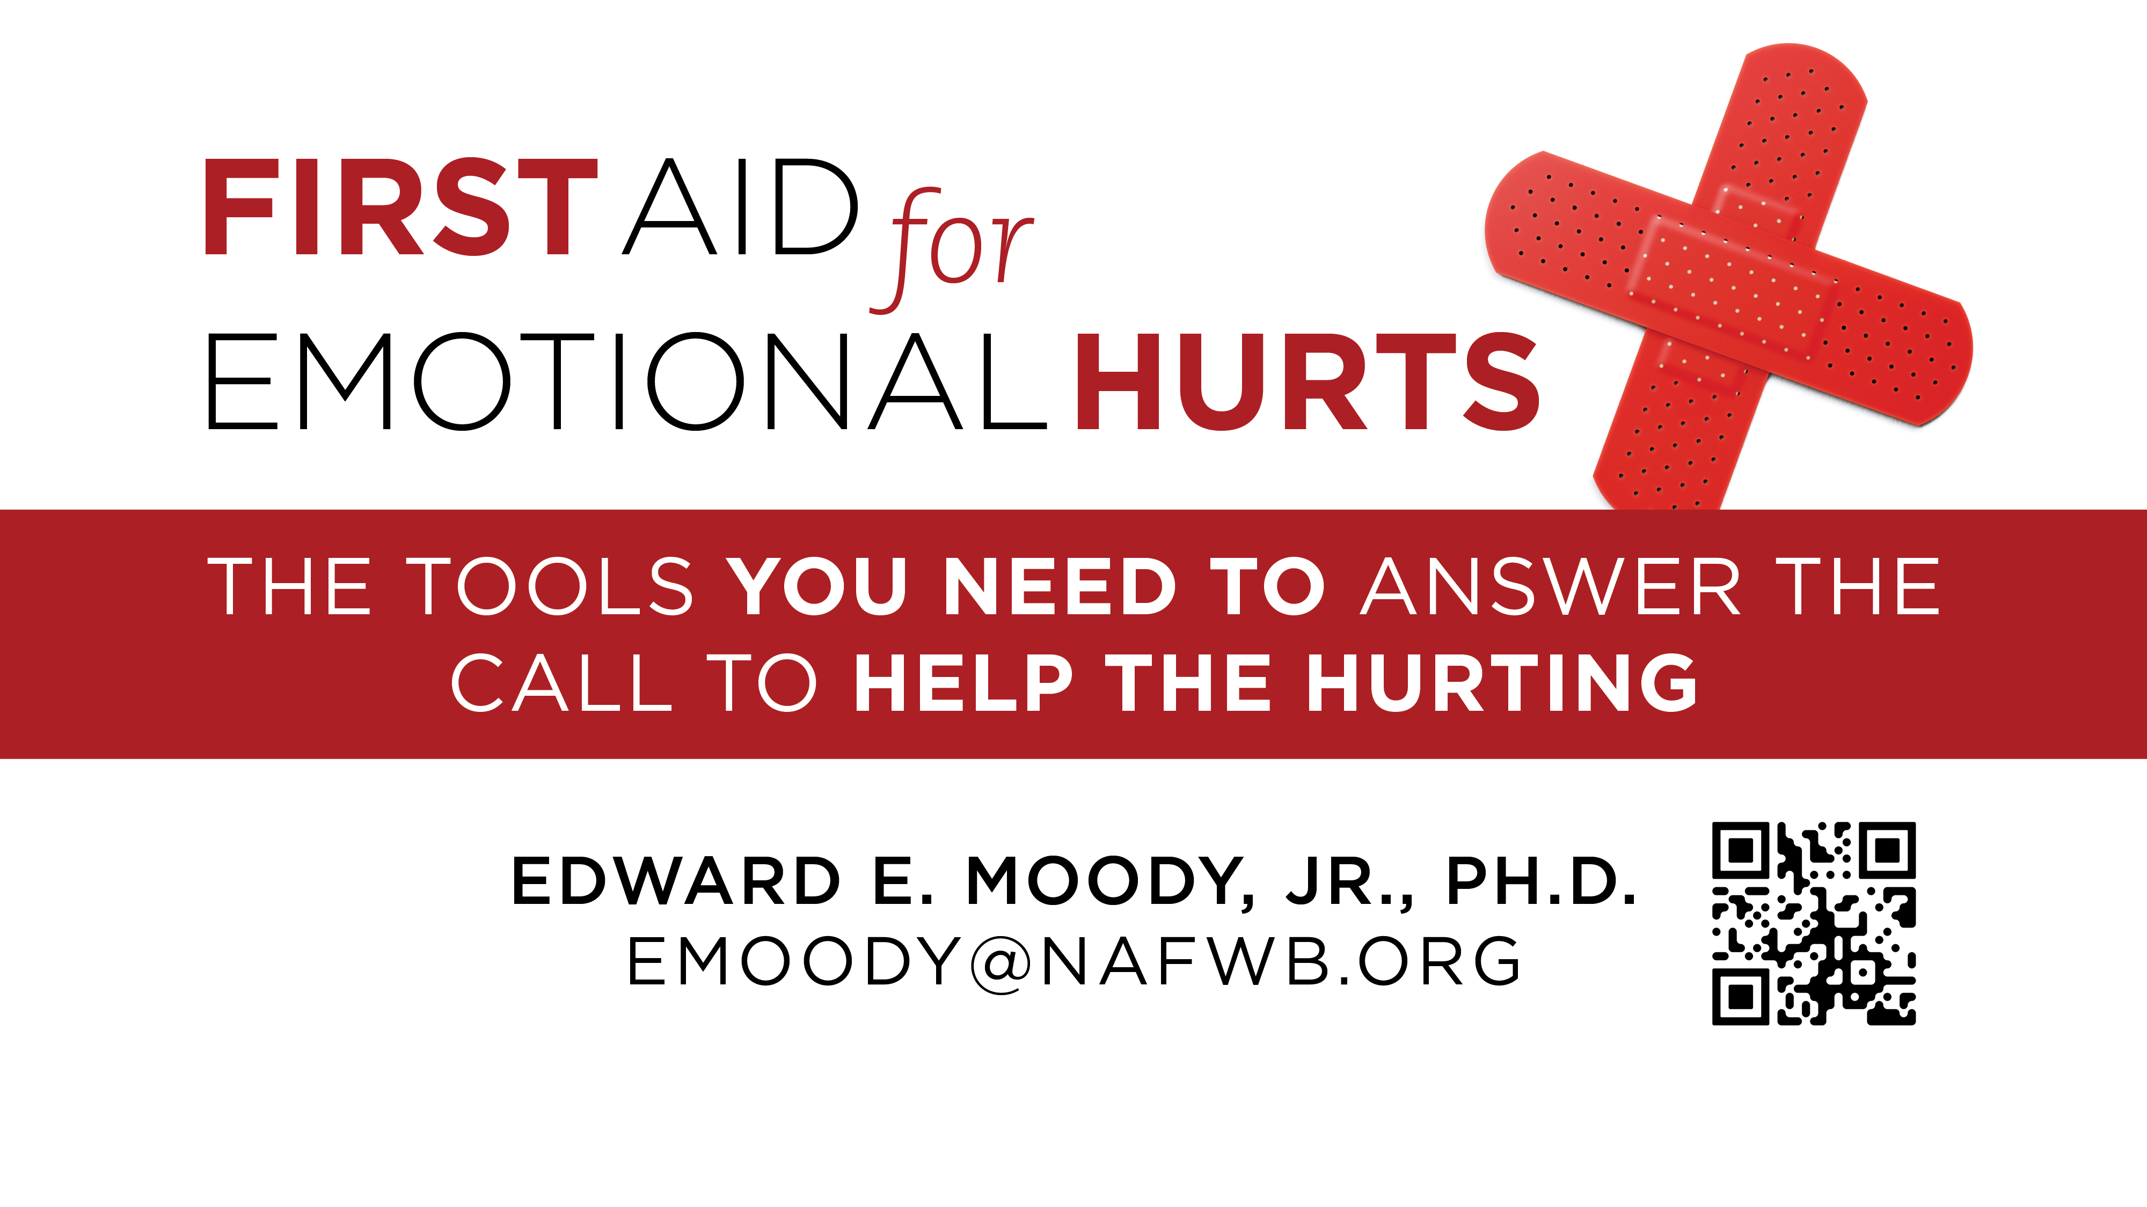

Slide 3
First Aid for Psychosis and Other Problems
Edward E. Moody, Jr., Ph.D emoody@nafwb.org

Slide 4
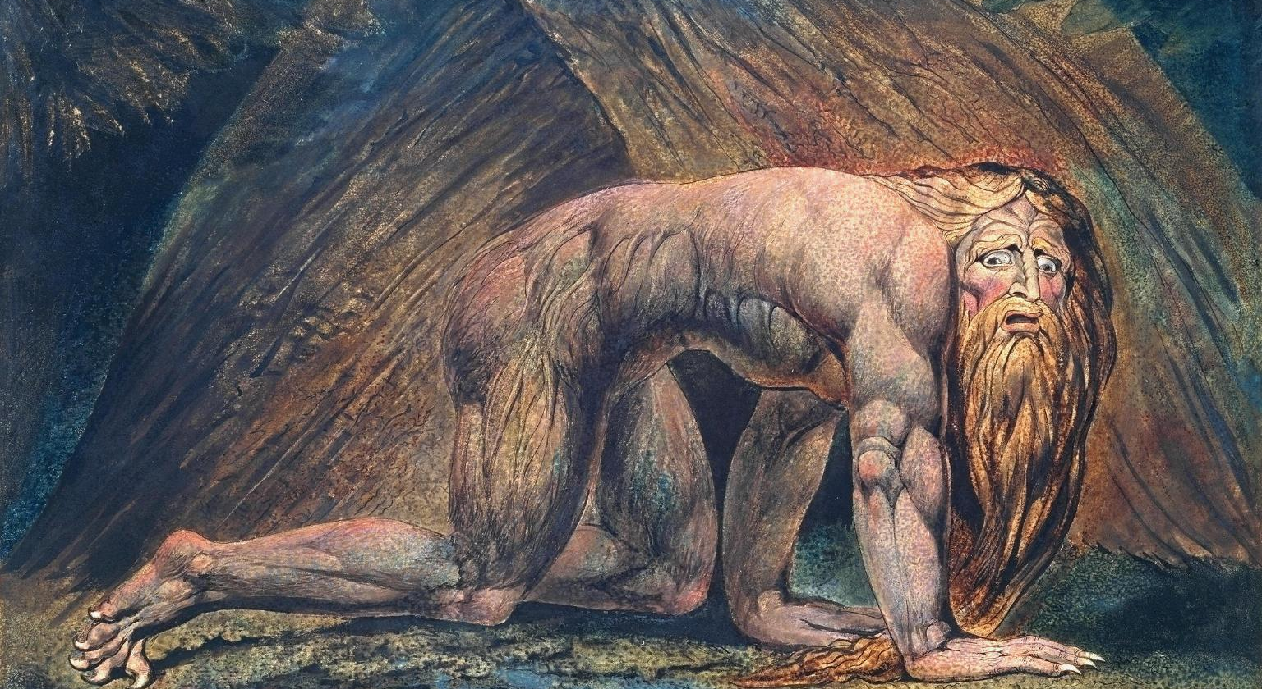

Slide 5
No one you know has schizophrenia, right?
Do you know someone with Alzheimer’s Disorder? The prevalence rate for schizophrenia is two times that of Alzheimer’s Disorder.
Do you know someone with Multiple Sclerosis? The prevalence rate for schizophrenia is five times that for Multiple Sclerosis.
Notes:
more>

Slide 6
No one you know has schizophrenia, right?
Do you know someone with insulin-dependent diabetes? The prevalence rate for schizophrenia is six times that for insulin-dependent diabetes.
Notes:
more>

Slide 7
No one you know has schizophrenia, right?
Do you know someone who has muscular dystrophy? The prevalence rate for schizophrenia is sixty times that for muscular dystrophy. Chances are you know someone with schizophrenia.
Notes:
When does it occur?>

Slide 8
Observe and Listen Characteristic Symptoms of Schizophrenia (2 or more)
Delusions
Hallucinations
Disorganized speech
Disorganized or catatonic behavior
Negative symptoms (affective flattening)
Notes:
you don’t know>
Social/Occupational dysfunction
Duration (Continuous signs for at least 6 months)
Schizoaffective and mood disorder exclusion
Paranoid
Disorganized
Catatonic
Undifferentiated
Residual

Slide 9
When does it occur?
Notes:
should we worry?>

Slide 10
Types of Schizophrenia
Paranoid
Disorganized
Catatonic
Undifferentiated
Residual

Slide 11
Should we worry about Schizophrenia?
Notes:
predicting dangerousness>

Slide 12
Predicting Dangerousness
Explore criminal records.
Notes:
Is there hope?>
May continue therapeutic management, assisting the client in controlling their behavior
Arrange for hospitalization or notify the Police
Notify relative of the person
Notify the potential victim
Be ready--expect the unexpected
What you wear
What you do
Be cool and calm
First reports are rarely correct
This is your job!

Slide 13
Predicting Dangerousness
Explore criminal records.
Ownership of weapons
Notes:
Is there hope?>
May continue therapeutic management, assisting the client in controlling their behavior
Arrange for hospitalization or notify the Police
Notify relative of the person
Notify the potential victim
Be ready--expect the unexpected
What you wear
What you do
Be cool and calm
First reports are rarely correct
This is your job!

Slide 14
Predicting Dangerousness
Explore criminal records.
Ownership of weapons
Individual’s current living condition.
Notes:
Is there hope?>
May continue therapeutic management, assisting the client in controlling their behavior
Arrange for hospitalization or notify the Police
Notify relative of the person
Notify the potential victim
Be ready--expect the unexpected
What you wear
What you do
Be cool and calm
First reports are rarely correct
This is your job!

Slide 15
Predicting Dangerousness
Explore criminal records
Ownership of weapons
Individual’s current living condition
Past history of violence is the most important clue.
Notes:
Is there hope?>
May continue therapeutic management, assisting the client in controlling their behavior
Arrange for hospitalization or notify the Police
Notify relative of the person
Notify the potential victim
Be ready--expect the unexpected
What you wear
What you do
Be cool and calm
First reports are rarely correct
This is your job!

Slide 16
Other Criteria
Social/Occupational dysfunction
Duration (Continuous signs for at least 6 months)

Slide 17
Schizophreniform Disorder Schizoaffective Disorder

Slide 18
Brief Psychotic Disorder
Shared Psychotic Disorder

Slide 19
Other
Brief Psychotic Disorder
Shared Psychotic Disorder

Slide 20
Dissociative Disorders
Dissociative Amnesia
Dissociative Fugue
Dissociative Identity Disorder
Depersonalization Disorder

Slide 21
Is there any hope?
Notes:
Elon Saks>

Slide 22
Elyn R. Saks
Notes:
what to do>

Slide 23
How can we help them?
Talk to them.
Notes:
Luke 8>

Slide 24
How can we help them?
Talk to them.
Intervene if necessary.
Notes:
Luke 8>

Slide 25
How can we help them?
Talk to them.
Intervene if necessary.
Encourage them to take their medication.
Notes:
Luke 8>

Slide 26
How can we help them?
Talk to them.
Intervene if necessary.
Encourage them to take their medication.
Stay involved.
Notes:
Luke 8>

Slide 27
How can we help them?
Talk to them.
Intervene if necessary.
Encourage them to take their medication.
Stay involved.
Help them become more active.
Notes:
Luke 8>

Slide 28
What about demons and devils? Luke 8:27-33
What symptoms did the demon possessed man exhibit?
Notes:
spiritual vs. physical>

Slide 29
Spiritual Illness vs. Physical Illness
Supernatural knowledge
Supernatural strength
Going around naked
Unable to speak, hear, or see
Seizures
Use of a different voice or the presence of a distinct personality
Bizarre behavior
Violent behavior
Schizophrenia (may claim during psychosis)
Bipolar disorder, at times schizophrenia
At times schizophrenia
Conversion disorder
Conversion disorder with seizures
Dissociative identity disorder
Schizophrenia
At times schizophrenia, antisocial personality disorder

Slide 30
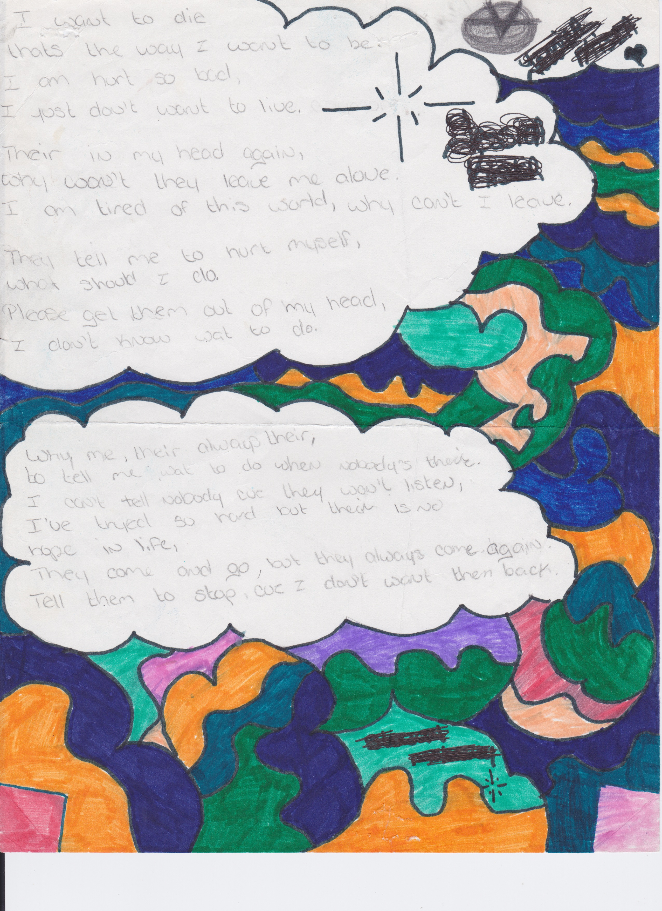

Slide 31
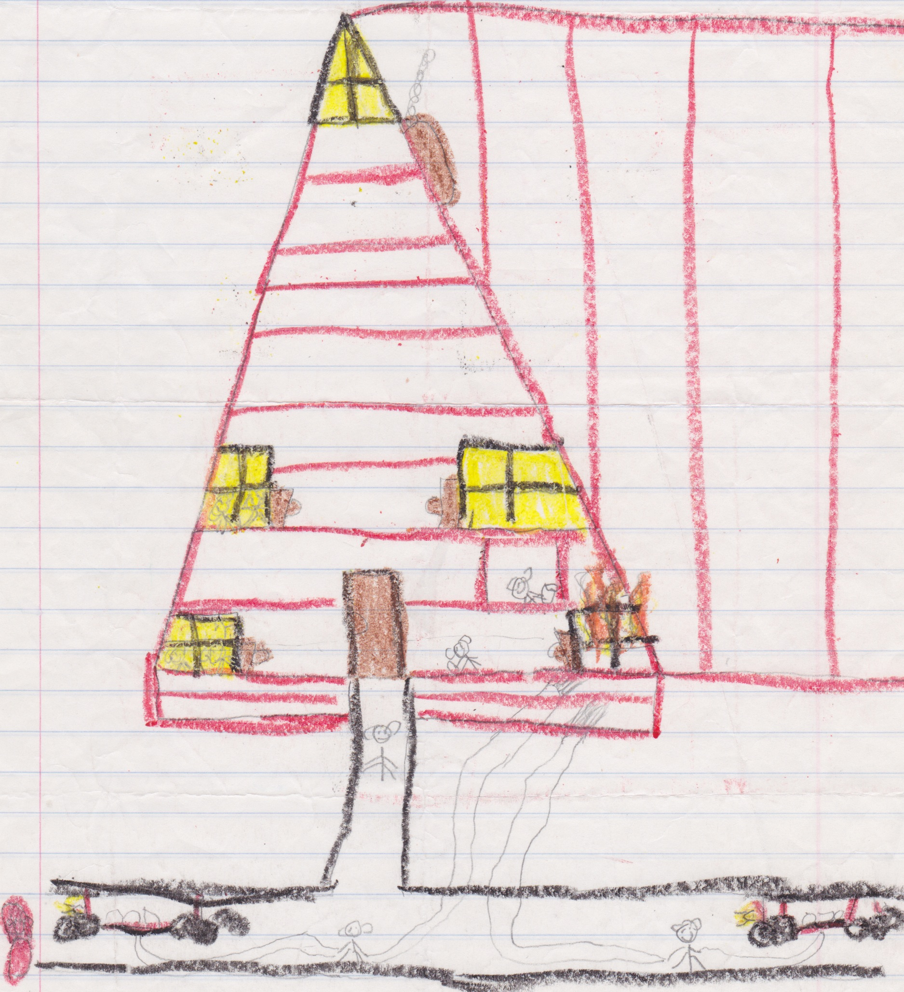

Slide 32
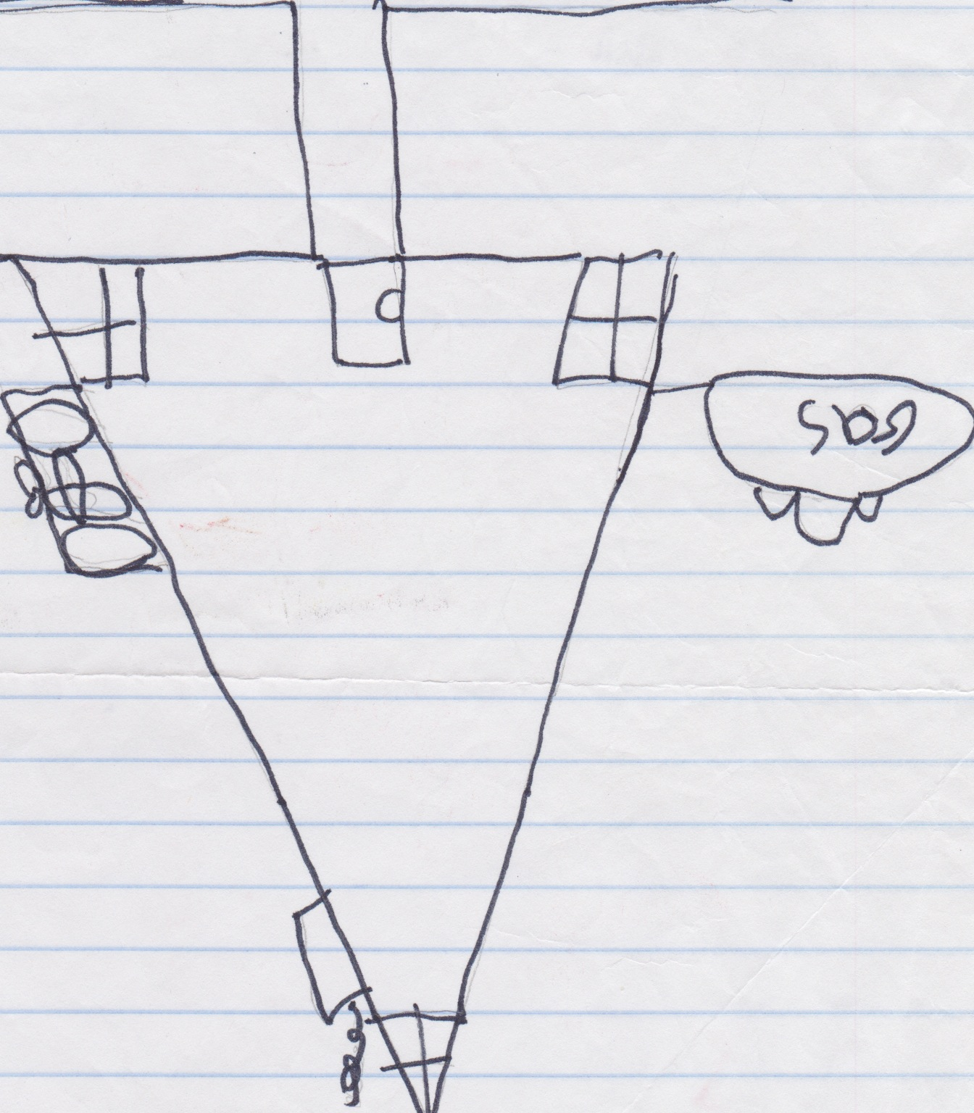

Slide 33
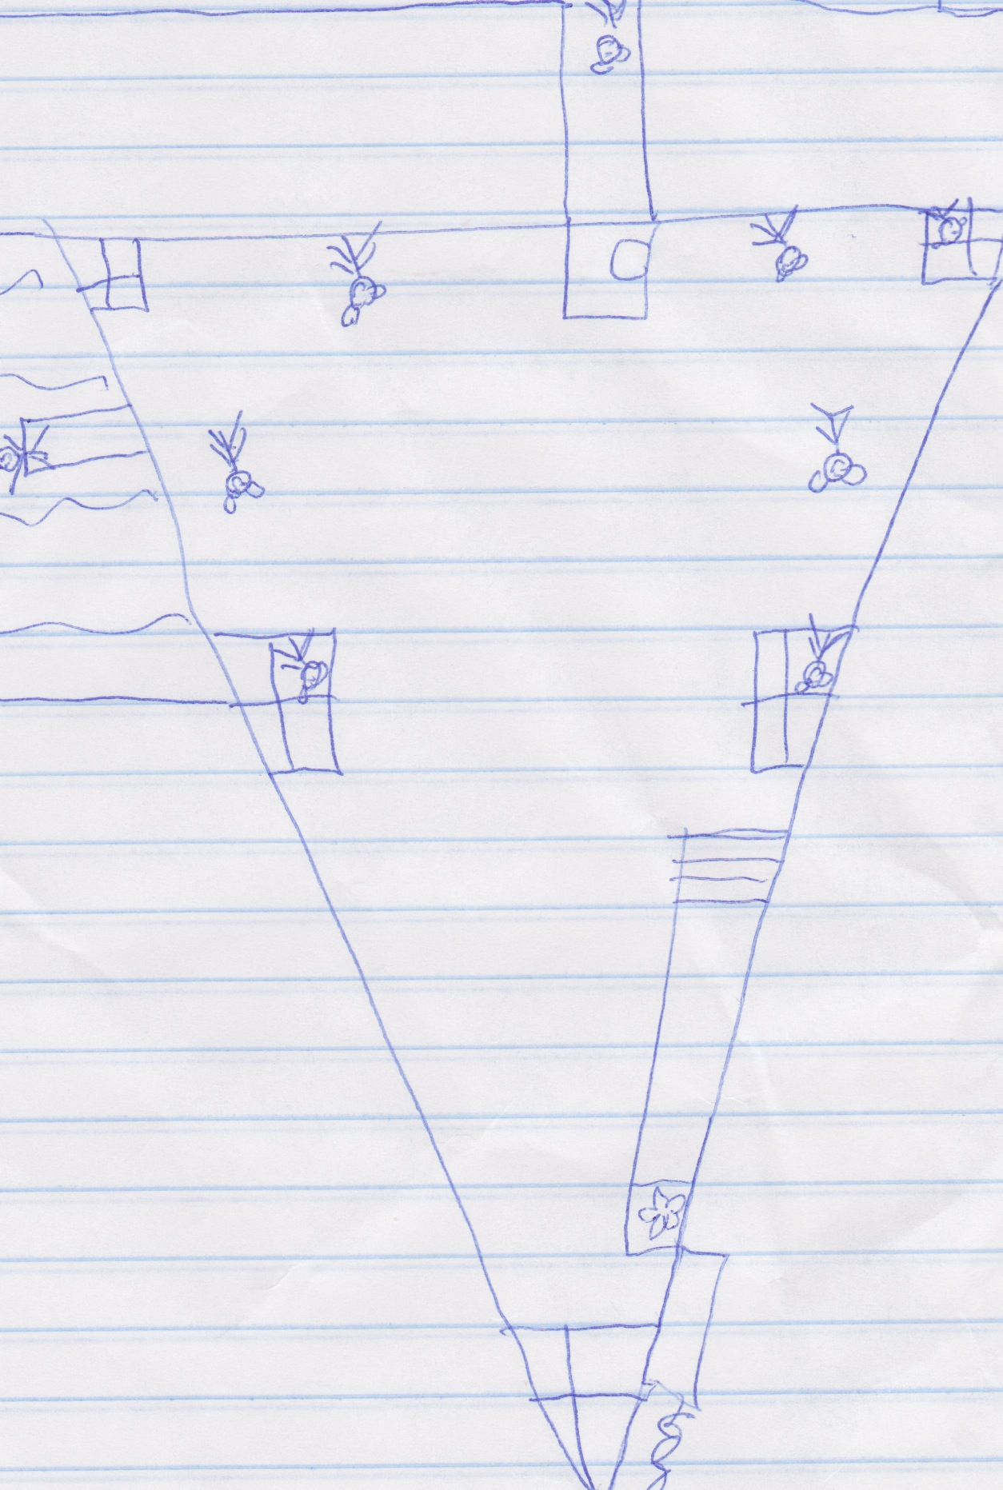

Slide 34
General diagnostic criteria for a personality disorder
Enduring pattern of inner experience and behavior (cognition, affectivity, interpersonal functioning, impulse control)
Inflexible and pervasive across a broad range of situations
Significant distress or impairment
Stable and long duration

Slide 35
Cluster A Personality Disorders
Paranoid
Schizoid
Schizotypal

Slide 36
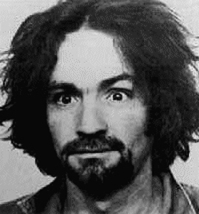

Slide 37
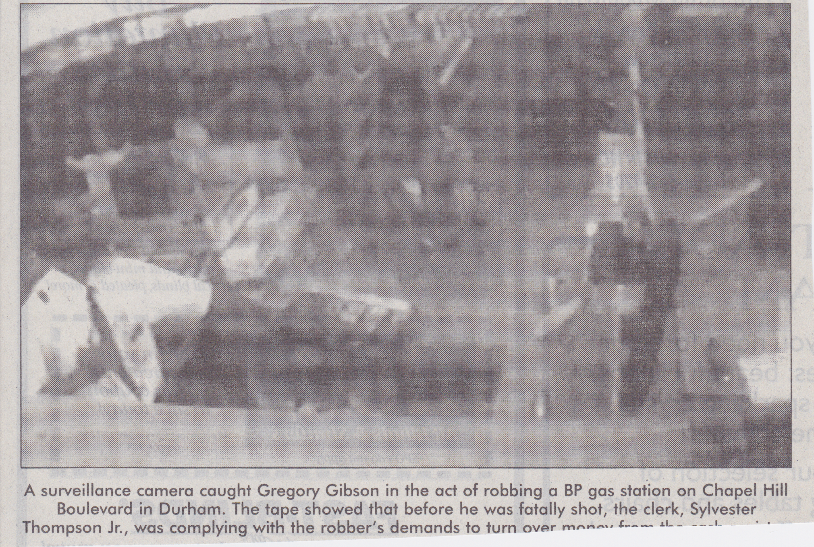

Slide 38
Cluster B Personality Disorders
Antisocial
Borderline
Histrionic
Narcissistic

Slide 39
Cluster C Personality Disorders
Avoidant
Dependent
Obsessive-Compulsive
Personality Disorder NOS

Slide 40
First Aid for Psychosis and Other Problems
Edward E. Moody, Jr., Ph.D emoody@nafwb.org

