Slide 2
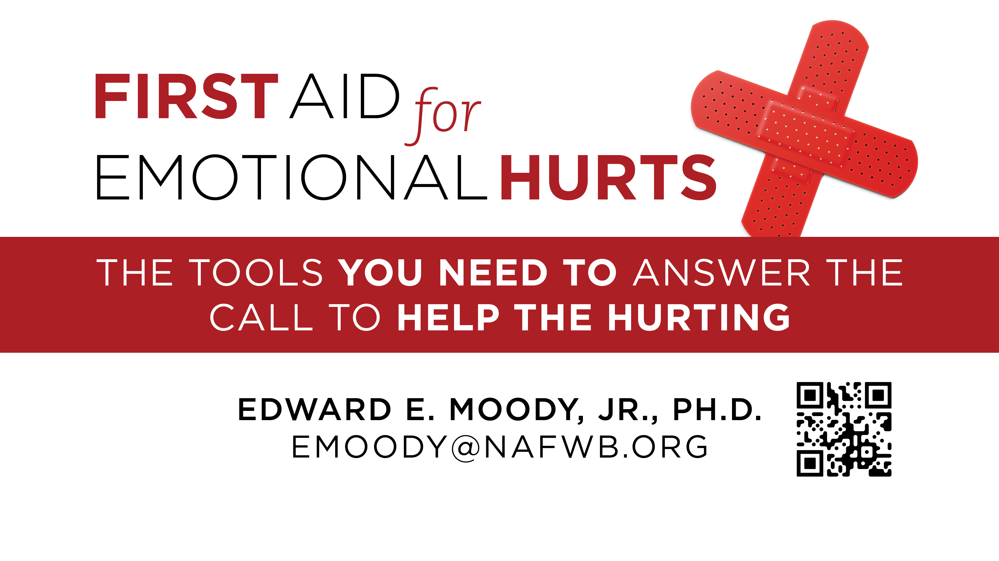

Slide 3
First Aid for Sexual Abuse
Edward E. Moody, Jr., Ph.D.
emoody@nafwb.org

Slide 4
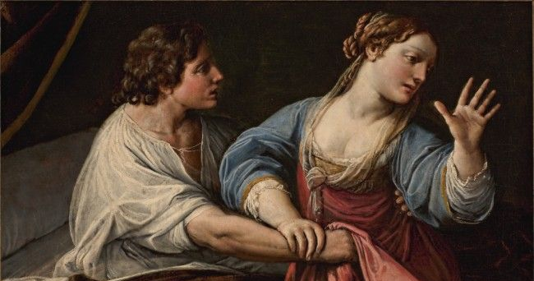

Slide 5
I lay here and it’s late at night, Granny’s just shut off the light. Pretty soon he will be here telling me not fear. I hear him creeping in the night and what he does I know ain’t right. He’s my uncle, I must obey so once again he has his way. I’d tell daddy but he’d be blue, most likely say it isn’t true. No one knows how much I’ve tried to keep this secret that I hide. When morning comes he’ll go to work, I’ll take a bath wash off this dirt. I think that I should run away. But that’s no use where would I stay.

Slide 6
Childhood Sexual Abuse Statistics
1 in 5 girls and 1 in 20 boys are victims of child sexual abuse.
Self-report studies show that 20% of adult females and 5-10% of adult males recall a childhood sexual assault or sexual abuse incident.
During a one-year period in the U.S., 16% of youth ages 14 to 17 had been sexually victimized.
Over the course of their lifetime, 28% of U.S. youth ages 14 to 17 had been sexually victimized.
Children are most vulnerable to CSA between the ages of 7 and 13.

Slide 7
Observe: Watch for perpetrators
3 out of 4 adolescents who have been sexually assaulted were victimized by someone they knew well.
He’s my uncle, I must obey so once again he has his way.

Slide 8
Observe: Indicators of Sexual Abuse
Behavioral
Medical
Familial

Slide 9
The impact can be long- lasting.
Children who had an experience of rape or attempted rape in their adolescent years were 13.7 times more likely to experience rape or attempted rape in their first year of college.

Slide 10
Compared to those with no history of sexual abuse, young males who were sexually abused were five times more likely to cause teen pregnancy, three times more likely to have multiple sexual partners, and two times more likely to have unprotected sex.
Journal of Adolescent Health

Slide 11
Care and Listen
Be calm.

Slide 12
Listen
Be calm.
Let them tell their story.

Slide 13
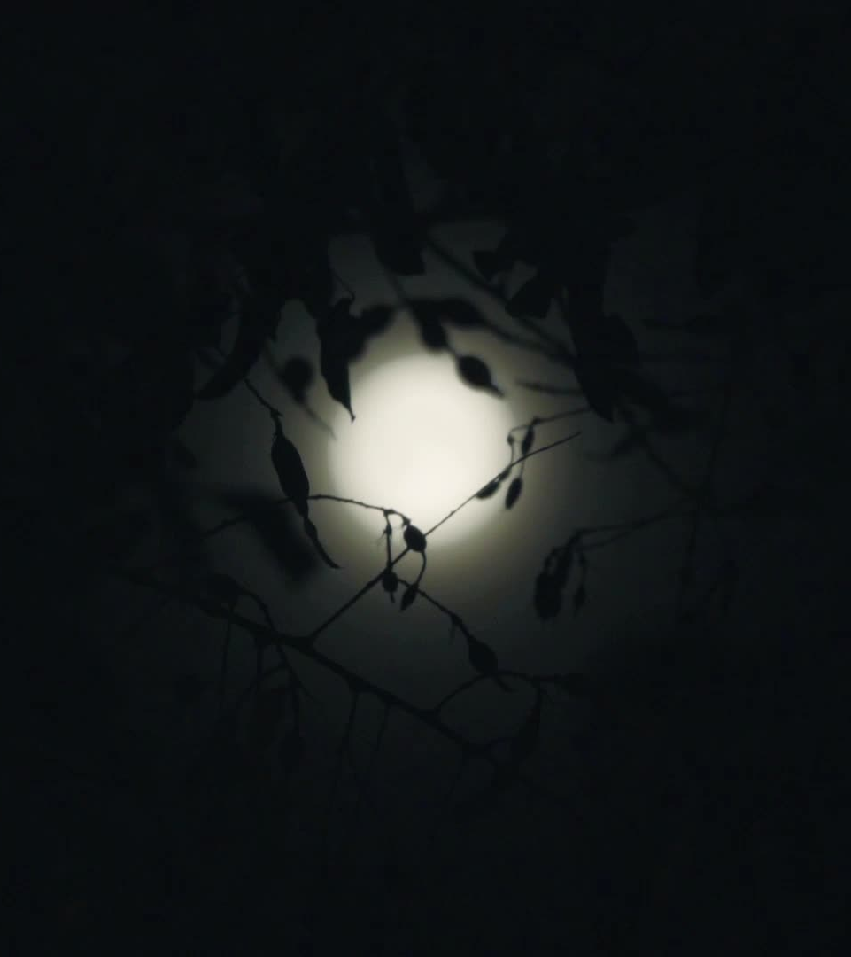
Respond to Fear
I lay here and it’s late at night, Granny’s just shut off the light. Pretty soon he will be here telling me not fear.

Slide 14
Respond to guilt and shame
I hear him creeping in the night and what he does I know ain’t right.
No one knows how much I’ve tried to keep this secret that I hide. When morning comes he’ll go to work, I’ll take a bath wash off this dirt.

Slide 15
Respond to betrayal and being abandoned
He’s my uncle, I must obey so once again he has his way. I’d tell daddy but he’d be blue, most likely say it isn’t true.
I think that I should run away. But that’s no use where would I stay.

Slide 16
How can we prevent sexual abuse?

Slide 17
Develop a close relationship with the child.

Slide 18
Talk and listen to the child.

Slide 19
Discuss the difference between a secret and a surprise.

Slide 20
There is safety in numbers.

Slide 21
Discuss the concept of body ownership.

Slide 22
Set up contingency plans

Slide 23
First Aid for Sexual Abuse
Edward E. Moody, Jr., Ph.D.
emoody@nafwb.org

