Slide 3
First Aid for Children With Learning Problems
Edward E. Moody, Jr., Ph.D emoody@nafwb.org

Slide 5
They are not alone!
5-8% of youth suffer from Attention Deficit Hyperactivity Disorder (ADHD).
7 out of every 100 school children have ADHD.
It is estimated that 5-15% of youth have a specific Learning Disability (LD).
The school dropout rate for children or adolescents with LD’s is reported at 40% or approximately 1.5 times the average.

Slide 6
44% of children with ADHD have at least one other disorder.
20-25% of children with ADHD have learning difficulties.

Slide 8
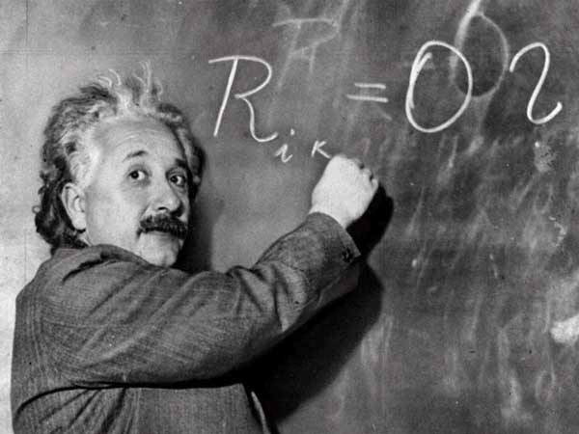

Slide 9
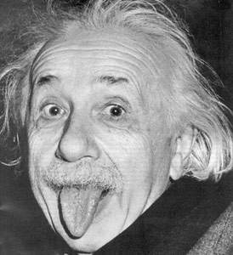

Slide 10
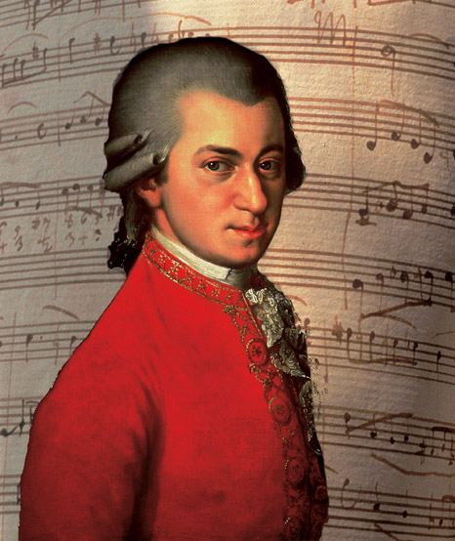

Slide 11
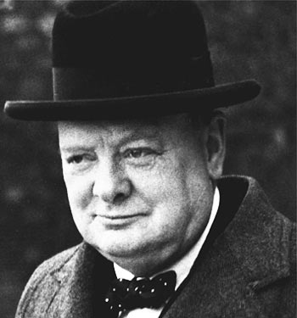

Slide 12
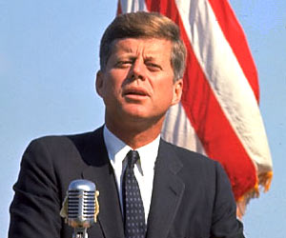
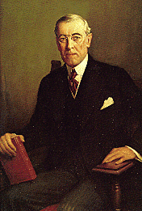

Slide 14
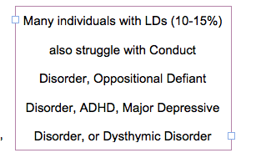

Slide 16
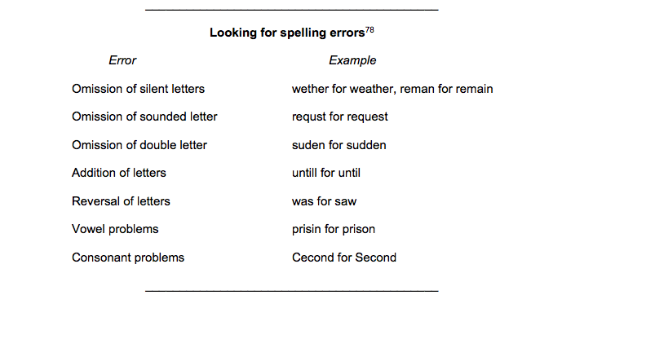

Slide 17
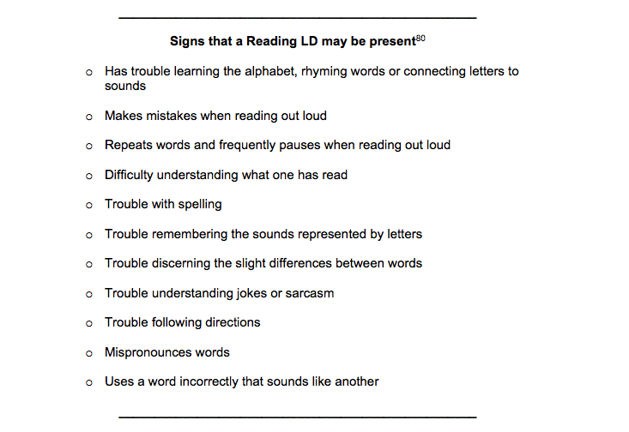

Slide 18
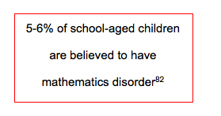

Slide 21
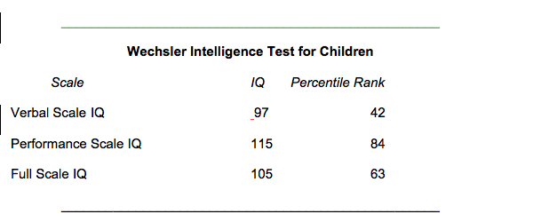

Slide 22
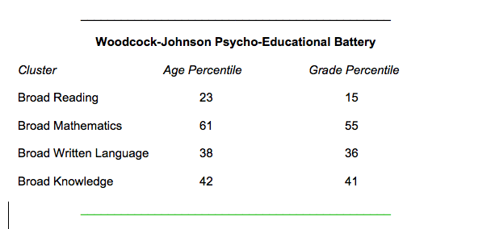

Slide 23
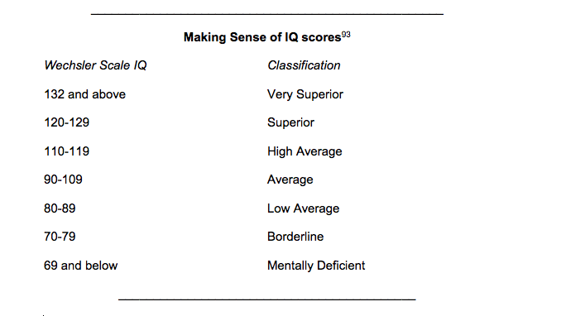

Slide 24
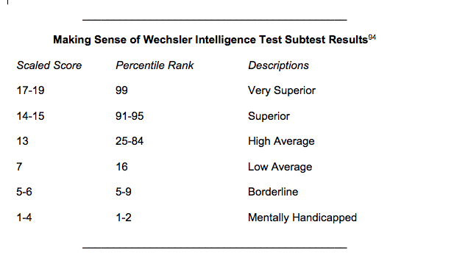

Slide 25
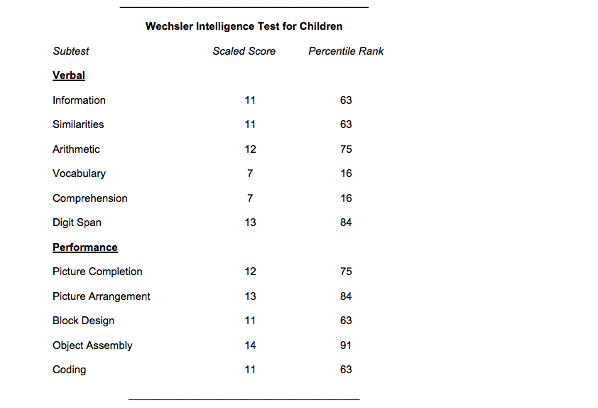

Slide 26
Respond

Slide 29
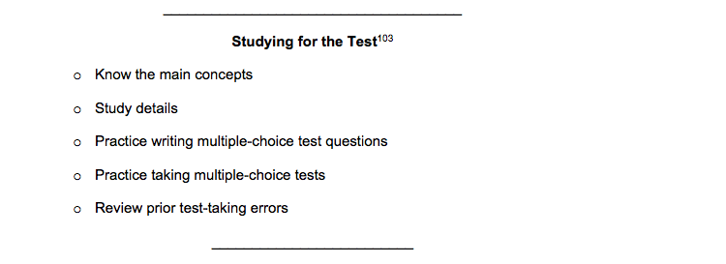

Slide 30
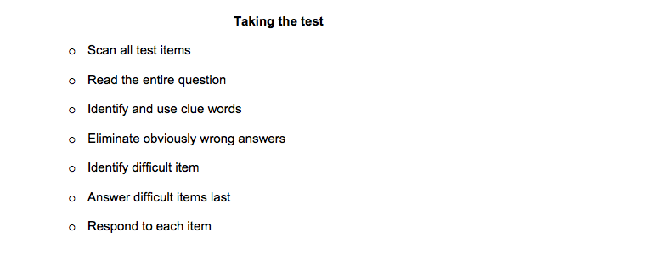

Slide 31
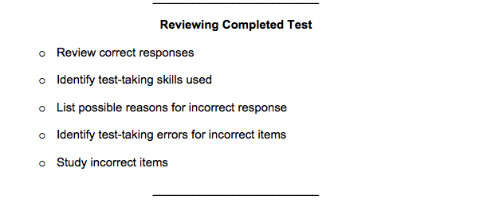

Slide 32
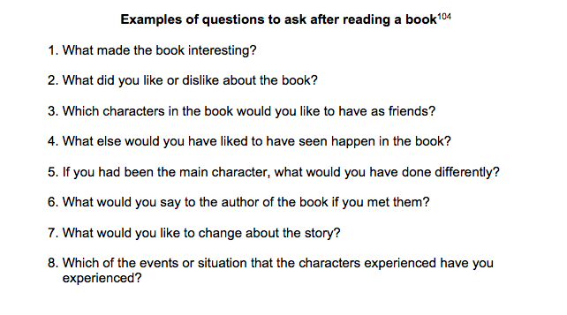

Slide 33
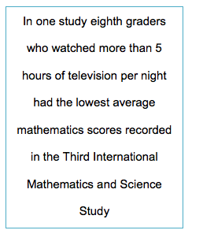

Slide 34
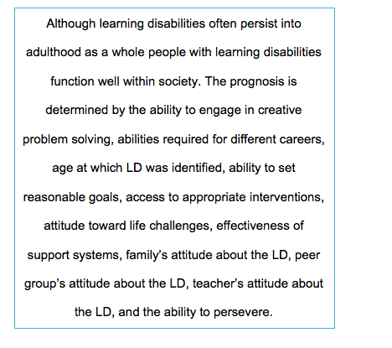

Slide 35
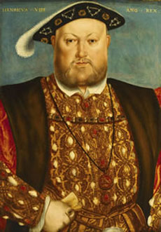

Slide 36
ADHD through History
1890—William James describes an “explosive will.”
1902—George Still lectures about attention symptoms.
1950s—1970s— “Hyperactive child syndrome” emerges.
1968—“Hyperkinetic reaction of childhood” is described.
1987—“Attention-deficit hyperactivity disorder” listed in the DSM-III.

Slide 37
ADHD Problems in Early Elementary School
Off-task behavior
Incomplete or lost assignments
Sloppy work or messy handwriting
Errors in accuracy
Inconsistent performance
Daydreaming
Disruptive behavior
Difficulty interacting with others

Slide 38
Hyperactivity Symptoms
Fidgets or squirms
Leaves seat in situations when remaining seated is expected
Runs or climbs excessively in situations in which it is inappropriate
Has difficulty playing or engaging in leisure activities quietly
“On the go”
Talks excessively

Slide 39
Impulsivity Symptoms
Blurts out answers before questions have been completed
Has difficulty awaiting their turn
Interrupts or intrudes on others

Slide 40
Inattention Symptoms
Fails to give attention to details or makes careless mistakes
Has difficulty sustaining attention
Does not seem to listen when spoken to directly
Does not follow through on instructions
Has difficulty organizing tasks
Avoids tasks that require sustained mental effort

Slide 41
Inattention Symptoms . . .
Loses things necessary for tasks or activities
Distracted by external stimuli
Forgetful

Slide 42
Executive Functioning Difficulties in Children with ADHD
Lack problem-solving skills
Poor sense of timing
Inconsistent
Difficulty resisting distraction
Difficulty delaying gratification
Trouble working on long-term goals
Easily frustrated
Poor judgment

Slide 43
Many ADHD students also have problems with:
Time management
Prioritizing work
Reading comprehension
Note taking
Study skills
Completing tasks with multiple steps

Slide 44
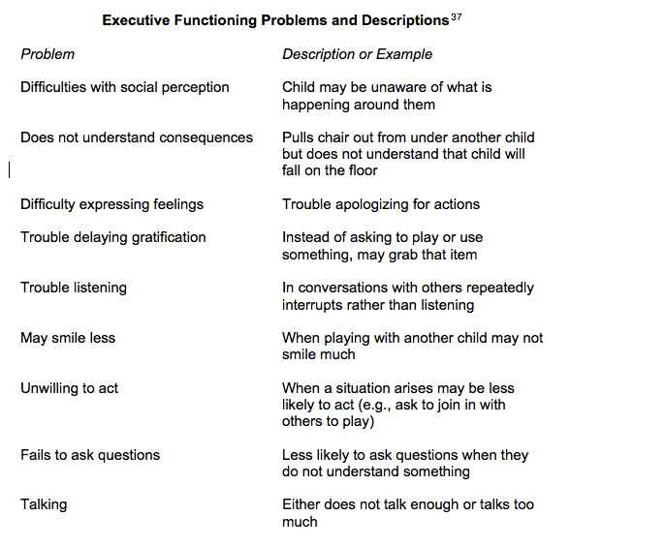

Slide 45
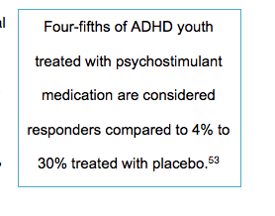
Respond: Address Impulsivity

Slide 46
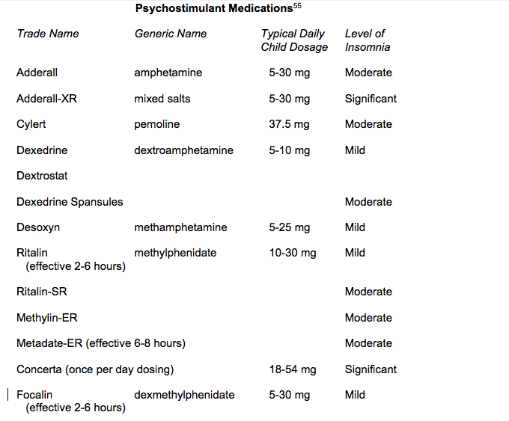

Slide 47
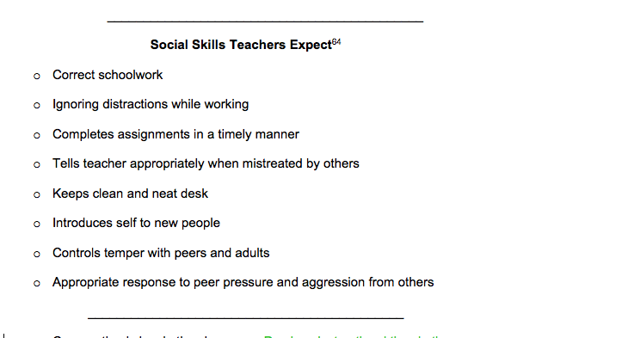

Slide 48
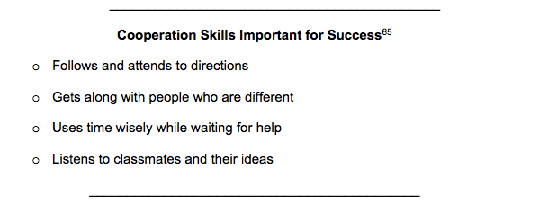
Address Inattention

Slide 49
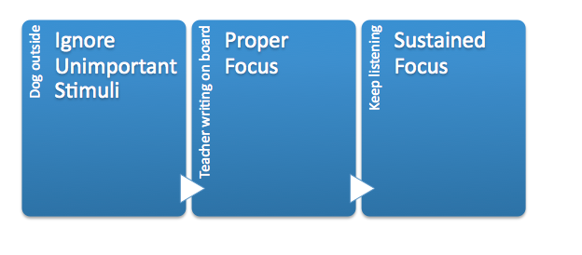

Slide 50
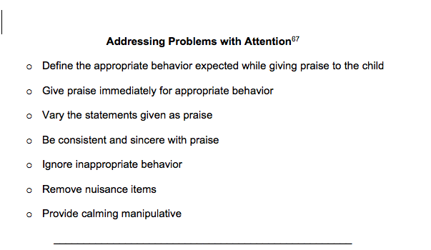

Slide 51
Address Executive Functioning
Work on Communication Skills

Slide 52
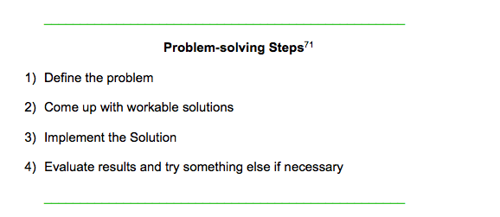

Slide 53
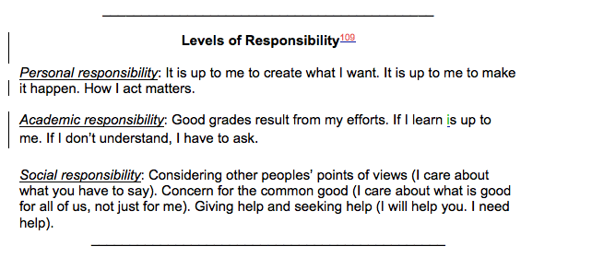

Slide 54
First Aid for Children With Learning Problems
Edward E. Moody, Jr., Ph.D emoody@nafwb.org

