Slide 2
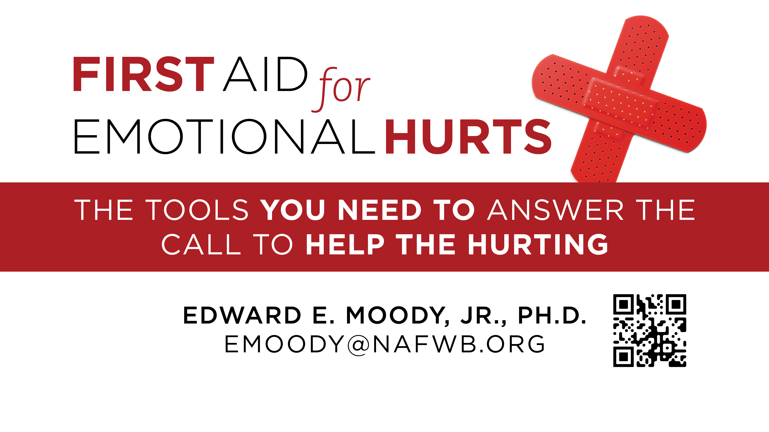

Slide 3
First Aid for Addictions
Edward E. Moody, Jr.
emoody@nafwb.org
www.FirstAidforEmotionalHurts.com
Notes:
I realized I had not prepared my people for this kind of thing.
Clearly Jesus is in the helping business.

Slide 4
¹⁵ For that which I do I allow not: for what I would, that do I not; but what I hate, that do I. ¹⁶ If then I do that which I would not, I consent unto the law that it is good. ¹⁷ Now then it is no more I that do it, but sin that dwelleth in me. ¹⁸ For I know that in me (that is, in my flesh,) dwelleth no good thing: for to will is present with me; but how to perform that which is good I find not. ¹⁹ For the good that I would I do not: but the evil which I would not, that I do. ²⁰ Now if I do that I would not, it is no more I that do it, but sin that dwelleth in me.
Romans 7:15-20

Slide 5
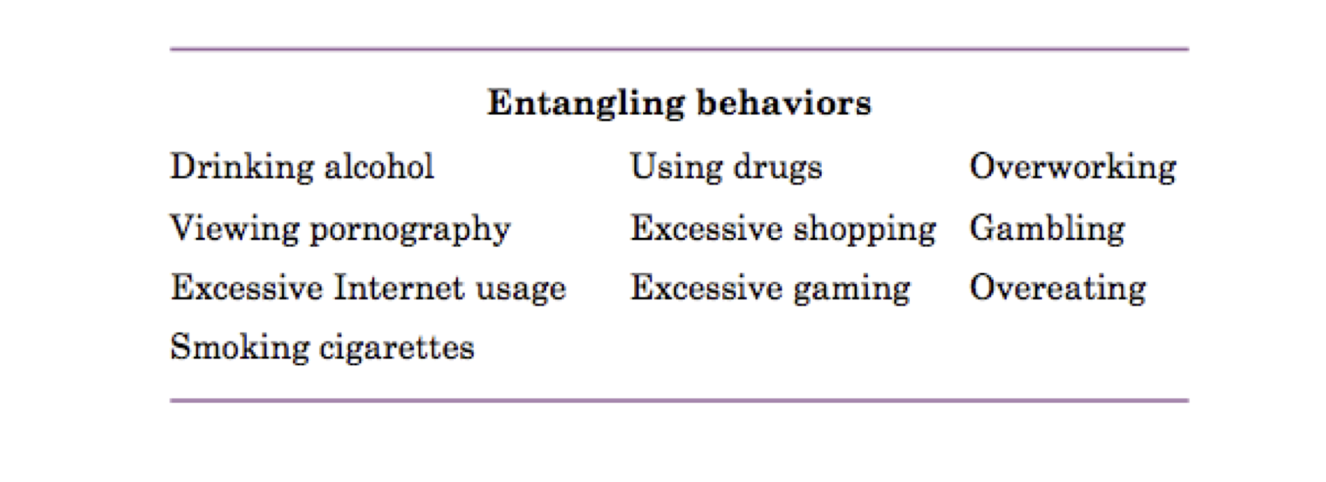

Slide 7
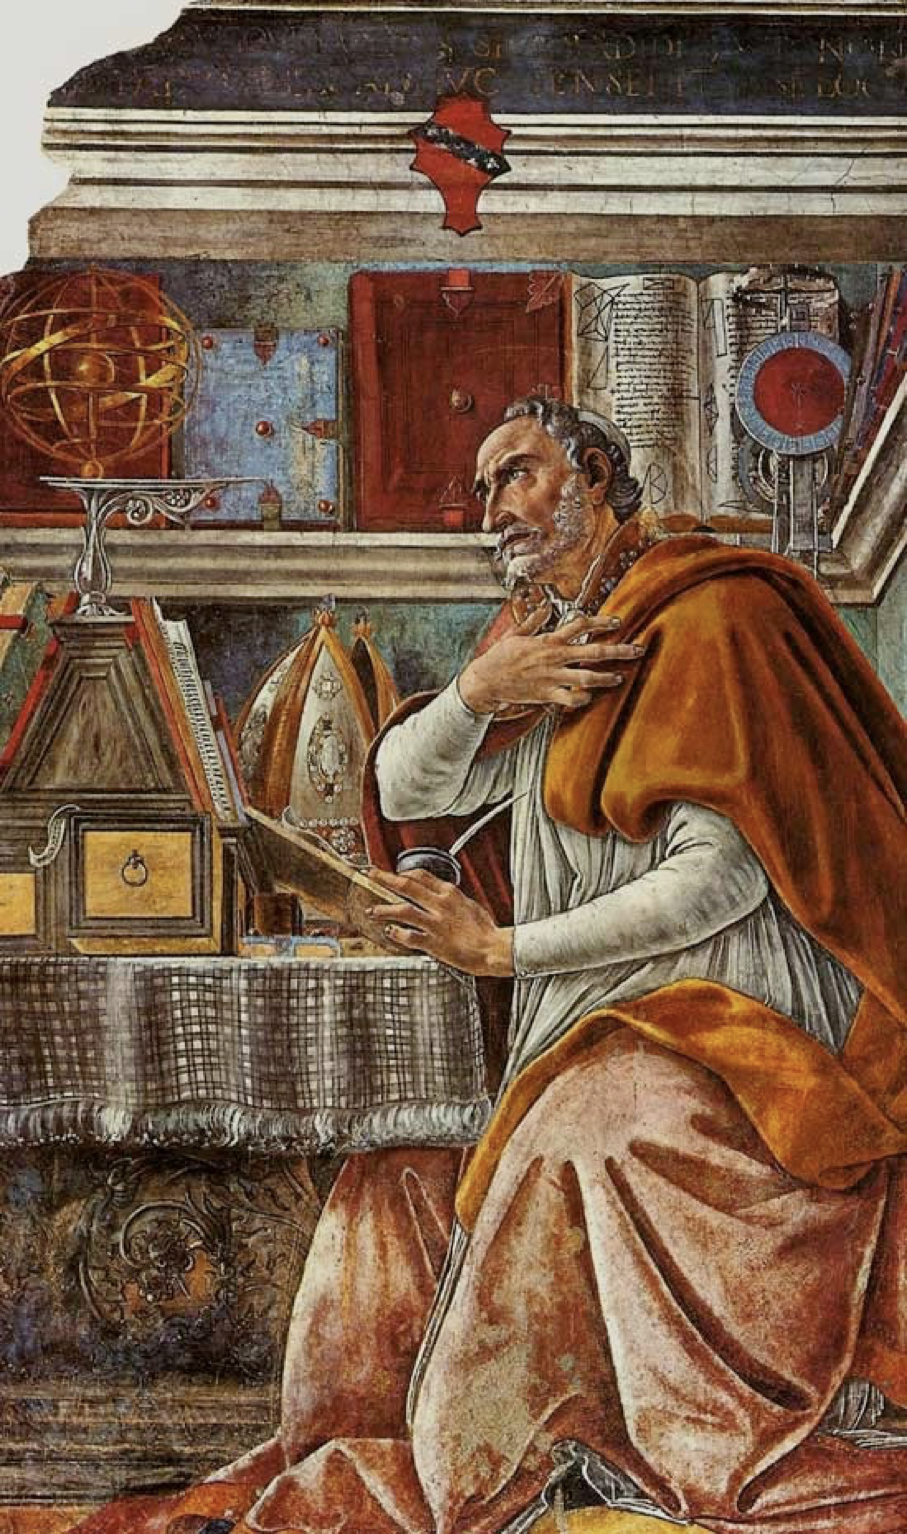

Slide 8
Observe: Is this abuse or dependence?

Slide 9
Criteria for Substance Dependence (in same 12 months)
Tolerance
Withdrawal
Taken in larger amounts and for longer than intended
Persistent desire to cut down
Social and occupational activities are reduced
Use despite knowledge that problems will be exacerbated

Slide 10
Substance Abuse (12 month period)
Substance use results in failure at school, work or home
Use when physically hazardous
Recurrent substance use legal problems
Continued use despite having social and interpersonal problems exacerbated

Slide 11
Four Stages of Addiction
Experimental

Slide 12
Four Stages of Addiction
Experimental
Recreation

Slide 13
Four Stages of Addiction
Experimental
Recreation
Habitual

Slide 14
Four Stages of Addiction
Experimental
Recreation
Habitual
Addicted

Slide 15
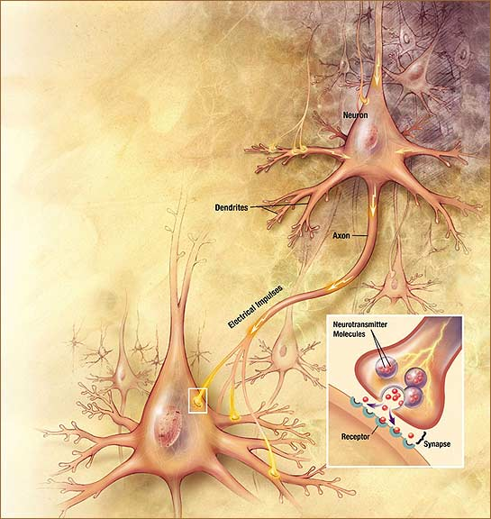

Slide 16
Withdrawal

Slide 17
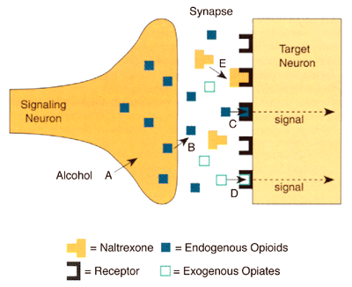

Slide 18
How can you help?

Slide 19
Respond: Intervene

Slide 20
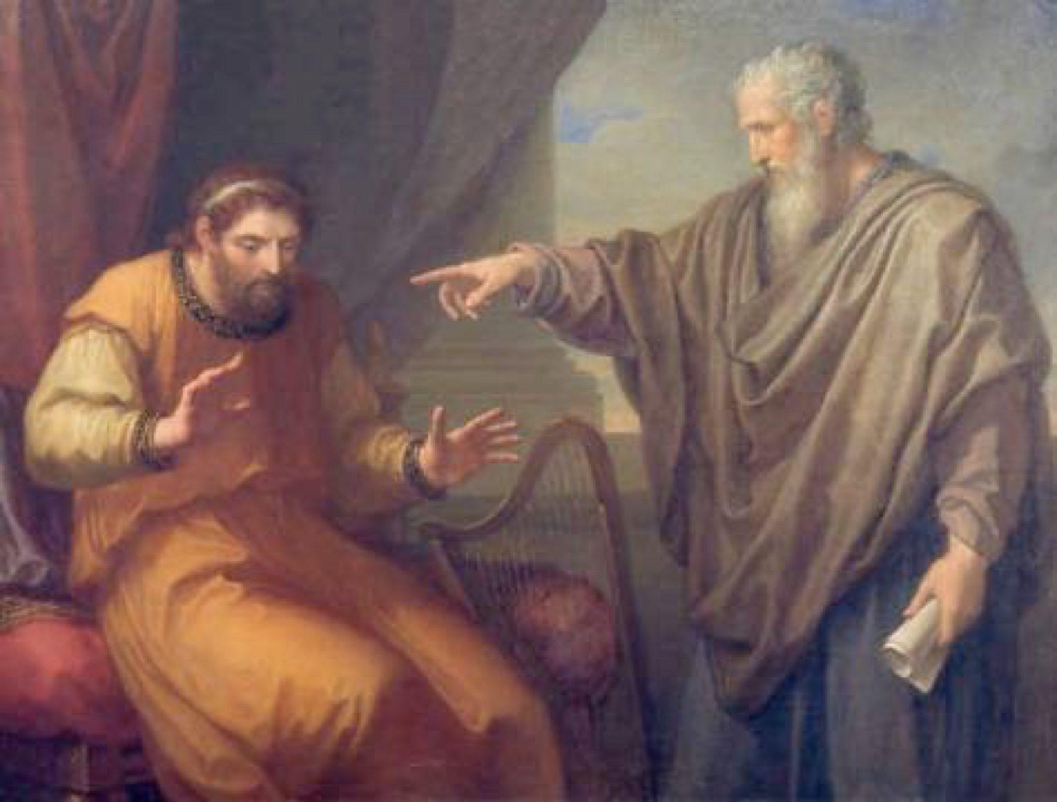

Slide 21
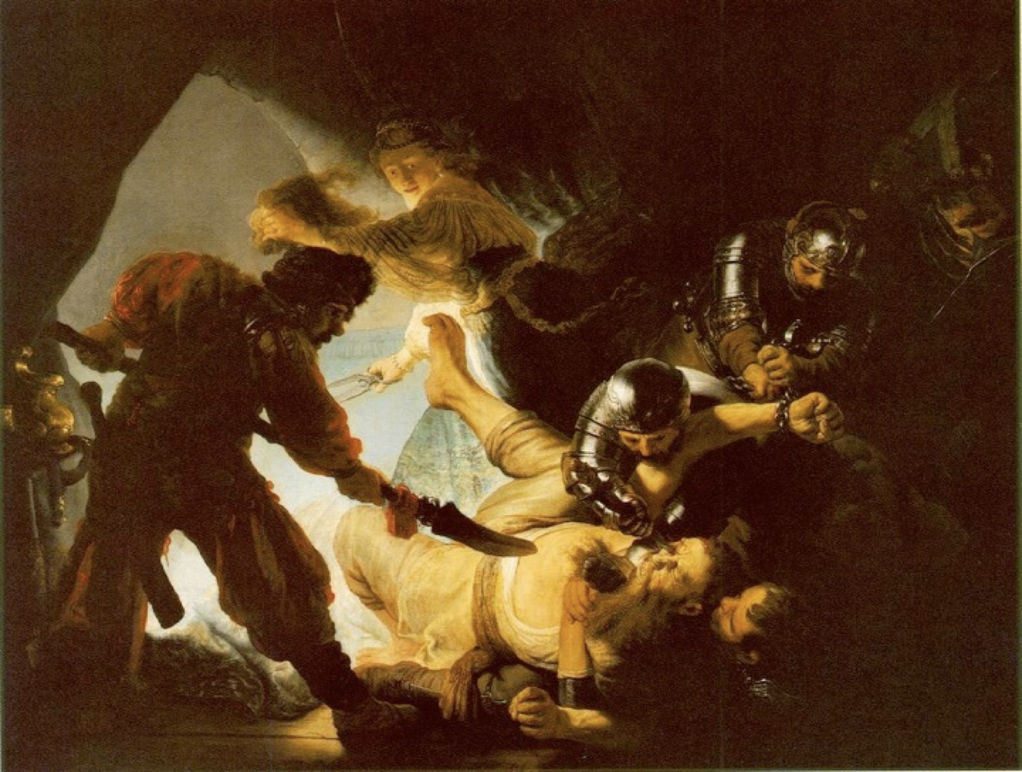

Slide 22
Some Myths
It isn’t that bad.

Slide 23
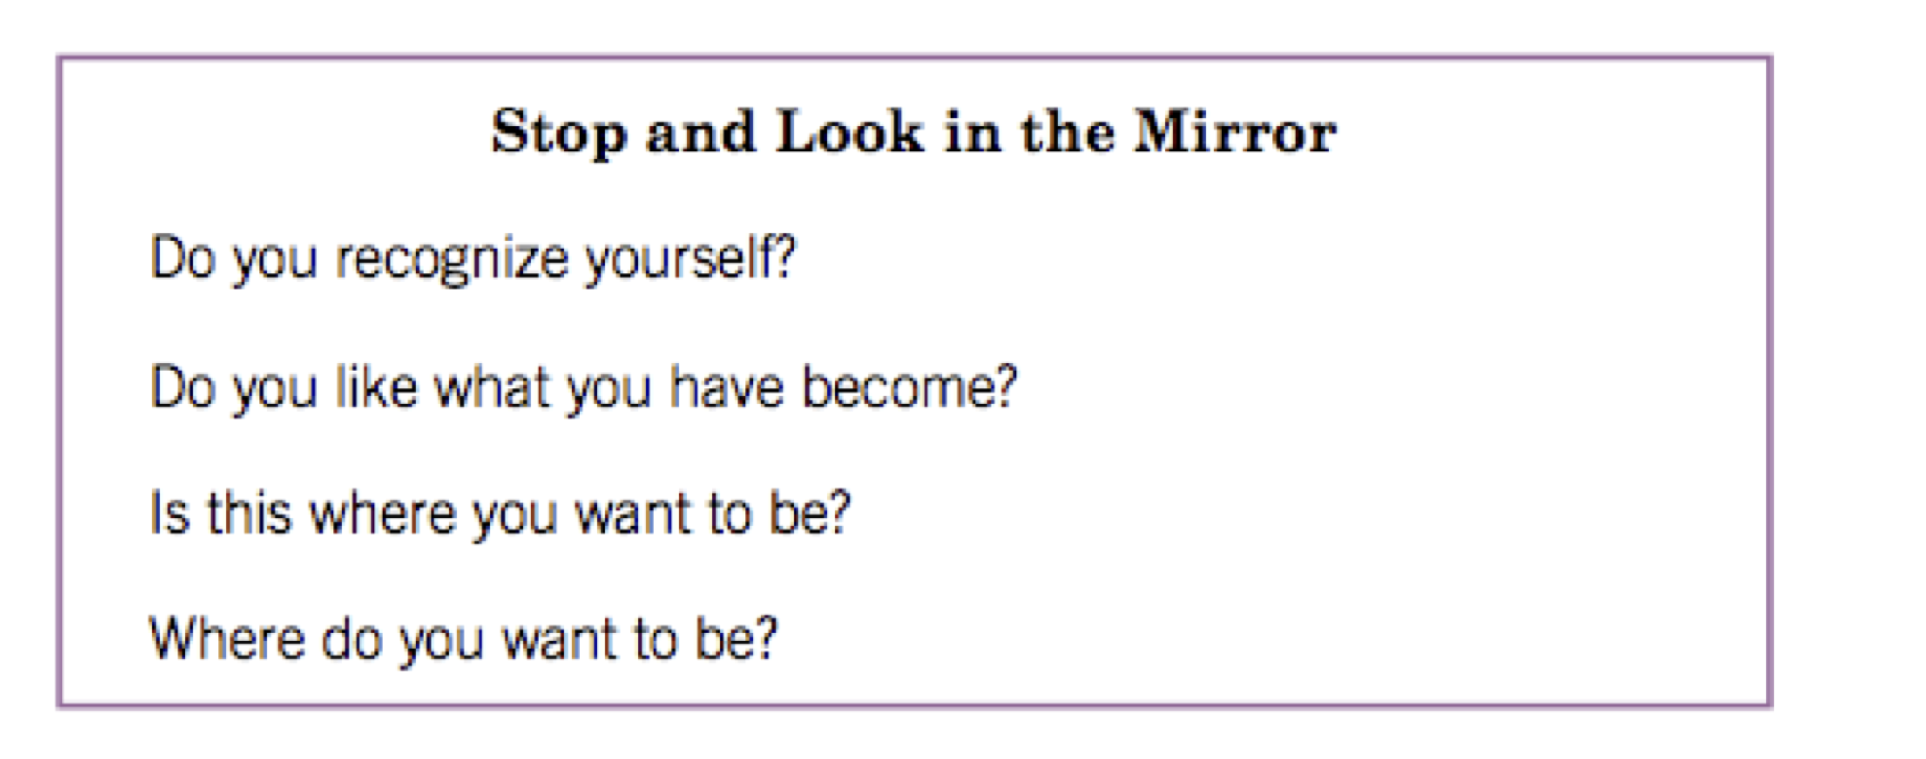
Stop and Reflect

Slide 24
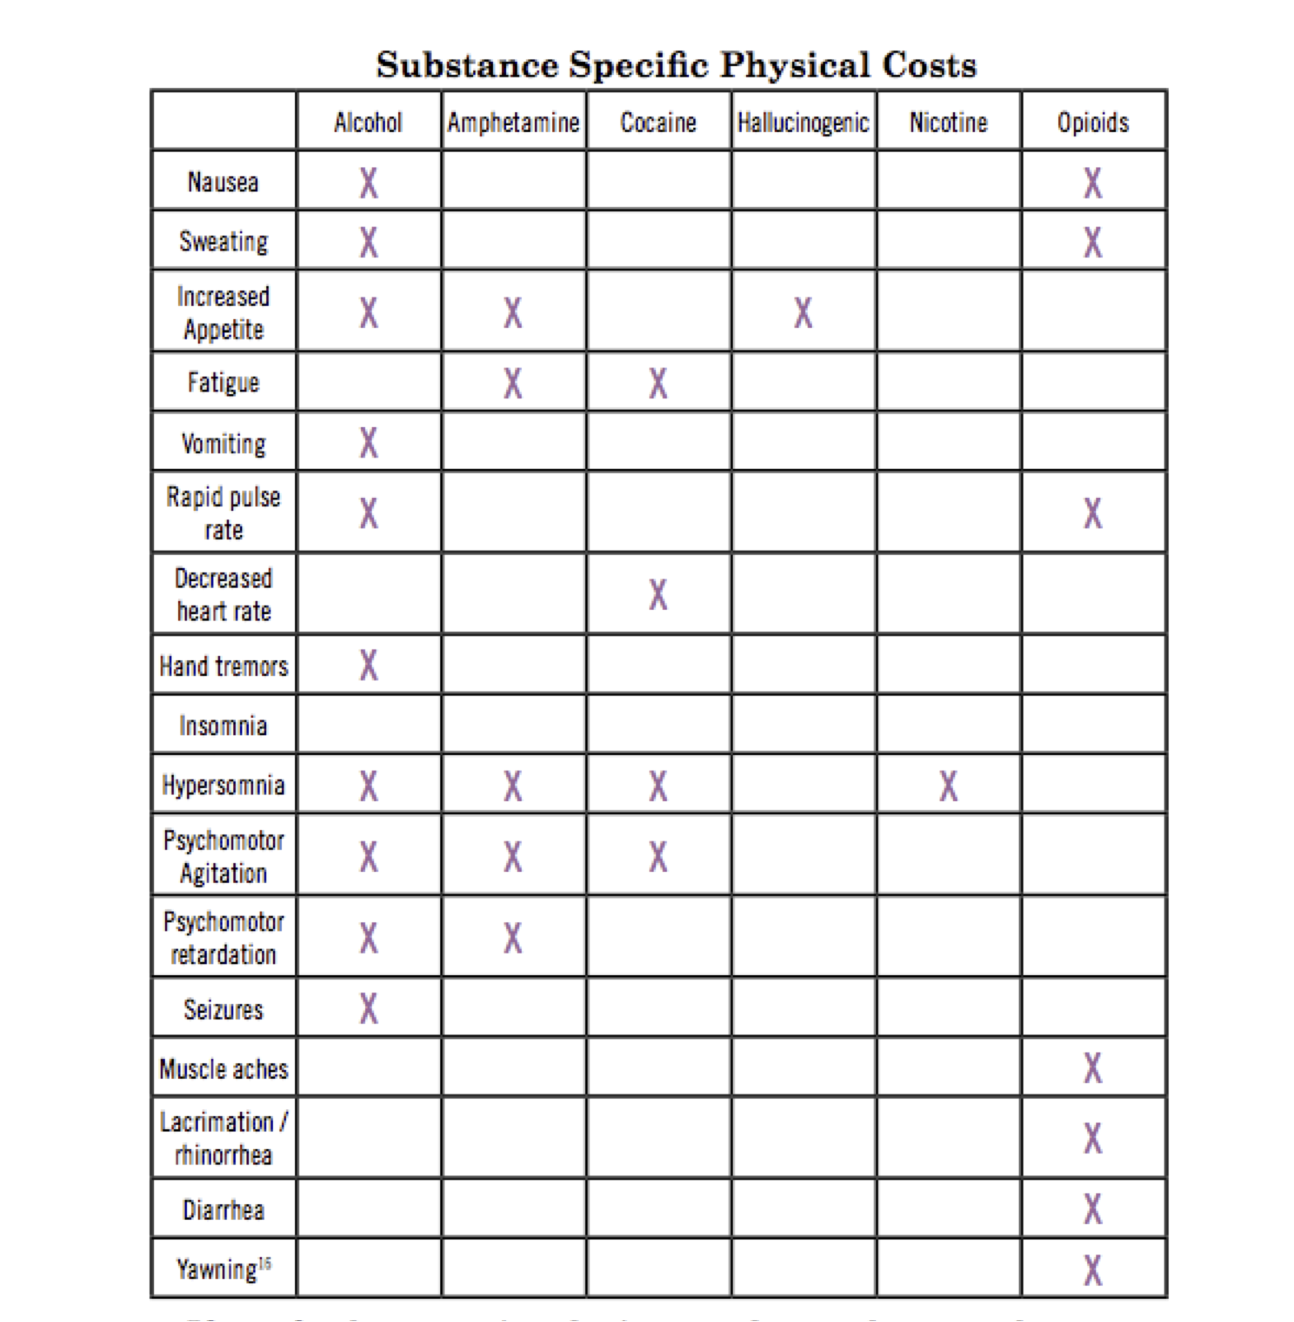

Slide 25
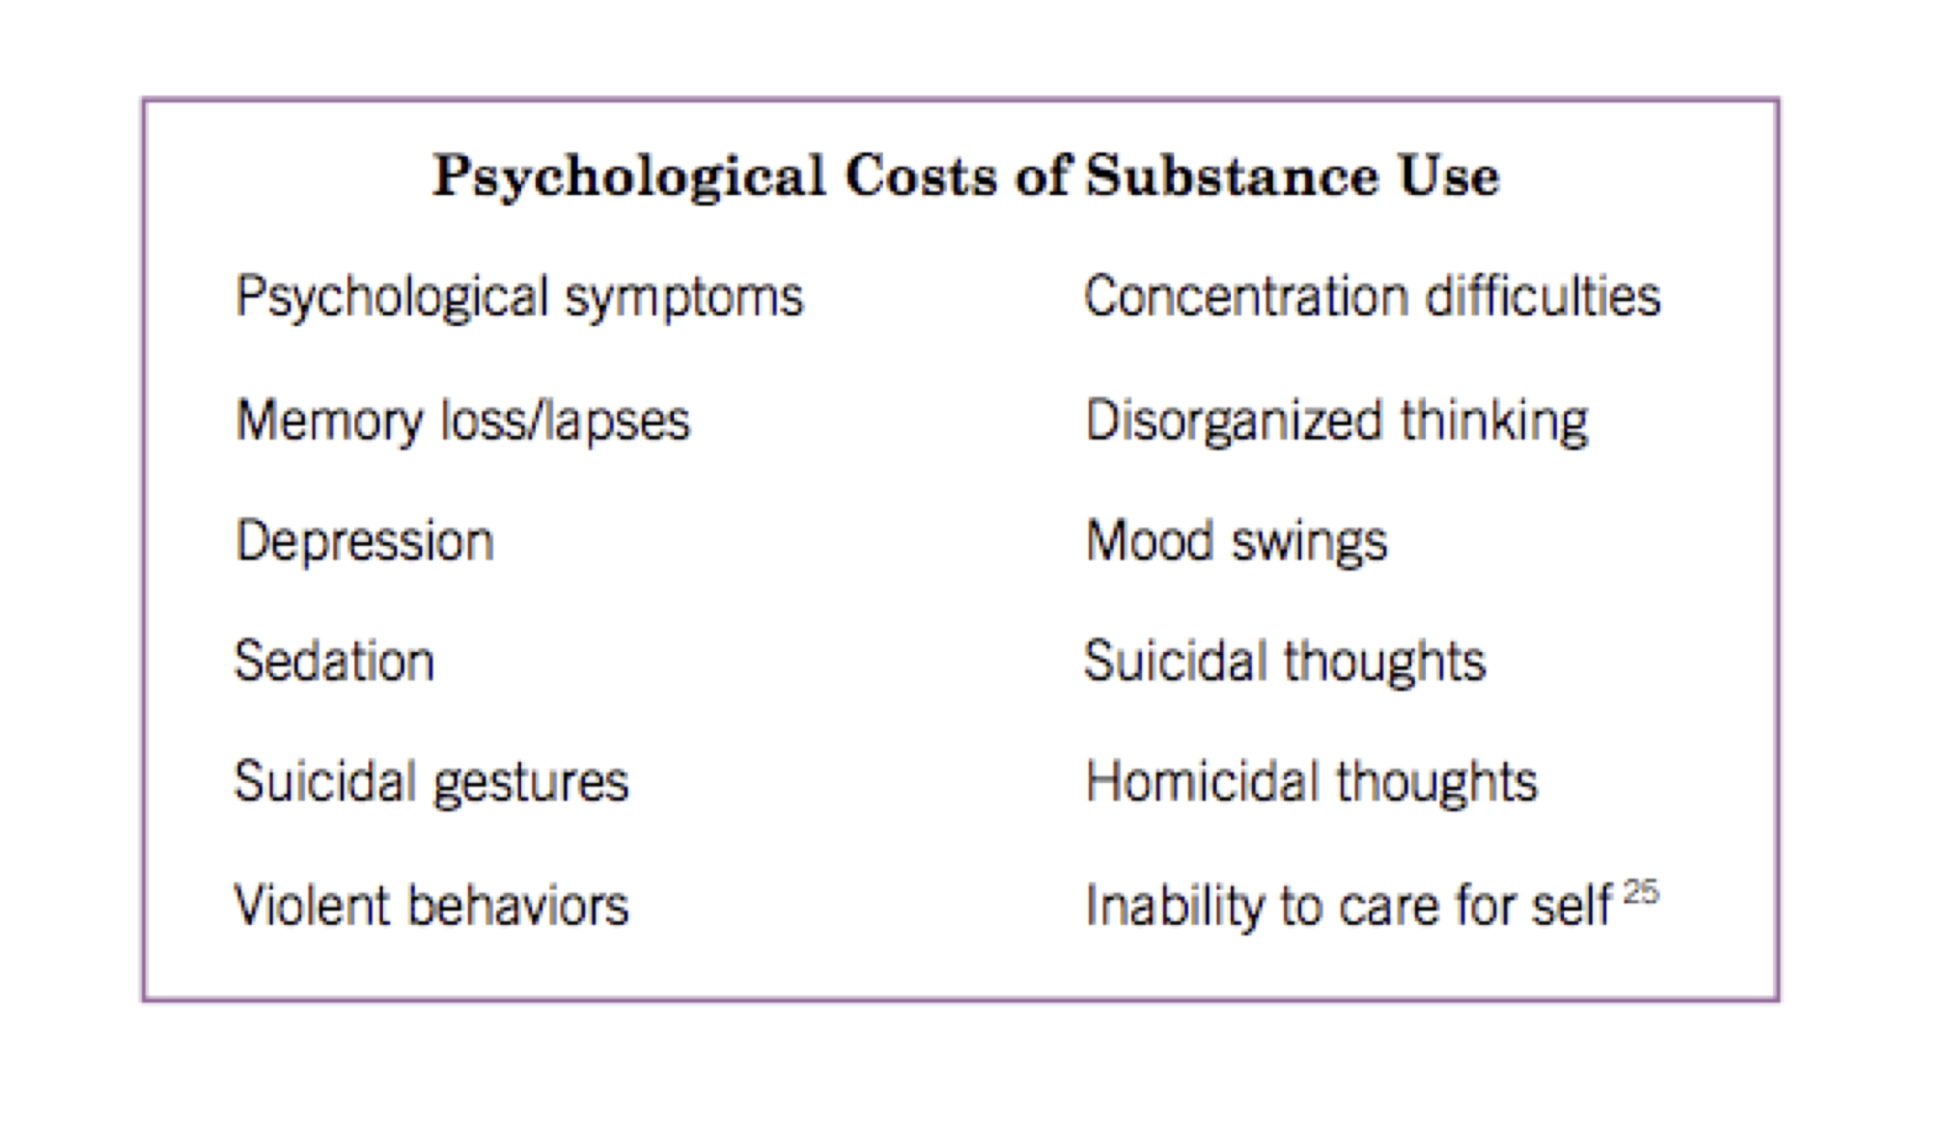

Slide 26
Some Myths
It isn’t that bad.
I am entitled.

Slide 27
Some Myths
It isn’t that bad.
I am entitled.
It only hurts me.

Slide 28
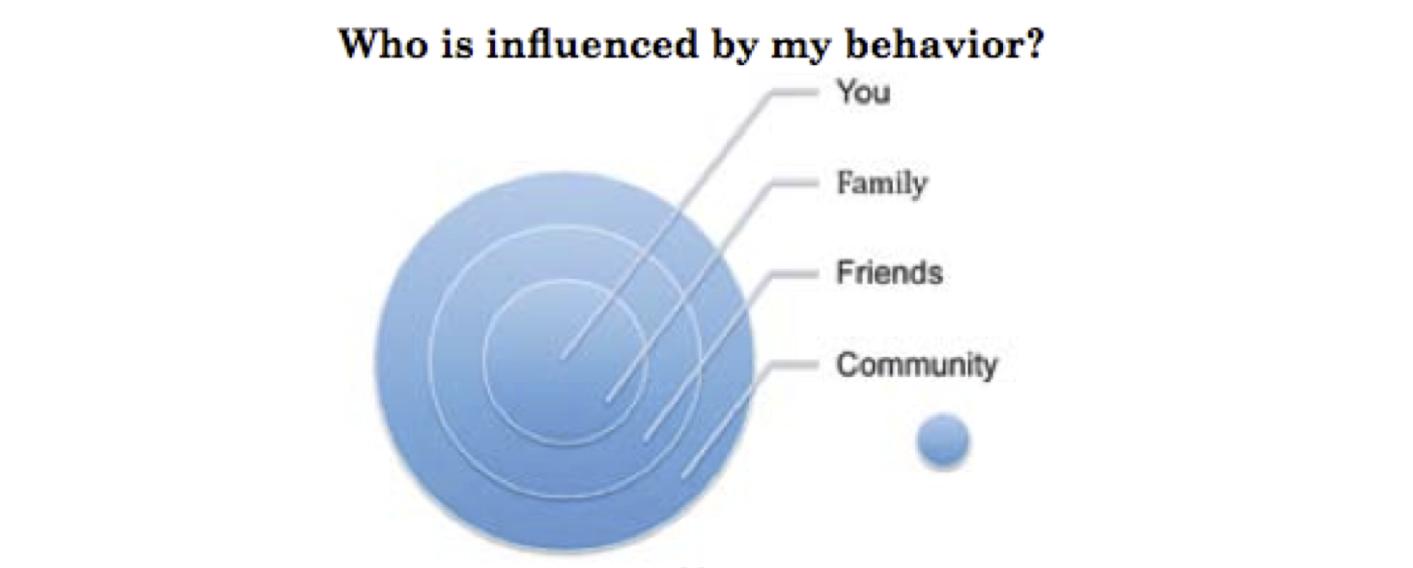

Slide 29
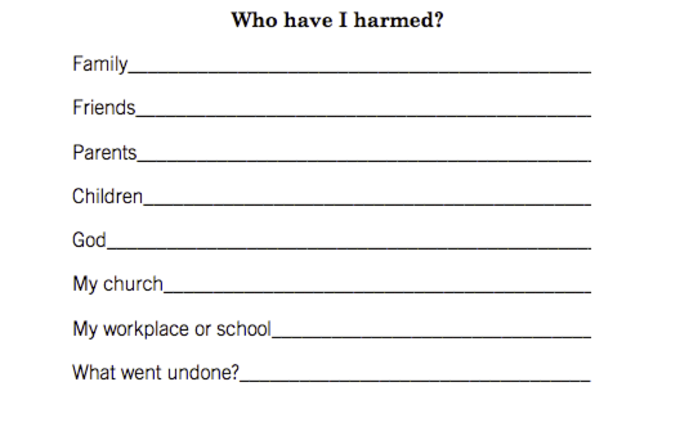

Slide 30
Some Myths
It isn’t that bad.
I am entitled.
It only hurts me.
I can’t get better.

Slide 31
Breaking the Cycle
Repent

Slide 32
Breaking the Cycle
Repent
Get clean

Slide 33
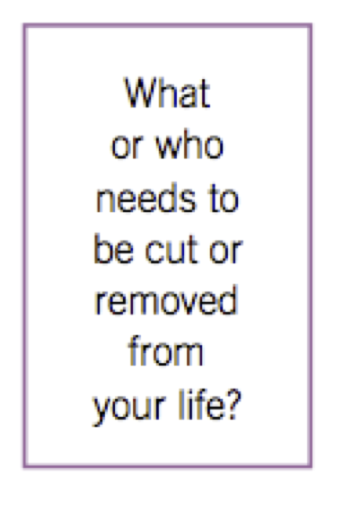

Slide 34
Breaking the Cycle
Repent
Get clean
Restructure thinking (Romans 6)

Slide 36
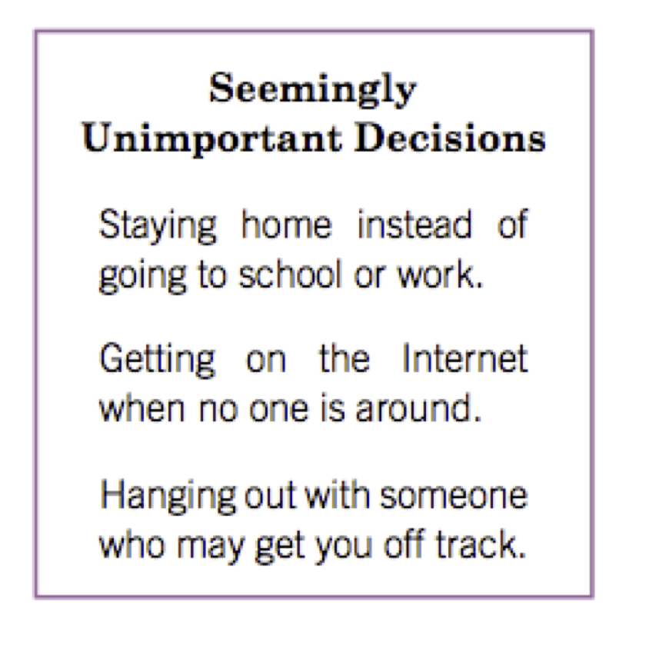

Slide 37
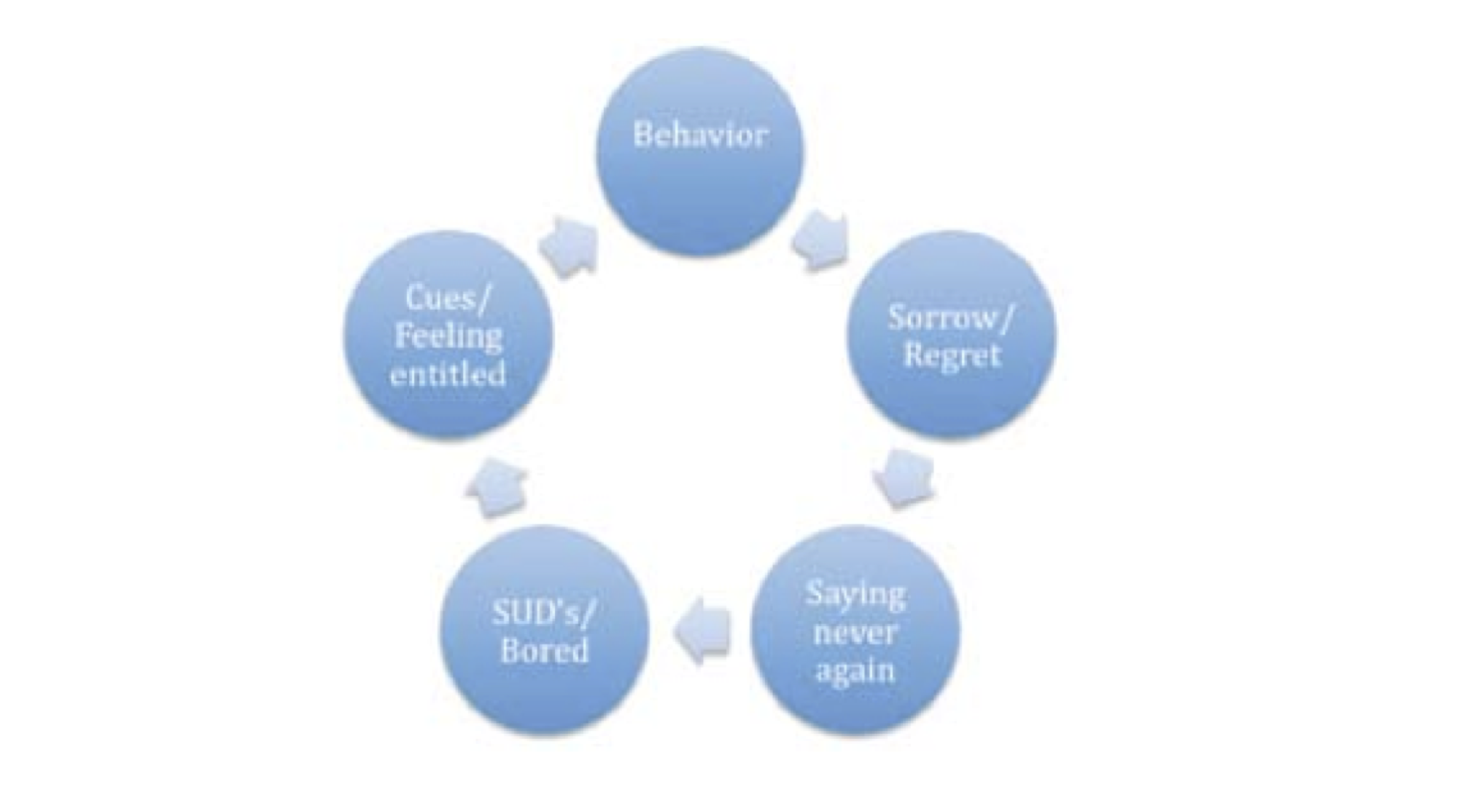

Slide 38
Breaking the Cycle
Repent
Get clean
Restructure thinking (Romans 6)
Sanitize the environment

Slide 39
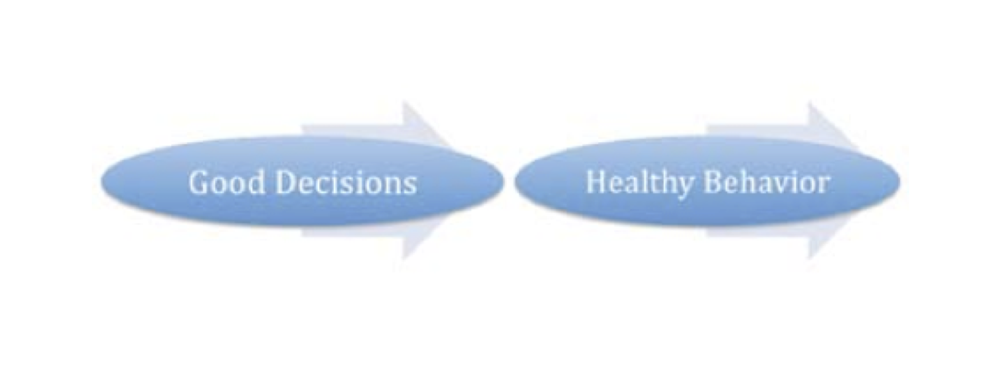

Slide 41
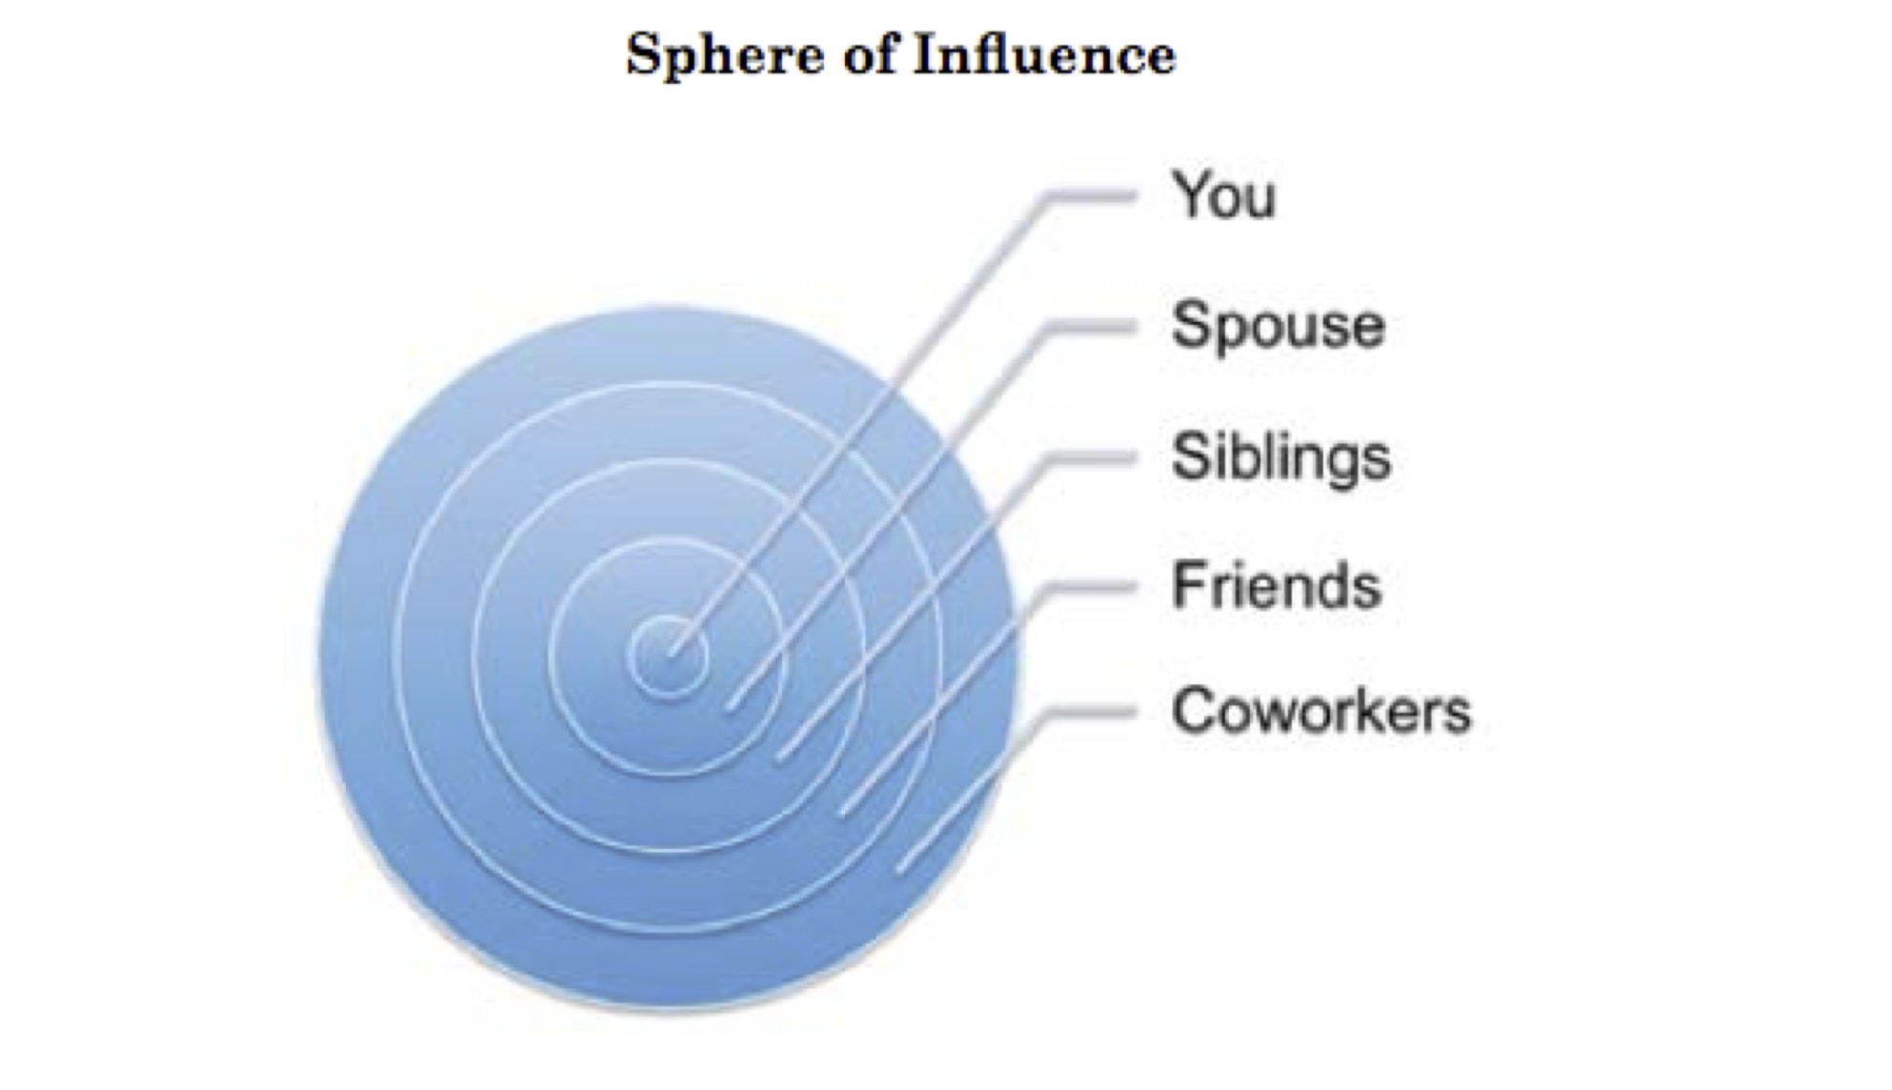

Slide 42
First Aid for Addictions
Edward E. Moody, Jr.
emoody@nafwb.org
www.FirstAidforEmotionalHurts.com
Notes:
I realized I had not prepared my people for this kind of thing.
Clearly Jesus is in the helping business.

