Slide 3
First Aid for Sexual Issues
Ferdinand Bol Elijah Fed by an Angel

Slide 4
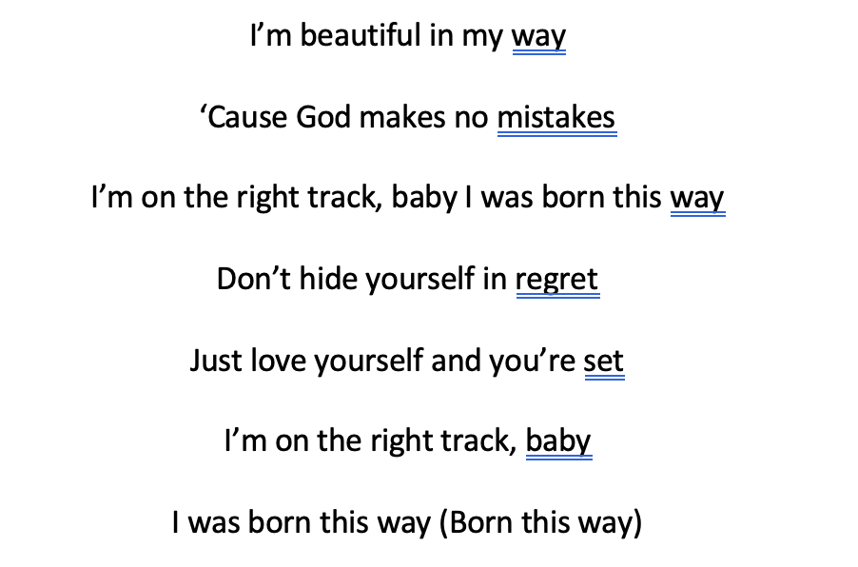
2011

Slide 5
Less than 0.1% of the population has been assessed to struggle with gender dysphoria.

Slide 6
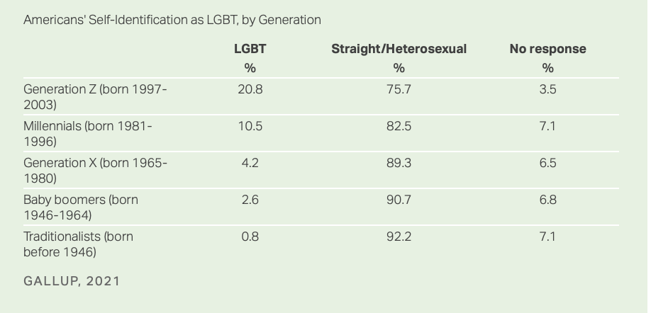

Slide 7
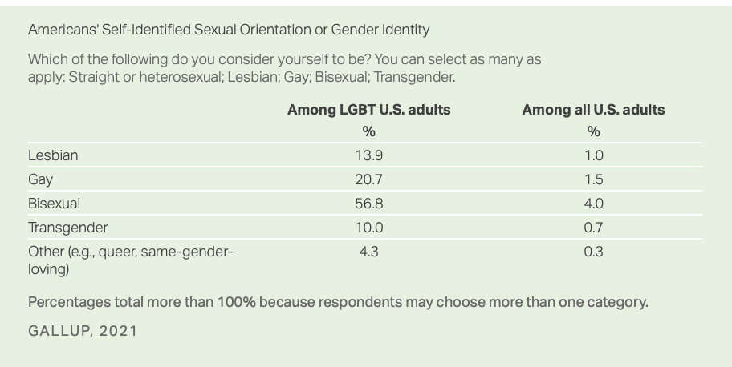

Slide 8
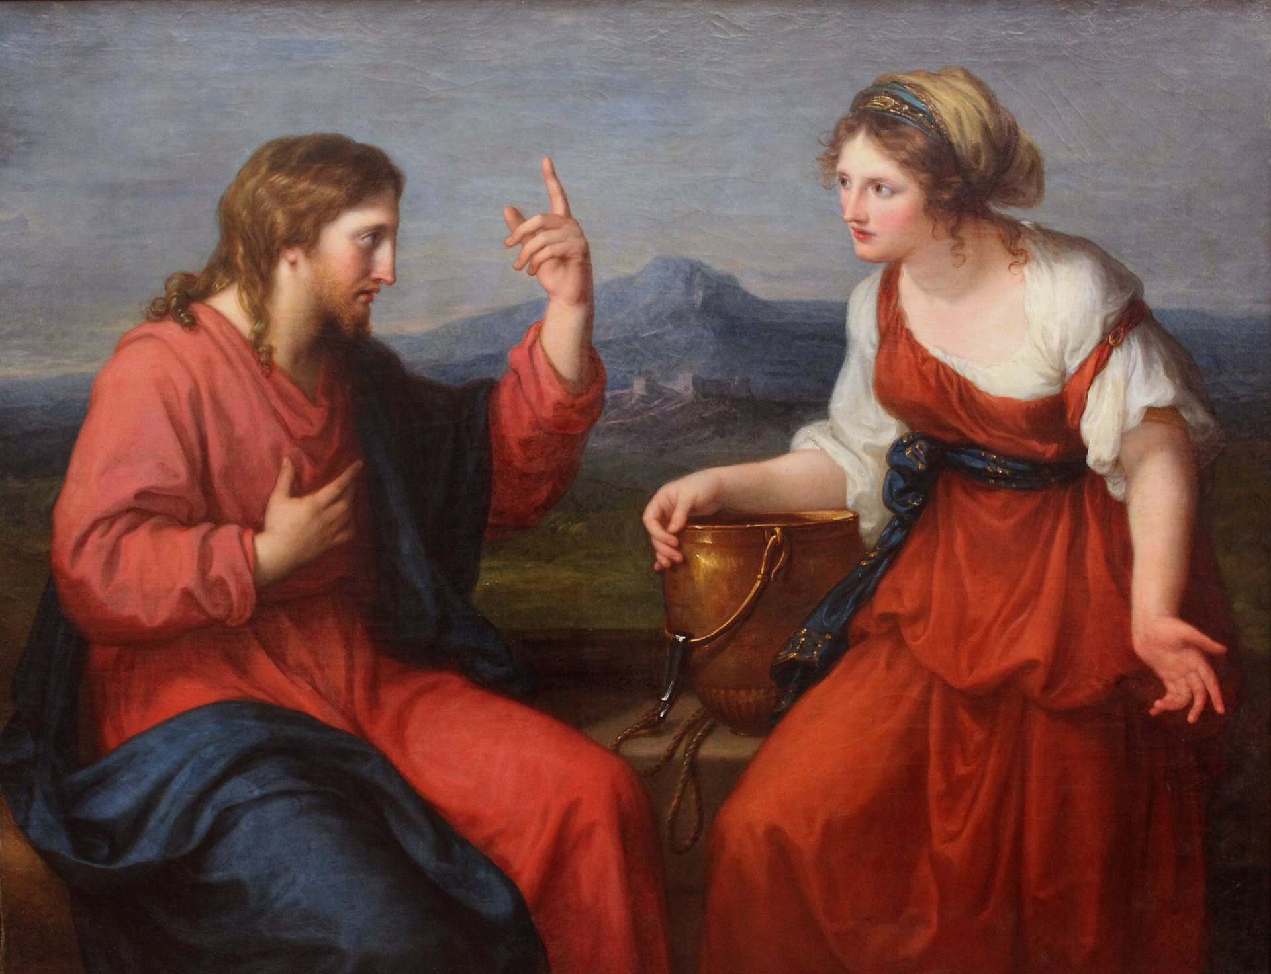
First Aid for Sexual Issues John 4
The Water of Life Discourse between Jesus and the Samaritan Woman at the Well by Angelika Kauffmann

Slide 9
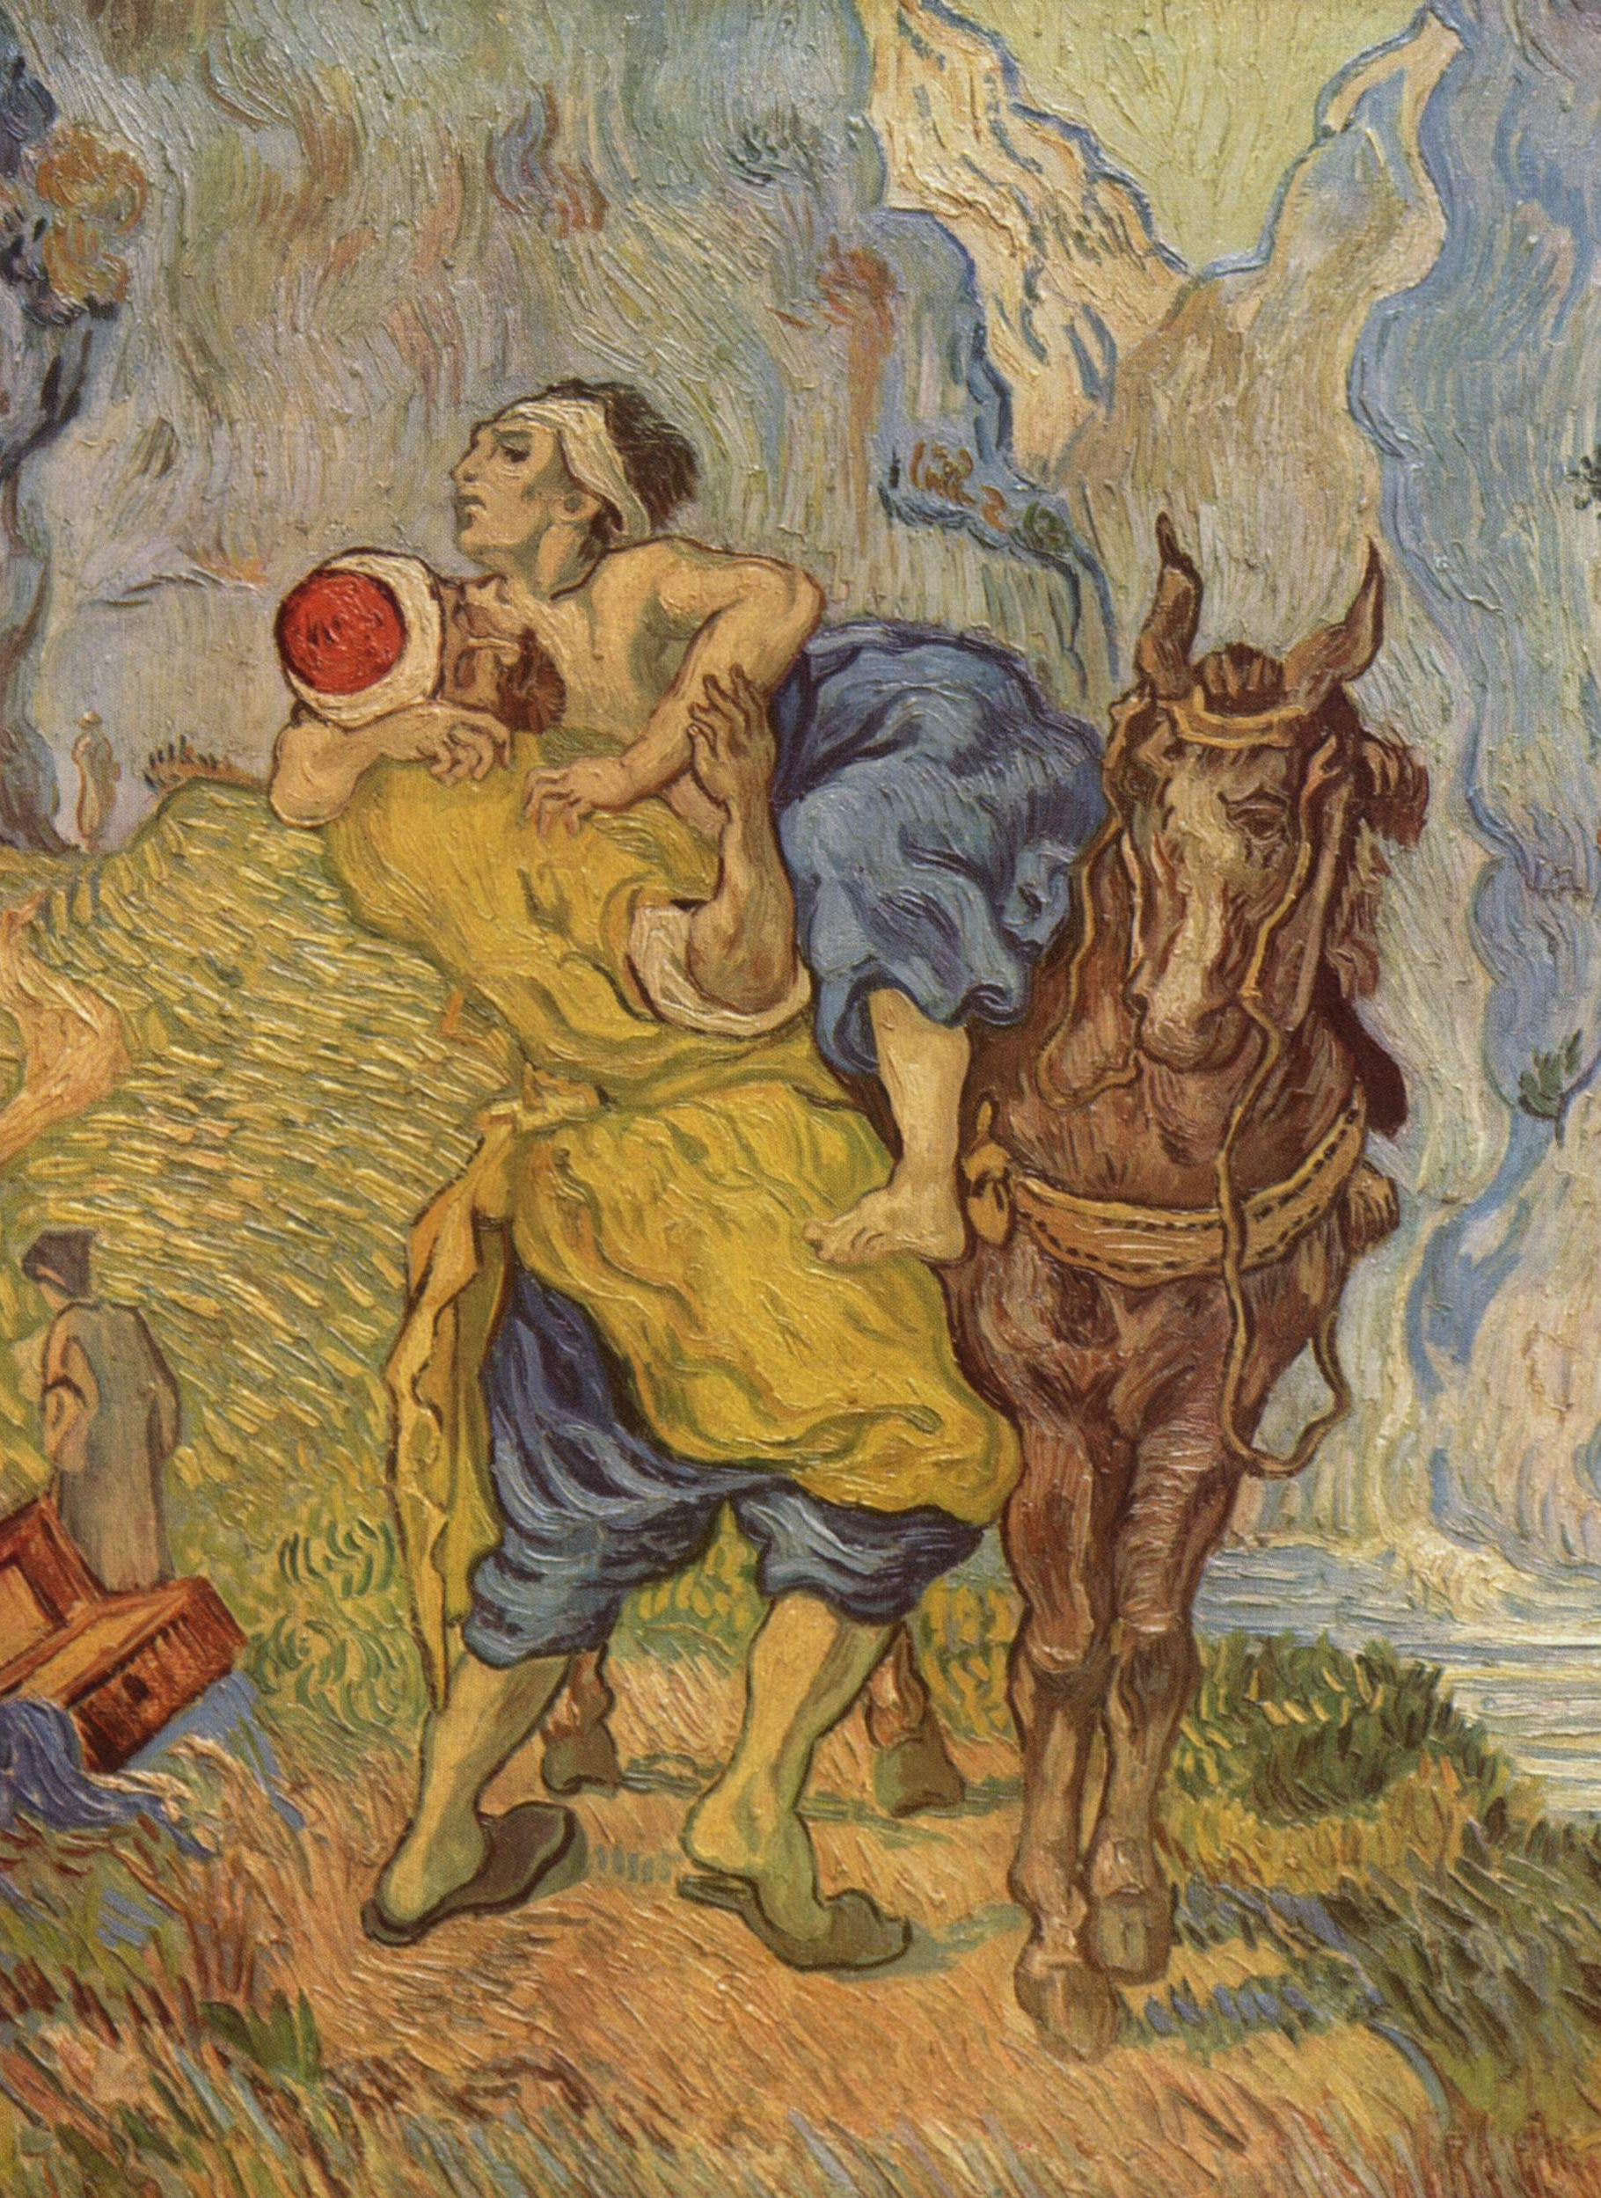
The Tools of the Responder The Word: Truth Prayer The Church Your Relationships Your Words
The Good Samaritan by Vincent van Gogh
Notes:
^{Covid 19>}
³⁰ And Jesus answering said, A certain man went down from Jerusalem to Jericho, and fell among thieves, which stripped him of his raiment, and wounded him, and departed, leaving him half dead.
³¹ And by chance there came down a certain priest that way: and when he saw him, he passed by on the other side.
³² And likewise a Levite, when he was at the place, came and looked on him, and passed by on the other side.
³³ But a certain Samaritan, as he journeyed, came where he was: and when he saw him, he had compassion on him,
³⁴ And went to him, and bound up his wounds, pouring in oil and wine, and set him on his own beast, and brought him to an inn, and took care of him.
³⁵ And on the morrow when he departed, he took out two pence, and gave them to the host, and said unto him, Take care of him; and whatsoever thou spendest more, when I come again, I will repay thee.
³⁶ Which now of these three, thinkest thou, was neighbour unto him that fell among the thieves?
³⁷ And he said, He that shewed mercy on him. Then said Jesus unto him, Go, and do thou likewise.

Slide 10
Truth
So God created man in his own image, in the image of God created he him; male and female created he them.
Genesis 1:27

Slide 11
²⁰ For the creature was made subject to vanity, not willingly, but by reason of him who hath subjected the same in hope, ²¹ Because the creature itself also shall be delivered from the bondage of corruption into the glorious liberty of the children of God. ²² For we know that the whole creation groaneth and travaileth in pain together until now.
Romans 8

Slide 12
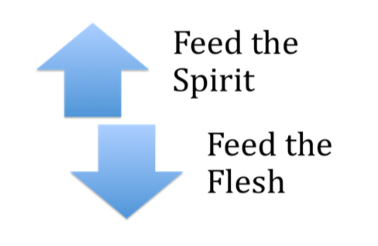
Gratifying
Notes:
Wrong places>

Slide 13
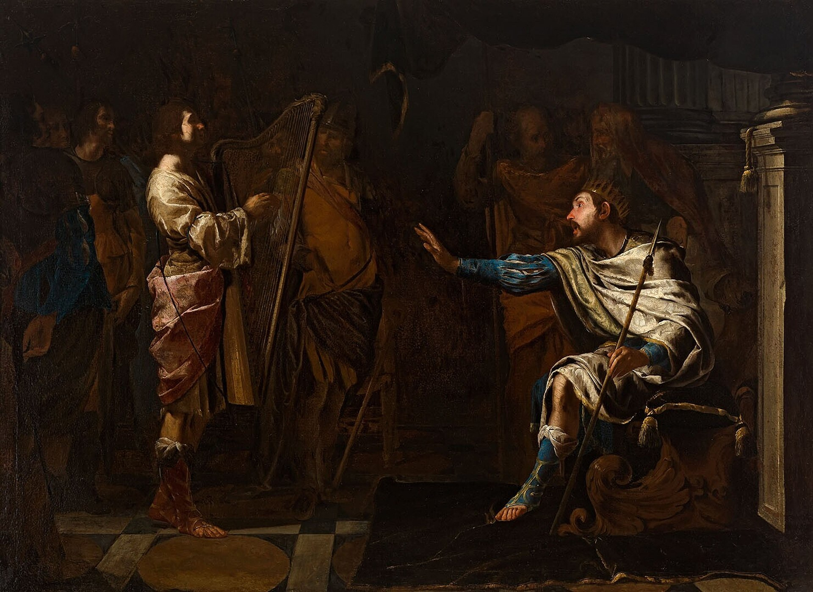
Examples
Bernardo Cavallino - David

Slide 14
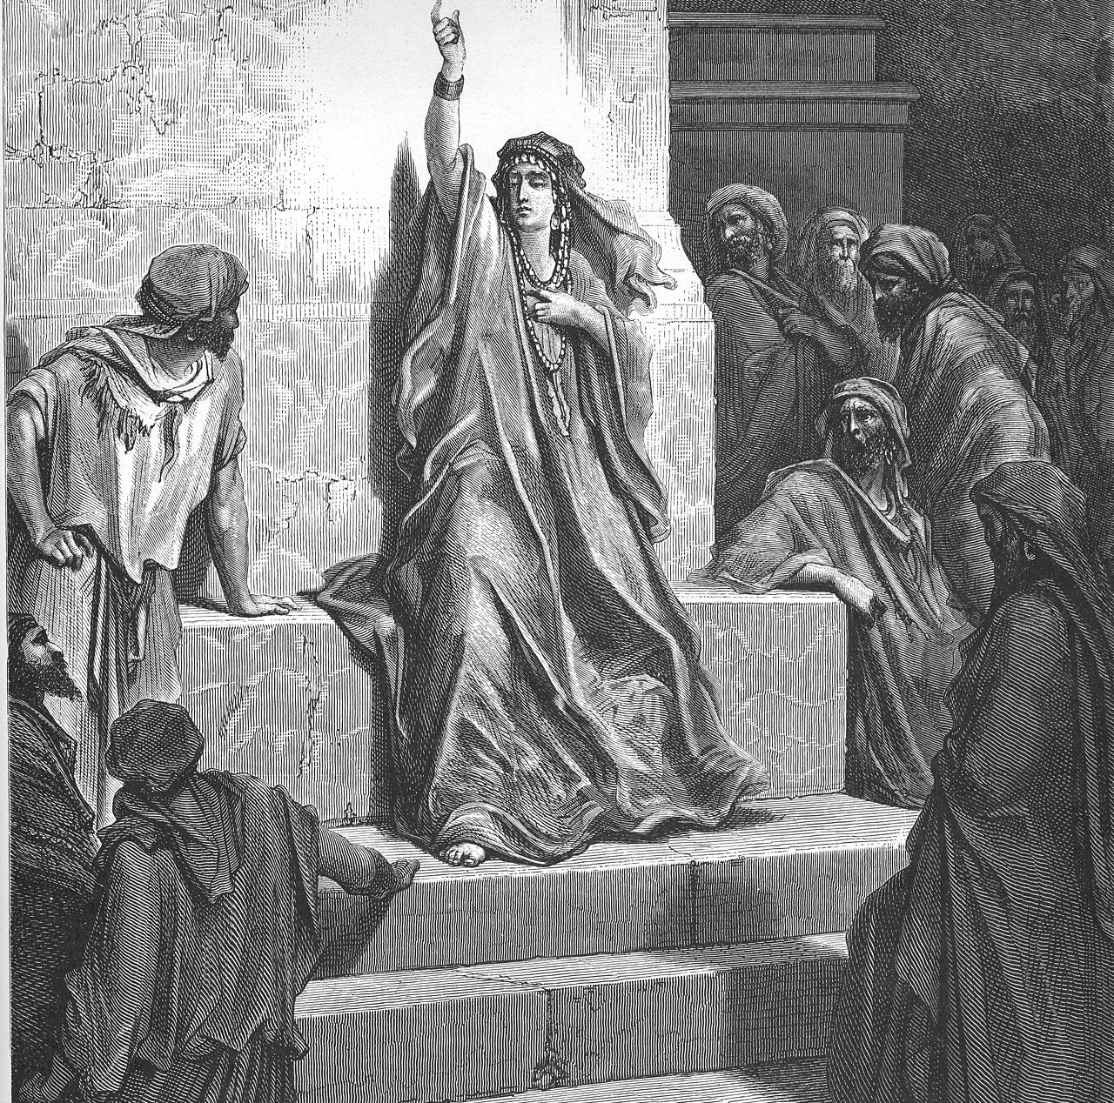
Deborah Gustave Doré (1865)

Slide 15
Instill Hope
⁴ And the vessel that he made of clay was marred in the hand of the potter: so he made it again another vessel, as seemed good to the potter to make it. ⁵ Then the word of the Lord came to me, saying, ⁶ O house of Israel, cannot I do with you as this potter? saith the Lord. Behold, as the clay is in the potter's hand, so are ye in mine hand, O house of Israel.
Jeremiah 18

Slide 17
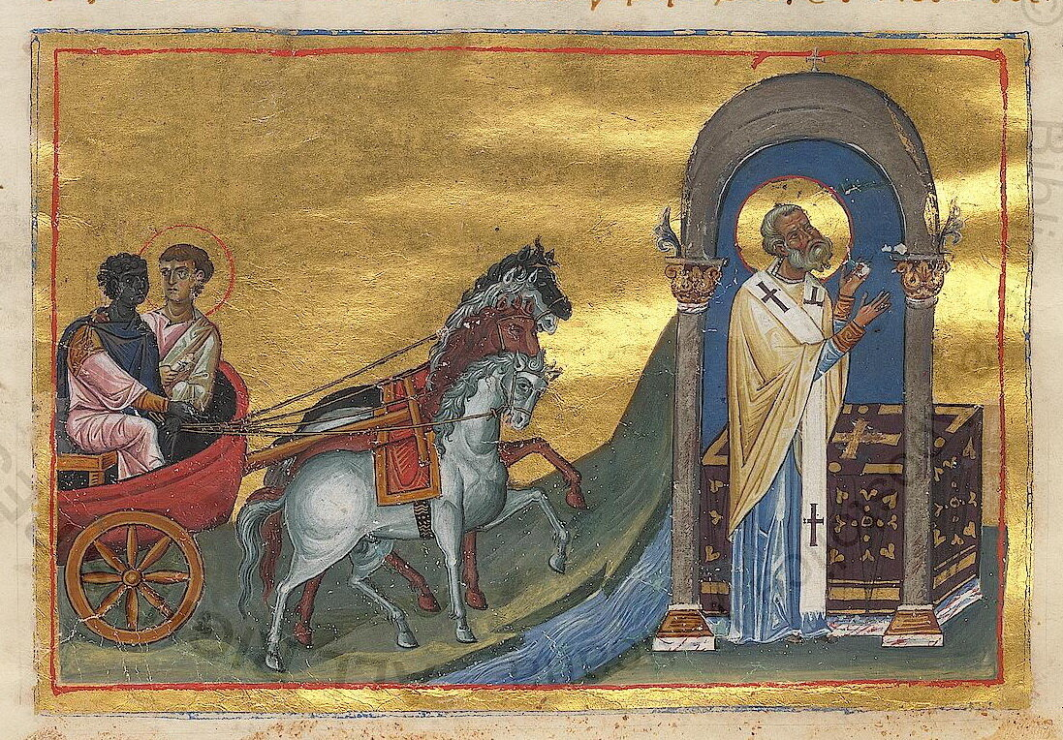
For there are some eunuchs, which were so born from their mother's womb: and there are some eunuchs, which were made eunuchs of men: and there be eunuchs, which have made themselves eunuchs for the kingdom of heaven's sake. He that is able to receive it, let him receive it. Matthew 19:12

Slide 18
The Tools of the Responder The Word Prayer The Church Your Relationships Your Words
The Good Samaritan by Vincent van Gogh
Notes:
^{Covid 19>}
³⁰ And Jesus answering said, A certain man went down from Jerusalem to Jericho, and fell among thieves, which stripped him of his raiment, and wounded him, and departed, leaving him half dead.
³¹ And by chance there came down a certain priest that way: and when he saw him, he passed by on the other side.
³² And likewise a Levite, when he was at the place, came and looked on him, and passed by on the other side.
³³ But a certain Samaritan, as he journeyed, came where he was: and when he saw him, he had compassion on him,
³⁴ And went to him, and bound up his wounds, pouring in oil and wine, and set him on his own beast, and brought him to an inn, and took care of him.
³⁵ And on the morrow when he departed, he took out two pence, and gave them to the host, and said unto him, Take care of him; and whatsoever thou spendest more, when I come again, I will repay thee.
³⁶ Which now of these three, thinkest thou, was neighbour unto him that fell among the thieves?
³⁷ And he said, He that shewed mercy on him. Then said Jesus unto him, Go, and do thou likewise.

Slide 19
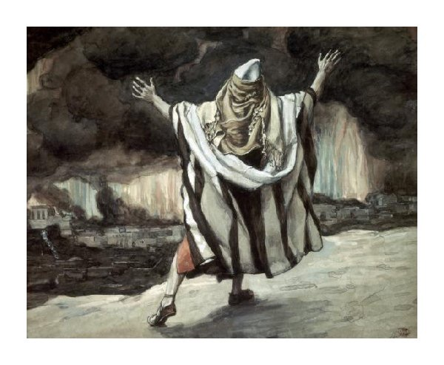
Do we pray like Jonah or Abraham?
Abraham Sees Sodom in Flames, James Tissot

Slide 20
The Tools of the Responder The Word Prayer The Church Your Relationships Your Words
The Good Samaritan by Vincent van Gogh
Notes:
^{Covid 19>}
³⁰ And Jesus answering said, A certain man went down from Jerusalem to Jericho, and fell among thieves, which stripped him of his raiment, and wounded him, and departed, leaving him half dead.
³¹ And by chance there came down a certain priest that way: and when he saw him, he passed by on the other side.
³² And likewise a Levite, when he was at the place, came and looked on him, and passed by on the other side.
³³ But a certain Samaritan, as he journeyed, came where he was: and when he saw him, he had compassion on him,
³⁴ And went to him, and bound up his wounds, pouring in oil and wine, and set him on his own beast, and brought him to an inn, and took care of him.
³⁵ And on the morrow when he departed, he took out two pence, and gave them to the host, and said unto him, Take care of him; and whatsoever thou spendest more, when I come again, I will repay thee.
³⁶ Which now of these three, thinkest thou, was neighbour unto him that fell among the thieves?
³⁷ And he said, He that shewed mercy on him. Then said Jesus unto him, Go, and do thou likewise.

Slide 23
The Tools of the Responder The Word Prayer The Church Your Relationships Your Words
The Good Samaritan by Vincent van Gogh
Notes:
^{Covid 19>}
³⁰ And Jesus answering said, A certain man went down from Jerusalem to Jericho, and fell among thieves, which stripped him of his raiment, and wounded him, and departed, leaving him half dead.
³¹ And by chance there came down a certain priest that way: and when he saw him, he passed by on the other side.
³² And likewise a Levite, when he was at the place, came and looked on him, and passed by on the other side.
³³ But a certain Samaritan, as he journeyed, came where he was: and when he saw him, he had compassion on him,
³⁴ And went to him, and bound up his wounds, pouring in oil and wine, and set him on his own beast, and brought him to an inn, and took care of him.
³⁵ And on the morrow when he departed, he took out two pence, and gave them to the host, and said unto him, Take care of him; and whatsoever thou spendest more, when I come again, I will repay thee.
³⁶ Which now of these three, thinkest thou, was neighbour unto him that fell among the thieves?
³⁷ And he said, He that shewed mercy on him. Then said Jesus unto him, Go, and do thou likewise.

Slide 24
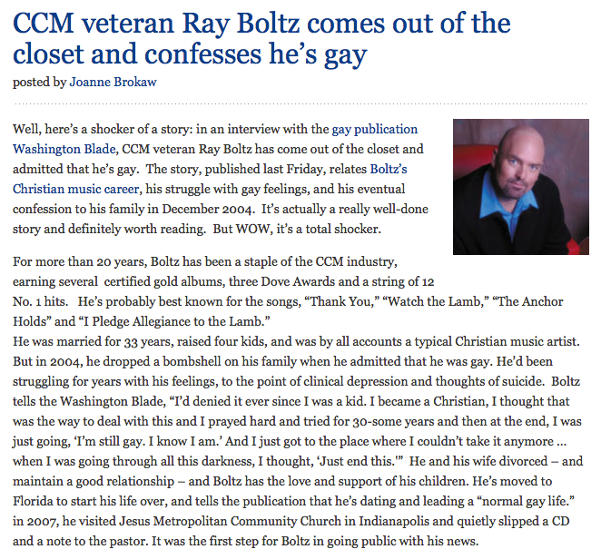
Notes:
don’t be quarrelsome>

Slide 25
Be careful about our tone
Notes:
calm like Paul>
Matthew 10:16, we are better than that>
Jonah
They are asking, can I bring my friend to this church?
3 out of 5 teens who struggle with these issues do not feel safe.
Actual or perceived sexual orientation is one of the most common reasons that students are harassed by their peers, second only to physical appearance.
What am I trying to accomplish?
Lose the jokes.
Lose the stereotypes. David played a harp. NC Pastor?
The church ought to be the safest place there is.
Should feel welcome.
Admit imperfection.
You are speaking to them whether you realize it or not. Think of 1 Cor. 9.
Lose the jokes.
Lose the stereotypes. David. Deborah.
When you freelance it gets dangerous.
Pastor in NC.
Ask, what am I trying to accomplish?

Slide 26
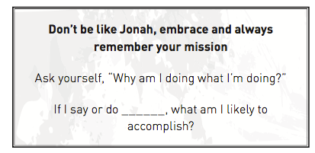

Slide 27
The Tools of the Responder The Word Prayer The Church Your Relationships Your Words
The Good Samaritan by Vincent van Gogh
Notes:
^{Covid 19>}
³⁰ And Jesus answering said, A certain man went down from Jerusalem to Jericho, and fell among thieves, which stripped him of his raiment, and wounded him, and departed, leaving him half dead.
³¹ And by chance there came down a certain priest that way: and when he saw him, he passed by on the other side.
³² And likewise a Levite, when he was at the place, came and looked on him, and passed by on the other side.
³³ But a certain Samaritan, as he journeyed, came where he was: and when he saw him, he had compassion on him,
³⁴ And went to him, and bound up his wounds, pouring in oil and wine, and set him on his own beast, and brought him to an inn, and took care of him.
³⁵ And on the morrow when he departed, he took out two pence, and gave them to the host, and said unto him, Take care of him; and whatsoever thou spendest more, when I come again, I will repay thee.
³⁶ Which now of these three, thinkest thou, was neighbour unto him that fell among the thieves?
³⁷ And he said, He that shewed mercy on him. Then said Jesus unto him, Go, and do thou likewise.

Slide 28
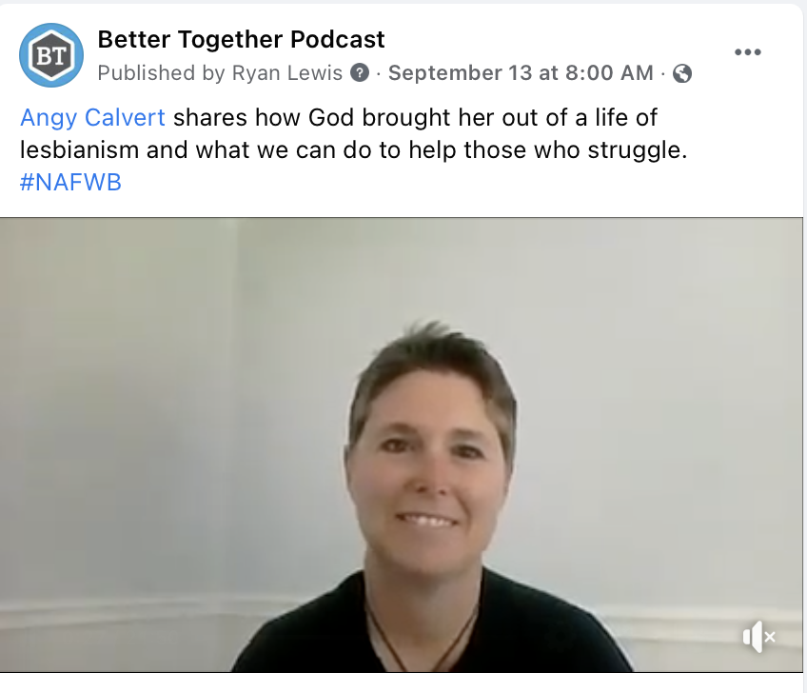

Slide 29
Behold, I send you forth as sheep in the midst of wolves: be ye therefore wise as serpents, and harmless as doves.
Matthew 10:16

Slide 30
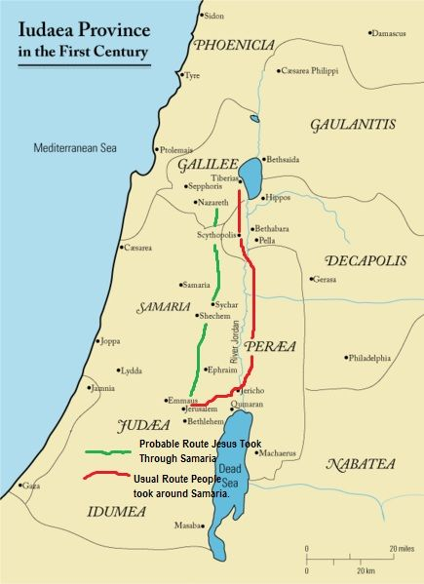
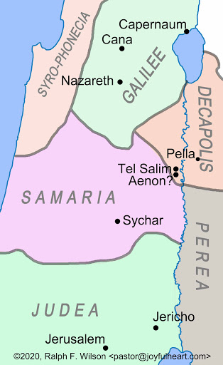

Slide 31
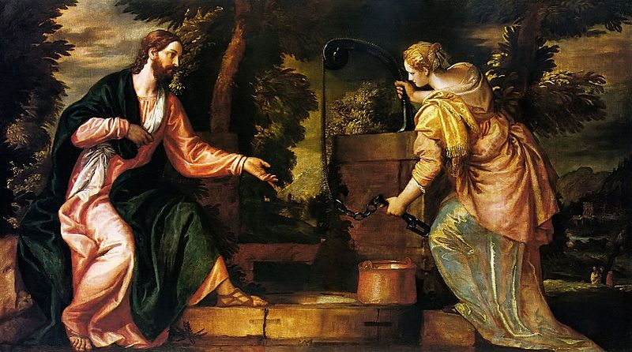

Slide 32
The Techniques of the Responder Attend Observe Listen Care Respond Act Find the Inn
The Good Samaritan by Vincent van Gogh
Notes:
^{Covid 19>}
³⁰ And Jesus answering said, A certain man went down from Jerusalem to Jericho, and fell among thieves, which stripped him of his raiment, and wounded him, and departed, leaving him half dead.
³¹ And by chance there came down a certain priest that way: and when he saw him, he passed by on the other side.
³² And likewise a Levite, when he was at the place, came and looked on him, and passed by on the other side.
³³ But a certain Samaritan, as he journeyed, came where he was: and when he saw him, he had compassion on him,
³⁴ And went to him, and bound up his wounds, pouring in oil and wine, and set him on his own beast, and brought him to an inn, and took care of him.
³⁵ And on the morrow when he departed, he took out two pence, and gave them to the host, and said unto him, Take care of him; and whatsoever thou spendest more, when I come again, I will repay thee.
³⁶ Which now of these three, thinkest thou, was neighbour unto him that fell among the thieves?
³⁷ And he said, He that shewed mercy on him. Then said Jesus unto him, Go, and do thou likewise.

Slide 33
The Techniques of the Responder Attend Observe Listen Care Respond Act Find the Inn
The Good Samaritan by Vincent van Gogh
Notes:
^{Covid 19>}
³⁰ And Jesus answering said, A certain man went down from Jerusalem to Jericho, and fell among thieves, which stripped him of his raiment, and wounded him, and departed, leaving him half dead.
³¹ And by chance there came down a certain priest that way: and when he saw him, he passed by on the other side.
³² And likewise a Levite, when he was at the place, came and looked on him, and passed by on the other side.
³³ But a certain Samaritan, as he journeyed, came where he was: and when he saw him, he had compassion on him,
³⁴ And went to him, and bound up his wounds, pouring in oil and wine, and set him on his own beast, and brought him to an inn, and took care of him.
³⁵ And on the morrow when he departed, he took out two pence, and gave them to the host, and said unto him, Take care of him; and whatsoever thou spendest more, when I come again, I will repay thee.
³⁶ Which now of these three, thinkest thou, was neighbour unto him that fell among the thieves?
³⁷ And he said, He that shewed mercy on him. Then said Jesus unto him, Go, and do thou likewise.

Slide 34
Gender Dysphoria in Children (6 or more of the following for at least 6 months)
A strong desire to be of the other gender or an insistence that one is the other gender
In boys (assigned gender), a strong preference for cross-dressing or simulating female attire; or in girls (assigned gender), a strong preference for wearing only typical masculine clothing and a strong resistance to wearing typical feminine clothing
A strong preference for cross-gender roles in make-believe play or fantasy play
A strong preference for toys, games, or activities stereotypically used or engaged in by the other gender
A strong preference for playmates of the other gender
In boys (assigned gender), a strong rejection of typically masculine toys, games, and activities and a strong rejection of rough-and-tumble play; or in girls (as assigned gender), a strong rejection of typically feminine toys, games, and activities
A strong dislike for one’s sexual anatomy
A strong desire for the primary and/or secondary sex characteristic that match one’s experienced gender

Slide 35
The Techniques of the Responder Attend Observe Listen Care Respond Act Find the Inn
The Good Samaritan by Vincent van Gogh
Notes:
^{Covid 19>}
³⁰ And Jesus answering said, A certain man went down from Jerusalem to Jericho, and fell among thieves, which stripped him of his raiment, and wounded him, and departed, leaving him half dead.
³¹ And by chance there came down a certain priest that way: and when he saw him, he passed by on the other side.
³² And likewise a Levite, when he was at the place, came and looked on him, and passed by on the other side.
³³ But a certain Samaritan, as he journeyed, came where he was: and when he saw him, he had compassion on him,
³⁴ And went to him, and bound up his wounds, pouring in oil and wine, and set him on his own beast, and brought him to an inn, and took care of him.
³⁵ And on the morrow when he departed, he took out two pence, and gave them to the host, and said unto him, Take care of him; and whatsoever thou spendest more, when I come again, I will repay thee.
³⁶ Which now of these three, thinkest thou, was neighbour unto him that fell among the thieves?
³⁷ And he said, He that shewed mercy on him. Then said Jesus unto him, Go, and do thou likewise.

Slide 36
Suggestions from a Parent
What was helpful for us from other Christians?
Listening, not judging and not giving advice we didn't ask for.
Acknowledging our sorrow and asking about how our daughter is doing, instead of acting like she is dead to us.
Telling us they are praying, fasting, and grieving for our child.

Slide 37
The Techniques of the Responder Attend Observe Listen Care Respond Act Find the Inn
The Good Samaritan by Vincent van Gogh
Notes:
^{Covid 19>}
³⁰ And Jesus answering said, A certain man went down from Jerusalem to Jericho, and fell among thieves, which stripped him of his raiment, and wounded him, and departed, leaving him half dead.
³¹ And by chance there came down a certain priest that way: and when he saw him, he passed by on the other side.
³² And likewise a Levite, when he was at the place, came and looked on him, and passed by on the other side.
³³ But a certain Samaritan, as he journeyed, came where he was: and when he saw him, he had compassion on him,
³⁴ And went to him, and bound up his wounds, pouring in oil and wine, and set him on his own beast, and brought him to an inn, and took care of him.
³⁵ And on the morrow when he departed, he took out two pence, and gave them to the host, and said unto him, Take care of him; and whatsoever thou spendest more, when I come again, I will repay thee.
³⁶ Which now of these three, thinkest thou, was neighbour unto him that fell among the thieves?
³⁷ And he said, He that shewed mercy on him. Then said Jesus unto him, Go, and do thou likewise.

Slide 38
Notes:
calm like Paul>
Matthew 10:16, we are better than that>
Jonah
They are asking, can I bring my friend to this church?
3 out of 5 teens who struggle with these issues do not feel safe.
Actual or perceived sexual orientation is one of the most common reasons that students are harassed by their peers, second only to physical appearance.
What am I trying to accomplish?
Lose the jokes.
Lose the stereotypes. David played a harp. NC Pastor?
The church ought to be the safest place there is.
Should feel welcome.
Admit imperfection.
You are speaking to them whether you realize it or not. Think of 1 Cor. 9.
Lose the jokes.
Lose the stereotypes. David. Deborah.
When you freelance it gets dangerous.
Pastor in NC.
Ask, what am I trying to accomplish?

Slide 39
The Techniques of the Responder Attend Observe Listen Care Respond Act Find the Inn
The Good Samaritan by Vincent van Gogh
Notes:
^{Covid 19>}
³⁰ And Jesus answering said, A certain man went down from Jerusalem to Jericho, and fell among thieves, which stripped him of his raiment, and wounded him, and departed, leaving him half dead.
³¹ And by chance there came down a certain priest that way: and when he saw him, he passed by on the other side.
³² And likewise a Levite, when he was at the place, came and looked on him, and passed by on the other side.
³³ But a certain Samaritan, as he journeyed, came where he was: and when he saw him, he had compassion on him,
³⁴ And went to him, and bound up his wounds, pouring in oil and wine, and set him on his own beast, and brought him to an inn, and took care of him.
³⁵ And on the morrow when he departed, he took out two pence, and gave them to the host, and said unto him, Take care of him; and whatsoever thou spendest more, when I come again, I will repay thee.
³⁶ Which now of these three, thinkest thou, was neighbour unto him that fell among the thieves?
³⁷ And he said, He that shewed mercy on him. Then said Jesus unto him, Go, and do thou likewise.

Slide 40
More suggestions from a parent . . .
What did Christians do that was unhelpful?
Giving me advice and opinions on the matter that I didn't ask for.
Telling me at least I have another child who is faithful to God.
Speaking in front of me how blessed they are because all of their children are serving the Lord.
Dismissing the trauma our daughter had as a child and pointing only to her sin.

Slide 41
Ye are of your father the devil, and the lusts of your father ye will do. He was a murderer from the beginning, and abode not in the truth, because there is no truth in him. When he speaketh a lie, he speaketh of his own: for he is a liar, and the father of it.
John 8:44
And ye shall know the truth, and the truth shall make you free.
John 8:32

Slide 42
Notes:
truth about science>

Slide 43
Notes:
truth about science>

Slide 44
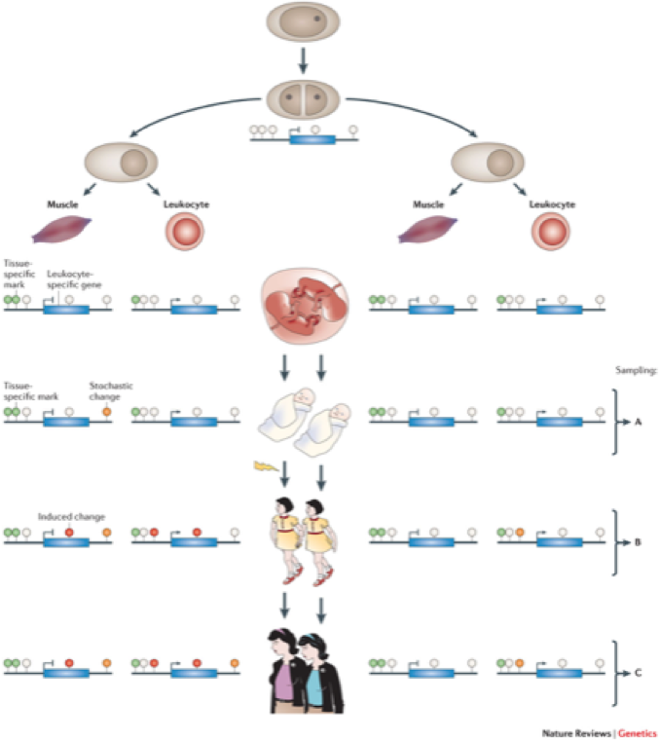
Notes:
February 1992

Slide 46
The Techniques of the Responder Attend Observe Listen Care Respond Act Find the Inn
The Good Samaritan by Vincent van Gogh
Notes:
^{Covid 19>}
³⁰ And Jesus answering said, A certain man went down from Jerusalem to Jericho, and fell among thieves, which stripped him of his raiment, and wounded him, and departed, leaving him half dead.
³¹ And by chance there came down a certain priest that way: and when he saw him, he passed by on the other side.
³² And likewise a Levite, when he was at the place, came and looked on him, and passed by on the other side.
³³ But a certain Samaritan, as he journeyed, came where he was: and when he saw him, he had compassion on him,
³⁴ And went to him, and bound up his wounds, pouring in oil and wine, and set him on his own beast, and brought him to an inn, and took care of him.
³⁵ And on the morrow when he departed, he took out two pence, and gave them to the host, and said unto him, Take care of him; and whatsoever thou spendest more, when I come again, I will repay thee.
³⁶ Which now of these three, thinkest thou, was neighbour unto him that fell among the thieves?
³⁷ And he said, He that shewed mercy on him. Then said Jesus unto him, Go, and do thou likewise.

Slide 47
Act
Foster positive relationships with one’s father, male caregiver, or role model.
01
Foster positive relationships with male peers.
02
Foster gender typical habits and skills.
03
Facilitate positive feelings about being male.
04
Notes:
What would Jesus do?, What did Jesus do?>
the church needs to feel this void

Slide 48
The Right Approach
Build relationships
Tell me your story
Listen
Put yourself in their shoes
Sow seeds
Realize there will be no quick fix
Notes:
sow seeds>

Slide 49
The Right Approach: Build a Bridge
Notes:
proclaim the truth>

Slide 50
Notes:
seeing process>

Slide 51
Notes:
Wrong places>

Slide 52
The Wrong Places
Notes:
Wrong People>

Slide 53
The Wrong People
Notes:
Delilah>

Slide 54
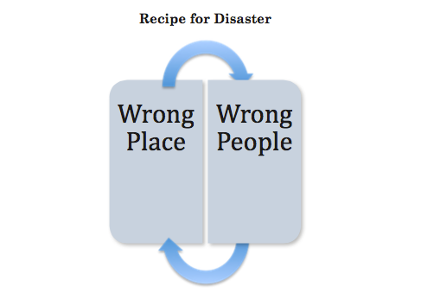
Notes:
The wrong activities>

Slide 55
The Wrong Activities
Notes:
The Wrong thinking>

Slide 56
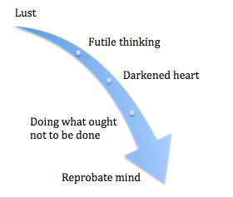
The Wrong Thinking
Notes:
The terrible results>

Slide 57
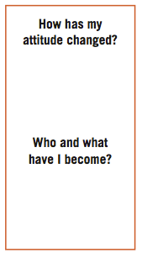
The Terrible Results
Notes:
The Terrible Impact>

Slide 58
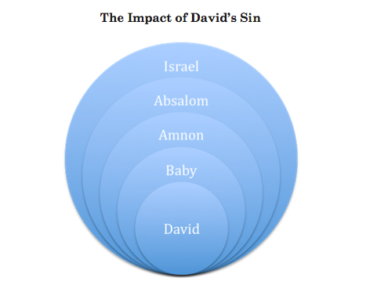
Notes:
Knowing is not enough>

Slide 59
The Solution: Repent
Notes:
Why do I feel this way?>

Slide 60
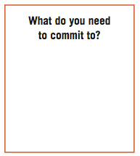
Create in Me
Notes:
seeing>fleeing>

Slide 61
Notes:
deny yourself>

Slide 62
Deny Yourself
Notes:
hard choices>

Slide 63
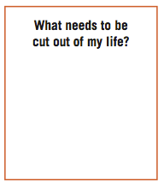
Hard Choices
Notes:
right places>

Slide 64
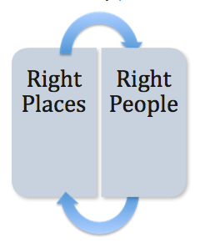
The Right Places
Notes:
take up your cross>

Slide 65
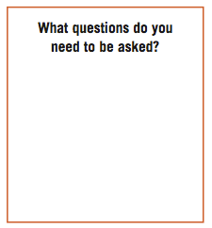
The Right People
Notes:
right activities>

Slide 66
The Right Activities
Notes:
right thinking>

Slide 67
The Right Thinking
Notes:
The choice>

Slide 68
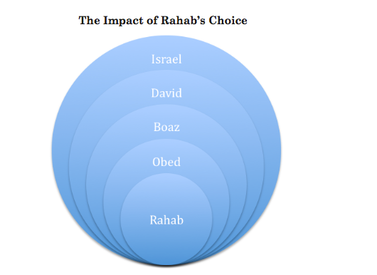
Notes:
Stop.

Slide 70
First Aid for Sexual Issues
Ferdinand Bol Elijah Fed by an Angel

