Slide 3
First Aid for Anxiety
Eddie Moody
emoody@nafwb.org

Slide 6
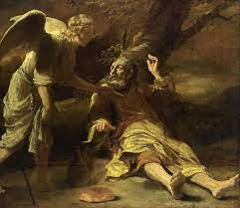
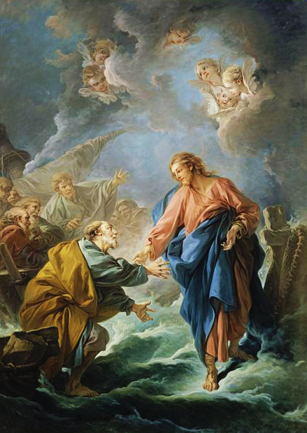
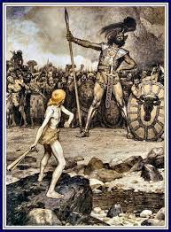
Notes:
David and Goliath, a color lithograph by Osmar Schindler(c. 1888)
Maarten van Heemskerck (1498–1574)
TitleGideon and the Fleece
François Boucher Cathédrale Saint-Louis (1766) Versailles
erdinand Bol (1616–1680)
TitleElijah Fed by an Angel

Slide 7
Can fear be good?

Slide 9
²⁸ Nevertheless the people be strong that dwell in the land, and the cities are walled, and very great: and moreover we saw the children of Anak there.
²⁹ The Amalekites dwell in the land of the south: and the Hittites, and the Jebusites, and the Amorites, dwell in the mountains: and the Canaanites dwell by the sea, and by the coast of Jordan.
Numbers 13:28-29

Slide 10
And Caleb stilled the people before Moses, and said, Let us go up at once, and possess it; for we are well able to overcome it.
Numbers 13:30

Slide 11
³¹ But the men that went up with him said, We be not able to go up against the people; for they are stronger than we.
³² And they brought up an evil report of the land which they had searched unto the children of Israel, saying, The land, through which we have gone to search it, is a land that eateth up the inhabitants thereof; and all the people that we saw in it are men of a great stature.
³³ And there we saw the giants, the sons of Anak, which come of the giants: and we were in our own sight as grasshoppers, and so we were in their sight.
Numbers 13:31-33

Slide 12
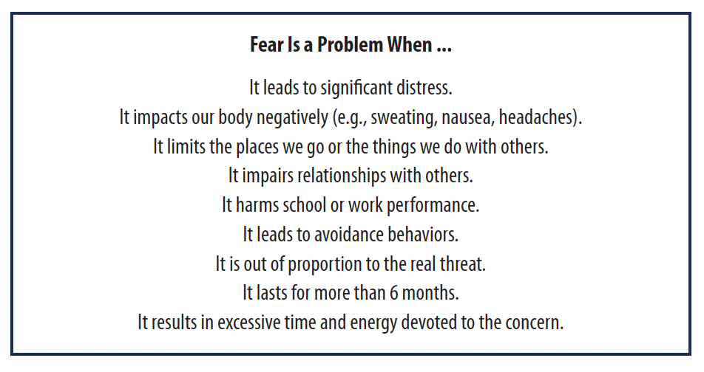

Slide 15
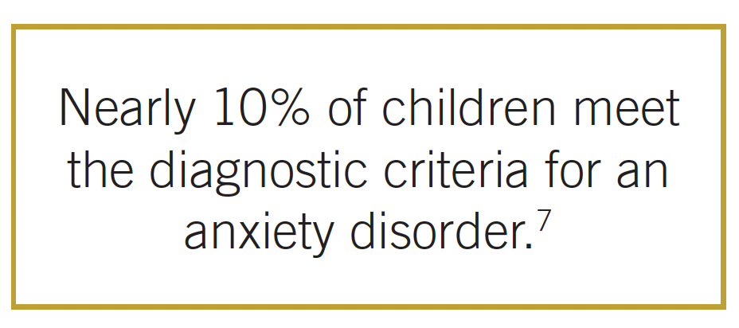
Heaviness in the heart of man maketh it stoop: but a good word maketh it glad.
Proverbs 12:25

Slide 16
Common anxiety disorders
Separation Anxiety Disorder

Slide 17
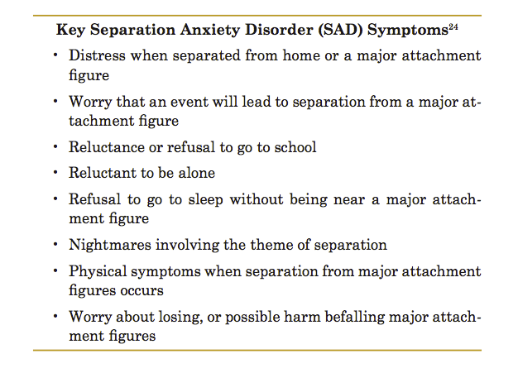

Slide 18
Common anxiety disorders
Social Anxiety Disorder

Slide 19
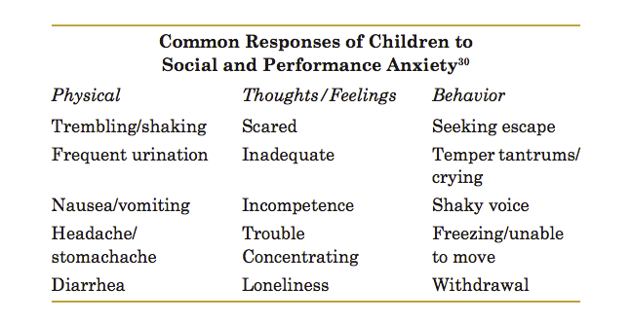
Notes:
Hurricane Andrew>

Slide 20
Common anxiety disorders
Separation Anxiety Disorder
Social Anxiety Disorder
Generalized Anxiety Disorder

Slide 21
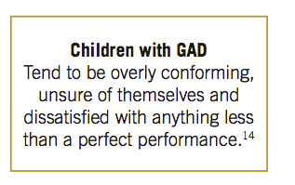
Notes:
OCD>

Slide 22
Common anxiety disorders
Separation Anxiety Disorder
Social Anxiety Disorder
Generalized Anxiety Disorder
Obsessive-compulsive Disorder

Slide 23
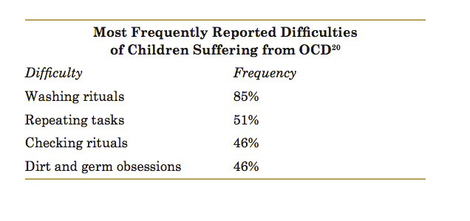

Slide 24
Common anxiety disorders
Separation Anxiety Disorder
Social Anxiety Disorder
Generalized Anxiety Disorder
Obsessive-compulsive Disorder
Posttraumatic Stress Disorder

Slide 25
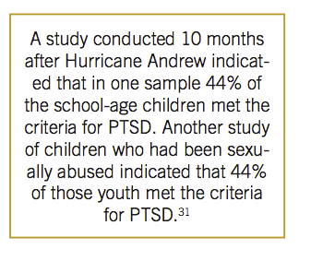

Slide 26
Common anxiety disorders
Separation Anxiety Disorder
Social Anxiety Disorder
Generalized Anxiety Disorder
Obsessive-compulsive Disorder
Posttraumatic Stress Disorder
Panic Disorder

Slide 27
Criteria for a Panic Attack
Palpitations, pounding heart, or accelerated heartbeat
Sweating.
Trembling or shaking
Feeling of choking
Chest pain
Nausea
Feeling Dizzy
Chills or heat sensations
Numbness or tingling sensations
Feelings of unreality
Fear of “going crazy”
Fear of dying

Slide 28
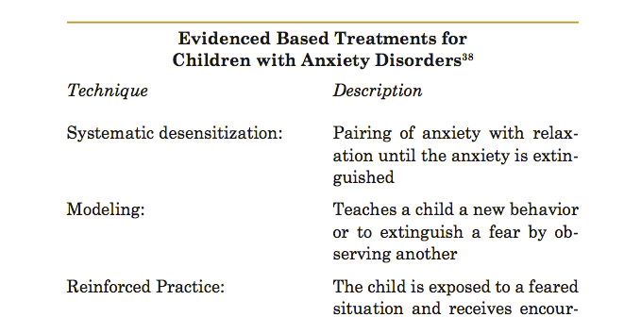
Notes:
what can you do?>

Slide 29
Observe: Assess

Slide 30
Listen: Where is their focus?

Slide 31
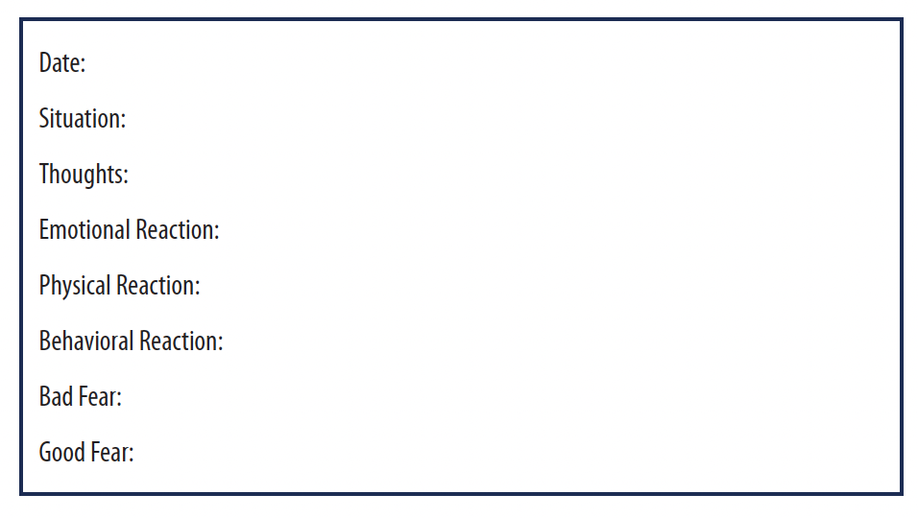

Slide 32
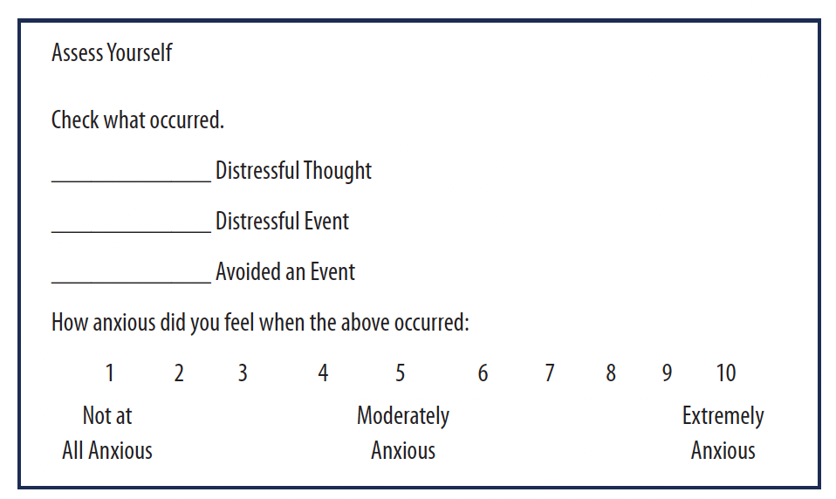
Respond: Identify Which Thoughts and Situations are Most Stressful?

Slide 33
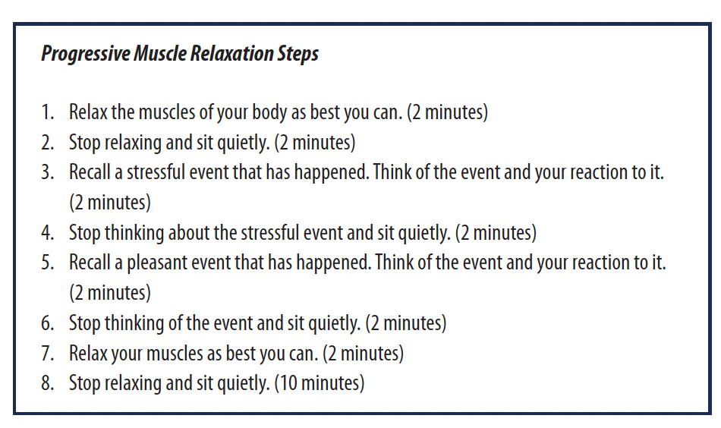
Relaxation Training

Slide 35
Devotional Meditation

Slide 36
Prayer

Slide 37
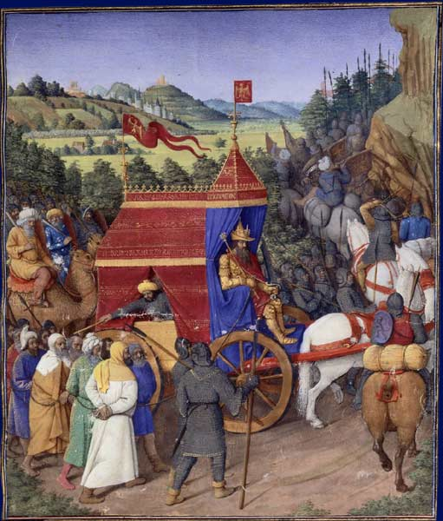
Music
Notes:
Triumph of Jehoshaphat over Adad of Syria as illustrated by Jean Fouquet (1470s) for Josephus' Antiquities of the Jews

Slide 38
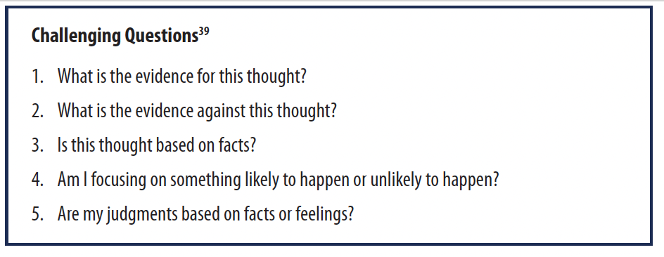
Work on Thinking
Notes:
Triumph of Jehoshaphat over Adad of Syria as illustrated by Jean Fouquet (1470s) for Josephus' Antiquities of the Jews

Slide 43
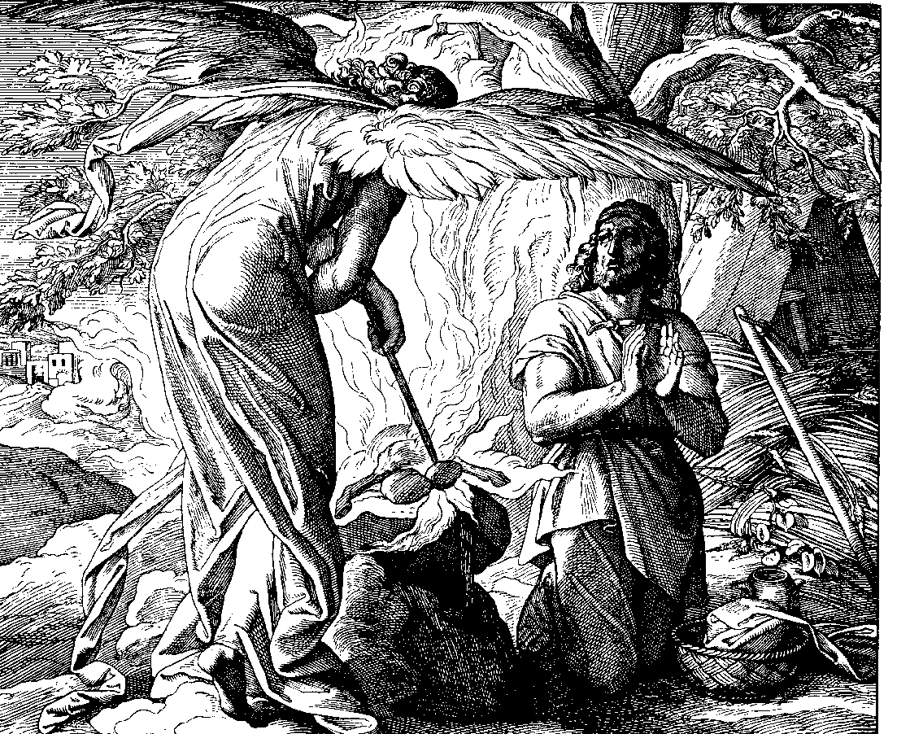
Act: Do Hard Things
Notes:
Gideon's Call, 1860 woodcut by Julius Schnorr von Karolsfeld

Slide 44
Prepare
Notes:
Gideon's Call, 1860 woodcut by Julius Schnorr von Karolsfeld

Slide 45
Bring It All Together (Philippians 4)
Rejoice
Rejoice in the Lord (4:4)
Pray
Pray (4:6)
Correct
Correct Thinking (4:8)
Prepare and Practice
Prepare and Practice (4:9)
Find
Find Peace and Contentment (4:7, 12)

Slide 46
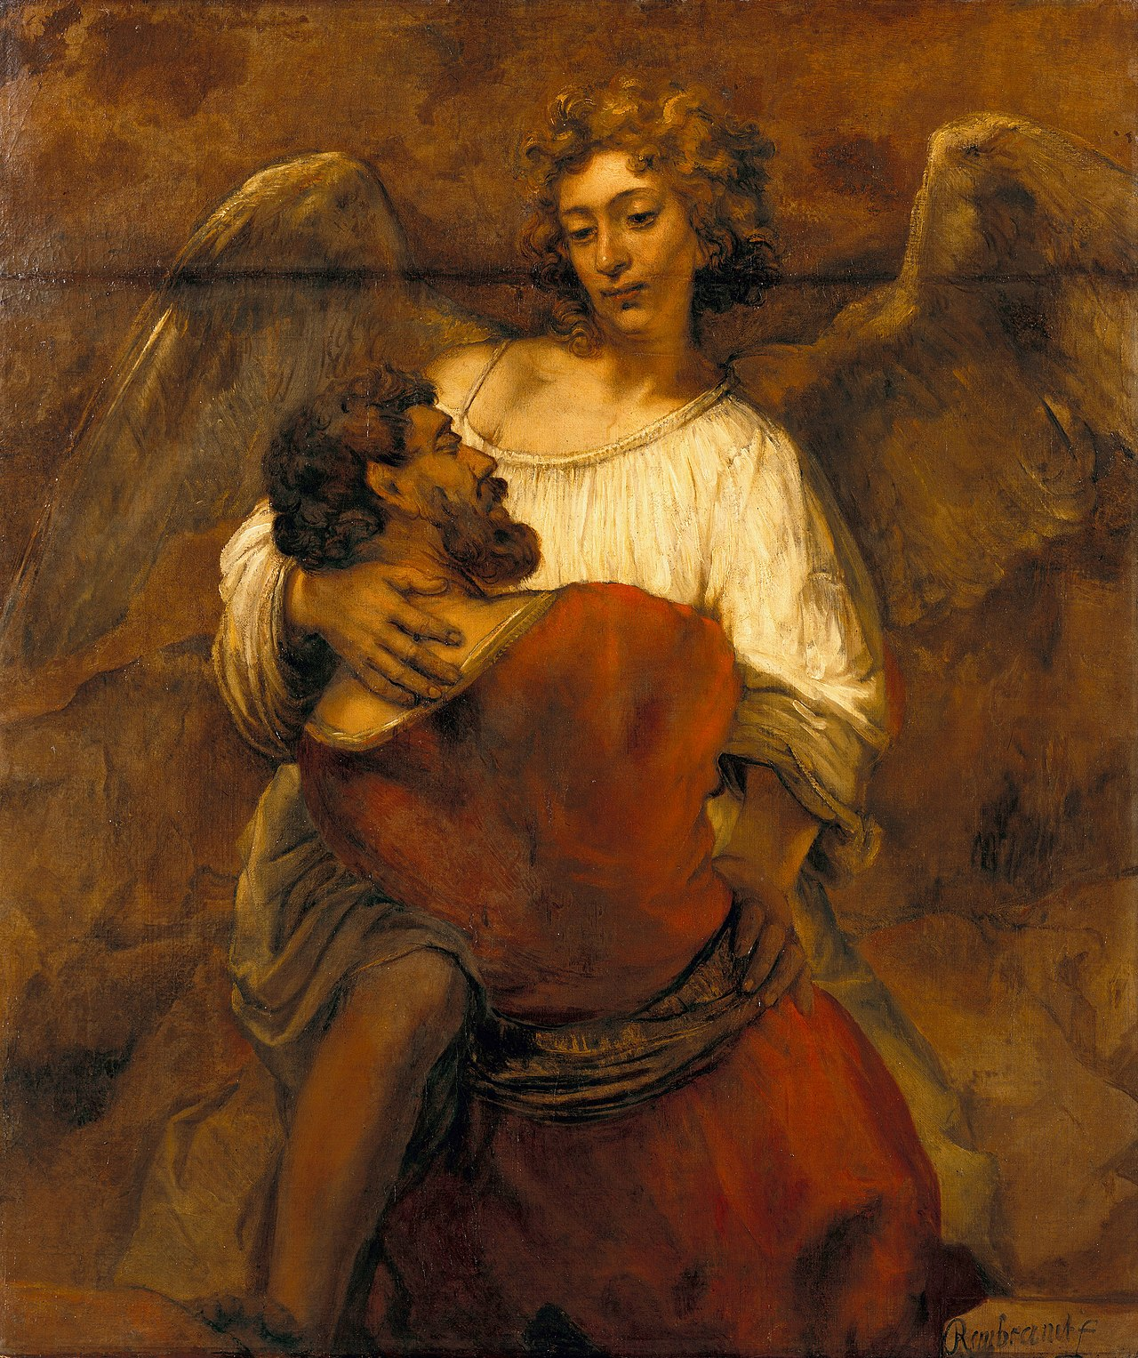
The God of Jacob Is With You

Slide 47
First Aid for Anxiety
Eddie Moody
emoody@nafwb.org

