Slide 2
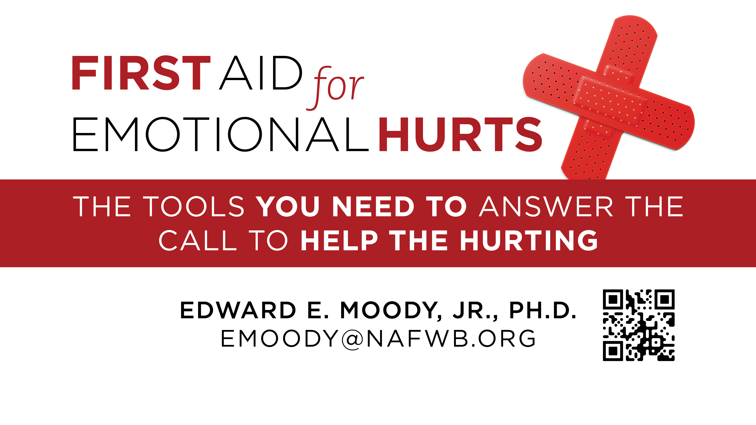

Slide 3
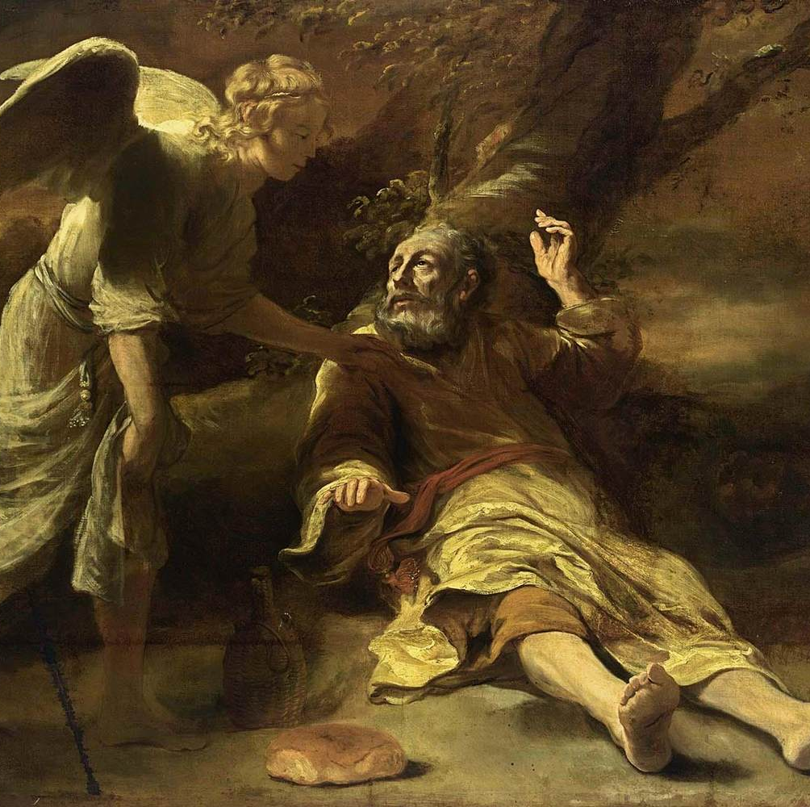
First Aid for Depression: Finding Your Way Out of the Cave
1 Kings 19
Ferdinand Bol Elijah Fed by an Angel

Slide 4
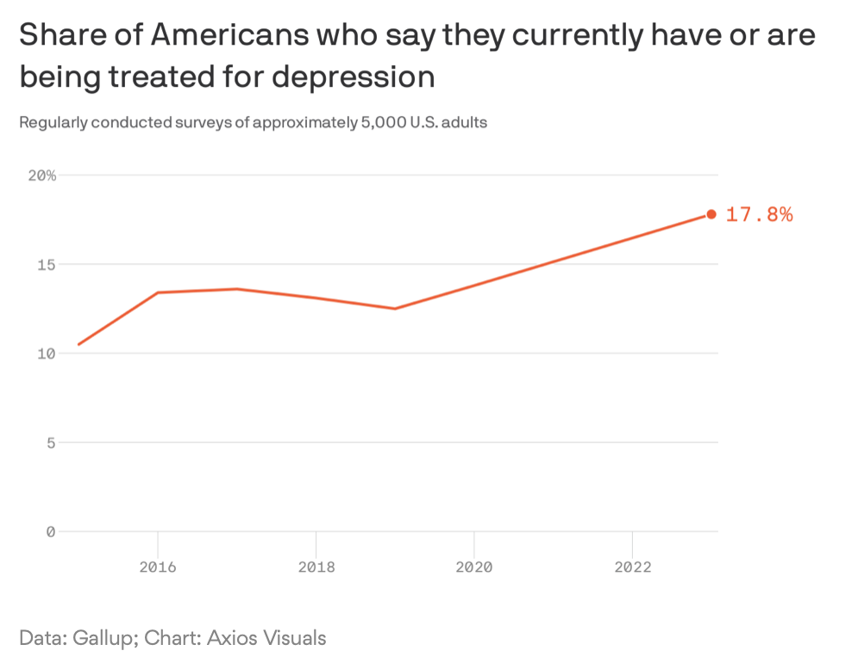
Notes:
https://news.gallup.com/poll/505745/depression-rates-reach-new-highs.aspx?utm_source=newsletter&utm_medium=email&utm_campaign=newsletter_axiospm&stream=top
https://www.axios.com/2022/10/26/loneliness-pandemic-america-phone-calls?utm_source=newsletter&utm_medium=email&utm_campaign=newsletter_axiospm&stream=top
elmoody@mindspring.com has shared an Axios story with you: 1 big thing: Depression on the rise https://www.axios.com/newsletters/axios-pm-d0579eaa-ab5f-43cb-83af-cc4a48d065fd.html?chunk=0&utm_term=emshare#story0

Slide 5
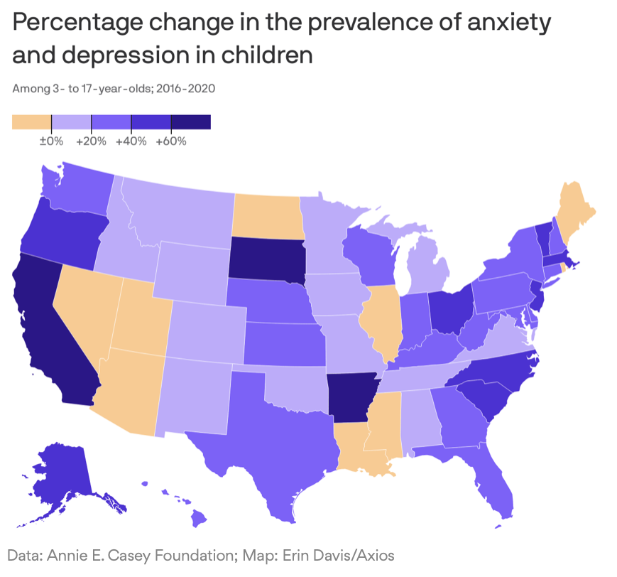
Notes:
1 big thing: More N.C. kids have anxiety and depression https://www.axios.com/newsletters/axios-raleigh-da7602c9-1eab-4972-9fc7-522b38b44c64.html?chunk=0&utm_term=emshare#story0

Slide 6
First Aid for Depression: Finding Your Way Out of the Cave
1 Kings 19
Ferdinand Bol Elijah Fed by an Angel

Slide 7
Elias was a man subject to like passions as we are, and he prayed earnestly that it might not rain: and it rained not on the earth by the space of three years and six months.
James 5:17

Slide 8
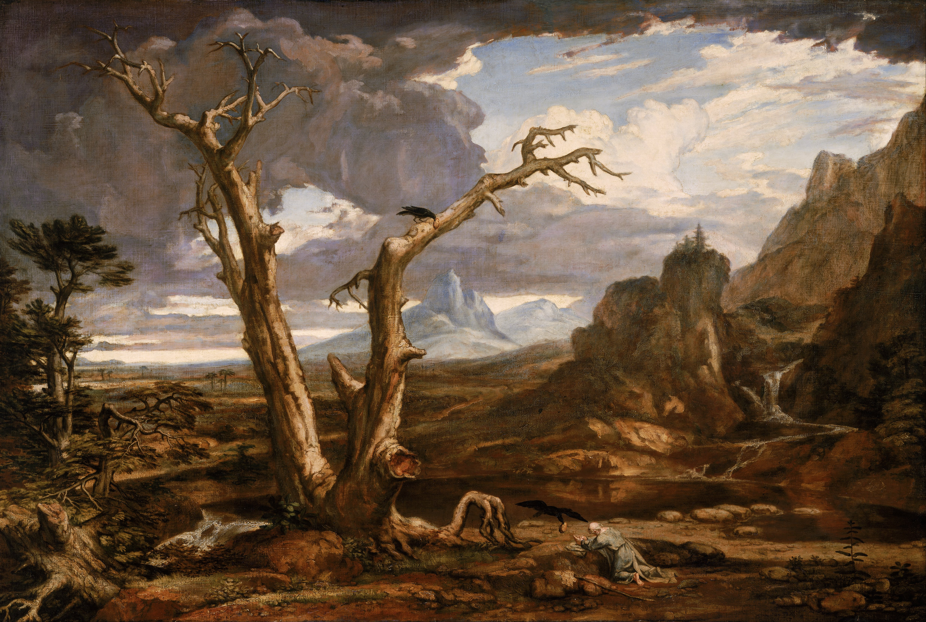
Elijah in the wilderness, by Washington Allston

Slide 9
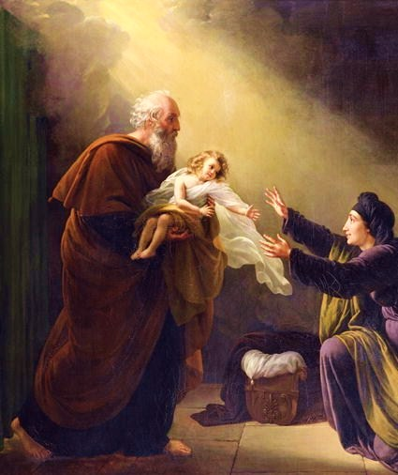
Elijah reviving the Son of the Widow of Zarephath by Louis

Slide 10
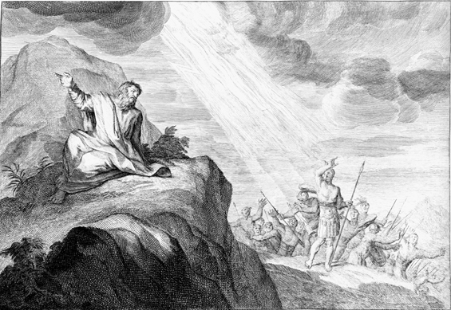
Elijah Calls Down Fire from Heaven

Slide 11
Elias was a man subject to like passions as we are, and he prayed earnestly that it might not rain: and it rained not on the earth by the space of three years and six months.
James 5:17

Slide 12
Finding Your Way Out of the Cave
1 Kings 19
Ferdinand Bol Elijah Fed by an Angel

Slide 13
What increases our risk for depression?
¹ And Ahab told Jezebel all that Elijah had done, and withal how he had slain all the prophets with the sword.
² Then Jezebel sent a messenger unto Elijah, saying, So let the gods do to me, and more also, if I make not thy life as the life of one of them by to morrow about this time.
1 Kings 19:1-2

Slide 14
What increases our risk for depression? Fear
And when he saw that, he arose, and went for his life, and came to Beersheba, which belongeth to Judah, and left his servant there.
1 Kings 19:3

Slide 15
What increases our risk for depression? Fatigue
And when he saw that, he arose, and went for his life, and came to Beersheba, which belongeth to Judah, and left his servant there.
1 Kings 19:3

Slide 16
What increases our risk for depression? Isolation
And when he saw that, he arose, and went for his life, and came to Beersheba, which belongeth to Judah, and left his servant there.
1 Kings 19:3

Slide 17
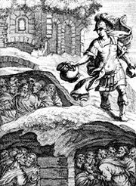
And as Obadiah was in the way, behold, Elijah met him: and he knew him, and fell on his face, and said, Art thou that my lord Elijah? And he answered him, I am: go, tell thy lord, Behold, Elijah is here. And he said, What have I sinned, that thou wouldest deliver thy servant into the hand of Ahab, to slay me?
1 Kings 18:7-9
Obadiah hiding the prophets. Johann Christoph Weigel, 1695.
Notes:
Modern day Schindler

Slide 18
What increases our risk for depression? Quitting
But he himself went a day's journey into the wilderness, and came and sat down under a juniper tree: and he requested for himself that he might die; and said, It is enough; now, O Lord, take away my life; for I am not better than my fathers.
1 Kings 19:4

Slide 19
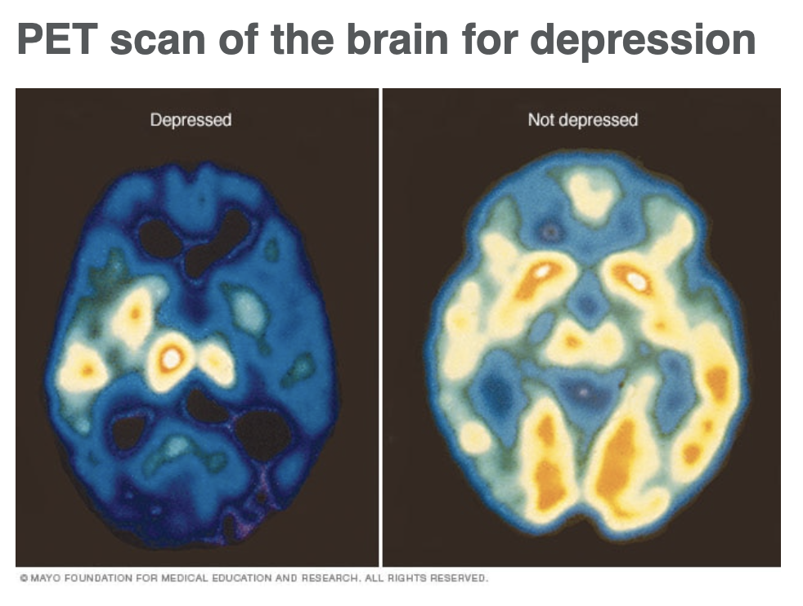

Slide 20
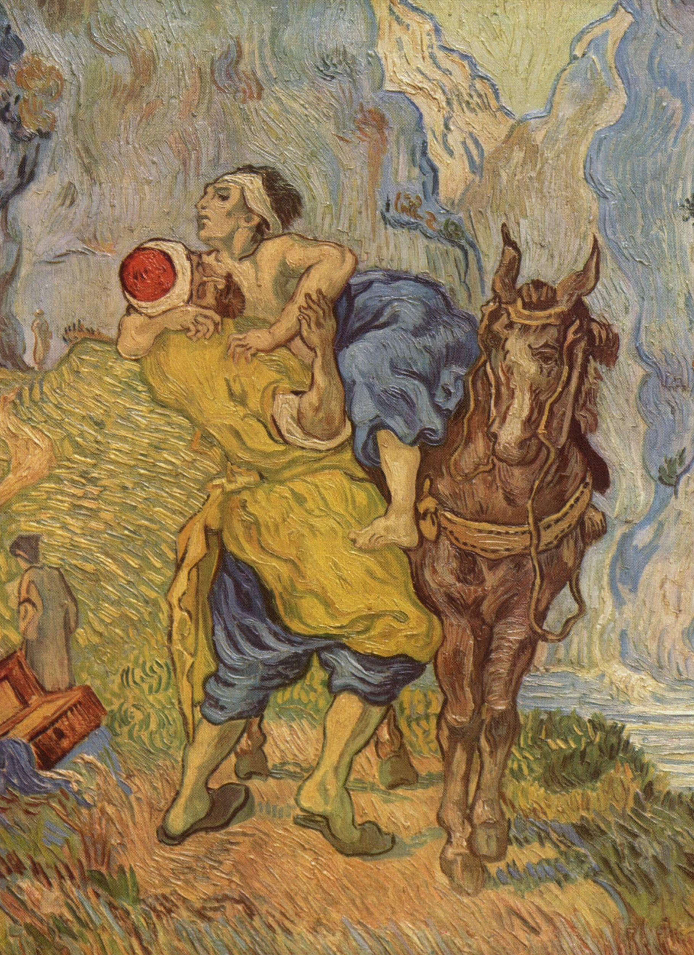
The Tools of the Responder The Word Prayer The Church Your Relationships Your Words
The Good Samaritan by Vincent van Gogh
Notes:
^{Covid 19>}
³⁰ And Jesus answering said, A certain man went down from Jerusalem to Jericho, and fell among thieves, which stripped him of his raiment, and wounded him, and departed, leaving him half dead.
³¹ And by chance there came down a certain priest that way: and when he saw him, he passed by on the other side.
³² And likewise a Levite, when he was at the place, came and looked on him, and passed by on the other side.
³³ But a certain Samaritan, as he journeyed, came where he was: and when he saw him, he had compassion on him,
³⁴ And went to him, and bound up his wounds, pouring in oil and wine, and set him on his own beast, and brought him to an inn, and took care of him.
³⁵ And on the morrow when he departed, he took out two pence, and gave them to the host, and said unto him, Take care of him; and whatsoever thou spendest more, when I come again, I will repay thee.
³⁶ Which now of these three, thinkest thou, was neighbour unto him that fell among the thieves?
³⁷ And he said, He that shewed mercy on him. Then said Jesus unto him, Go, and do thou likewise.

Slide 21
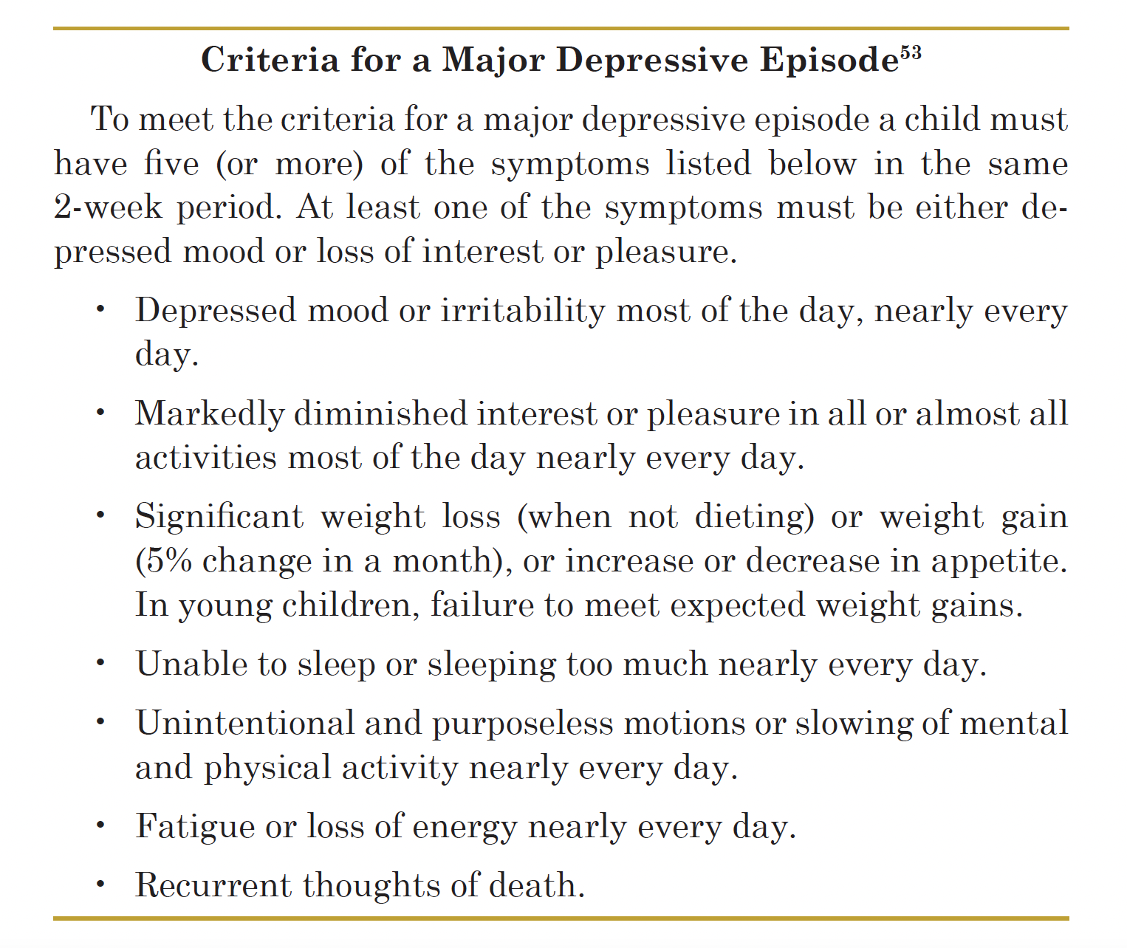
The Techniques of the Responder Observe

Slide 22
The Techniques of the Responder Attend
⁵ And as he lay and slept under a juniper tree, behold, then an angel touched him, and said unto him, Arise and eat.
⁶ And he looked, and, behold, there was a cake baken on the coals, and a cruse of water at his head. And he did eat and drink, and laid him down again.
1 Kings 19:5-6

Slide 23
The Techniques of the Responder Attend Observe Listen Care Respond Act Find the Inn
The Good Samaritan by Vincent van Gogh
Notes:
^{Covid 19>}
³⁰ And Jesus answering said, A certain man went down from Jerusalem to Jericho, and fell among thieves, which stripped him of his raiment, and wounded him, and departed, leaving him half dead.
³¹ And by chance there came down a certain priest that way: and when he saw him, he passed by on the other side.
³² And likewise a Levite, when he was at the place, came and looked on him, and passed by on the other side.
³³ But a certain Samaritan, as he journeyed, came where he was: and when he saw him, he had compassion on him,
³⁴ And went to him, and bound up his wounds, pouring in oil and wine, and set him on his own beast, and brought him to an inn, and took care of him.
³⁵ And on the morrow when he departed, he took out two pence, and gave them to the host, and said unto him, Take care of him; and whatsoever thou spendest more, when I come again, I will repay thee.
³⁶ Which now of these three, thinkest thou, was neighbour unto him that fell among the thieves?
³⁷ And he said, He that shewed mercy on him. Then said Jesus unto him, Go, and do thou likewise.

Slide 24
¹⁰ And he said, I have been very jealous for the Lord God of hosts: for the children of Israel have forsaken thy covenant, thrown down thine altars, and slain thy prophets with the sword; and I, even I only, am left; and they seek my life, to take it away. ¹⁴ And he said, I have been very jealous for the Lord God of hosts: because the children of Israel have forsaken thy covenant, thrown down thine altars, and slain thy prophets with the sword; and I, even I only, am left; and they seek my life, to take it away.
1 Kings 19:10, 14

Slide 25
The Techniques of the Responder Attend Observe Listen Care Respond Act Find the Inn
The Good Samaritan by Vincent van Gogh
Notes:
^{Covid 19>}
³⁰ And Jesus answering said, A certain man went down from Jerusalem to Jericho, and fell among thieves, which stripped him of his raiment, and wounded him, and departed, leaving him half dead.
³¹ And by chance there came down a certain priest that way: and when he saw him, he passed by on the other side.
³² And likewise a Levite, when he was at the place, came and looked on him, and passed by on the other side.
³³ But a certain Samaritan, as he journeyed, came where he was: and when he saw him, he had compassion on him,
³⁴ And went to him, and bound up his wounds, pouring in oil and wine, and set him on his own beast, and brought him to an inn, and took care of him.
³⁵ And on the morrow when he departed, he took out two pence, and gave them to the host, and said unto him, Take care of him; and whatsoever thou spendest more, when I come again, I will repay thee.
³⁶ Which now of these three, thinkest thou, was neighbour unto him that fell among the thieves?
³⁷ And he said, He that shewed mercy on him. Then said Jesus unto him, Go, and do thou likewise.

Slide 26
The Techniques of the Responder Respond Address the physical
⁵ And as he lay and slept under a juniper tree, behold, then an angel touched him, and said unto him, Arise and eat.
⁶ And he looked, and, behold, there was a cake baken on the coals, and a cruse of water at his head. And he did eat and drink, and laid him down again.
1 Kings 19:5-6

Slide 27
The Techniques of the Responder Act
⁷ And the angel of the Lord came again the second time, and touched him, and said, Arise and eat; because the journey is too great for thee.
⁸ And he arose, and did eat and drink, and went in the strength of that meat forty days and forty nights unto Horeb the mount of God.
1 Kings 19:7-8

Slide 28
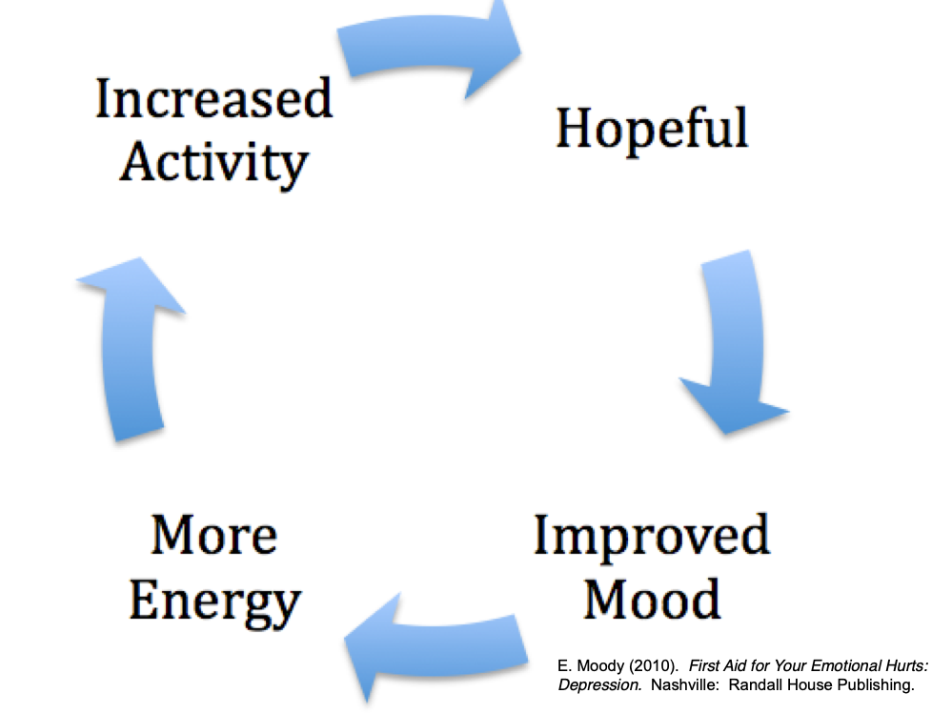

Slide 29
And he came thither unto a cave, and lodged there; and, behold, the word of the Lord came to him, and he said unto him, What doest thou here, Elijah?
1 Kings 19:9

Slide 30
And he said, I have been very jealous for the Lord God of hosts: for the children of Israel have forsaken thy covenant, thrown down thine altars, and slain thy prophets with the sword; and I, even I only, am left; and they seek my life, to take it away.
1 Kings 19:10

Slide 31
Act Get outside
And he said, Go forth, and stand upon the mount before the Lord. And, behold, the Lord passed by, and a great and strong wind rent the mountains, and brake in pieces the rocks before the Lord; but the Lord was not in the wind: and after the wind an earthquake; but the Lord was not in the earthquake:
1 Kings 19:11

Slide 32
¹² And after the earthquake a fire; but the Lord was not in the fire: and after the fire a still small voice. ¹³ And it was so, when Elijah heard it, that he wrapped his face in his mantle, and went out, and stood in the entering in of the cave. And, behold, there came a voice unto him, and said, What doest thou here, Elijah?
1 Kings 19:12-13

Slide 33
Address thinking
¹⁴ And he said, I have been very jealous for the Lord God of hosts: because the children of Israel have forsaken thy covenant, thrown down thine altars, and slain thy prophets with the sword; and I, even I only, am left; and they seek my life, to take it away.
1 Kings 19:14

Slide 34
Then said Elijah unto the people, I, even I only, remain a prophet of the LORD; but Baal's prophets are four hundred and fifty men.
1 Kings 18:22

Slide 35
Focus on the truth
Yet I have left me seven thousand in Israel, all the knees which have not bowed unto Baal, and every mouth which hath not kissed him.
1 Kings 19:18

Slide 36
Address the problem
¹⁵ And the Lord said unto him, Go, return on thy way to the wilderness of Damascus: and when thou comest, anoint Hazael to be king over Syria:
¹⁶ And Jehu the son of Nimshi shalt thou anoint to be king over Israel: and Elisha the son of Shaphat of Abelmeholah shalt thou anoint to be prophet in thy room.
¹⁷ And it shall come to pass, that him that escapeth the sword of Hazael shall Jehu slay: and him that escapeth from the sword of Jehu shall Elisha slay.
1 Kings 19:15-17

Slide 37
Problem
Solution
Action

Slide 38
Problem
1 Kings 19:2, 10, 14
Solution
1 Kings 19:15-18
Action
1 Kings 19:19

Slide 39
Act Focus on others
¹⁹ So he departed thence, and found Elisha the son of Shaphat, who was plowing with twelve yoke of oxen before him, and he with the twelfth: and Elijah passed by him, and cast his mantle upon him.
²⁰ And he left the oxen, and ran after Elijah, and said, Let me, I pray thee, kiss my father and my mother, and then I will follow thee. And he said unto him, Go back again: for what have I done to thee?
1 Kings 19:19-20

Slide 40
And he returned back from him, and took a yoke of oxen, and slew them, and boiled their flesh with the instruments of the oxen, and gave unto the people, and they did eat. Then he arose, and went after Elijah, and ministered unto him.
1 Kings 19:21

Slide 41
²⁰ And Ahab said to Elijah, Hast thou found me, O mine enemy? And he answered, I have found thee: because thou hast sold thyself to work evil in the sight of the Lord. ²¹ Behold, I will bring evil upon thee, and will take away thy posterity, and will cut off from Ahab him that pisseth against the wall, and him that is shut up and left in Israel,
1 Kings 21:20-21

Slide 42
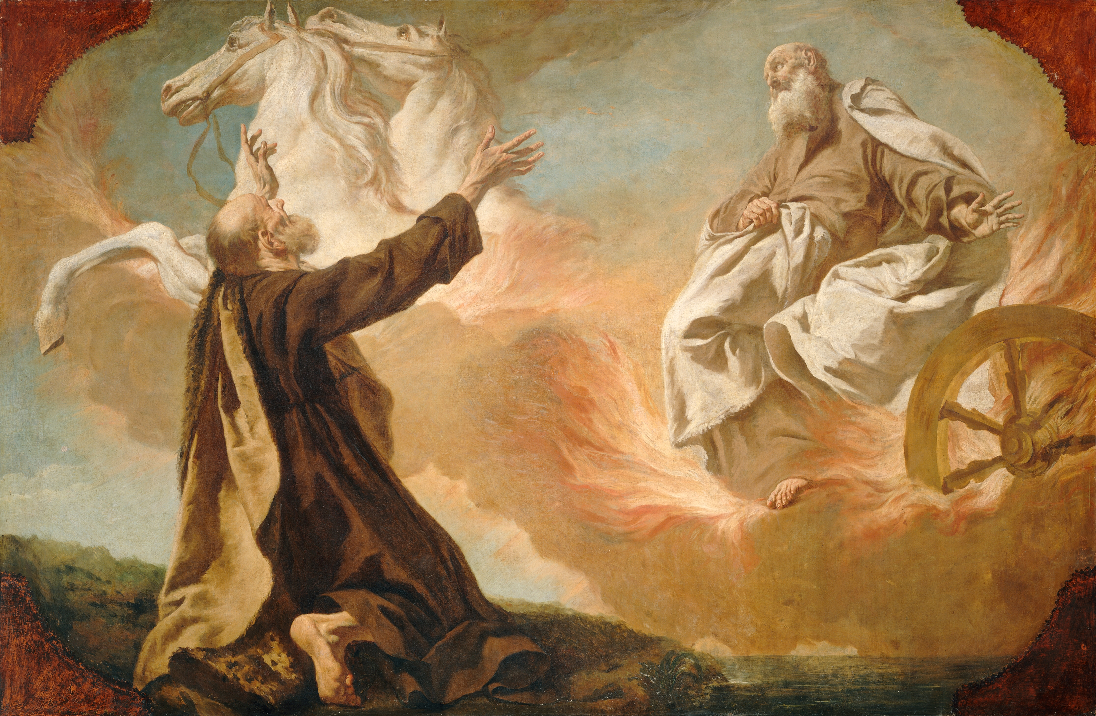
Giuseppe Angeli: Elijah Taken Up in a Chariot of Fire

Slide 43
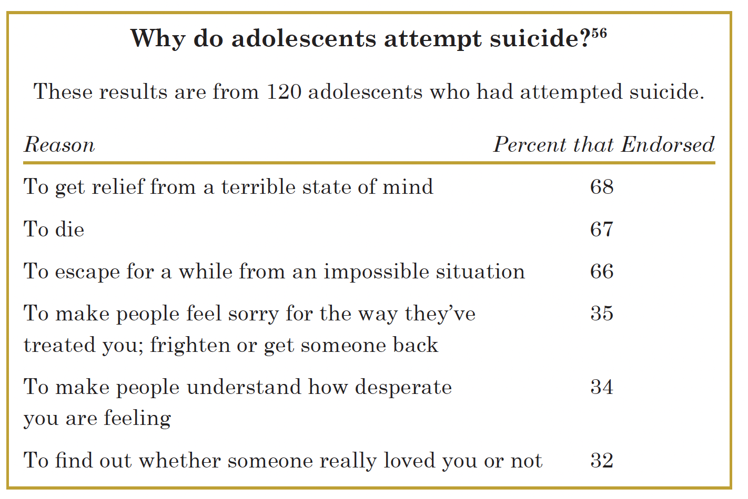

Slide 44
True or False Quiz
Most suicides occur in the dark and dreary months of the Winter.
People who talk about suicide rarely commit suicide
The majority of completed suicides take place between 11 PM and 4 AM

Slide 45
Quiz…
Improvement in a personal crisis or serious depression means that the risk of suicide is over
In teenagers, the break-up of a boy or girl relationship has little to do with their suicide risk
Females are more likely than males to kill themselves

Slide 46
Quiz…
People with a family history of suicide are less likely to attempt suicide
People who commit suicide do not wish to continue living
There is little another person can do to stop someone from committing suicide

Slide 47
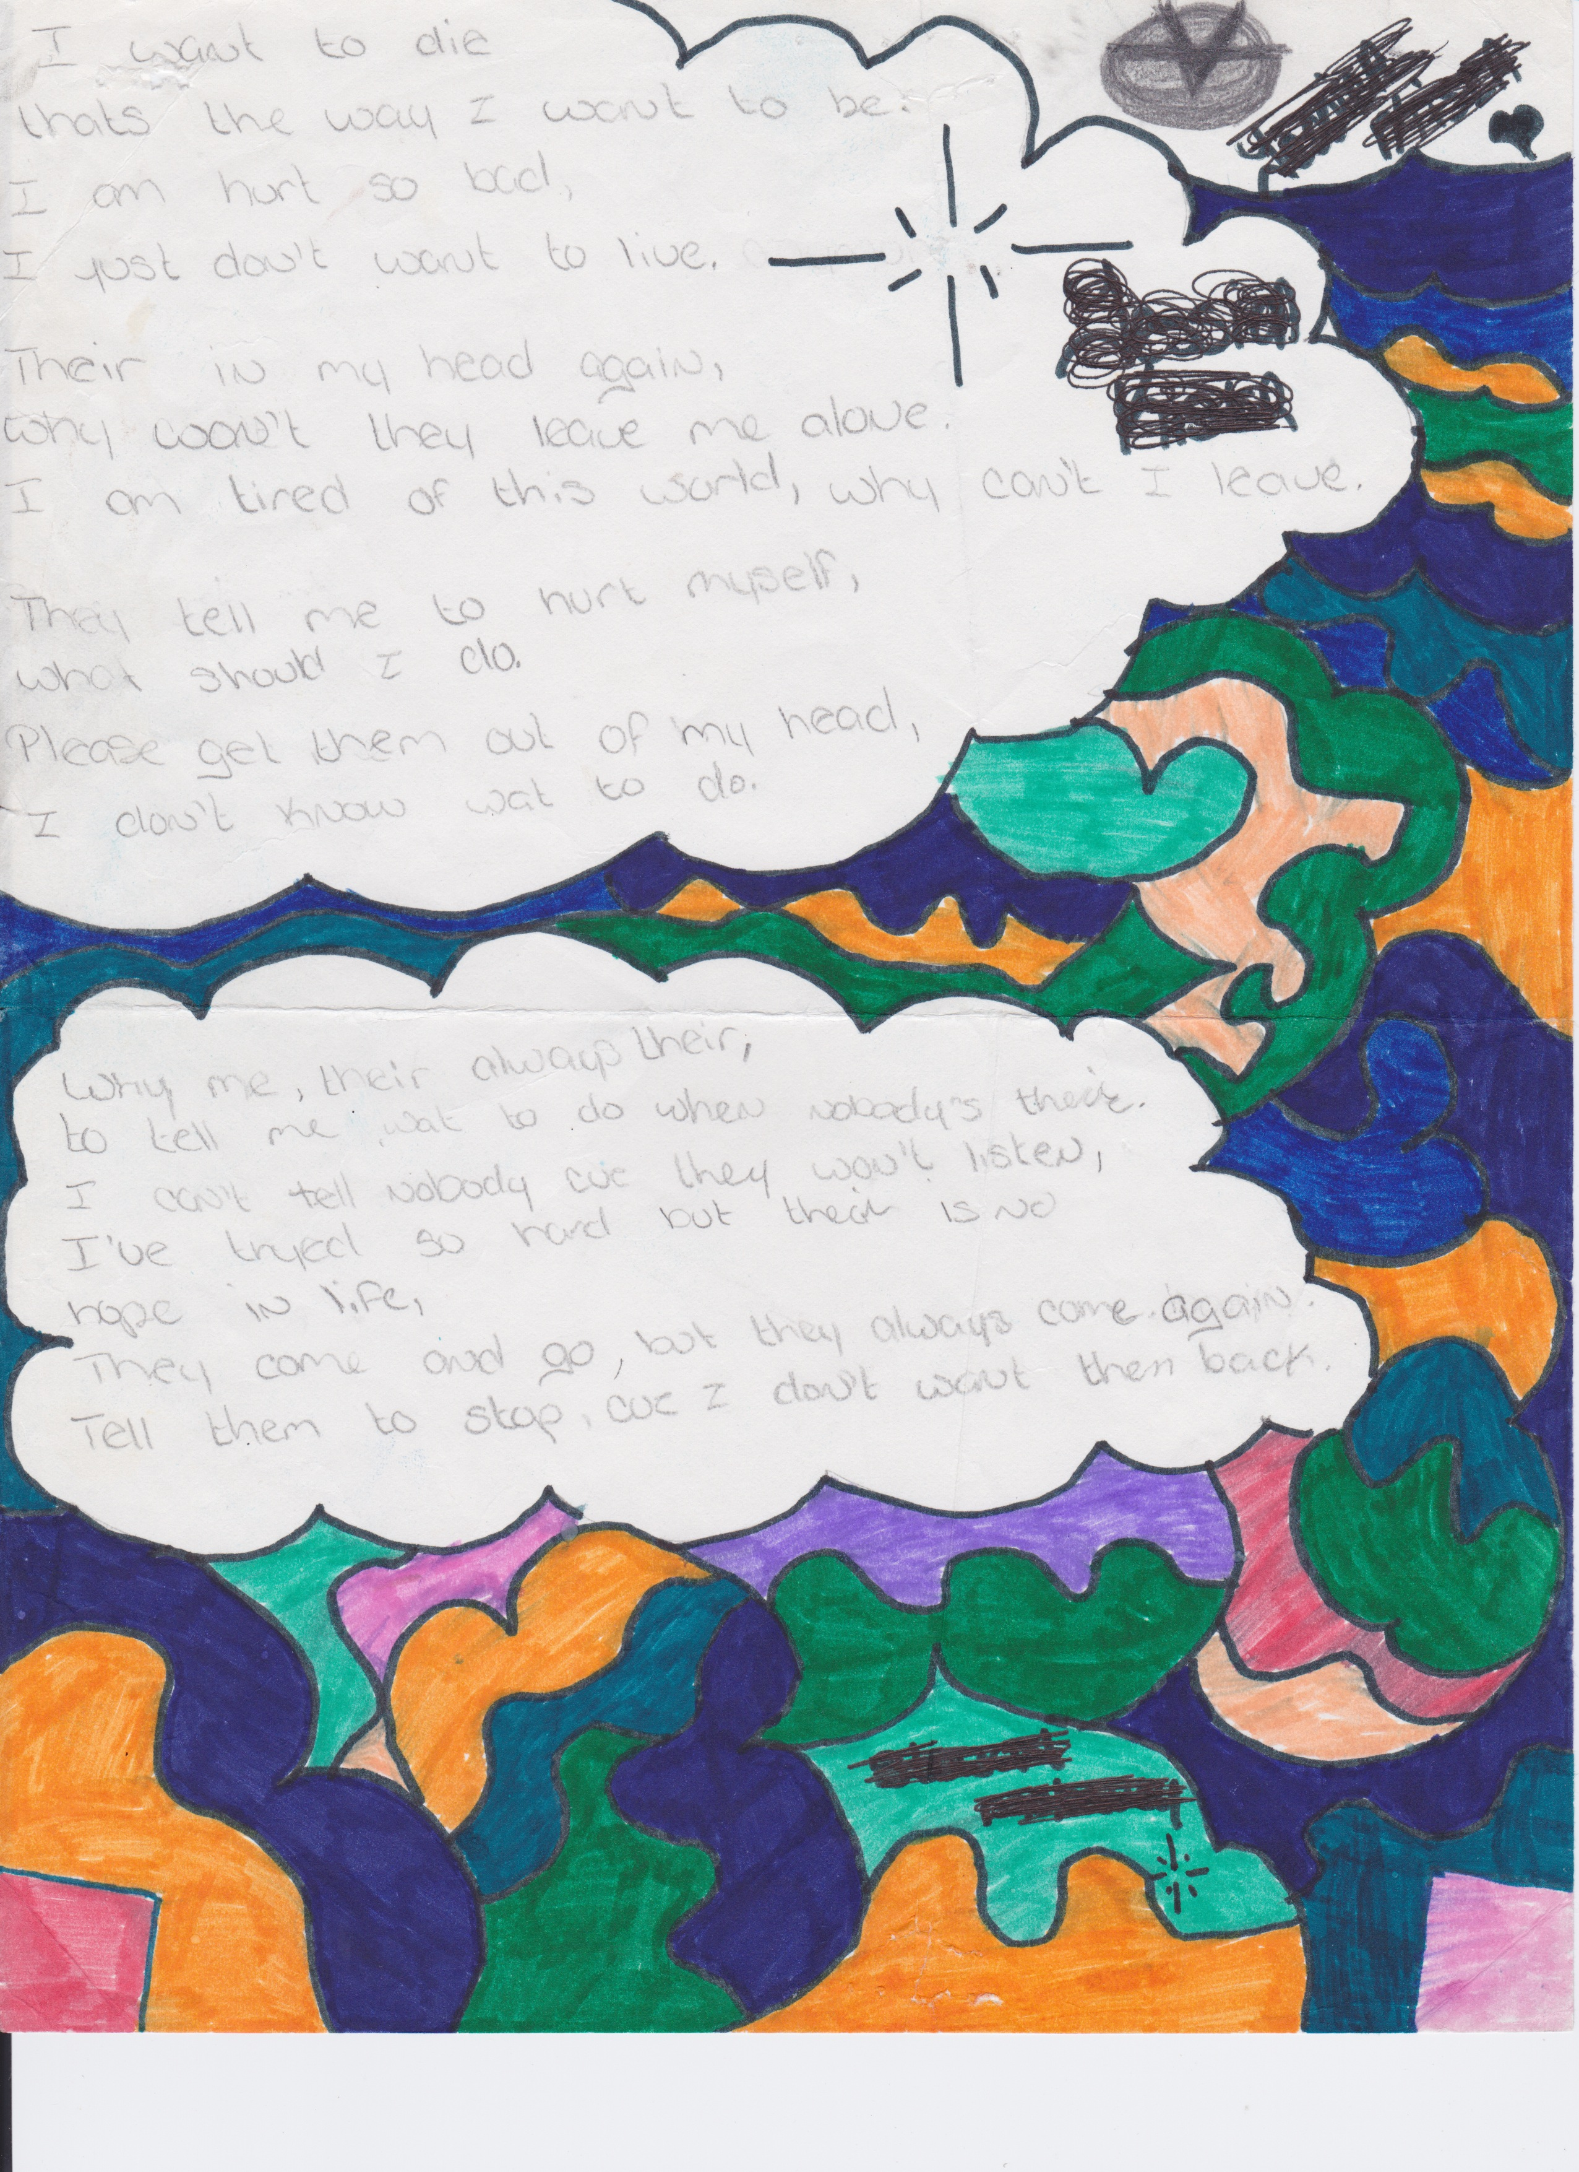

Slide 50
After a Suicide
Be alert for copycats.

Slide 51
After a Suicide
Be alert for copycats.
Address should of, would of and could of
Be careful about glorifying the one who has taken their life

Slide 52
After a Suicide
Be alert for copycats.
Address should of, would of and could of
Be careful about glorifying the one who has taken their life

Slide 53
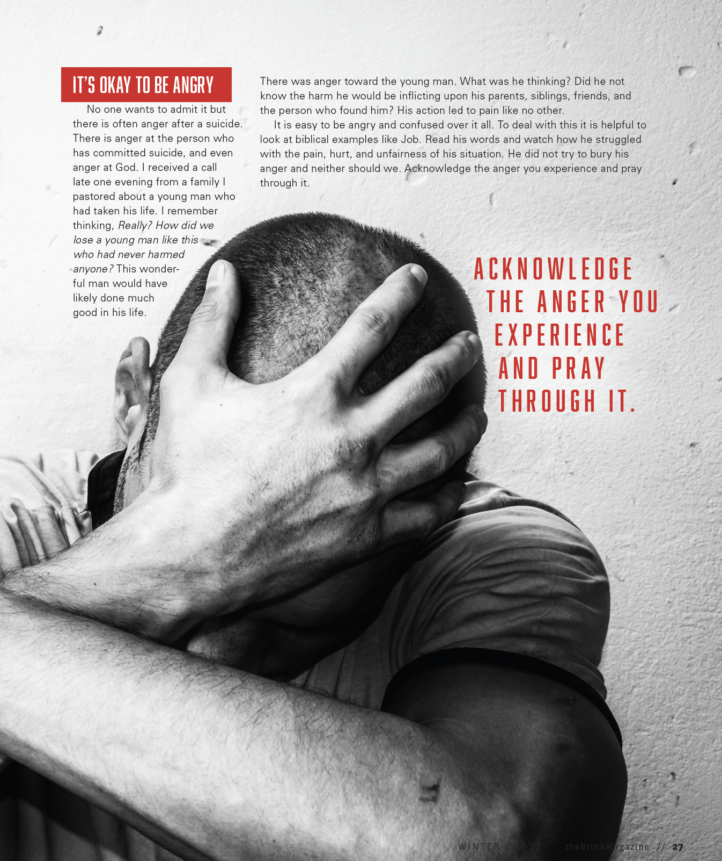

Slide 54
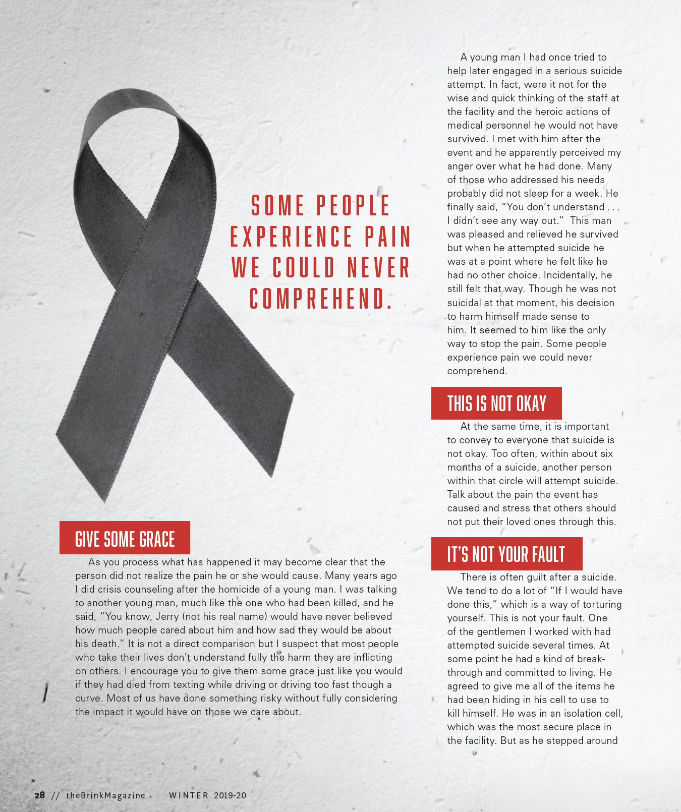
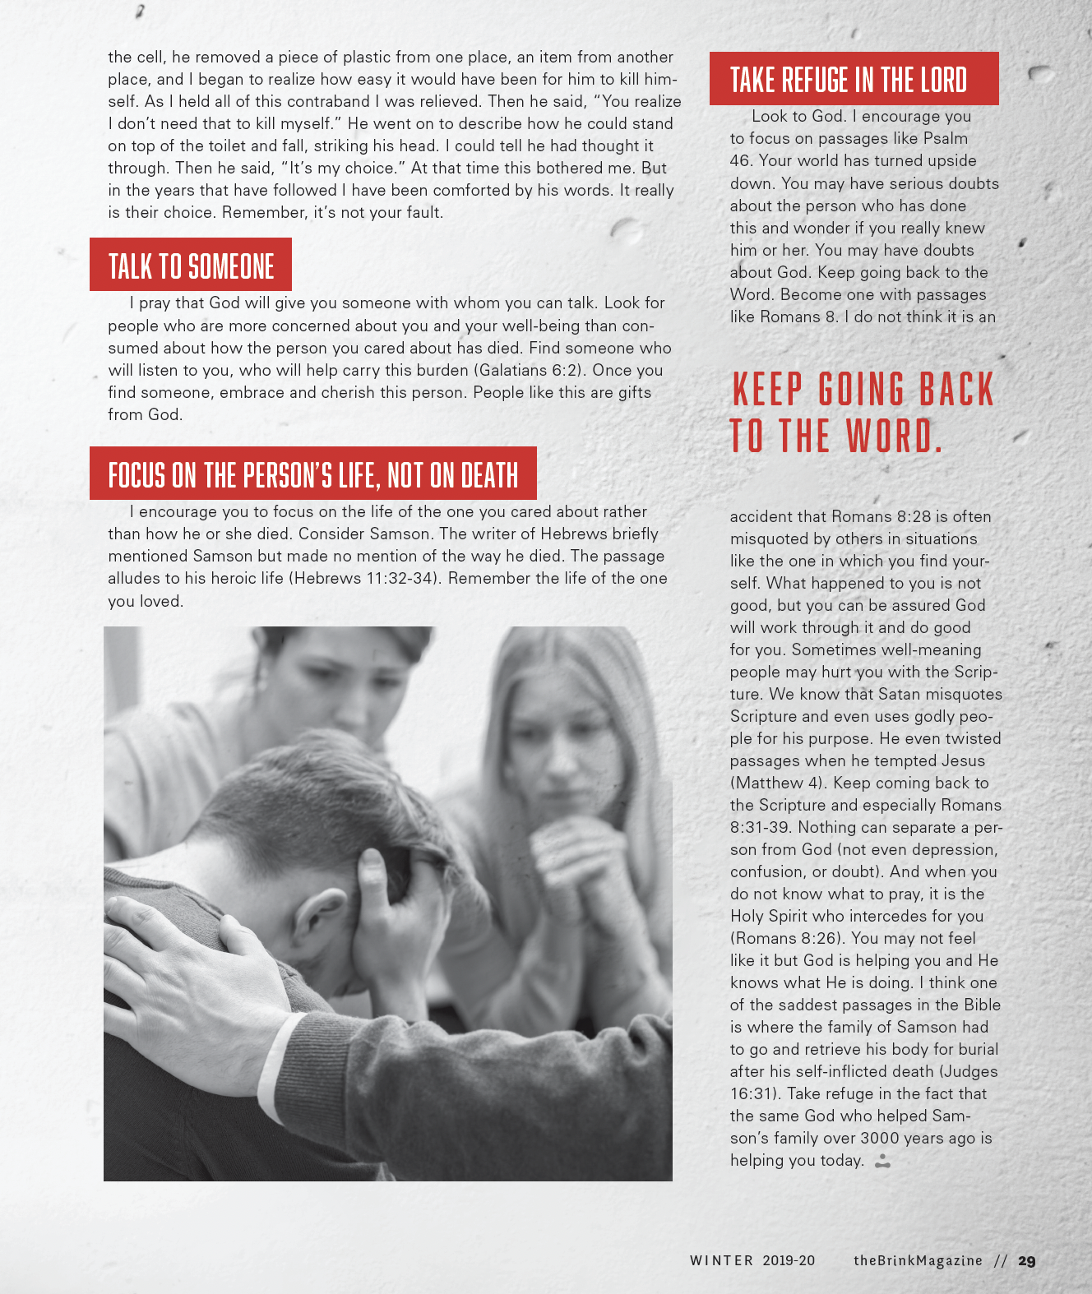

Slide 55
First Aid for Depression: Finding Your Way Out of the Cave
1 Kings 19
Ferdinand Bol Elijah Fed by an Angel

