Slide 3
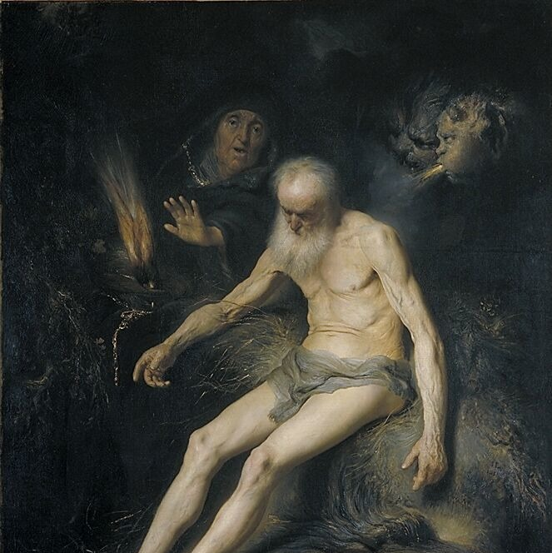
First Aid for Grief: The Techniques You Need to Respond
The Book of Job
Notes:
Jan Lievens
Job by Jan Lievens , 1631

Slide 4
¹ To every thing there is a season, and a time to every purpose under the heaven: ⁴ A time to weep, and a time to laugh; a time to mourn, and a time to dance. Ecclesiastes 3:1, 4

Slide 5
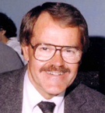
“Each person’s grief is like all other people’s grief;
Each person’s grief is like some other person’s grief;
And each person’s grief is like no other person’s grief.”
J. William Worden
Notes:
Biola Professor J. William Worden put it this way. A study a few years ago of 8 widows who had lost their husbands. MRIs. 8 and a half months earlier.

Slide 6
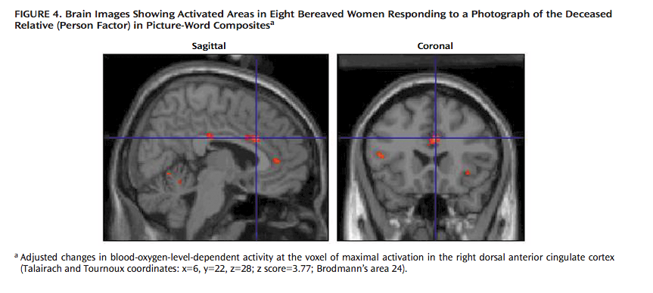

Slide 7
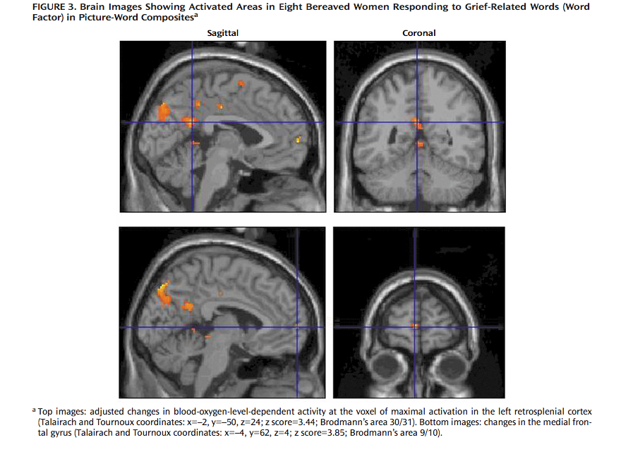

Slide 8
What happened to Job?
Notes:
Jan Lievens
Job by Jan Lievens , 1631

Slide 9
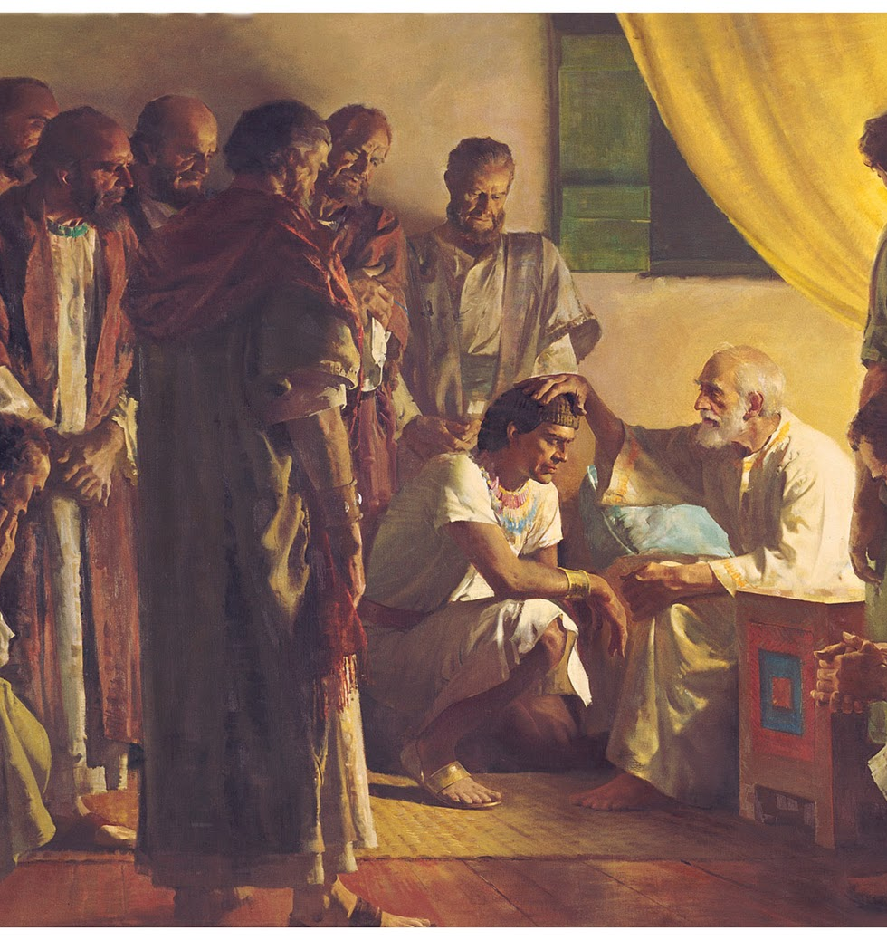
Types of Events
Natural, sometimes anticipated
Notes:
1 Kings 2
English Standard Version (ESV)
David's Instructions to Solomon
2 When David's time to die drew near, he commanded Solomon his son, saying, 2 “I am about to go the way of all the earth. Be strong, and show yourself a man, 3 and keep the charge of the Lord your God, walking in his ways and keeping his statutes, his commandments, his rules, and his testimonies, as it is written in the Law of Moses, that you may prosper in all that you do and wherever you turn, 4 that the Lord may establish his word that he spoke concerning me, saying, ‘If your sons pay close attention to their way, to walk before me in faithfulness with all their heart and with all their soul, you shall not lack[a] a man on the throne of Israel.’
5 “Moreover, you also know what Joab the son of Zeruiah did to me, how he dealt with the two commanders of the armies of Israel, Abner the son of Ner, and Amasa the son of Jether, whom he killed, avenging[b] in time of peace for blood that had been shed in war, and putting the blood of war[c] on the belt around his[d] waist and on the sandals on his feet. 6 Act therefore according to your wisdom, but do not let his gray head go down to Sheol in peace. 7 But deal loyally with the sons of Barzillai the Gileadite, and let them be among those who eat at your table, for with such loyalty[e] they met me when I fled from Absalom your brother. 8 And there is also with you Shimei the son of Gera, the Benjaminite from Bahurim, who cursed me with a grievous curse on the day when I went to Mahanaim. But when he came down to meet me at the Jordan, I swore to him by the Lord, saying, ‘I will not put you to death with the sword.’ 9 Now therefore do not hold him guiltless, for you are a wise man. You will know what you ought to do to him, and you shall bring his gray head down with blood to Sheol.”

Slide 10
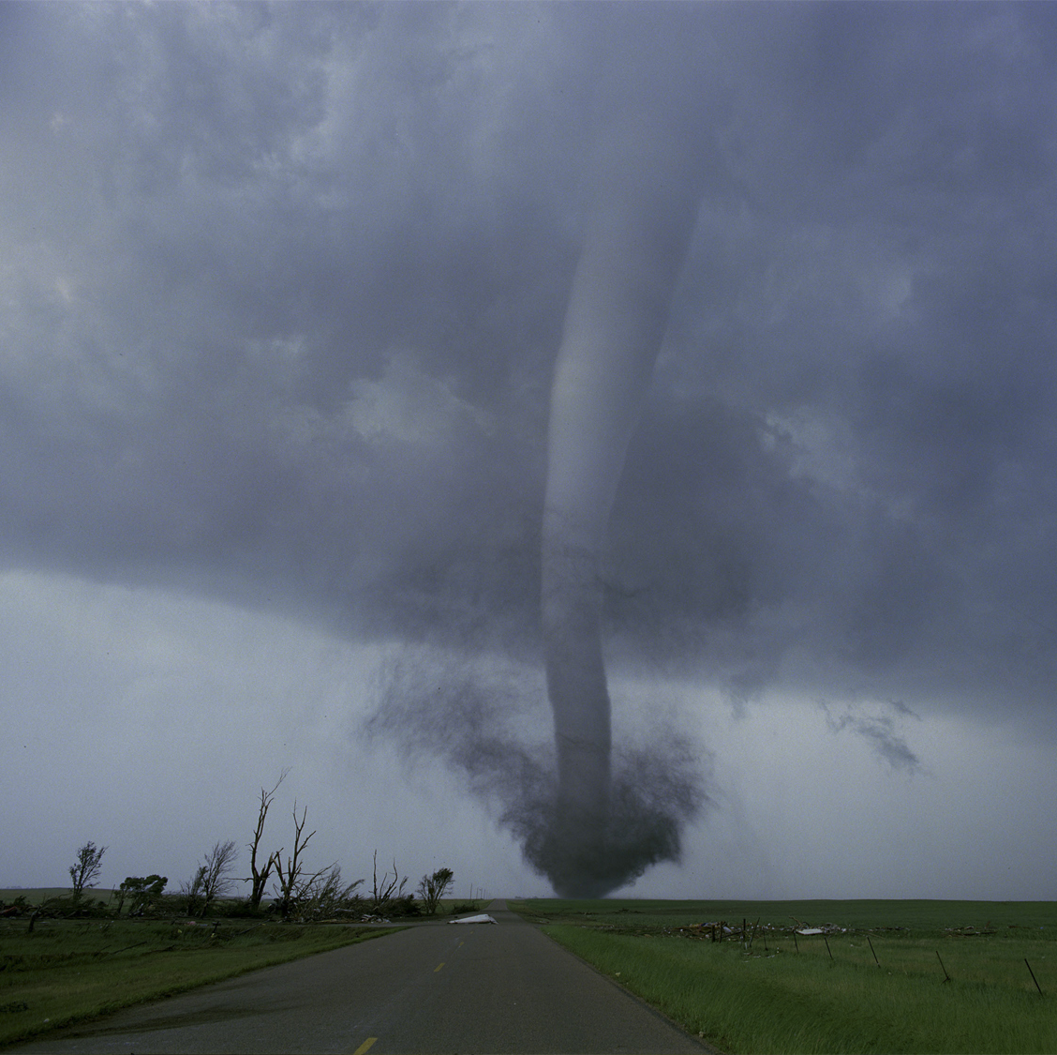
Types of Events
Unpredictable, natural disasters
-No time for anticipatory grief
Notes:
Job 1
English Standard Version (ESV)
Job's Character and Wealth
1 There was a man in the land of Uz whose name was Job, and that man was blameless and upright, one who feared God and turned away from evil. 2 There were born to him seven sons and three daughters. 3 He possessed 7,000 sheep, 3,000 camels, 500 yoke of oxen, and 500 female donkeys, and very many servants, so that this man was the greatest of all the people of the east. 4 His sons used to go and hold a feast in the house of each one on his day, and they would send and invite their three sisters to eat and drink with them. 5 And when the days of the feast had run their course, Job would send and consecrate them, and he would rise early in the morning and offer burnt offerings according to the number of them all. For Job said, “It may be that my children have sinned, and cursed[a] God in their hearts.” Thus Job did continually.
Satan Allowed to Test Job
6 Now there was a day when the sons of God came to present themselves before the Lord, and Satan[b] also came among them. 7 The Lord said to Satan, “From where have you come?” Satan answered the Lord and said, “From going to and fro on the earth, and from walking up and down on it.” 8 And the Lord said to Satan, “Have you considered my servant Job, that there is none like him on the earth, a blameless and upright man, who fears God and turns away from evil?” 9 Then Satan answered the Lord and said, “Does Job fear God for no reason? 10 Have you not put a hedge around him and his house and all that he has, on every side? You have blessed the work of his hands, and his possessions have increased in the land. 11 But stretch out your hand and touch all that he has, and he will curse you to your face.” 12 And the Lord said to Satan, “Behold, all that he has is in your hand. Only against him do not stretch out your hand.” So Satan went out from the presence of the Lord.
Satan Takes Job's Property and Children
13 Now there was a day when his sons and daughters were eating and drinking wine in their oldest brother's house, 14 and there came a messenger to Job and said, “The oxen were plowing and the donkeys feeding beside them, 15 and the Sabeans fell upon them and took them and struck down the servants[c] with the edge of the sword, and I alone have escaped to tell you.” 16 While he was yet speaking, there came another and said, “The fire of God fell from heaven and burned up the sheep and the servants and consumed them, and I alone have escaped to tell you.” 17 While he was yet speaking, there came another and said, “The Chaldeans formed three groups and made a raid on the camels and took them and struck down the servants with the edge of the sword, and I alone have escaped to tell you.” 18 While he was yet speaking, there came another and said, “Your sons and daughters were eating and drinking wine in their oldest brother's house, 19 and behold, a great wind came across the wilderness and struck the four corners of the house, and it fell upon the young people, and they are dead, and I alone have escaped to tell you.”
20 Then Job arose and tore his robe and shaved his head and fell on the ground and worshiped. 21 And he said, “Naked I came from my mother's womb, and naked shall I return. The Lord gave, and the Lord has taken away; blessed be the name of the Lord.”
22 In all this Job did not sin or charge God with wrong.

Slide 11
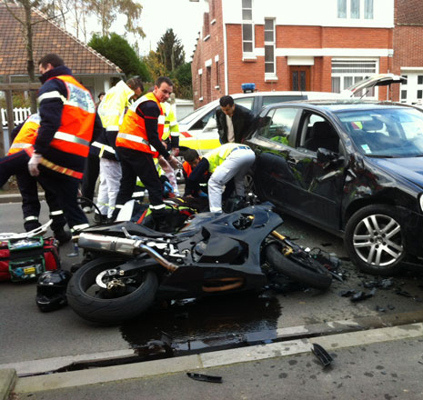
Types of Events
Human-induced, accidental
Complications from sudden death

Slide 12
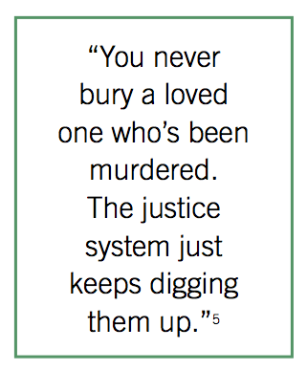
Types of Events
Human-induced, deliberate violence
Notes:
Suicide and murder.

Slide 13
Types of Losses Job Experienced
Loss of a child

Slide 14
Types of Losses Job Experienced
Loss of a child
Loss of an adult child

Slide 15
Types of Losses Job Experienced
Loss of a child
Loss of an adult child
Complications from murder

Slide 16
Types of Losses Job Experienced
Loss of a child
Loss of an adult child
Complications from murder
Financial loss

Slide 17
Types of Losses Job Experienced
Loss of a child
Loss of an adult child
Complications from murder
Financial loss
Health loss

Slide 18
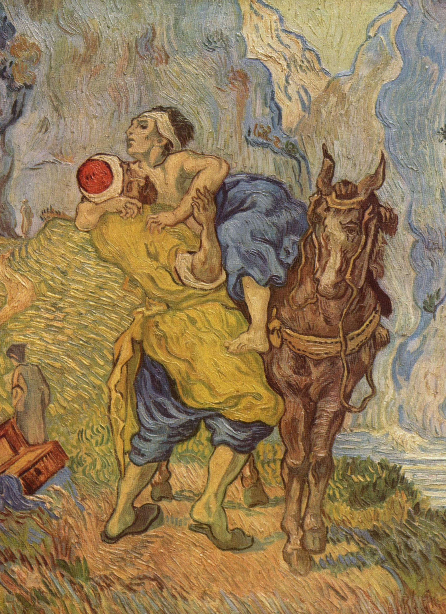
The Tools of the Responder The Word
The Good Samaritan by Vincent van Gogh
Notes:
^{Covid 19>}
³⁰ And Jesus answering said, A certain man went down from Jerusalem to Jericho, and fell among thieves, which stripped him of his raiment, and wounded him, and departed, leaving him half dead.
³¹ And by chance there came down a certain priest that way: and when he saw him, he passed by on the other side.
³² And likewise a Levite, when he was at the place, came and looked on him, and passed by on the other side.
³³ But a certain Samaritan, as he journeyed, came where he was: and when he saw him, he had compassion on him,
³⁴ And went to him, and bound up his wounds, pouring in oil and wine, and set him on his own beast, and brought him to an inn, and took care of him.
³⁵ And on the morrow when he departed, he took out two pence, and gave them to the host, and said unto him, Take care of him; and whatsoever thou spendest more, when I come again, I will repay thee.
³⁶ Which now of these three, thinkest thou, was neighbour unto him that fell among the thieves?
³⁷ And he said, He that shewed mercy on him. Then said Jesus unto him, Go, and do thou likewise.

Slide 19
Myths that Get in the Way
Bad things don’t happen to good people.

Slide 20
Your Tools: The Word Myth: Bad things don’t happen to good people.
⁸ And the Lord said unto Satan, Hast thou considered my servant Job, that there is none like him in the earth, a perfect and an upright man, one that feareth God, and escheweth evil?
⁹ Then Satan answered the Lord, and said, Doth Job fear God for nought?
Job 1:8-9

Slide 21
Myths that Get in the Way
Bad things don’t happen to good people.
Christians don’t grieve.

Slide 22
Myths that Get in the Way
Bad things don’t happen to good people.
Christians don’t grieve.
Christians don’t have doubts.

Slide 23
Myths that Get in the Way
Bad things don’t happen to good people.
Christians don’t grieve.
Christians don’t have doubts.
You should be over it by now.

Slide 24
The Tools of the Responder Prayer The Anniversary of the Event Special Days
The Good Samaritan by Vincent van Gogh
Notes:
^{Covid 19>}
³⁰ And Jesus answering said, A certain man went down from Jerusalem to Jericho, and fell among thieves, which stripped him of his raiment, and wounded him, and departed, leaving him half dead.
³¹ And by chance there came down a certain priest that way: and when he saw him, he passed by on the other side.
³² And likewise a Levite, when he was at the place, came and looked on him, and passed by on the other side.
³³ But a certain Samaritan, as he journeyed, came where he was: and when he saw him, he had compassion on him,
³⁴ And went to him, and bound up his wounds, pouring in oil and wine, and set him on his own beast, and brought him to an inn, and took care of him.
³⁵ And on the morrow when he departed, he took out two pence, and gave them to the host, and said unto him, Take care of him; and whatsoever thou spendest more, when I come again, I will repay thee.
³⁶ Which now of these three, thinkest thou, was neighbour unto him that fell among the thieves?
³⁷ And he said, He that shewed mercy on him. Then said Jesus unto him, Go, and do thou likewise.

Slide 26
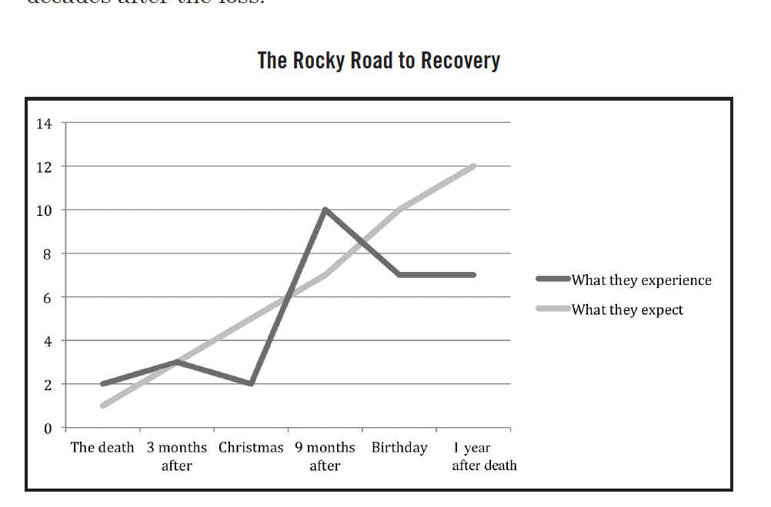
The Church and Your Relationships

Slide 27
Tools: Your Words

Slide 28
The Techniques of the Responder
Attend
(Job 2:11-13)
Notes:
Jan Lievens
Job by Jan Lievens , 1631

Slide 29
The Techniques of the Responder
Observe (Job 3)
Notes:
Jan Lievens
Job by Jan Lievens , 1631

Slide 30
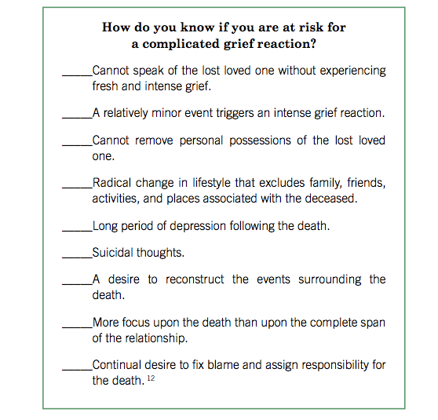

Slide 31
The Techniques of the Responder
Listen (Job 4)
They should have!
Notes:
Jan Lievens
Job by Jan Lievens , 1631

Slide 32
² Oh that my grief were throughly weighed, and my calamity laid in the balances together!
³ For now it would be heavier than the sand of the sea: therefore my words are swallowed up.
Job 6:2-3

Slide 33
For the arrows of the Almighty are within me, the poison whereof drinketh up my spirit: the terrors of God do set themselves in array against me.
Job 6:4

Slide 34
The Techniques of the Responder
Care
They should have!
Notes:
Jan Lievens
Job by Jan Lievens , 1631

Slide 35
¹³ When I say, My bed shall comfort me, my couch shall ease my complaints;
¹⁴ Then thou scarest me with dreams, and terrifiest me through visions:
Job 7:13-14

Slide 36
I have heard many such things: miserable comforters are ye all.
Job 16:2

Slide 37
The Techniques of the Responder
Respond
Notes:
Jan Lievens
Job by Jan Lievens , 1631

Slide 38
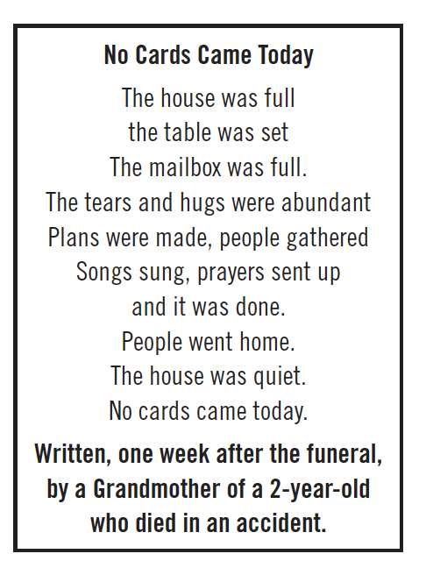

Slide 39
² Oh that I were as in months past, as in the days when God preserved me; ³ When his candle shined upon my head, and when by his light I walked through darkness; ⁴ As I was in the days of my youth, when the secret of God was upon my tabernacle;
Job 29:2-4

Slide 40
⁵ When the Almighty was yet with me, when my children were about me; ⁶ When I washed my steps with butter, and the rock poured me out rivers of oil;
Job 29:5-6

Slide 41
The Rollercoaster
The Anniversary of the Event
Special Days
Losing Control

Slide 42
The Techniques of the Responder
Act
Notes:
Jan Lievens
Job by Jan Lievens , 1631

Slide 43
¹³ He hath put my brethren far from me, and mine acquaintance are verily estranged from me.
¹⁴ My kinsfolk have failed, and my familiar friends have forgotten me.
Job 19:13-14

Slide 44
⁹ And now am I their song, yea, I am their byword. ¹⁰ They abhor me, they flee far from me, and spare not to spit in my face.
Job 30:9-10

Slide 45
I am a brother to dragons, and a companion to owls.
Job 30:29

Slide 46
⁴ Answer not a fool according to his folly, lest thou also be like unto him.
⁵ Answer a fool according to his folly, lest he be wise in his own conceit. Proverbs 26:4-5

Slide 47
The Techniques of the Responder
Find the Inn
Notes:
Jan Lievens
Job by Jan Lievens , 1631

Slide 48
Activities to Help Grieve
Programmed cry

Slide 49
Activities to Help Grieve
Programmed cry
Memory book

Slide 50
Activities to Help Grieve
Programmed cry
Memory book
Grief Recovery Completion Letter

Slide 51
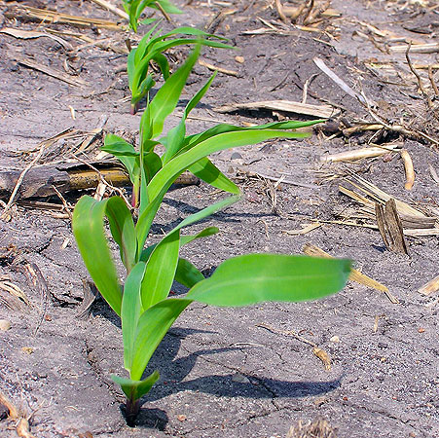
A Road Map Out
⁷ Be patient therefore, brethren, unto the coming of the Lord. Behold, the husbandman waiteth for the precious fruit of the earth, and hath long patience for it, until he receive the early and latter rain.
⁸ Be ye also patient; stablish your hearts: for the coming of the Lord draweth nigh.
James 5

Slide 52
A Road Map Out
⁷ Be patient therefore, brethren, unto the coming of the Lord. Behold, the husbandman waiteth for the precious fruit of the earth, and hath long patience for it, until he receive the early and latter rain.
⁸ Be ye also patient; stablish your hearts: for the coming of the Lord draweth nigh.
James 5

Slide 53
A Road Map Out
Grudge not one against another, brethren, lest ye be condemned: behold, the judge standeth before the door.
James 5:9

Slide 54
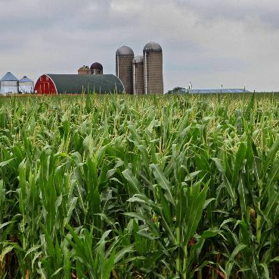
A Road Map Out
¹⁰ Take, my brethren, the prophets, who have spoken in the name of the Lord, for an example of suffering affliction, and of patience. ¹¹ Behold, we count them happy which endure. Ye have heard of the patience of Job, and have seen the end of the Lord; that the Lord is very pitiful, and of tender mercy.
James 5:10-11

Slide 55
The Theme from Job
And the Lord said unto Satan, Hast thou considered my servant Job, that there is none like him in the earth, a perfect and an upright man, one that feareth God, and escheweth evil? and still he holdeth fast his integrity, although thou movedst me against him, to destroy him without cause.
Job 2:3

Slide 56
The Theme from Job
⁹ Then said his wife unto him, Dost thou still retain thine integrity? curse God, and die.
¹⁰ But he said unto her, Thou speakest as one of the foolish women speaketh. What? shall we receive good at the hand of God, and shall we not receive evil? In all this did not Job sin with his lips.
Job 2:9-10

Slide 57
The Theme from Job
⁵ God forbid that I should justify you: till I die I will not remove mine integrity from me. ⁶ My righteousness I hold fast, and will not let it go: my heart shall not reproach me so long as I live.
Job 27:5-6

Slide 58
Wherefore seeing we also are compassed about with so great a cloud of witnesses, let us lay aside every weight, and the sin which doth so easily beset us, and let us run with patience the race that is set before us,
Hebrews 12:1

Slide 59
¹⁶ For which cause we faint not; but though our outward man perish, yet the inward man is renewed day by day. ¹⁷ For our light affliction, which is but for a moment, worketh for us a far more exceeding and eternal weight of glory;
2 Corinthians 4

Slide 61
