Slide 3
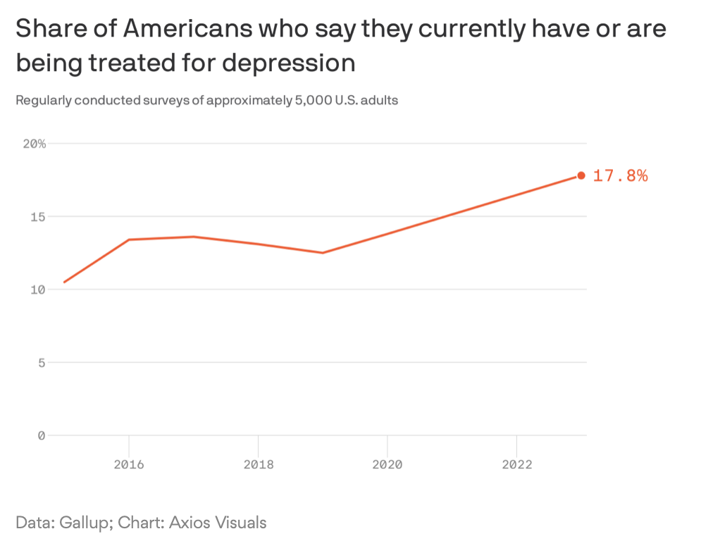
Notes:
https://news.gallup.com/poll/505745/depression-rates-reach-new-highs.aspx?utm_source=newsletter&utm_medium=email&utm_campaign=newsletter_axiospm&stream=top
https://www.axios.com/2022/10/26/loneliness-pandemic-america-phone-calls?utm_source=newsletter&utm_medium=email&utm_campaign=newsletter_axiospm&stream=top
elmoody@mindspring.com has shared an Axios story with you: 1 big thing: Depression on the rise https://www.axios.com/newsletters/axios-pm-d0579eaa-ab5f-43cb-83af-cc4a48d065fd.html?chunk=0&utm_term=emshare#story0

Slide 4
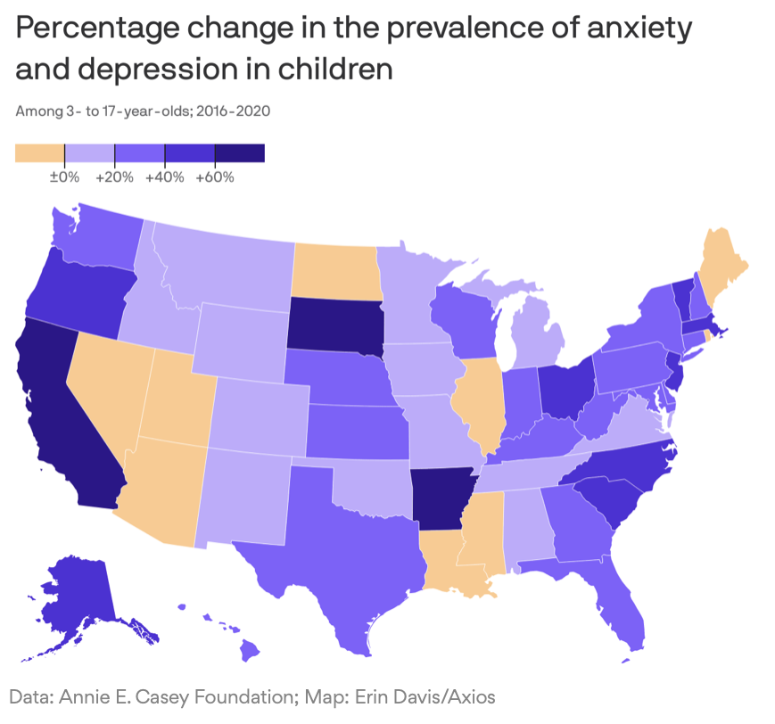
Notes:
1 big thing: More N.C. kids have anxiety and depression https://www.axios.com/newsletters/axios-raleigh-da7602c9-1eab-4972-9fc7-522b38b44c64.html?chunk=0&utm_term=emshare#story0

Slide 5
Notes:
https://www.barna.com/research/church-pastor-role/

Slide 6
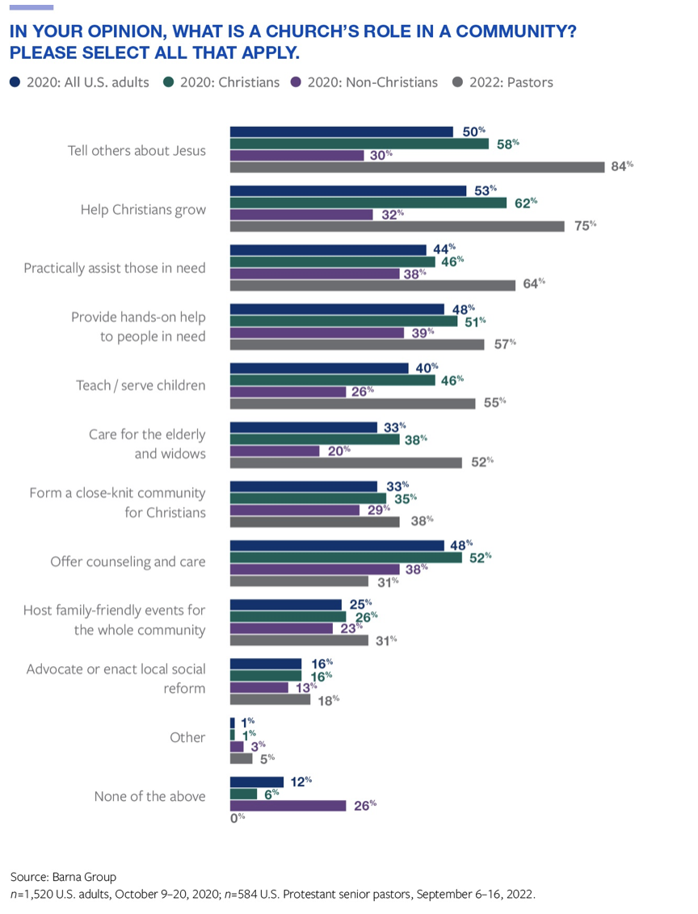

Slide 7
Notes:
How? You are an ambassador and burden bearer>
³⁰ And Jesus answering said, A certain man went down from Jerusalem to Jericho, and fell among thieves, which stripped him of his raiment, and wounded him, and departed, leaving him half dead.
³¹ And by chance there came down a certain priest that way: and when he saw him, he passed by on the other side.
³² And likewise a Levite, when he was at the place, came and looked on him, and passed by on the other side.
³³ But a certain Samaritan, as he journeyed, came where he was: and when he saw him, he had compassion on him,
³⁴ And went to him, and bound up his wounds, pouring in oil and wine, and set him on his own beast, and brought him to an inn, and took care of him.
³⁵ And on the morrow when he departed, he took out two pence, and gave them to the host, and said unto him, Take care of him; and whatsoever thou spendest more, when I come again, I will repay thee.
³⁶ Which now of these three, thinkest thou, was neighbour unto him that fell among the thieves?
³⁷ And he said, He that shewed mercy on him. Then said Jesus unto him, Go, and do thou likewise.

Slide 8
Barriers to Responding
Someone else will help

Slide 9
Barriers to Responding
Someone else will help
Time

Slide 10
Barriers to Responding
Someone else will help
Time
Fear

Slide 11
Barriers to Responding
Someone else will help
Time
Fear
Helpless

Slide 12
What tools do you have?
Prayer
Pray aloud

Slide 13
What tools do you have?
Prayer
Pray aloud
Pray by name

Slide 14
What tools do you have?
The Word
For comfort

Slide 15
What tools do you have?
Prayer
The Word
For comfort
For direction

Slide 16
What tools do you have?
Your Words
Text

Slide 17
What tools do you have?
Your Words
Text
Social media message

Slide 18
What tools do you have?
Your Words
Text
Social media message
Card

Slide 19
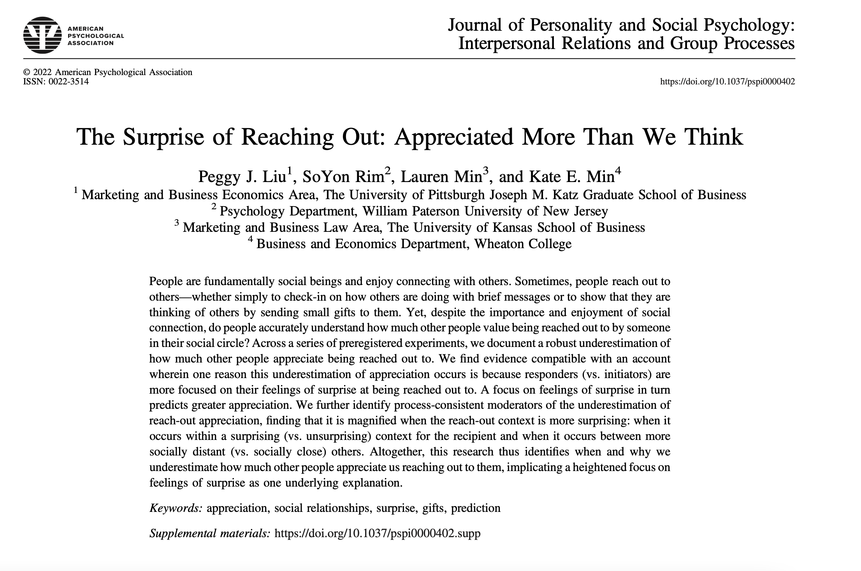
Notes:
https://www.apa.org/pubs/journals/releases/psp-pspi0000402.pdf?utm_source=newsletter&utm_medium=email&utm_campaign=newsletter_axiosfinishline&stream=top

Slide 20
What tools do you have?
The Church
Worship

Slide 21
What tools do you have?
The Church
Worship
Fellowship

Slide 22
What tools do you have?
The Church
Worship
Fellowship
Activities

Slide 23
Notes:
https://doc-0g-60-prod-03-apps-viewer.googleusercontent.com/viewer2/prod-03/pdf/diikpqn23bpesfpqch67fiac88oh1ji4/va5t5b5n5q7q9c7s32afign67osf8fq3/1669130775000/3/111659680590651400924/APznzaau0Ybo4jcP5et4e4hkQQk-DWq0o9HrPzD9D5N01GABVWL7Z_n1WQsUUCSd6z8GkQvSU4sgHIu8eQO6DWAKom8R_7lWXKCjpbgwx9Xk3W5m09OWHDFIrxxOJX_tqAKkTUUWkx39ZojKf25UJFSa__WHSOgkgYa2VeK57pRGJebbNmKT0DkVfJv5Y29DwKkoo3azZ2xHpZFXeUWg9FixWS1mZIgSus0CWjU6FGGLJPgBlZu_EmLQ72qz4VKvcZZjNvJEFjimiW35FTSGIbKTOYiIytxW8KfCiHBFiFbRQcilsLJfYqsEsk2ClCGCs9GR7Q7c-Na_fOZltrO--4aE-iqwiXk7b43CB_UtKGX9jXGJUUYwBmXJ82ypIGhFb982XuTX4w9-?authuser=0&nonce=naskdqg1hm8ie&user=111659680590651400924&hash=gf3o98kq9gtq9tnuparbdk9g4vsb8tcc

Slide 24
What tools do you have?
Your Relationships
Work

Slide 25
What tools do you have?
Your Relationships
Work
Neighbors

Slide 26
What tools do you have?
Your Relationships
Work
Neighbors
Family

Slide 27
The Character and Techniques of the Responder
The Fruit of the Spirit

Slide 28
The Character and Techniques of the Responder
The Fruit of the Spirit
Confidentiality

Slide 30
Techniques of the Responder
Observing
Depression
Complicated Grief
Addiction
Family difficulties

Slide 31
Techniques of the Responder
Attending

Slide 32
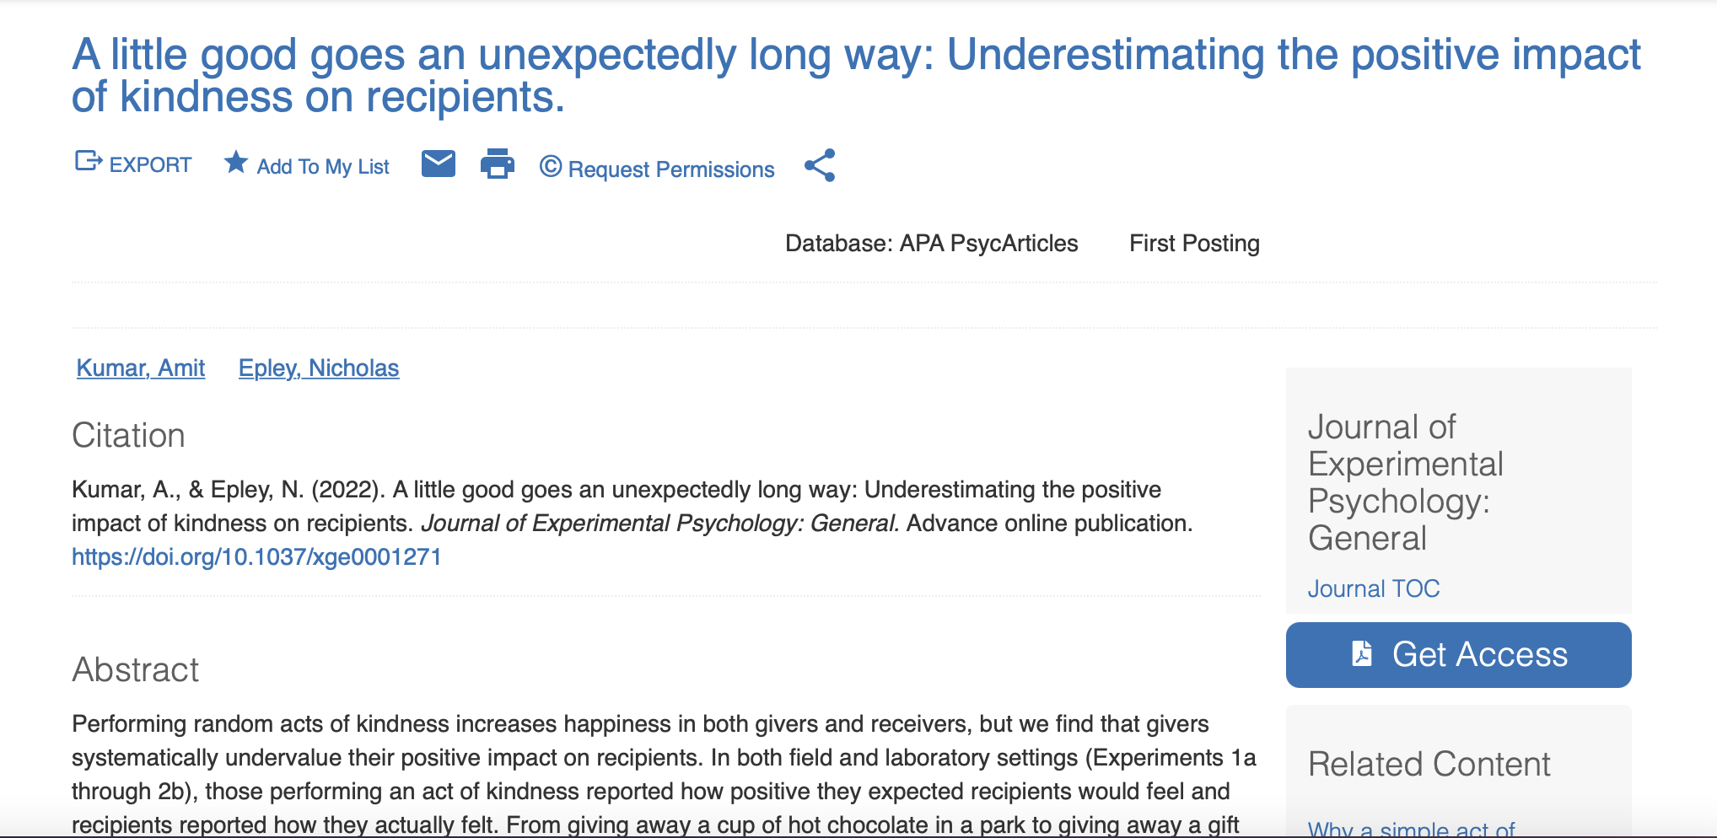
Notes:
https://psycnet.apa.org/record/2022-85307-001?utm_source=newsletter&utm_medium=email&utm_campaign=newsletter_axiosfinishline&stream=top

Slide 33
Techniques of the Responder
Listening

Slide 34
Techniques of the Responder
Observing
Attending
Listening
Caring (Empathy)

Slide 35
Techniques of the Responder
Observing
Attending
Listening
Caring (Empathy)
Responding

Slide 36
Techniques of the Responder
Observing
Attending
Listening
Caring (Empathy)
Responding
Acting

Slide 37
Techniques of the Responder
Observing
Attending
Listening
Caring (Empathy)
Responding
Acting

Slide 38
Find the Inn
Finding Help explores the helping process and how to find the particular helping professional needed.

Slide 39
OVERVIEW
First Aid for Emotional Hurts provides information to help people struggling with emotional issues.
Finding Help explores the helping process and how to find the particular helping professional needed.
Grief describes the physical, psychological, social, and spiritual impacts of loss and provides a biblical model for grieving.

Slide 40
OVERVIEW
Depression uncovers the types & nature of depression and how an individual can find their way out.
Addiction reveals the nature of entangling behaviors with a step-by-step biblical process for long-term escape.
Sexual Issues describes a broad range of sexual sins, how one can become entangled, and how to break the chains.

Slide 41
OVERVIEW
Veterans (with Lt. Col. David Trogdon) will help you help veterans and their families recover from war’s impact.
Helping Children With Emotional Problems explores how parents and caretakers can intervene to find the root of emotional issues. The book gives special attention to depression, anxiety, and eating disorders.
Helping Children With Learning Problems shows parents and caretakers how to help children struggling with a learning disability and attention deficit hyperactivity disorder.

Slide 42
OVERVIEW
Marriage shares practical instruction for marital difficulties, including affairs and domestic violence.
Ten Therapeutic Life Changes is an uplifting book describing how our faith has a positive impact upon our health.

Slide 44
