Slide 1
Ministering in a Changing Sexual Landscape
Eddie Moody
emoody@nafwb.org
Notes:
This session will provide an overview about steps Christian leaders can take to deal with the sexual changes transpiring in our culture. What do we need to know about the LGBT Community, and how can we deal with its influence upon our parents and students?

Slide 2
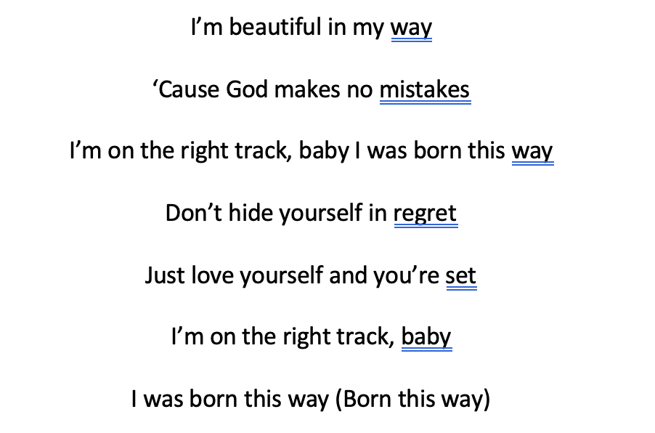
2011

Slide 3
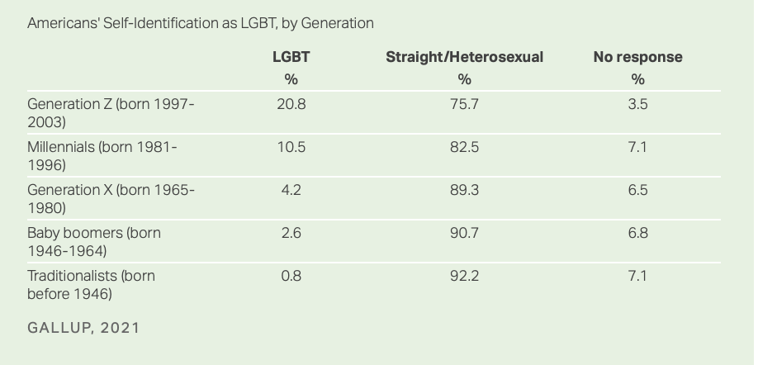

Slide 4
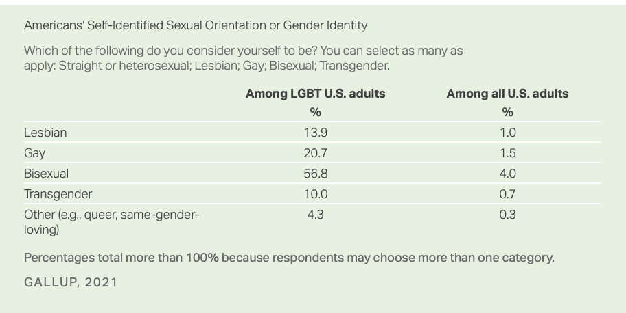

Slide 5
What do we need to know? Those who struggling are among us

Slide 6
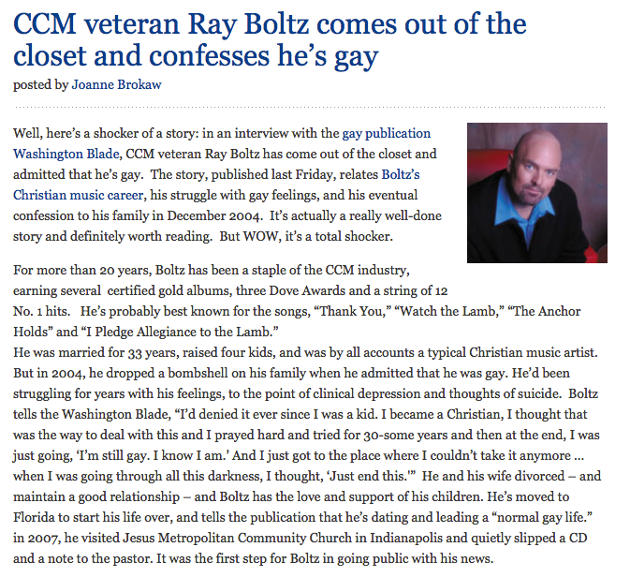
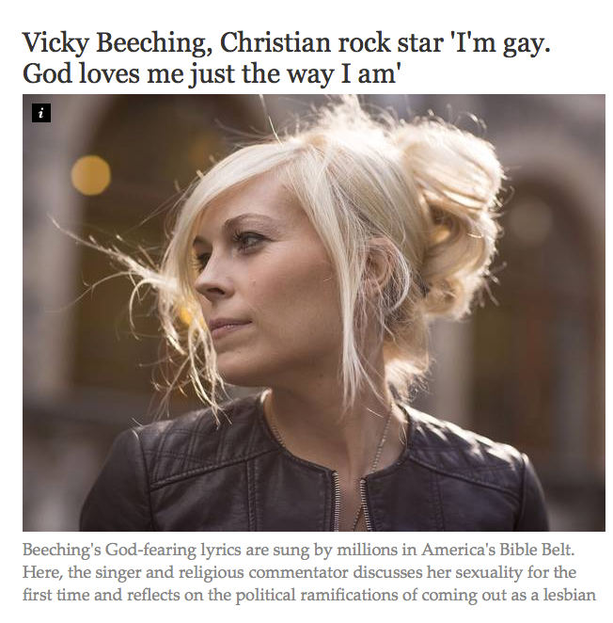
Notes:
don’t be quarrelsome>

Slide 7
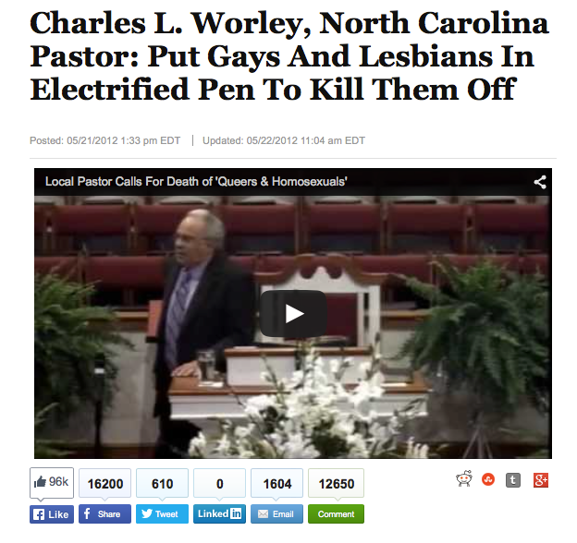
Be careful about our tone
Notes:
calm like Paul>
Matthew 10:16, we are better than that>
Jonah
They are asking, can I bring my friend to this church?
3 out of 5 teens who struggle with these issues do not feel safe.
Actual or perceived sexual orientation is one of the most common reasons that students are harassed by their peers, second only to physical appearance.
What am I trying to accomplish?
Lose the jokes.
Lose the stereotypes. David played a harp. NC Pastor?
The church ought to be the safest place there is.
Should feel welcome.
Admit imperfection.
You are speaking to them whether you realize it or not. Think of 1 Cor. 9.
Lose the jokes.
Lose the stereotypes. David. Deborah.
When you freelance it gets dangerous.
Pastor in NC.
Ask, what am I trying to accomplish?

Slide 8
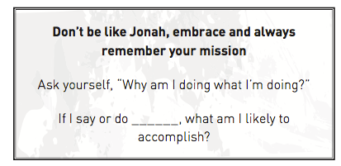

Slide 9
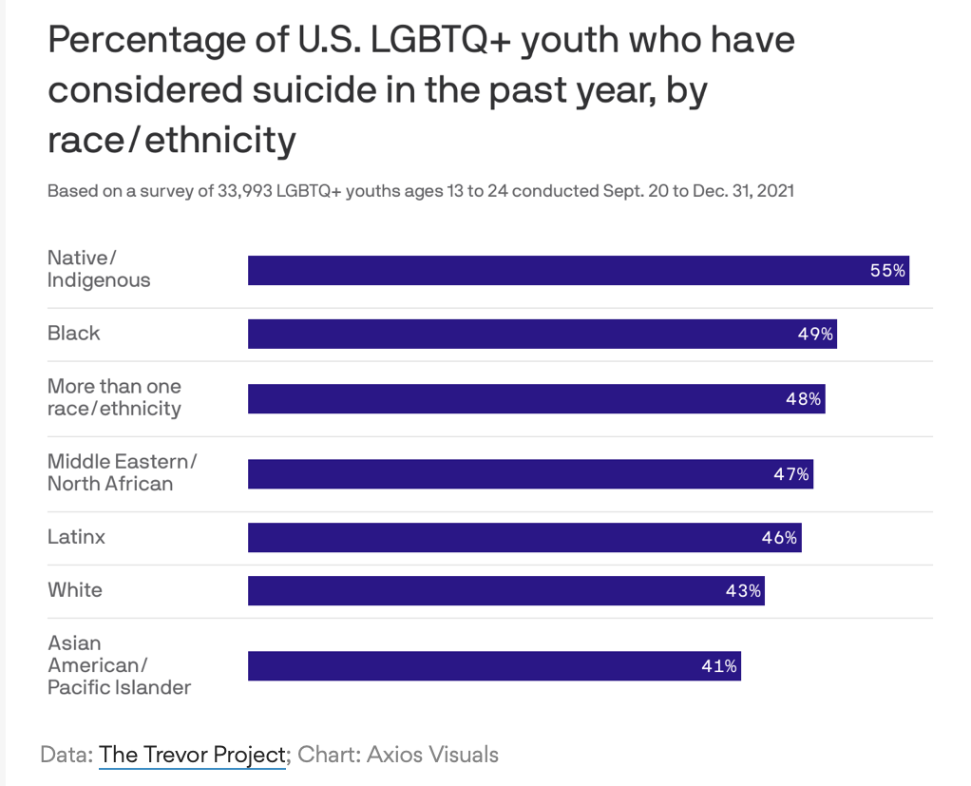
Many of them are suffering
Notes:
calm like Paul>
Matthew 10:16, we are better than that>
Jonah
They are asking, can I bring my friend to this church?
3 out of 5 teens who struggle with these issues do not feel safe.
Actual or perceived sexual orientation is one of the most common reasons that students are harassed by their peers, second only to physical appearance.
What am I trying to accomplish?
Lose the jokes.
Lose the stereotypes. David played a harp. NC Pastor?
The church ought to be the safest place there is.
Should feel welcome.
Admit imperfection.
You are speaking to them whether you realize it or not. Think of 1 Cor. 9.
Lose the jokes.
Lose the stereotypes. David. Deborah.
When you freelance it gets dangerous.
Pastor in NC.
Ask, what am I trying to accomplish?

Slide 10
What do we need to know? Many have been misinformed
Ye are of your father the devil, and the lusts of your father ye will do. He was a murderer from the beginning, and abode not in the truth, because there is no truth in him. When he speaketh a lie, he speaketh of his own: for he is a liar, and the father of it.
John 8:44
And ye shall know the truth, and the truth shall make you free.
John 8:32

Slide 11
The truth is being suppressed
For the wrath of God is revealed from heaven against all ungodliness and unrighteousness of men, who hold the truth in unrighteousness;
Romans 1:18

Slide 12
Notes:
everyone>

Slide 13
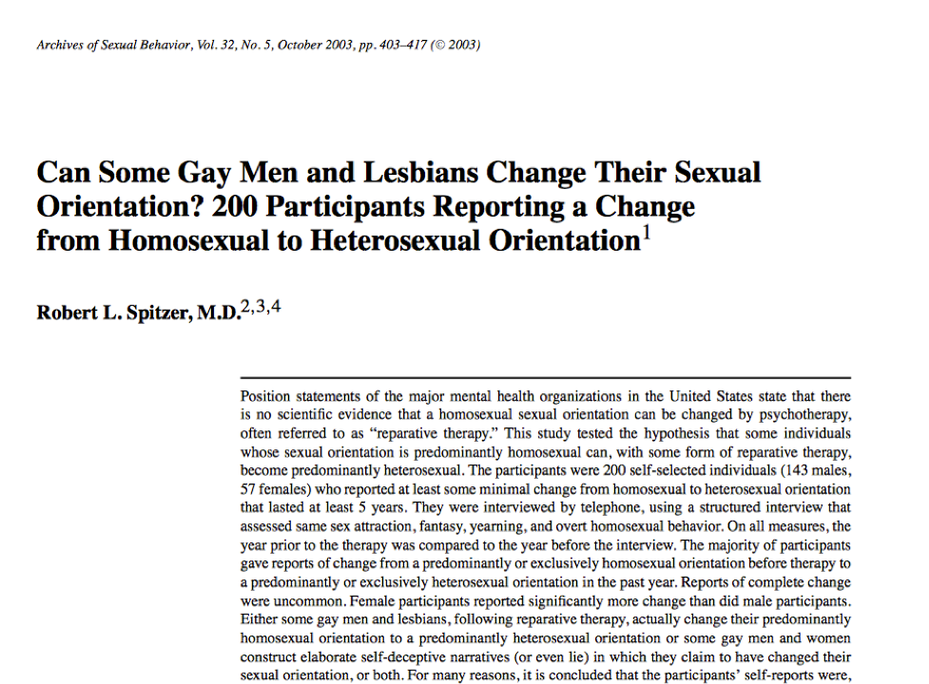

Slide 14
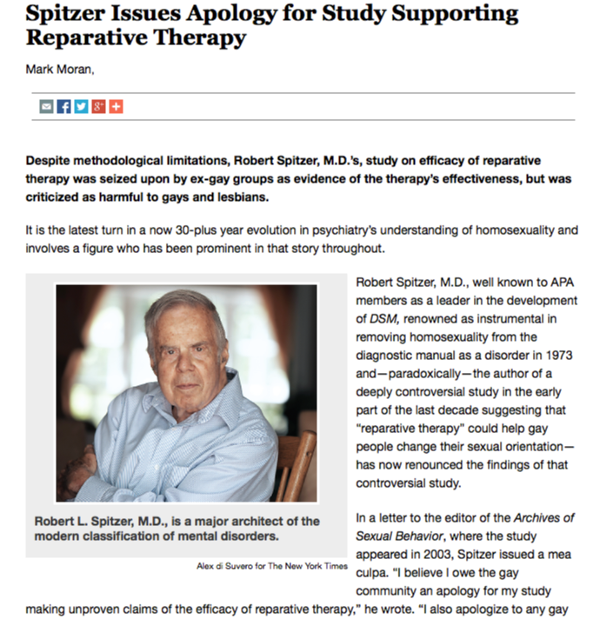

Slide 15
Proclaim the Truth
⁹ Know ye not that the unrighteous shall not inherit the kingdom of God? Be not deceived: neither fornicators, nor idolaters, nor adulterers, nor effeminate, nor abusers of themselves with mankind,
¹⁰ Nor thieves, nor covetous, nor drunkards, nor revilers, nor extortioners, shall inherit the kingdom of God.
¹¹ And such were some of you: but ye are washed, but ye are sanctified, but ye are justified in the name of the Lord Jesus, and by the Spirit of our God.
1 Corinthians 6:9-11

Slide 16
Proclaim the Truth about Scripture
Notes:
truth about science>

Slide 17
⁴⁸ As I live, saith the Lord God, Sodom thy sister hath not done, she nor her daughters, as thou hast done, thou and thy daughters. ⁴⁹ Behold, this was the iniquity of thy sister Sodom, pride, fulness of bread, and abundance of idleness was in her and in her daughters, neither did she strengthen the hand of the poor and needy. ⁵⁰ And they were haughty, and committed abomination before me: therefore I took them away as I saw good.
Ezekiel 16

Slide 18
Proclaim the Truth about Science
Notes:
truth about science>

Slide 19
²⁷ And likewise also the men, leaving the natural use of the woman, burned in their lust one toward another; men with men working that which is unseemly, and receiving in themselves that recompence of their error which was meet. ²⁸ And even as they did not like to retain God in their knowledge, God gave them over to a reprobate mind, to do those things which are not convenient;
Romans 1:27-28

Slide 20
Teach students to think scientifically Who is in the sample of a study and how was it obtained?
Notes:
February 1992

Slide 21
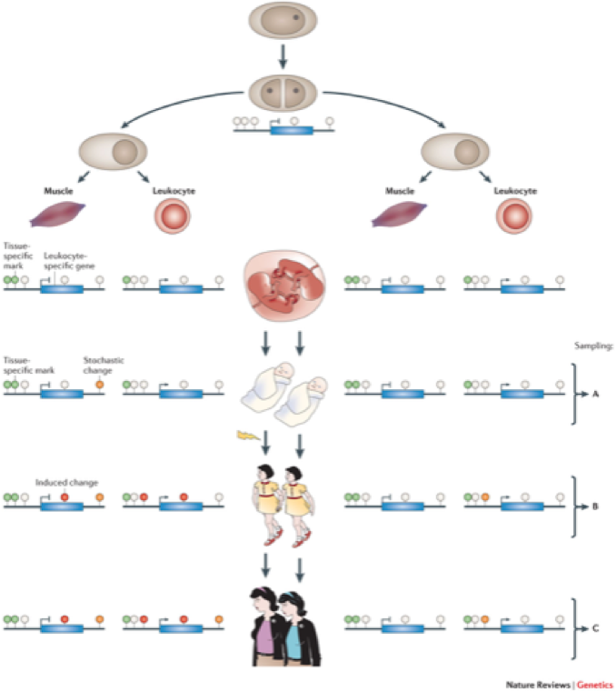
The Study: What exactly did they find?
Notes:
truth about science>

Slide 23
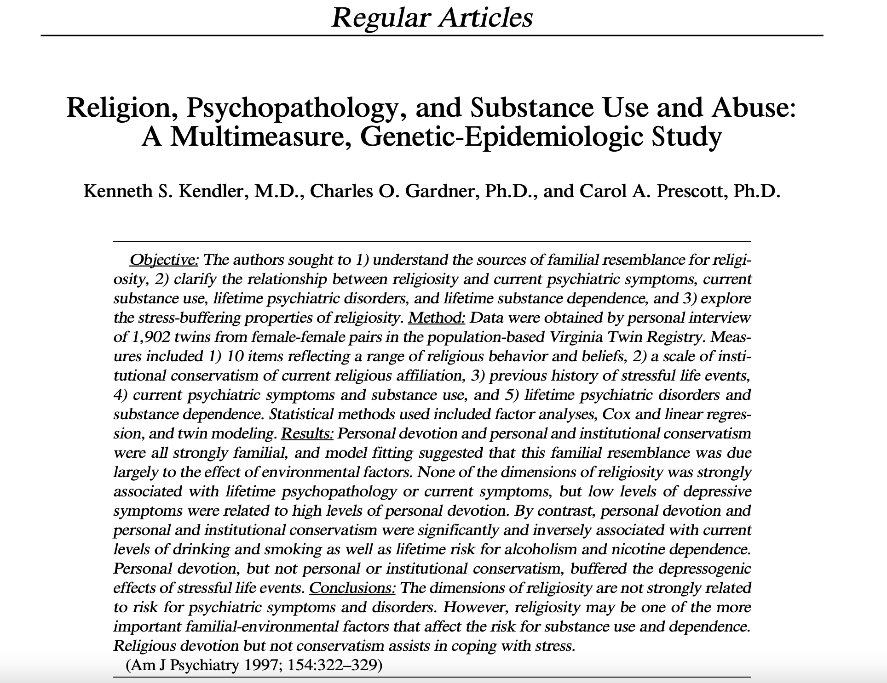

Slide 24
And ye shall know the truth, and the truth shall make you free.
John 8:32

Slide 25
Ministering in a Changing Sexual Landscape
Eddie Moody
emoody@nafwb.org
Notes:
This session will provide an overview about steps Christian leaders can take to deal with the sexual changes transpiring in our culture. What do we need to know about the LGBT Community, and how can we deal with its influence upon our parents and students?

Slide 26
Less than 0.1% of the population has been assessed to struggle with gender dysphoria.

Slide 27
Wherefore, as by one man sin entered into the world, and death by sin; and so death passed upon all men, for that all have sinned:
Romans 5:12

Slide 28
What can we do?
Do no harm
Behold, I send you forth as sheep in the midst of wolves: be ye therefore wise as serpents, and harmless as doves.
Matthew 10:16

Slide 29
Gender Dysphoria in Children (6 or more of the following for at least 6 months)
A strong desire to be of the other gender or an insistence that one is the other gender
In boys (assigned gender), a strong preference for cross-dressing or simulating female attire; or in girls (assigned gender), a strong preference for wearing only typical masculine clothing and a strong resistance to wearing typical feminine clothing
A strong preference for cross-gender roles in make-believe play or fantasy play
A strong preference for toys, games, or activities stereotypically used or engaged in by the other gender
A strong preference for playmates of the other gender
In boys (assigned gender), a strong rejection of typically masculine toys, games, and activities and a strong rejection of rough-and-tumble play; or in girls (as assigned gender), a strong rejection of typically feminine toys, games, and activities
A strong dislike for one’s sexual anatomy
A strong desire for the primary and/or secondary sex characteristic that match one’s experienced gender

Slide 30
Gender Dysphoria in Adolescents and Adults (2 or more of the following for at least 6 months)
A marked incongruence between one’s experienced/expressed gender and primary and/or secondary sex characteristics (or in young adolescents, the anticipated secondary sex characteristics)
A strong desire to be rid of one’s primary and/or secondary sex characteristics because of a marked incongruence with one’s experienced/expressed gender (or in young adolescents, a desire to prevent the development of the anticipated secondary sex characteristics
A strong desire for the primary and/or secondary sex characteristics of the other gender
A strong desire to be treated as the other gender (or some alternative gender different from one’s assigned gender)
A strong desire to be treated as the other gender (or some alternative gender different from one’s assigned gender)
A strong conviction that one has the typical feelings and reactions of the other gender (or some alternative gender different from one’s assigned gender)

Slide 31
What teachers do?
Foster positive relationships with one’s father, male caregiver or role model
Notes:
What would Jesus do?, What did Jesus do?>
the church needs to feel this void

Slide 32
What teachers do?
Foster positive relationships with one’s father, male caregiver or role model
Foster positive relationships with male peers
Notes:
What would Jesus do?, What did Jesus do?>
the church needs to feel this void

Slide 33
What teachers do?
Foster positive relationships with one’s father, male caregiver or role model
Foster positive relationships with male peers
Foster gender typical habits and skills
Facilitate positive feelings about being male
Notes:
What would Jesus do?, What did Jesus do?>
the church needs to feel this void

Slide 34
What teachers do?
Foster positive relationships with one’s father, male caregiver or role model
Foster positive relationships with male peers
Foster gender typical habits and skills
Facilitate positive feelings about being male
Notes:
What would Jesus do?, What did Jesus do?>
the church needs to feel this void

Slide 35
What can we do?
Teach
So God created man in his own image, in the image of God created he him; male and female created he them.
Genesis 1:27

Slide 36
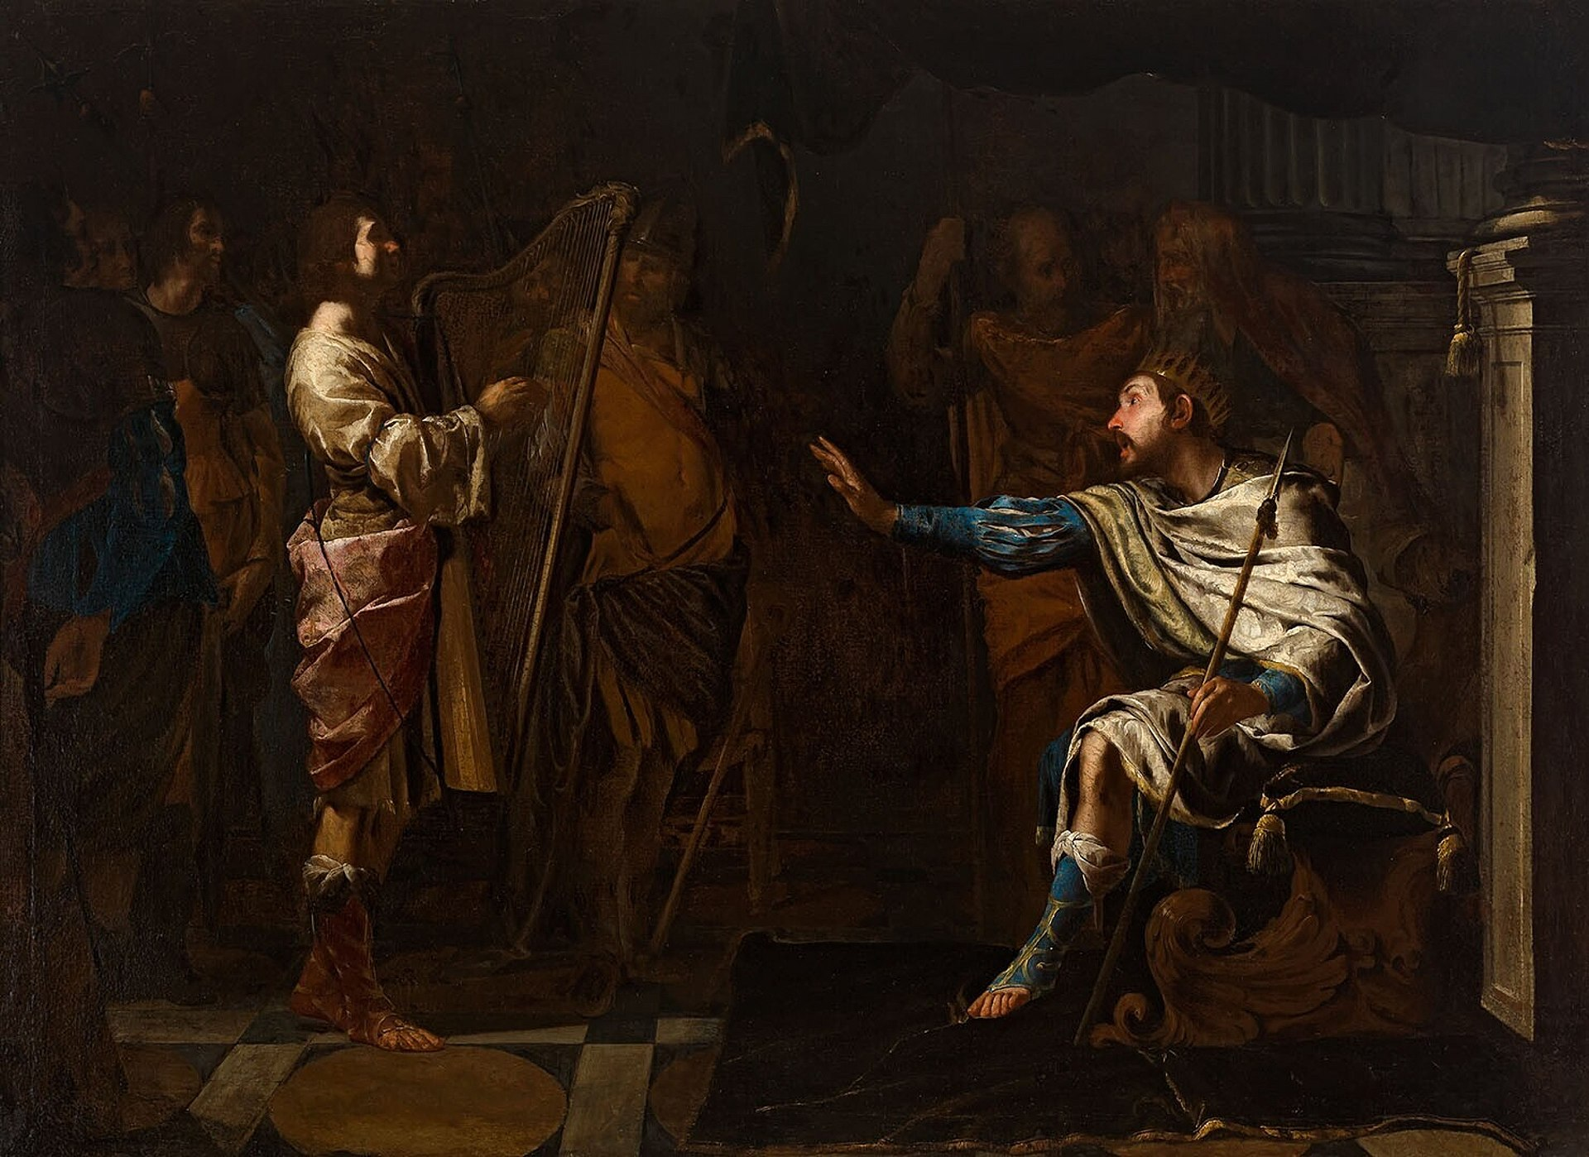
Bernardo Cavallino - David harpspelend voor Saul - St 115 - Museum Boijmans Van Beuningen

Slide 37
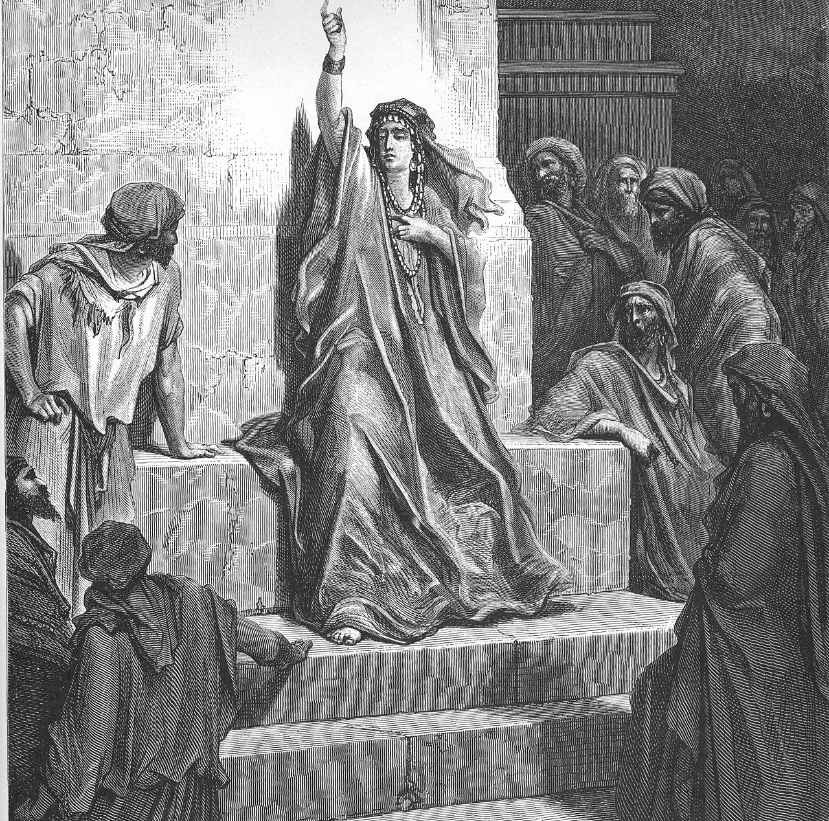
Deborah portrayed in Gustave Doré's illustrations for La Grande Bible de Tours (1865)

Slide 38
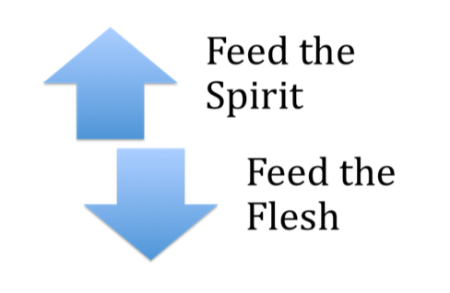
Gratifying
Notes:
Wrong places>

Slide 39
The Wrong People
Notes:
Delilah>

Slide 40
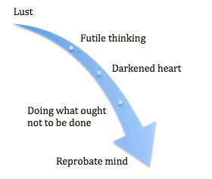
The Wrong Thinking
Notes:
The terrible results>

Slide 41
The Way Out
Notes:
Repent>

Slide 42
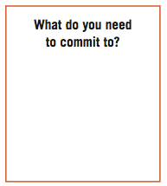
Create in Me
Notes:
seeing>fleeing>

Slide 43
Notes:
deny yourself>

Slide 44
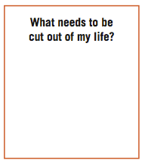
The Right People
Notes:
right places>

Slide 45
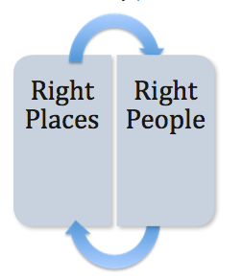
The Right Places
Notes:
take up your cross>

Slide 46
The Right Choices
Notes:
right thinking>

Slide 47
What can we do?
Instill Hope

Slide 48
¹⁹ What? know ye not that your body is the temple of the Holy Ghost which is in you, which ye have of God, and ye are not your own? ²⁰ For ye are bought with a price: therefore glorify God in your body, and in your spirit, which are God's.
1 Corinthians 6:19-20

Slide 49
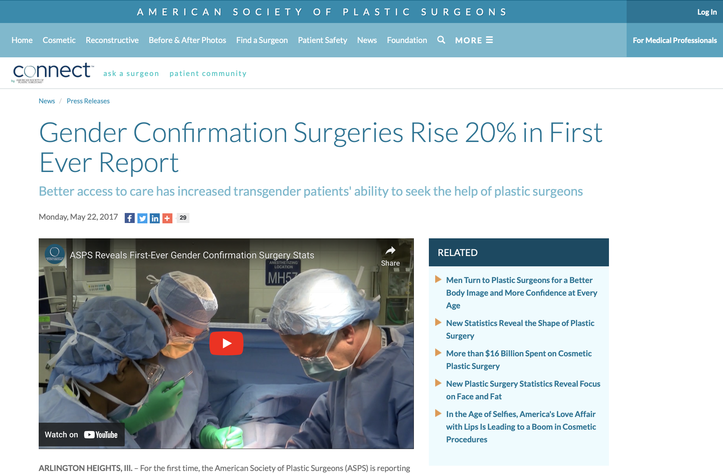

Slide 50
⁴ And the vessel that he made of clay was marred in the hand of the potter: so he made it again another vessel, as seemed good to the potter to make it. ⁵ Then the word of the Lord came to me, saying, ⁶ O house of Israel, cannot I do with you as this potter? saith the Lord. Behold, as the clay is in the potter's hand, so are ye in mine hand, O house of Israel.
Jeremiah 18

Slide 51
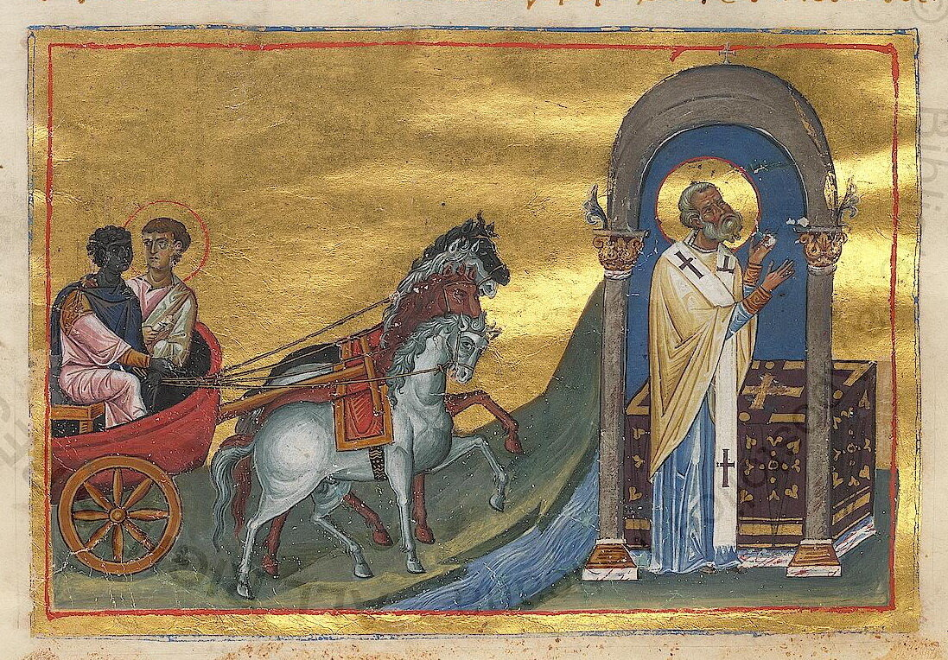
For there are some eunuchs, which were so born from their mother's womb: and there are some eunuchs, which were made eunuchs of men: and there be eunuchs, which have made themselves eunuchs for the kingdom of heaven's sake. He that is able to receive it, let him receive it. Matthew 19:12

Slide 52
What can we do?
Befriend
¹⁰ And it came to pass, as Jesus sat at meat in the house, behold, many publicans and sinners came and sat down with him and his disciples.
¹¹ And when the Pharisees saw it, they said unto his disciples, Why eateth your Master with publicans and sinners?
Matthew 9:10-11

Slide 53
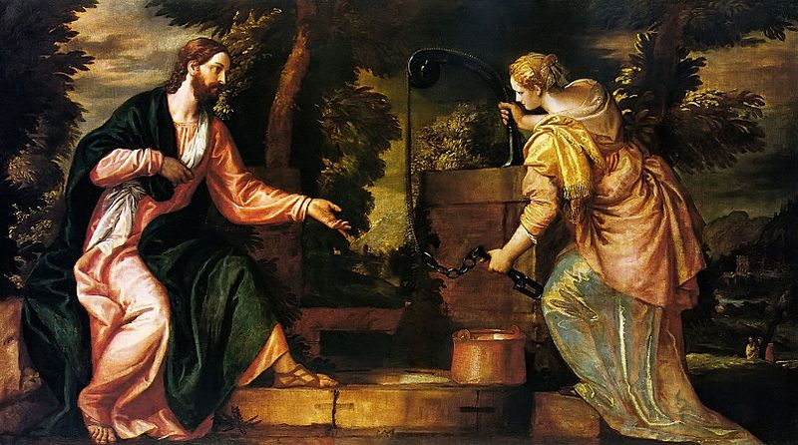

Slide 54
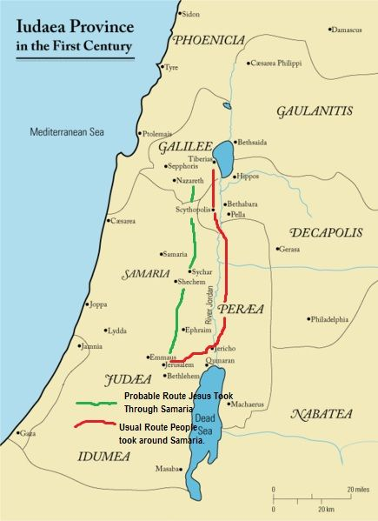
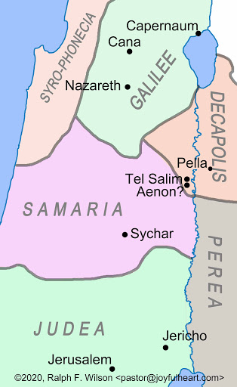

Slide 55
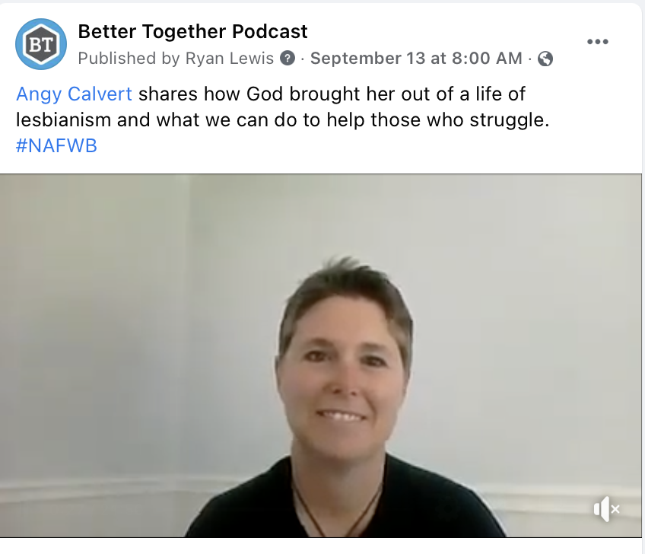

Slide 56
Suggestions from a parent
What was helpful for us from other Christians?
Listening, not judging and not giving advice we didn't ask for.
Acknowledging our sorrow and asking about our daughter how is she doing, instead of acting like she is dead to us.
Telling us they are praying, fasting and grieving for our child.
What Christians did that was unhelpful?
Giving me advices and opinions on the matter, I didn't ask for.
Telling me at least I have another child who is faithful to God.
Speaking in front of me how blessed they are because all of their children are serving the Lord.
Dismissing the trauma our daughter had as a child and pointing only to her sin.

Slide 57
Suggestions from a parent
Don't worry about their outward appearance, but try to earn their trust and communicate about their internal struggles.
Limit social media access and get them involved in family and church fun activities.
Talk to them about anything: sex, LGBTQ issues, dating etc. Don't shy away from difficult conversations and don't be shocked when they share stories and opinions with you.
If things are going bad for them-get them into Christian counseling before they are 18 and explore a possible trauma in their lives. .
Take care of your mental health too.
Find a support group.
Pray and fast about your child and give them back to God-He is their ultimate parent.

Slide 58
Suggestions from a parent
We have experienced deep trauma, loss and guilt. Listen and mourn with us. Help us to heal mentally, emotionally and spiritually.
Acknowledge our trauma and help us to heal.
Tell us it was not our fault.
Give us some practical advice when we ask for it.
Educate other people about trans issues, so they will not go through what we are going through, and we would feel that our suffering is not meaningless.
Give us hope for the future.

Slide 61
Ministering in a Changing Sexual Landscape
Eddie Moody
emoody@nafwb.org
Notes:
This session will provide an overview about steps Christian leaders can take to deal with the sexual changes transpiring in our culture. What do we need to know about the LGBT Community, and how can we deal with its influence upon our parents and students?

