Slide 1
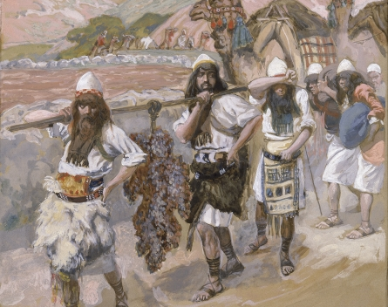
Leading Through Obstacles
Numbers 13-14
Notes:
The Grapes of Canaan by James Tissot. Although the spies brought back a cluster of grapes so large that it took two men to carry it (Numbers 13:23), only two of the twelve brought back a good report of the land.

Slide 2
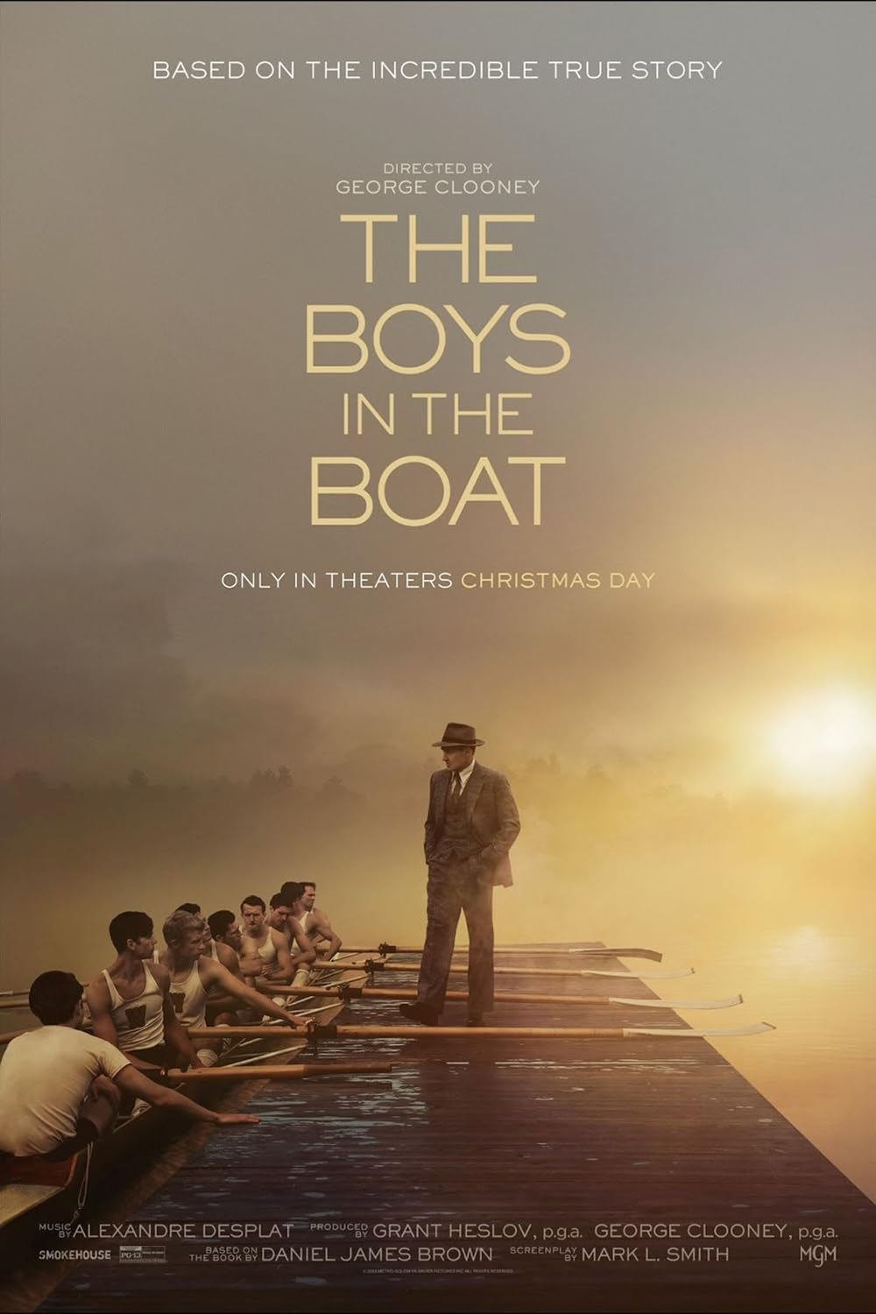
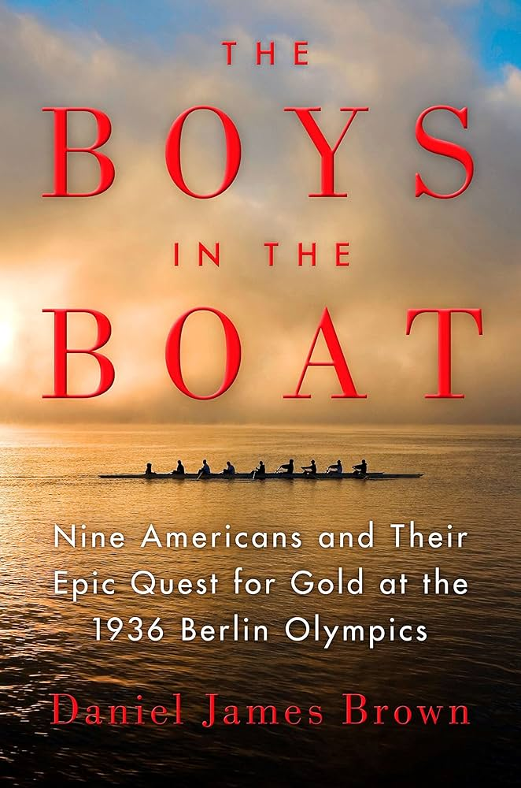

Slide 3
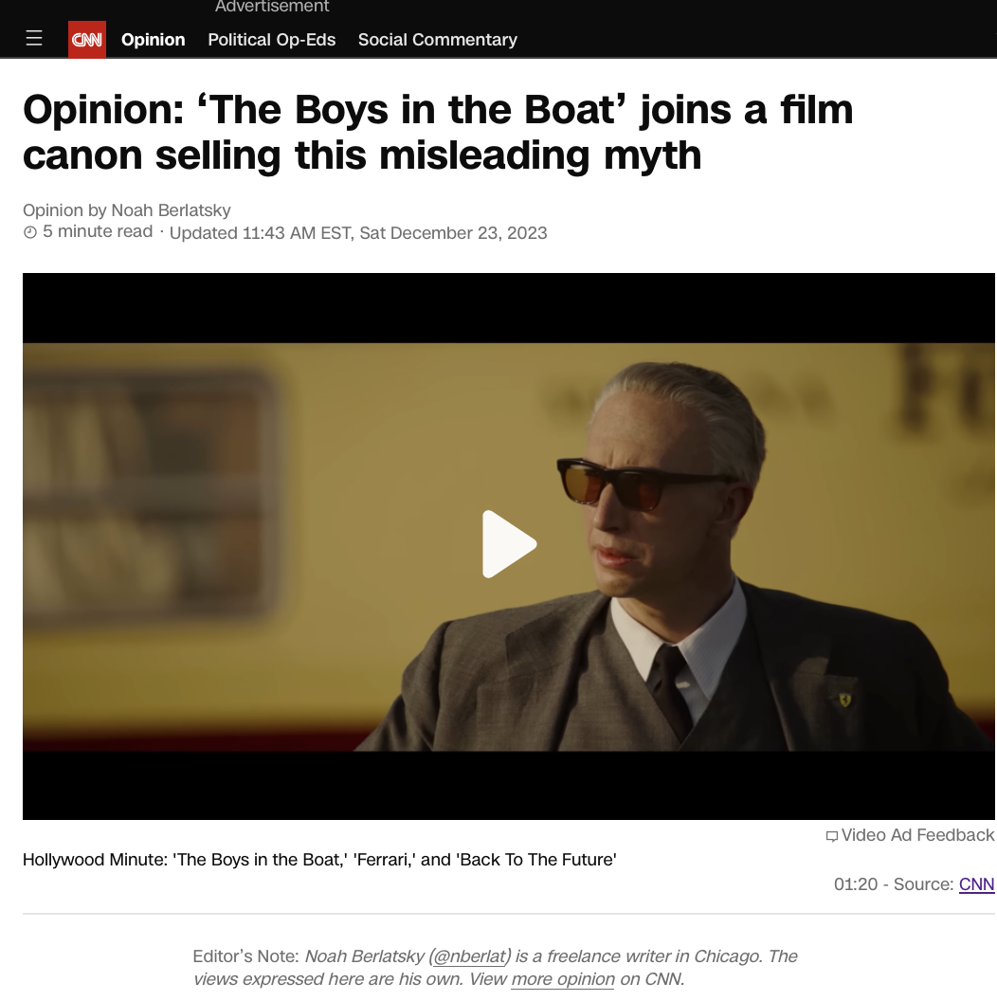
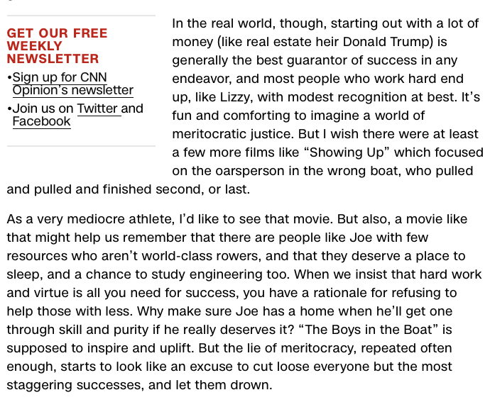
Notes:
CNN —
I swam competitively for 10 years between middle school and college. Most mornings, I’d get up at 5 a.m. to go to practice before classes started, then spend hours after school in the pool or thef weight room. A lot of days I wouldn’t be outside in daylight at all; I spent so much time in chlorine that my hair bleached.
Noah Berlatsky
Noah Berlatsky
I enjoyed swimming a lot, even though I was pretty bad at it. All that practice made me somewhat faster, but I was still an ectomorph with asthmatic lungs and a hard limit on my potential. Coaches kept trying to find a place where I would excel (Breaststroke? No. Distance swimming? No…). Finally most of them just shrugged, accepted that I was never, in fact, going to win anything and let me paddle along in the outside lanes.
I think this experience is pretty common; most people have at some point tried very hard at something they cared about without ever achieving great success. You wouldn’t know that that’s normal from Hollywood, though, which focuses almost exclusively on the outlier underdogs, who try and try and then have unlikely overwhelming success. It’s pat, predictable and in bulk ends up trumpeting a misleading and potentially dangerous faith in meritocracy — the idea that virtue and hard work always win out.
Director George Clooney’s new film, “The Boys in the Boat,” follows the usual trajectory with so little deviation you almost feel like you should shout, “Drink!” at each expected plot “twist.” The movie is a sports biopic about the eight-man crew team from the University of Washington that qualified for the 1936 Summer Olympic Games in Nazi Berlin.
ADVERTISING
The protagonist is Joe Rantz (Callum Turner), a freshman engineering student abandoned by his father. Joe is essentially homeless; he can’t pay his tuition and is afraid he’s going to get kicked out of school. He tries out for crew because he needs the team stipend and the housing reserved for school athletes.
Opinion: I’m making room during the winter break for this guilty pleasure
The movie is based on the historical events detailed in Daniel James Brown’s 2013 nonfiction book. But the decision to tell this story is, obviously, overdetermined by its Hollywood fit. As in the horse race film “Seabiscuit” (2003) or the fictional film about unlikely musical stars, “O Brother Where Art Thou?”(2000), the Great Depression provides a background milieu of poverty and desperation. Joe and most of his teammates are given determination by lack. They know little about rowing, but come out for the team because they have few other options.
Despite their inexperience, though, the crusty coach with a heart of gold, Al Ulbrickson (Joel Edgerton), sees something in the scrappy young men. Before you can say “training montage,” Joe and the rest of the team oar their way to glory, overcoming elitist skepticism and the manipulations of East Coast rivals like Harvard to take their rightful place in history.
Again, underdogs win sometimes (these rowers did). In Hollywood, though, it’s more than sometimes; if you watched “The Karate Kid” (1984), “Hoosiers” (1986), “Bring It On,” (2000), “Miracle” (2004), “Pitch Perfect” (2012) and on and on, you’d come away convinced that improbable or disadvantaged outcasts are constantly triumphing over better-trained and better-resourced rivals through the unbeatable combination of hard work and virtue.
Hollywood does occasionally focus on downtrodden losers who actually lose. But those losses aren’t usually presented as the result of bad luck or material disadvantage. Instead, failure is a result, supposedly, of character flaws or weaknesses.
In “Nightmare Alley” (2021), for example, Stan (Bradley Cooper), like Joe Rantz, is fatherless and impoverished in the Great Depression. Like Joe, he stumbles on his calling — though for Joe, it’s carny card-reading psychic sideshows rather than crew. Like Joe, Stan works hard to get to the top of his profession.
Opinion: Where the brilliance of ‘Wonka’ truly lies
But that’s where the parallels end. Joe, unlike Stan, never cheats or steals, and is a model of fidelity to his picture-perfect girlfriend (Hadley Robinson). Stan’s downfall, like Joe’s success, is a meritocratic morality tale; Stan ends up impoverished and debased because he’s a bad person who makes bad choices, not because people in a massive economic downturn just sometimes are impoverished and debased through no real fault of their own.
What would a film look like that didn’t pretend that the most virtuous and hardworking people always win? There aren’t a lot of examples. One, maybe, is Kelly Reichardt’s film, “Showing Up,” from earlier this year. The movie (like most of Reichardt’s movies) is slow and meandering; its schlubby, grumpy protagonist Lizzy (Michelle Williams) is a not-especially-successful artist preparing for a solo exhibit of her work — clay figures of women in everyday poses.
Lizzy approaches her art with obsessive meticulousness, but without great acclaim. Her reward is the art itself, and (maybe) the appreciation of friends and family. The film has little narrative drive because Lizzy has no real narrative arc; she’s not on a path to fame or fortune or Olympic gold.
Reichardt’s art (like Lizzy’s) has limited reach. “Showing Up” may do okay in awards season, but it was never going to be a blockbuster. One irony of those films about underdogs is that the films aren’t underdogs themselves. People have an endless appetite for narratives which tell them that hard work is rewarded and that good, handsome, all-American guys get the girl and the gold.
GET OUR FREE WEEKLY NEWSLETTER
Sign up for CNN Opinion’s newsletter
Join us on Twitter and Facebook
In the real world, though, starting out with a lot of money (like real estate heir Donald Trump) is generally the best guarantor of success in any endeavor, and most people who work hard end up, like Lizzy, with modest recognition at best. It’s fun and comforting to imagine a world of meritocratic justice. But I wish there were at least a few more films like “Showing Up” which focused on the oarsperson in the wrong boat, who pulled and pulled and finished second, or last.
As a very mediocre athlete, I’d like to see that movie. But also, a movie like that might help us remember that there are people like Joe with few resources who aren’t world-class rowers, and that they deserve a place to sleep, and a chance to study engineering too. When we insist that hard work and virtue is all you need for success, you have a rationale for refusing to help those with less. Why make sure Joe has a home when he’ll get one through skill and purity if he really deserves it? “The Boys in the Boat” is supposed to inspire and uplift. But the lie of meritocracy, repeated often enough, starts to look like an excuse to cut loose everyone but the most staggering successes, and let them drown.

Slide 4
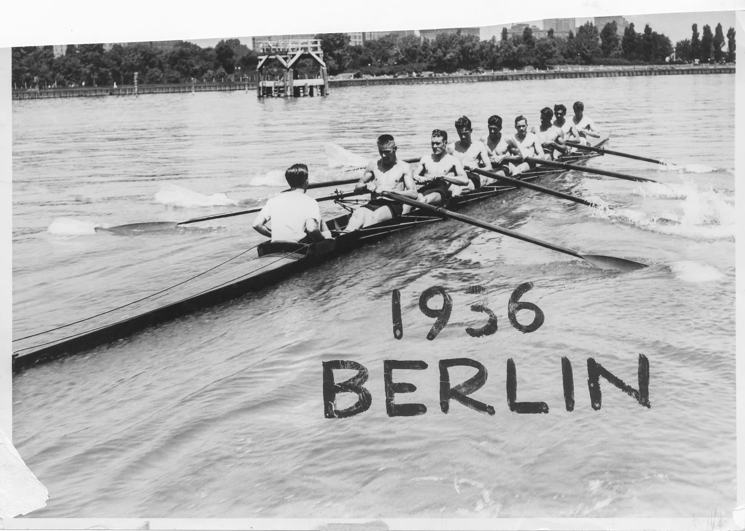
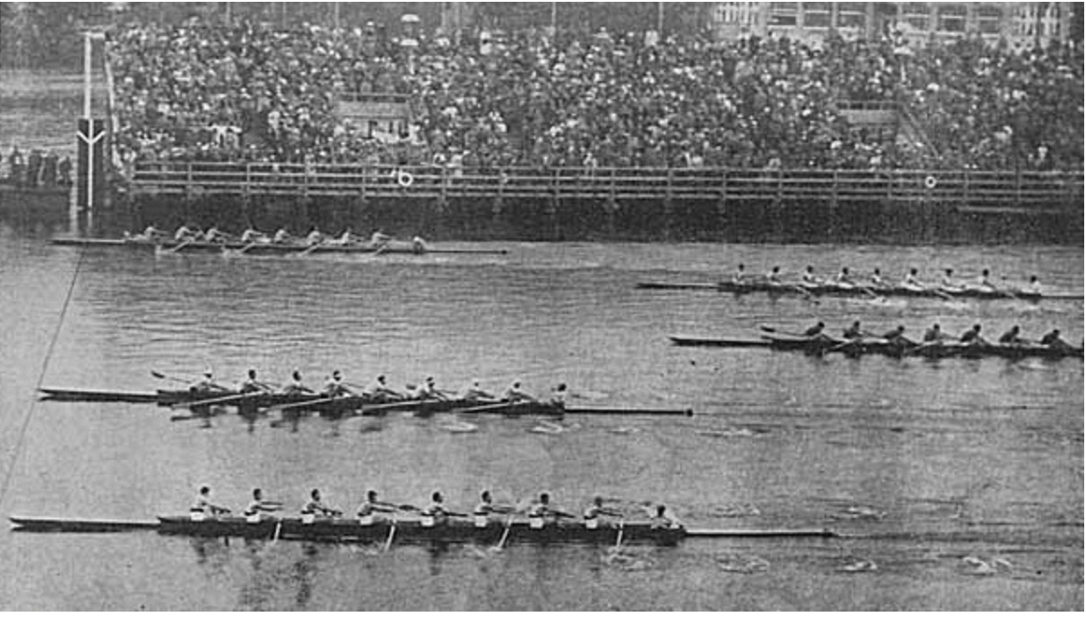

Slide 5
Send thou men, that they may search the land of Canaan, which I give unto the children of Israel: of every tribe of their fathers shall ye send a man, every one a ruler among them.
Numbers 13:2

Slide 6
And Moses by the commandment of the Lord sent them from the wilderness of Paran: all those men were heads of the children of Israel.
Numbers 13:3

Slide 7
We only remember two
⁵ Of the tribe of Simeon, Shaphat the son of Hori.
⁶ Of the tribe of Judah, Caleb the son of Jephunneh.
⁷ Of the tribe of Issachar, Igal the son of Joseph.
⁸ Of the tribe of Ephraim, Oshea the son of Nun.
⁹ Of the tribe of Benjamin, Palti the son of Raphu.
¹⁰ Of the tribe of Zebulun, Gaddiel the son of Sodi.
¹¹ Of the tribe of Joseph, namely, of the tribe of Manasseh, Gaddi the son of Susi.
¹² Of the tribe of Dan, Ammiel the son of Gemalli.
¹³ Of the tribe of Asher, Sethur the son of Michael.
Numbers 13:5-13

Slide 8
The task
¹⁷ And Moses sent them to spy out the land of Canaan, and said unto them, Get you up this way southward, and go up into the mountain:
¹⁸ And see the land, what it is, and the people that dwelleth therein, whether they be strong or weak, few or many;
¹⁹ And what the land is that they dwell in, whether it be good or bad; and what cities they be that they dwell in, whether in tents, or in strong holds;
²⁰ And what the land is, whether it be fat or lean, whether there be wood therein, or not. And be ye of good courage, and bring of the fruit of the land. Now the time was the time of the firstripe grapes.
Numbers 13:17-20

Slide 9
They fulfilled their task
²¹ So they went up, and searched the land from the wilderness of Zin unto Rehob, as men come to Hamath.
²² And they ascended by the south, and came unto Hebron; where Ahiman, Sheshai, and Talmai, the children of Anak, were. (Now Hebron was built seven years before Zoan in Egypt.)
²³ And they came unto the brook of Eshcol, and cut down from thence a branch with one cluster of grapes, and they bare it between two upon a staff; and they brought of the pomegranates, and of the figs.
²⁴ The place was called the brook Eshcol, because of the cluster of grapes which the children of Israel cut down from thence.
²⁵ And they returned from searching of the land after forty days.
Numbers 13:21-25

Slide 10
²⁶ And they went and came to Moses, and to Aaron, and to all the congregation of the children of Israel, unto the wilderness of Paran, to Kadesh; and brought back word unto them, and unto all the congregation, and shewed them the fruit of the land.
²⁷ And they told him, and said, We came unto the land whither thou sentest us, and surely it floweth with milk and honey; and this is the fruit of it.
Numbers 13:26-27

Slide 11
They got off track
²⁸ Nevertheless the people be strong that dwell in the land, and the cities are walled, and very great: and moreover we saw the children of Anak there.
²⁹ The Amalekites dwell in the land of the south: and the Hittites, and the Jebusites, and the Amorites, dwell in the mountains: and the Canaanites dwell by the sea, and by the coast of Jordan.
Numbers 13:28-29

Slide 12
They got off track by focusing on the obstacles
²⁸ Nevertheless the people be strong that dwell in the land, and the cities are walled, and very great: and moreover we saw the children of Anak there.
²⁹ The Amalekites dwell in the land of the south: and the Hittites, and the Jebusites, and the Amorites, dwell in the mountains: and the Canaanites dwell by the sea, and by the coast of Jordan.
Numbers 13:28-29

Slide 13
Caleb tried to redirect them
And Caleb stilled the people before Moses, and said, Let us go up at once, and possess it; for we are well able to overcome it.
Numbers 13:30

Slide 14
They refocused on the obstacles
³¹ But the men that went up with him said, We be not able to go up against the people; for they are stronger than we.
³² And they brought up an evil report of the land which they had searched unto the children of Israel, saying, The land, through which we have gone to search it, is a land that eateth up the inhabitants thereof; and all the people that we saw in it are men of a great stature.
³³ And there we saw the giants, the sons of Anak, which come of the giants: and we were in our own sight as grasshoppers, and so we were in their sight.
Numbers 13:31-33

Slide 15
What is our task?

Slide 16
What are the obstacles we face?
70% of youth stop attending church and start leaving when they graduate from high school
Only 10% of Gen Z (born between 1997-2012) attend church at least once a month
Gen Z is the least churched generation in American history

Slide 21
What Can We Do? Get their attention
And Caleb stilled the people before Moses, and said, Let us go up at once, and possess it; for we are well able to overcome it.
Numbers 13:30

Slide 22
What Can We Do? Get them focused on doing the right things
And Caleb stilled the people before Moses, and said, Let us go up at once, and possess it; for we are well able to overcome it.
Numbers 13:30

Slide 23
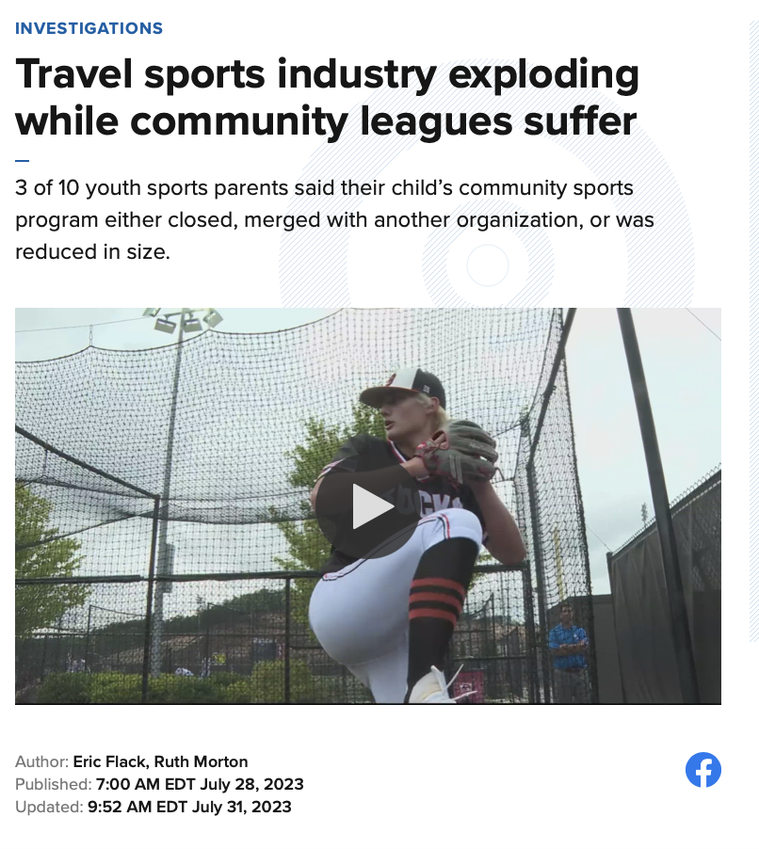
Notes:
39 billion dollars

Slide 24
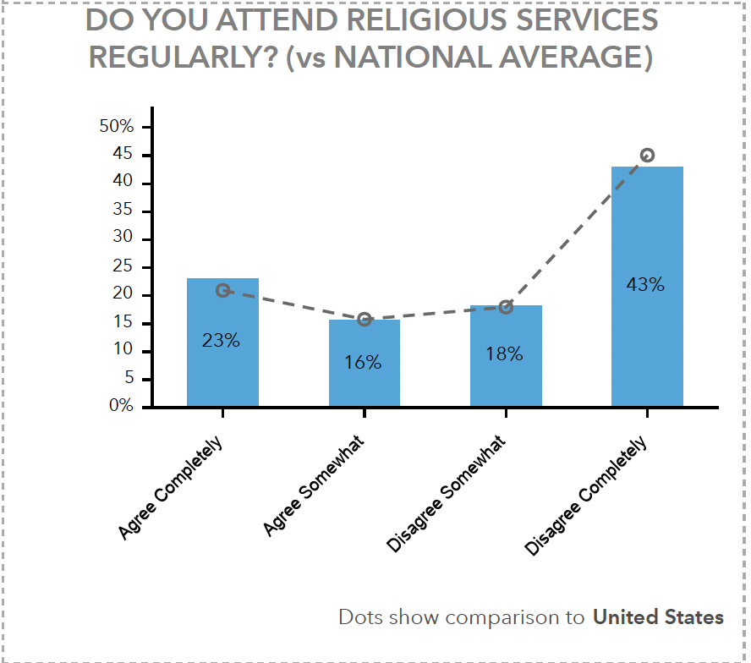
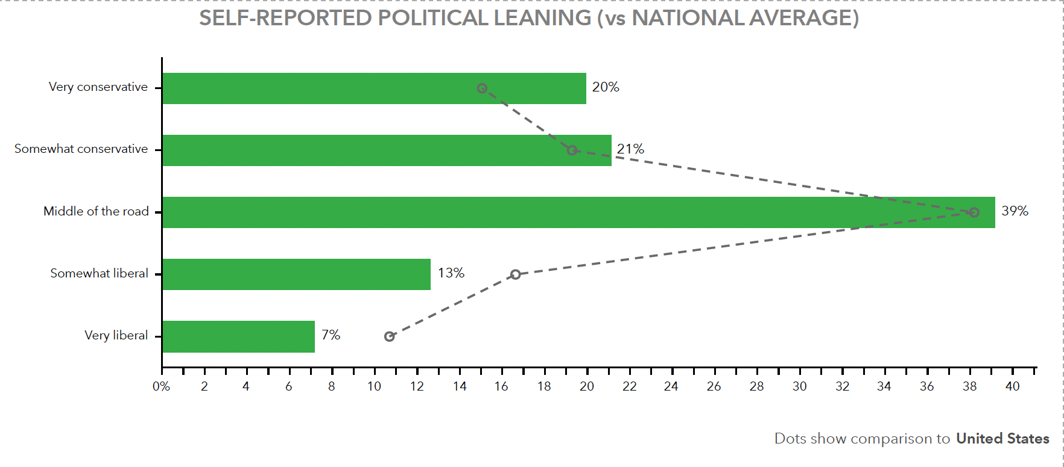

Slide 25
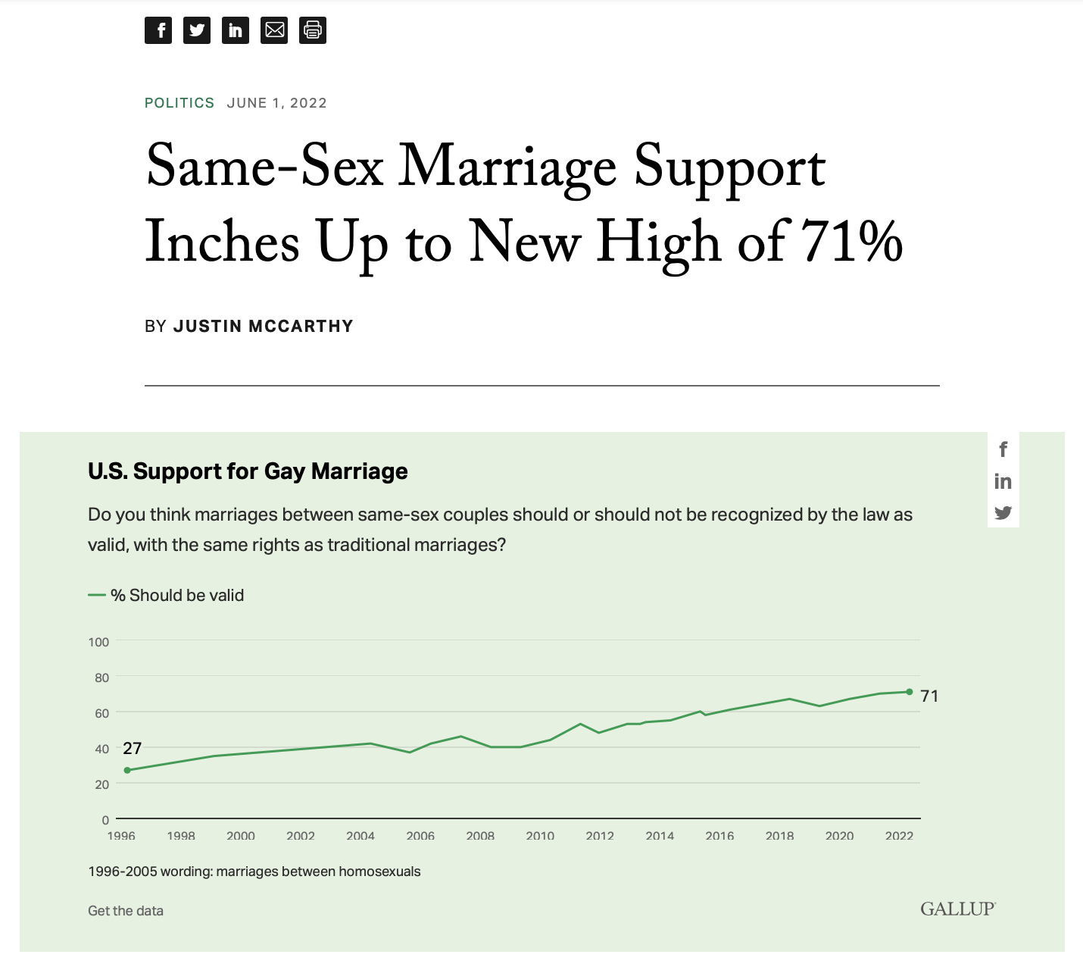
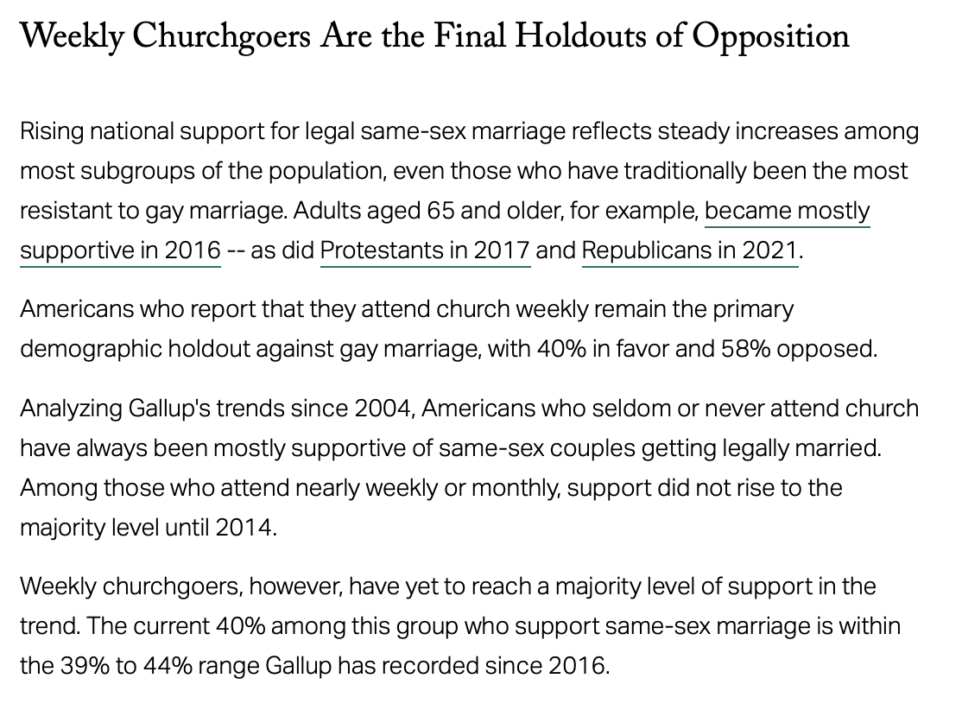

Slide 26
Is there real hope?

Slide 27
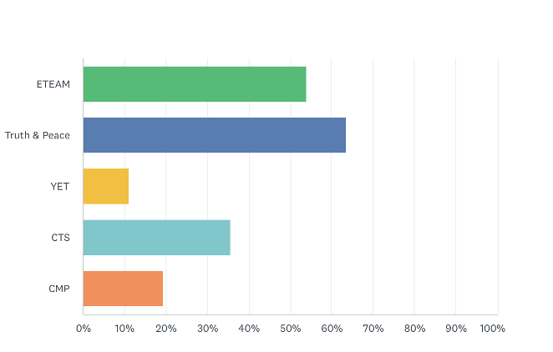
Our Sample 160 alumni

Slide 28
Our Sample
99.25% report regular church attendance (86% weekly, 13% bi-weekly)
87% report being involved in church ministry, most of which involved multiple ministries
85% attend a Free Will Baptist Church

Slide 29
How did we keep them?
Trained
Trained them in their youth
“I have been to church my entire life. It’s always been a priority over everything else that may be going on.”

Slide 30
How did we keep them?
Trained
Trained them in their youth
Challenged
Challenged and stretched them in their teen years
“CTS taught me the importance of memorizing Scripture as a very young age. Passages that I memorized in elementary school . . . I can still recite today! . . . Truth and Peace . . . Was a lot harder than I ever imagined! Lessons and words of wisdom . . . will always stick with me. . . it has taught me to be the leader I am today . . . it helped me more than I ever thought it would.”

Slide 31
How did we keep them?
Trained
Trained them in their youth
Challenged
Challenged and stretched them in their teen years
Handoff
Made the handoff to another church
“. . . we wanted to stay in the denomination, we have few friends going, and they instantly welcomed us and were excited about our desire to serve.”

Slide 32
How did we keep them?
Trained
Trained them in their youth
Challenged
Challenged and stretched them in their teen years
Handoff
Made the handoff to another church
Belonging
Created a sense of belonging

Slide 33
How did we keep them?
Trained
Trained them in their youth
Challenged
Challenged and stretched them in their teen years
Handoff
Made the handoff to another church
Belonging
Created a sense of belonging
“. . . our church allowed us to easily plug in and get involved while forming new relationships.”

Slide 34
How did we keep them?
Trained
Trained them in their youth
Challenged
Challenged and stretched them in their teen years
Handoff
Made the handoff to another church
Belonging
Created a sense of belonging
Let
We let them serve
“. . . I run my church social media, make the media for slides/announcements, teach kids class every week, and sing in our worship band every week. I am also part of a weekly discipleship group as well as a weekly Bible study.”

Slide 35
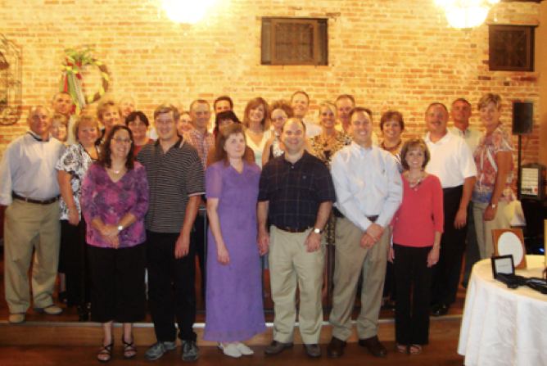

Slide 36
Leading Through Obstacles
Numbers 13-14
Notes:
The Grapes of Canaan by James Tissot. Although the spies brought back a cluster of grapes so large that it took two men to carry it (Numbers 13:23), only two of the twelve brought back a good report of the land.

