Slide 3
The Scope of the Problem
There are currently 209 Churches without Pastors
55% of Free Will Baptist pastors are over 50, and 80% of Free Will Baptist pastors are over 40
www.nafwb.org/blog

Slide 4
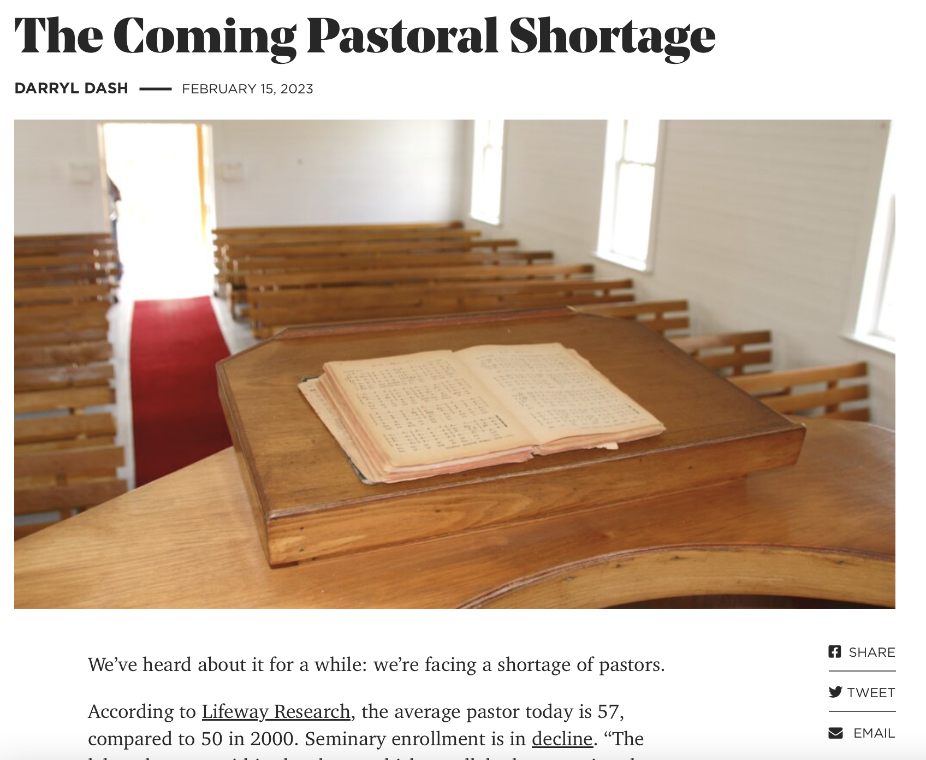

Slide 5
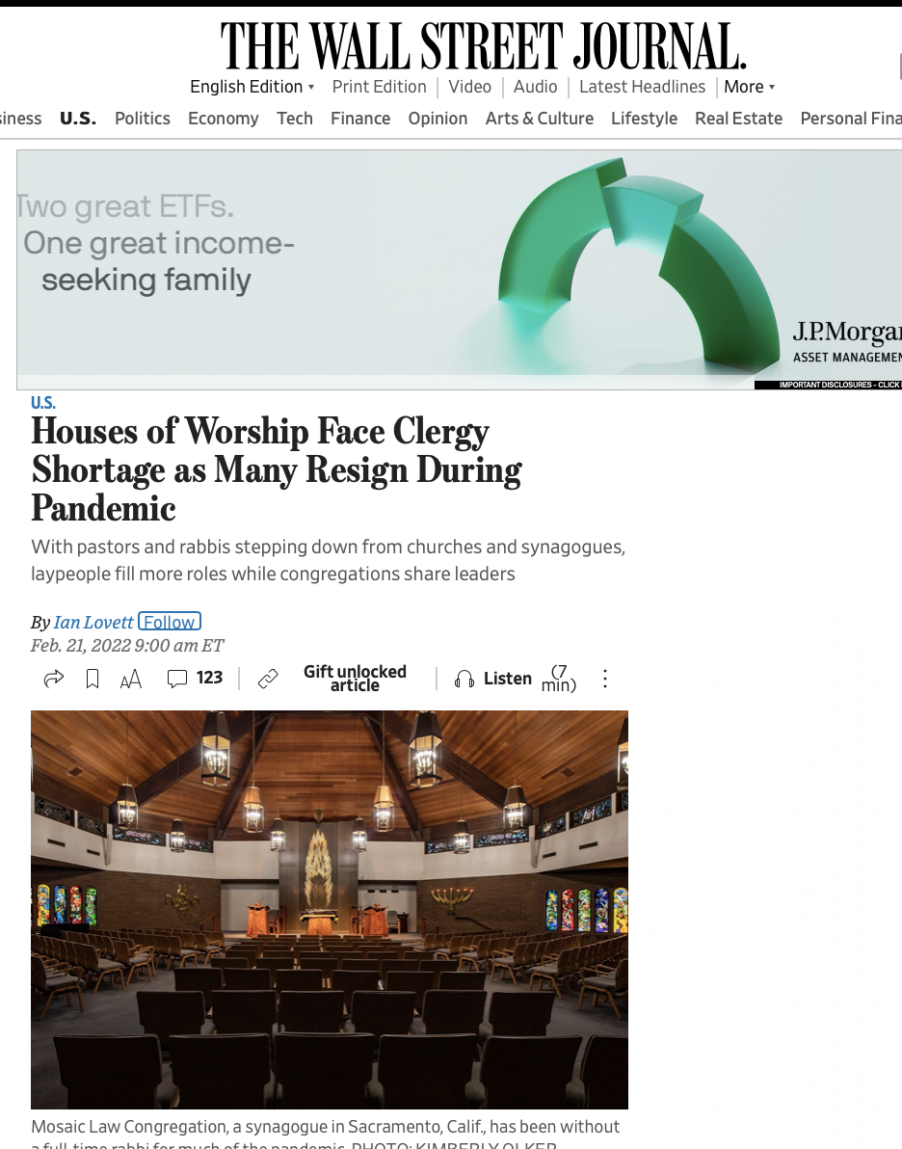

Slide 6
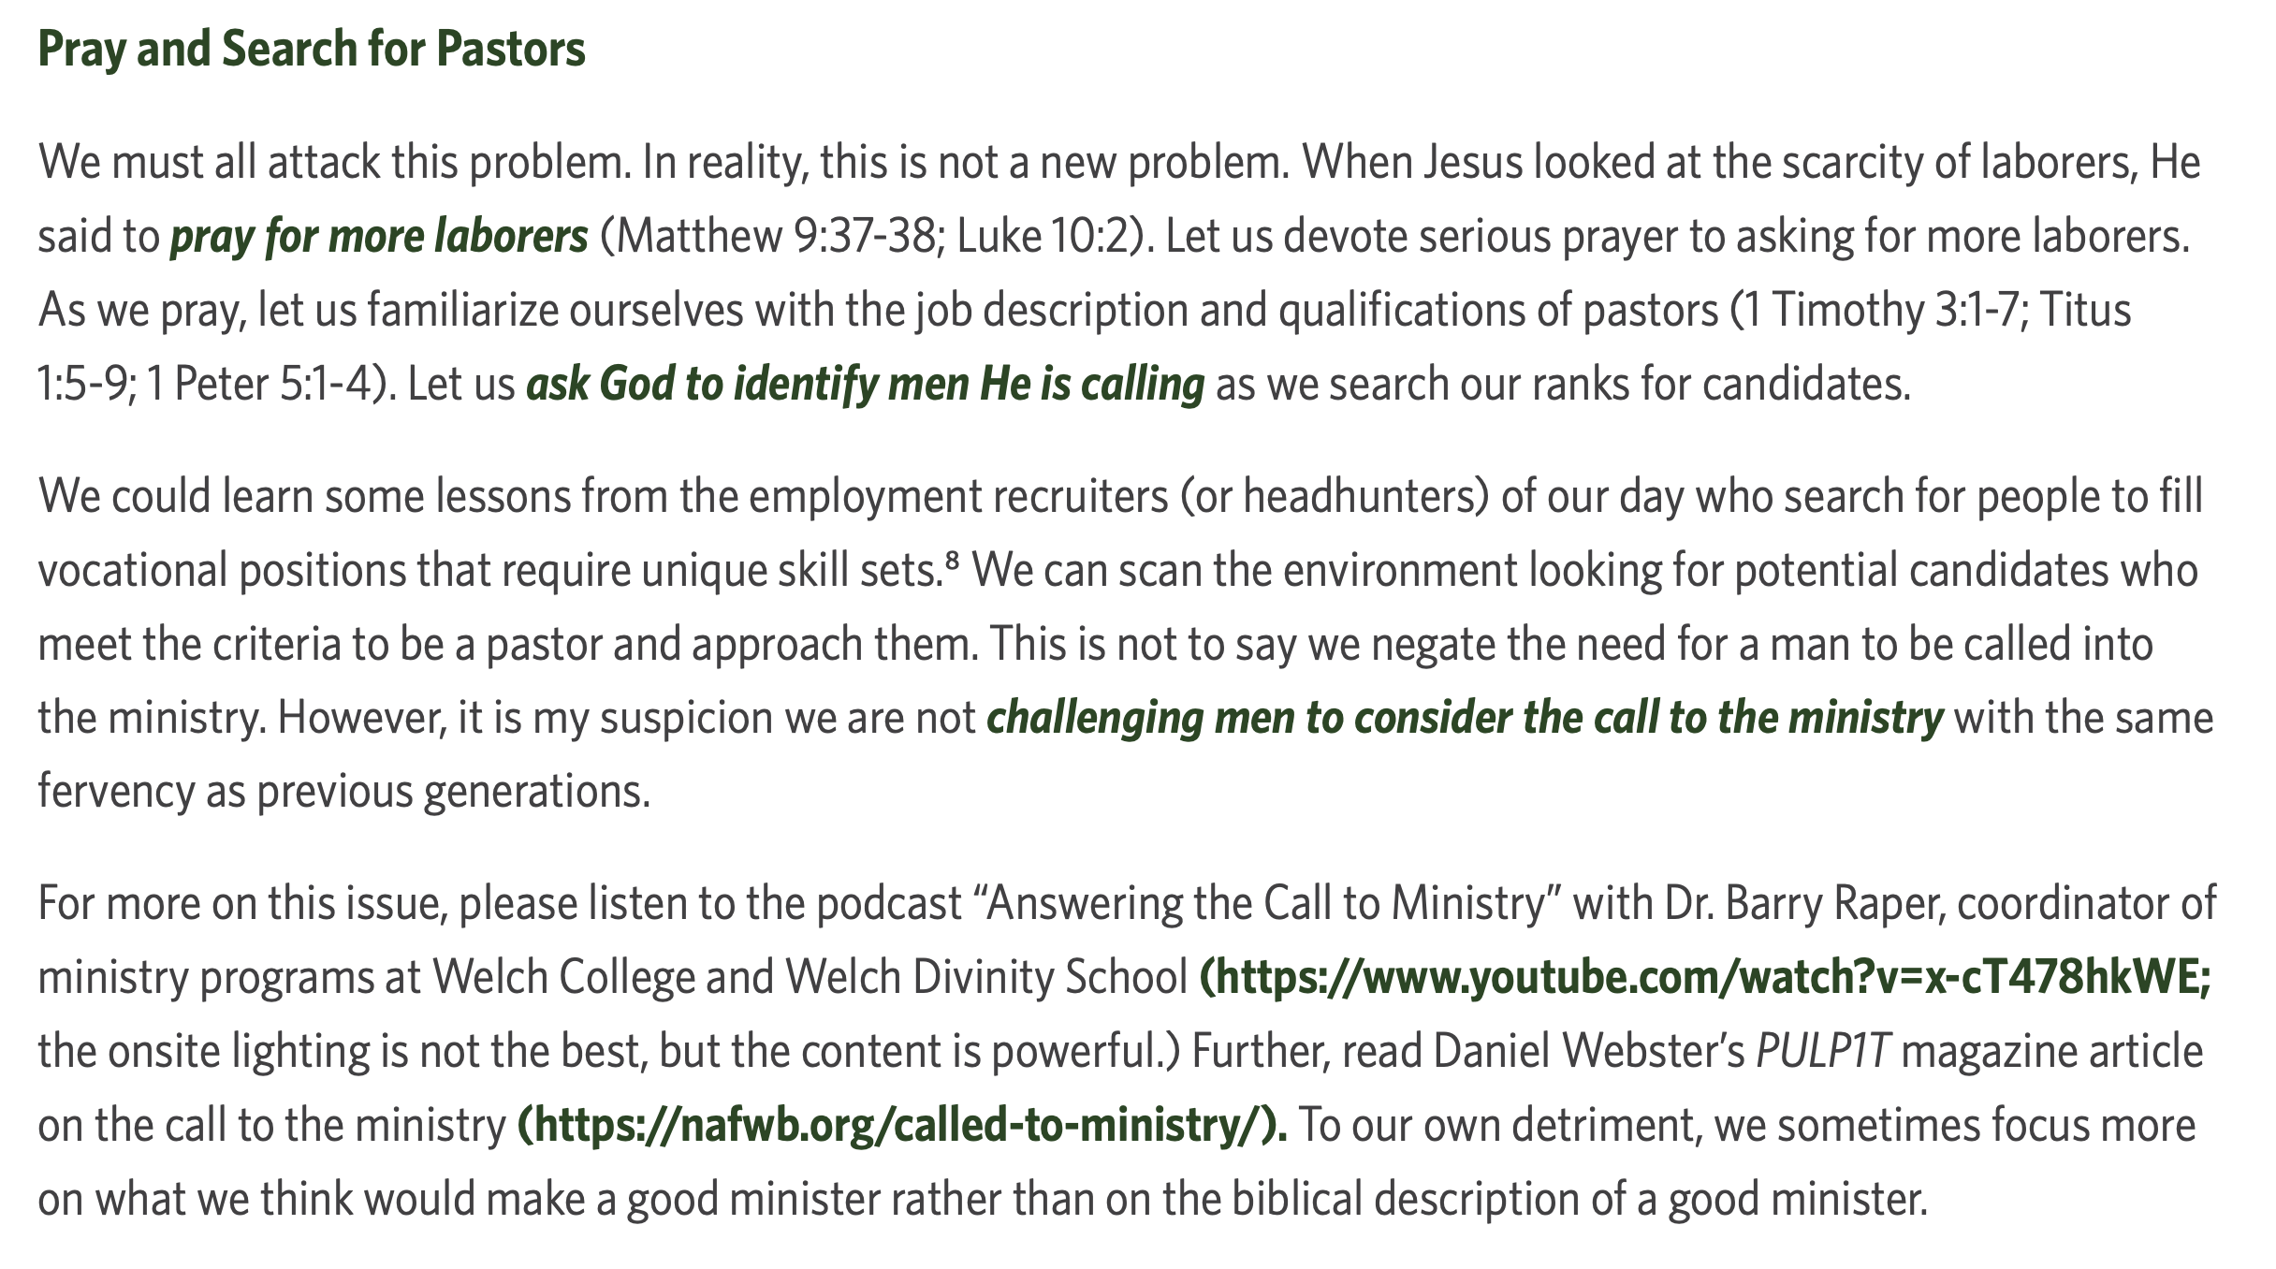
What can you do?
Pray for more pastors.

Slide 7
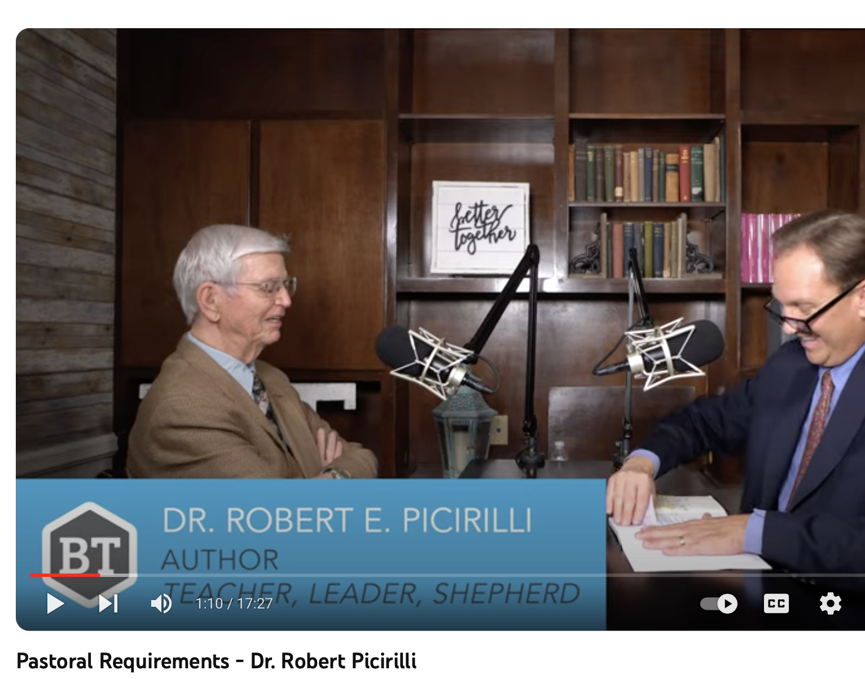
What can you do?
Pray for more pastors.
Search for more pastors.

Slide 8
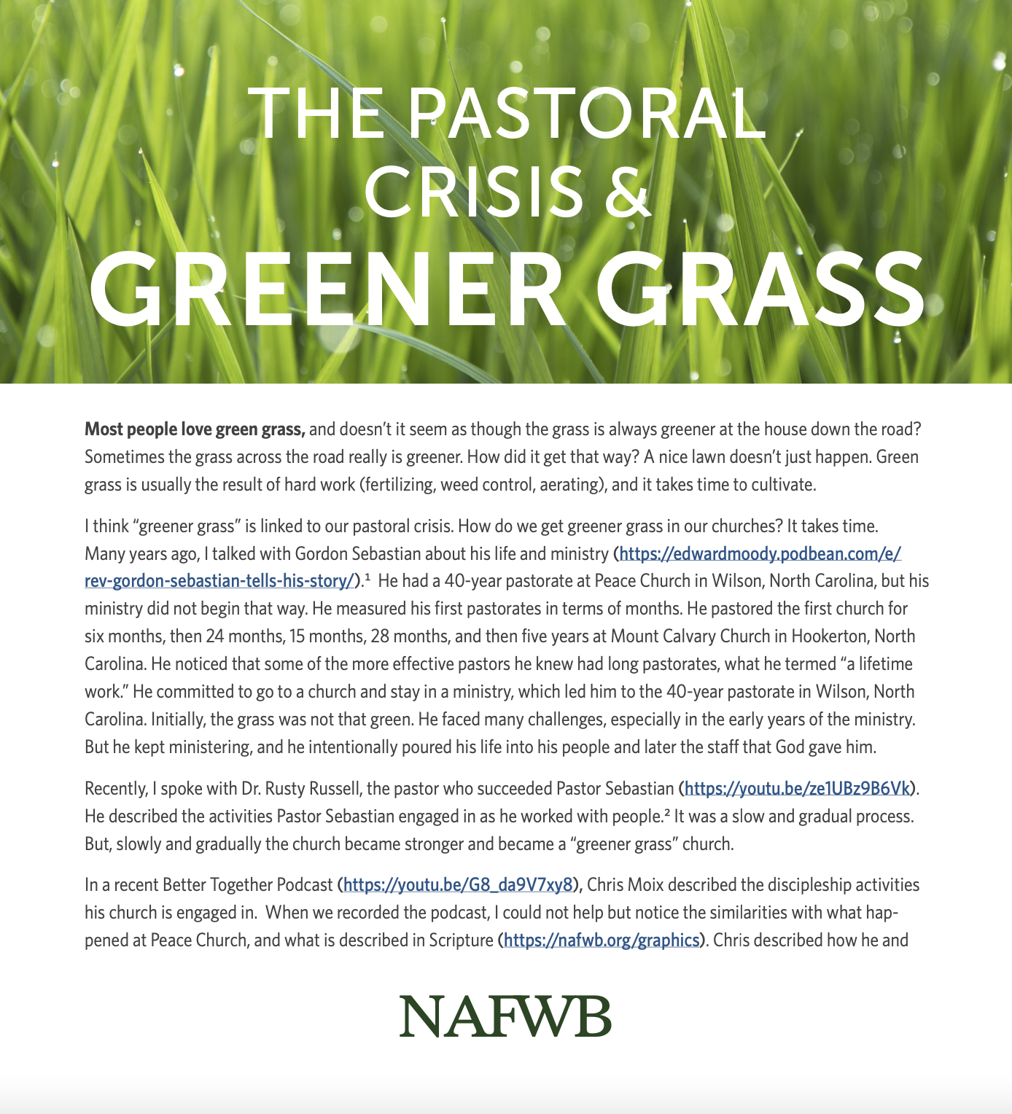
What can you do?
Pray for more leaders who will endure.
The most effective churches have pastors with tenures of 11.2 to 21.6 years

Slide 9
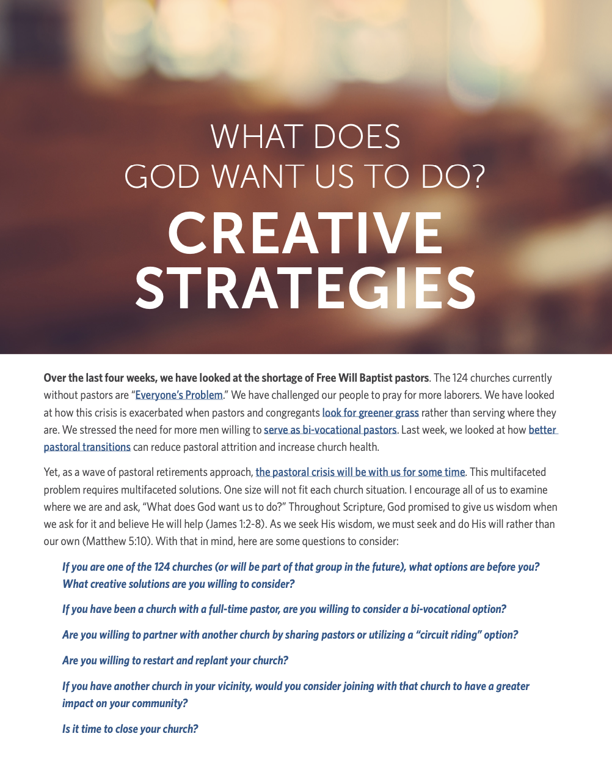
What can you do?
Pray for churches to be open to creative strategies
Sharing Pastors

Slide 10
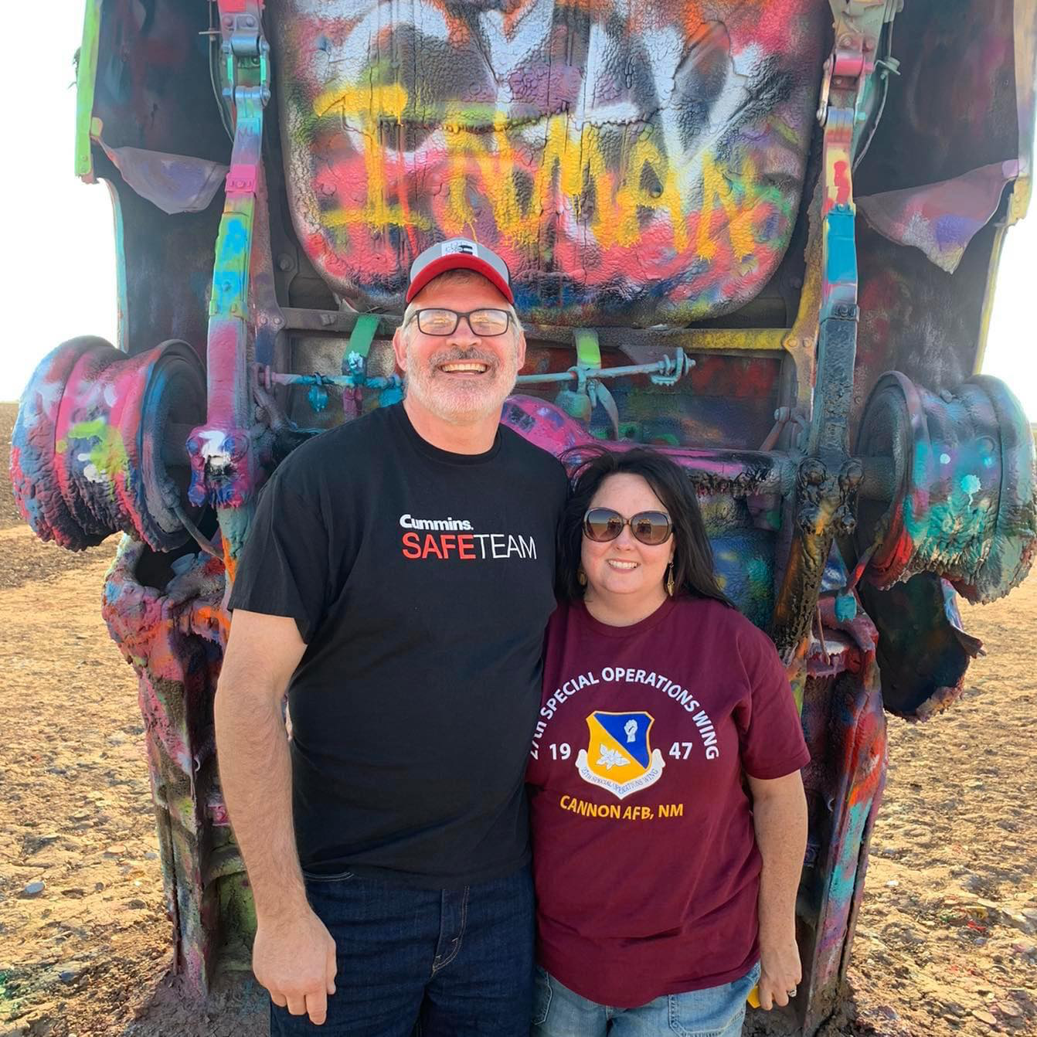
David and Tara Inman
2611 Fillmore Ln
Davenport IA 52804
Heritage FWB Church
1611 North Utah Avenue
Davenport IA 52804
Riverview FWB Church
820 18th St
Bettendorf IA 52722
Notes:
https://www.facebook.com/profile.php?id=100068580493787

Slide 11
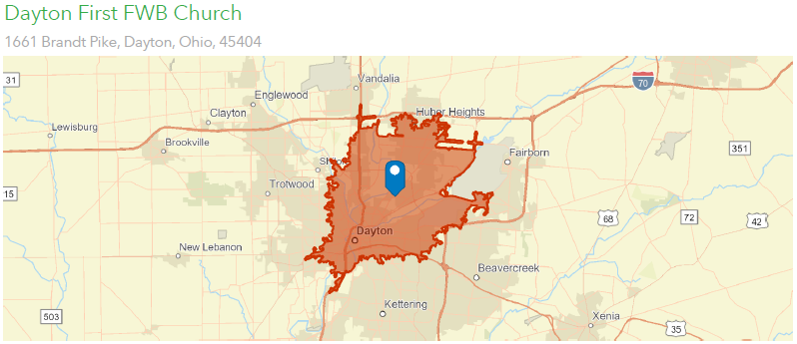
What can you do?
Pray for churches to be open to creative strategies.
Restart and replant
How many neighbors do you have within a 10-minute drive of your church? 129,824
Notes:
https://www.youtube.com/watch?v=RV0DjxygQkk&list=LL&index=2&t=96s

Slide 12
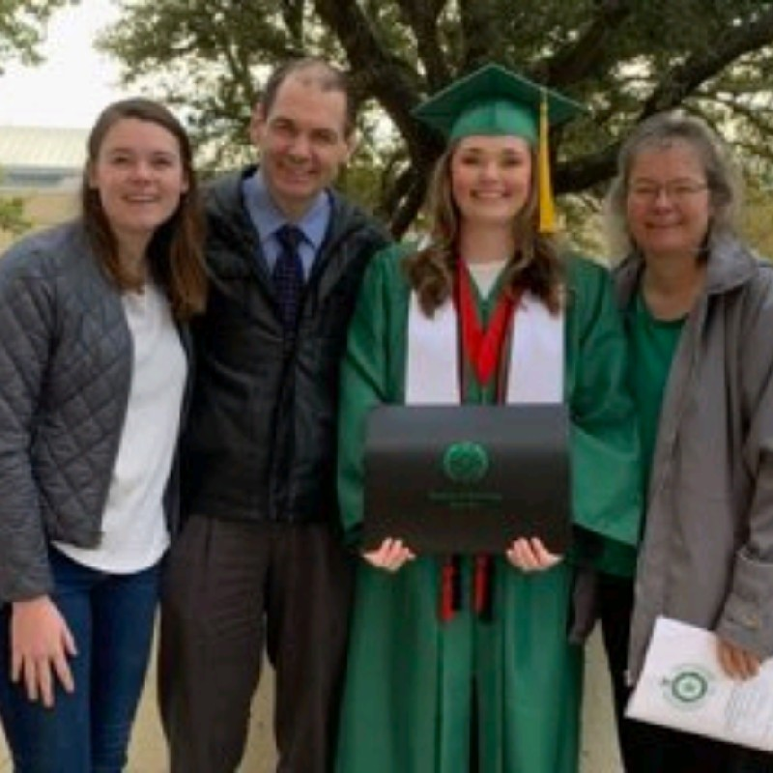
Dr. Gerald Pritchard 316 Warm Springs Drive Fairborn, OH 45324

Slide 13
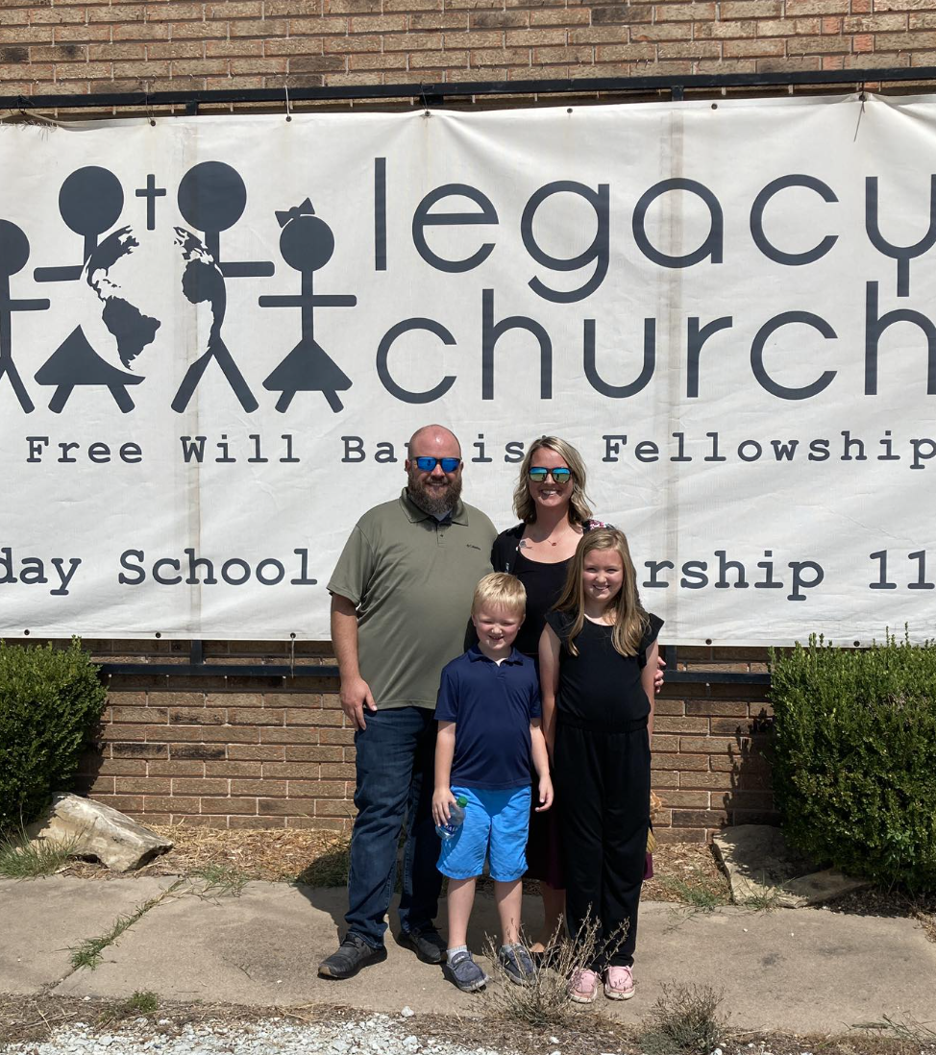
What can you do?
Pray for churches to be open to creative strategies.
More church mergers
Jarrod and Cali Presley
1625 US Hwy 377
Ada OK 74840

Slide 14
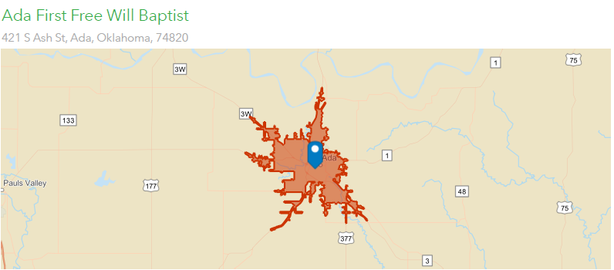
How many neighbors do you have within a 10-minute drive of your church? 18,893

Slide 15
What can you do?
Pray for churches to be open to creative strategies.
Churches merging

Slide 16
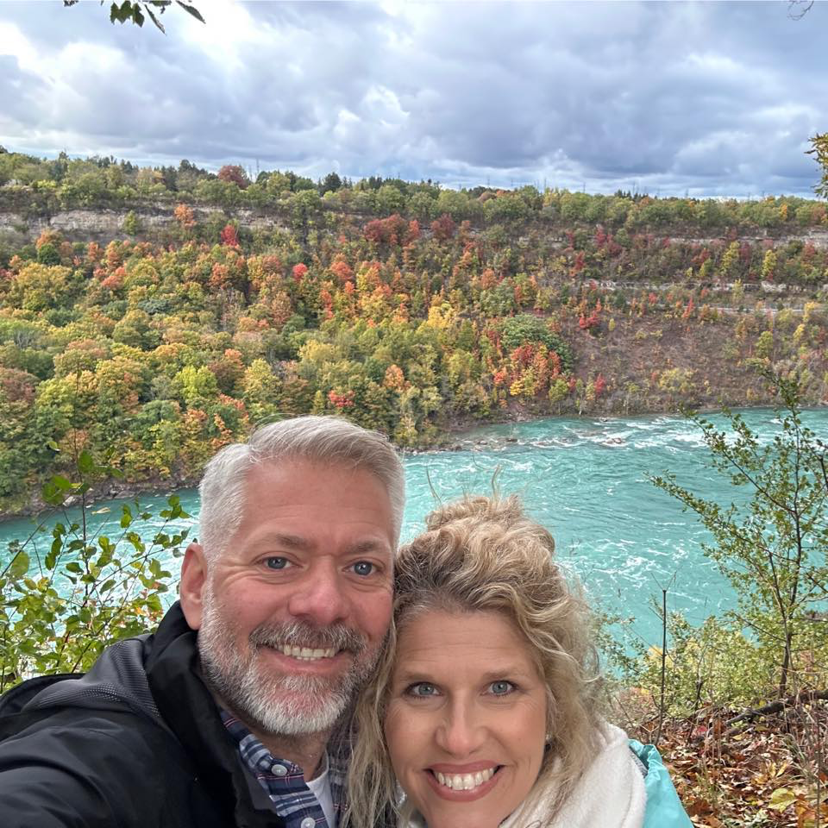
What can you do?
Pray for churches to be open to creative strategies
Bivocational Pastors
Michael and Lora McClintock
112 McClintock Ln
Alma, GA 31510

Slide 17
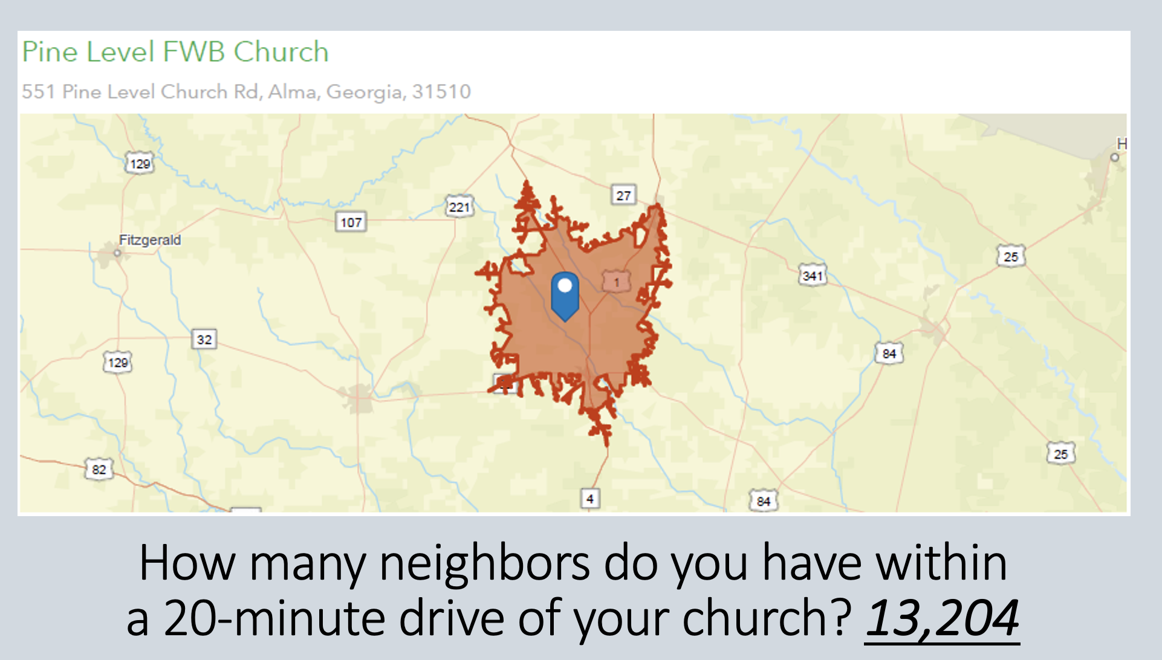

Slide 18
What can you do?
Pray for better pastoral transitions.

Slide 19
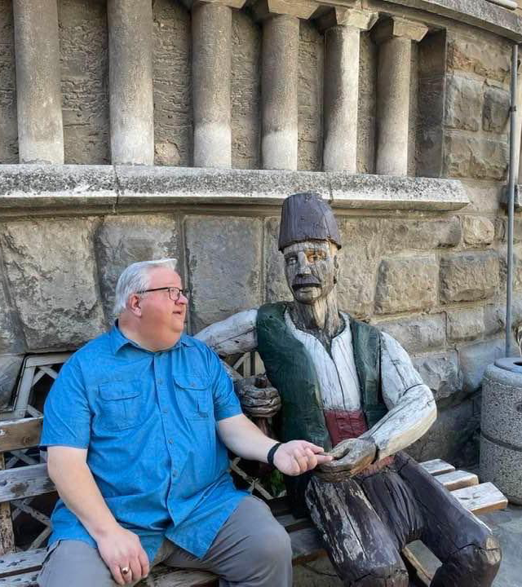
The Pastor Placement Program
Dr. Tim York
2015 Harbor Dr
Smyrna TN 37167

Slide 20
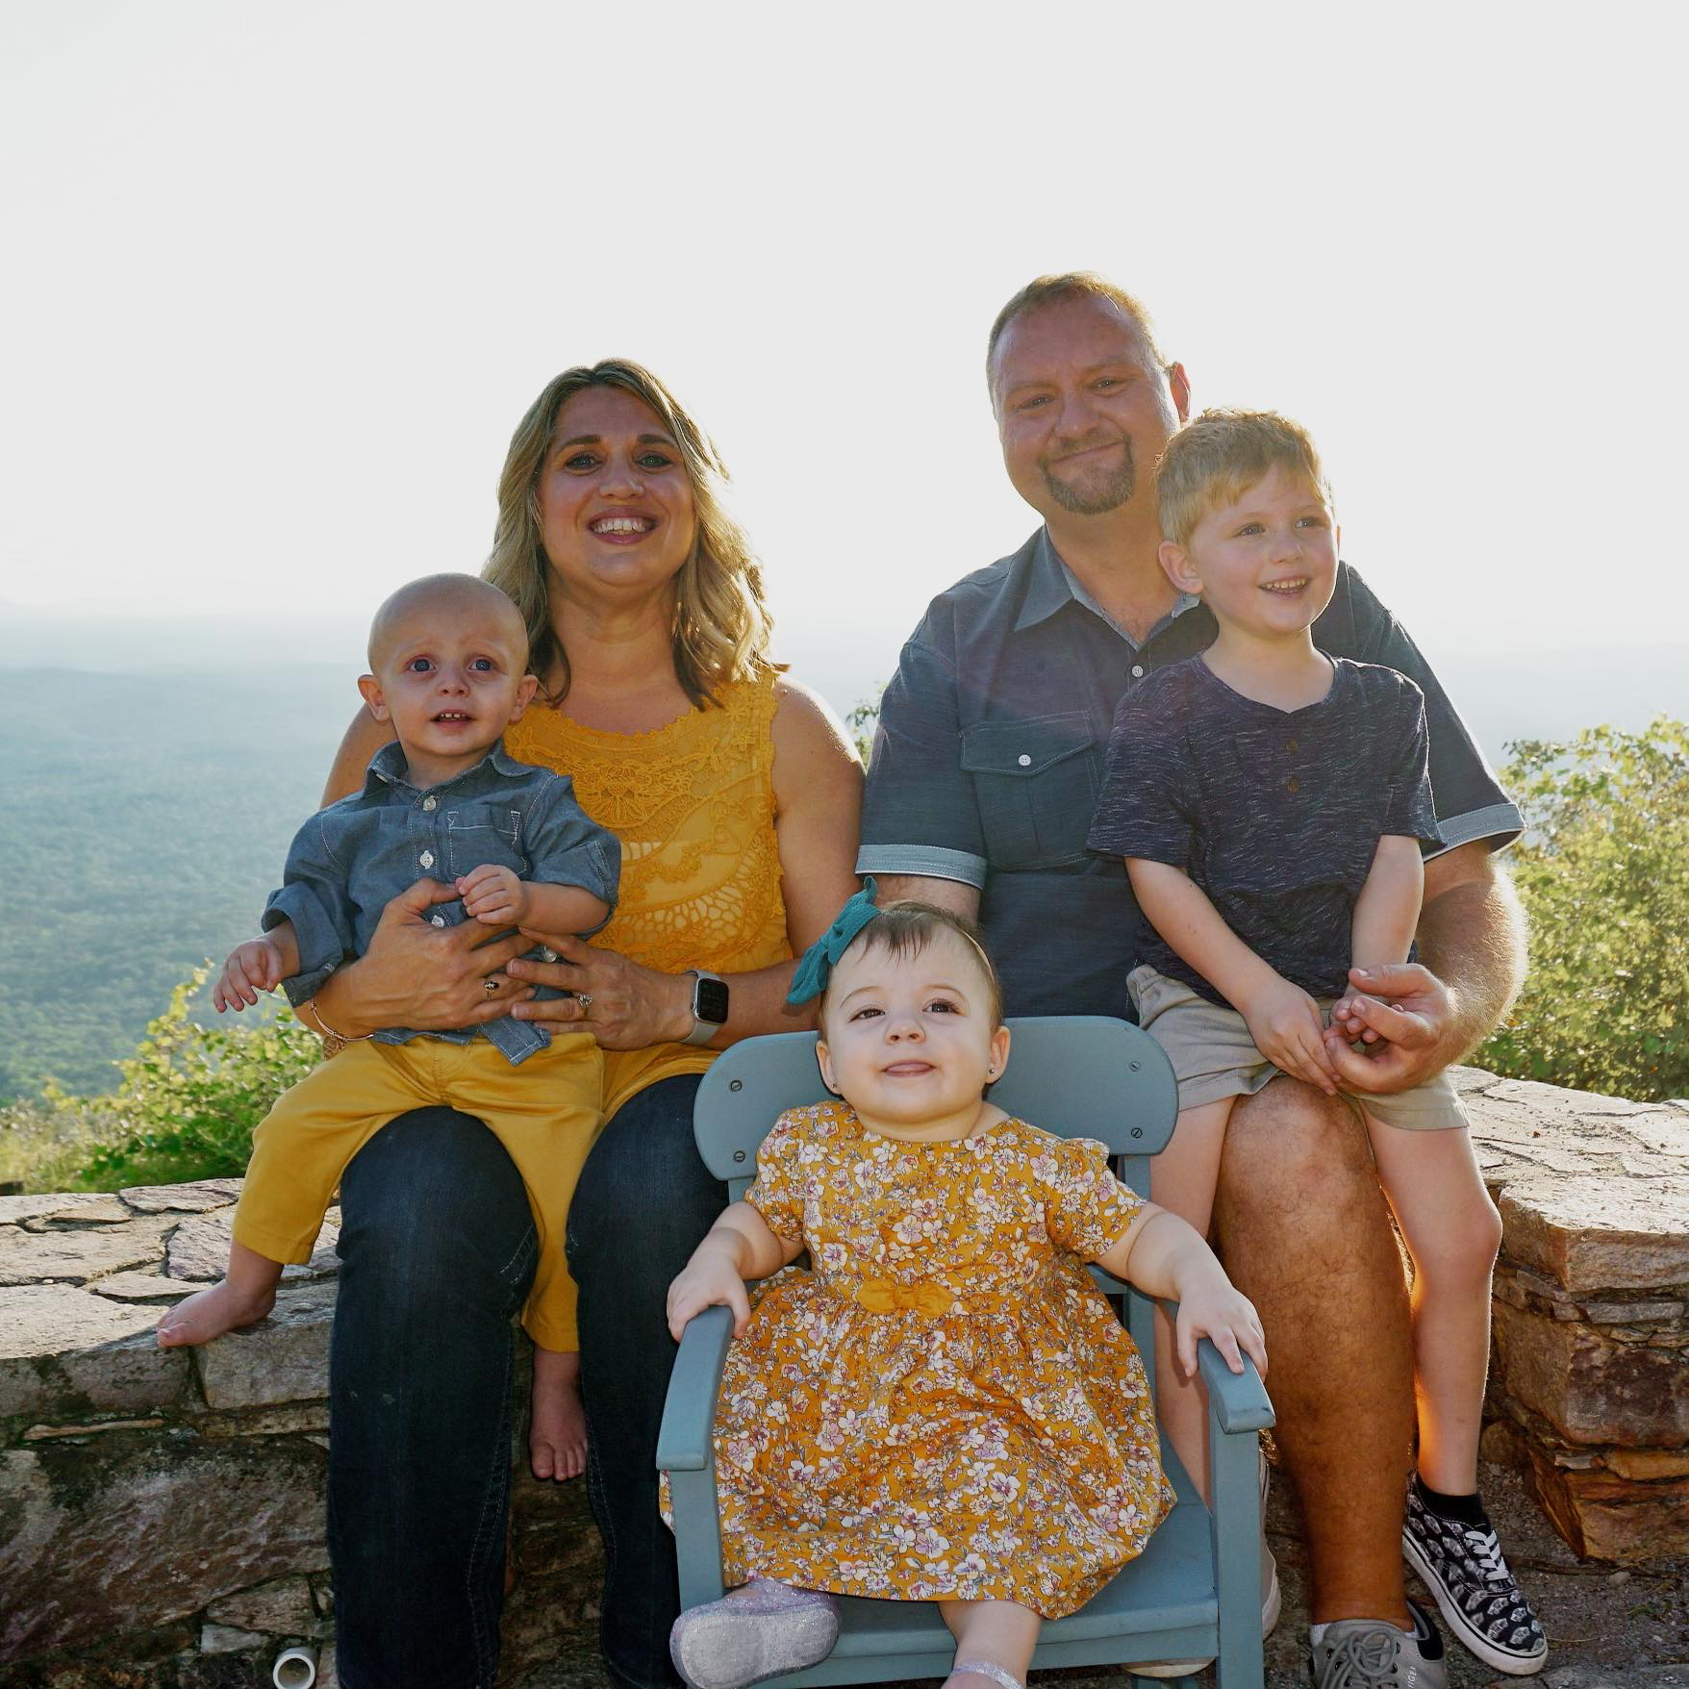
Barry and Jessica Long
PO Box 5060
Ashland KY 41105

Slide 21
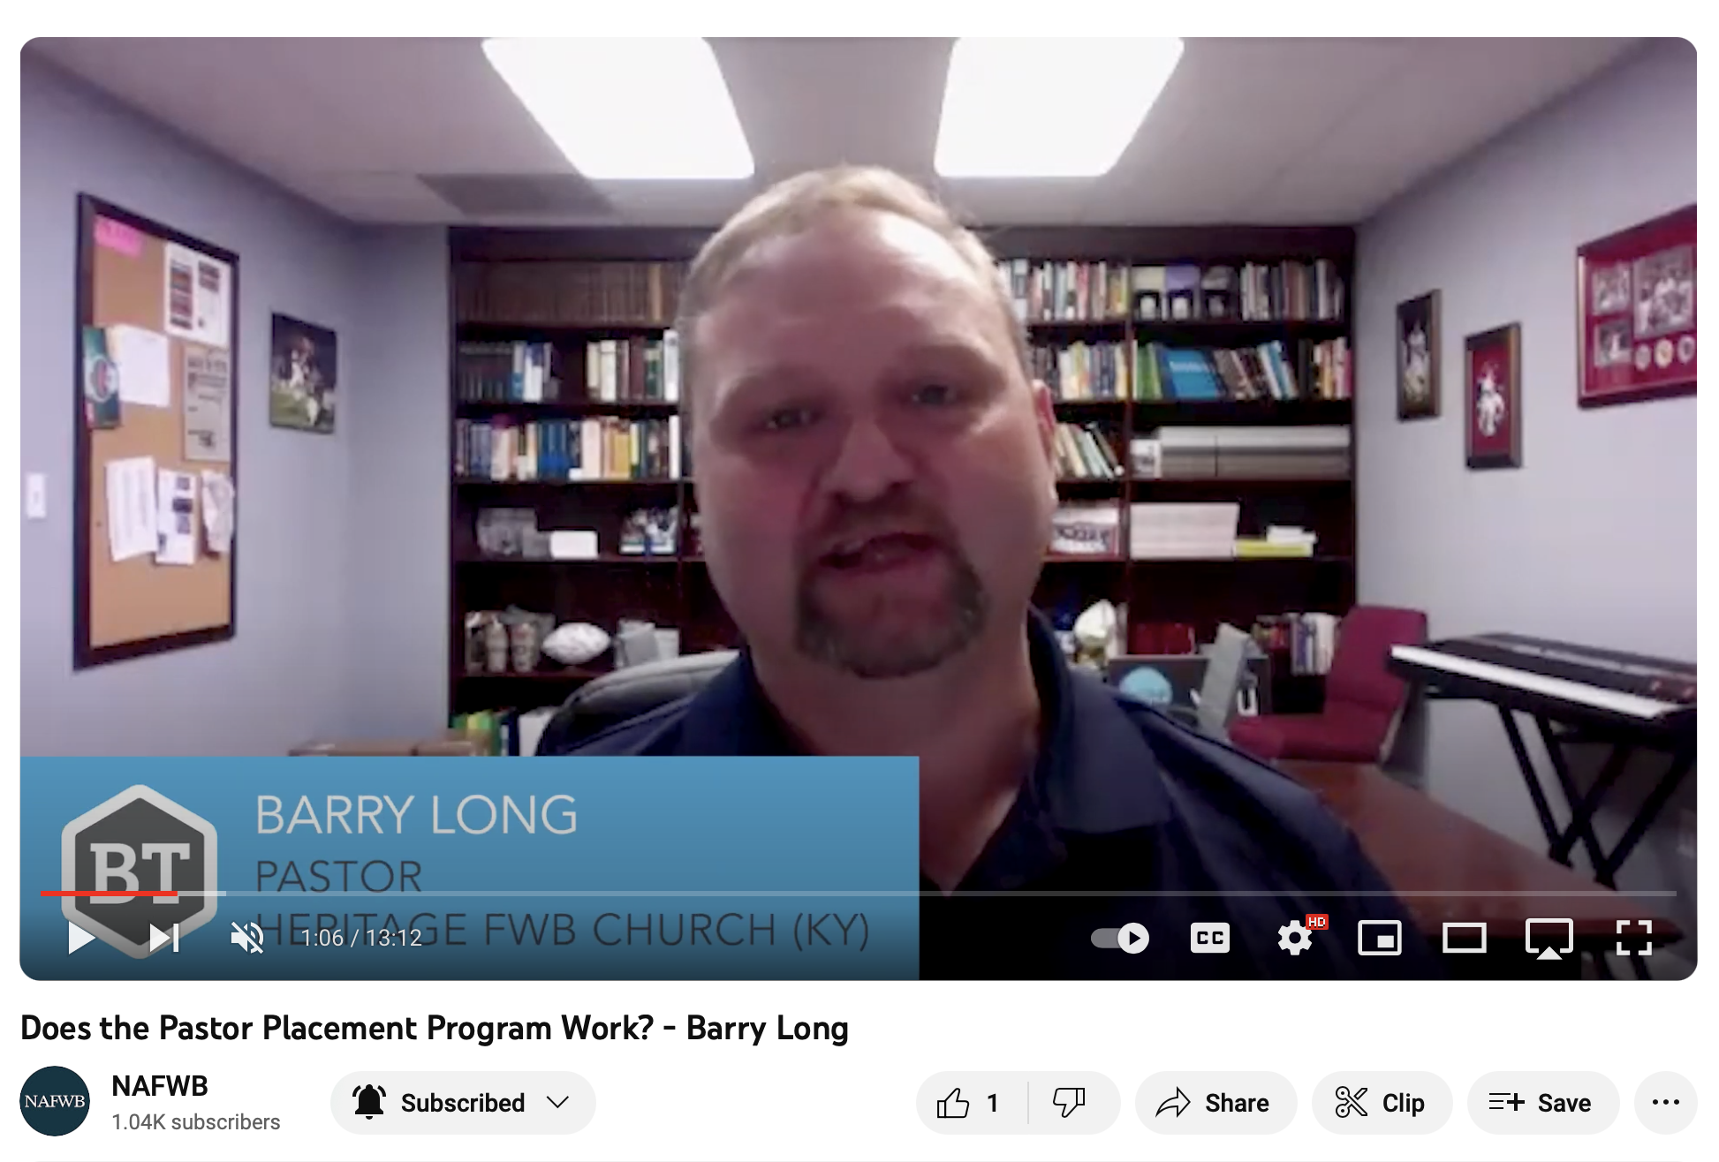

Slide 22
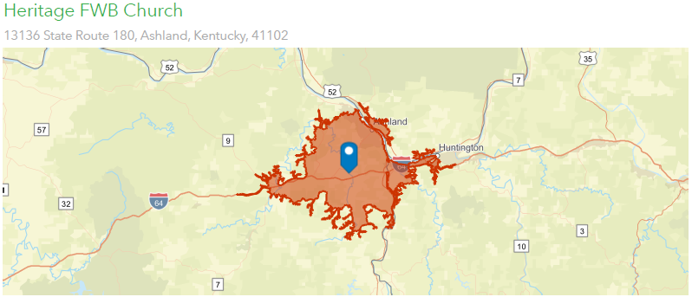
How many neighbors do you have within a 20-minute drive of your church? 86,568

Slide 23
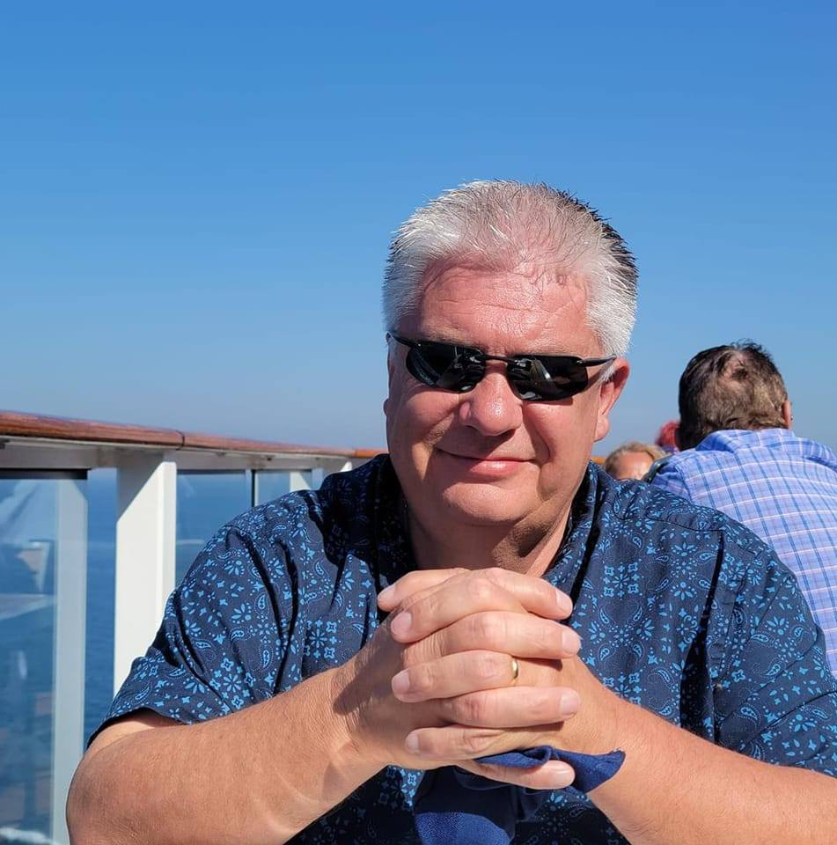
What can you do?
Pray that we can retain pastors
Tom Jones
101 Bovard Rd
Greensburg PA 15601

Slide 24
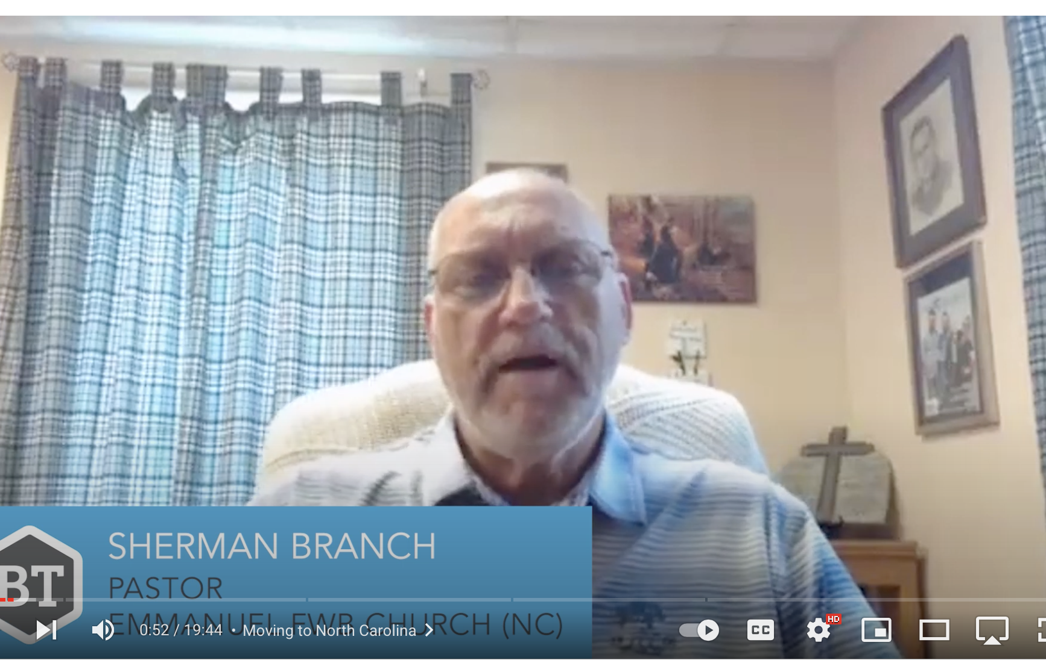
Sherman Branch
1214 Abernathy Dr
Stanley, NC 28164

Slide 26
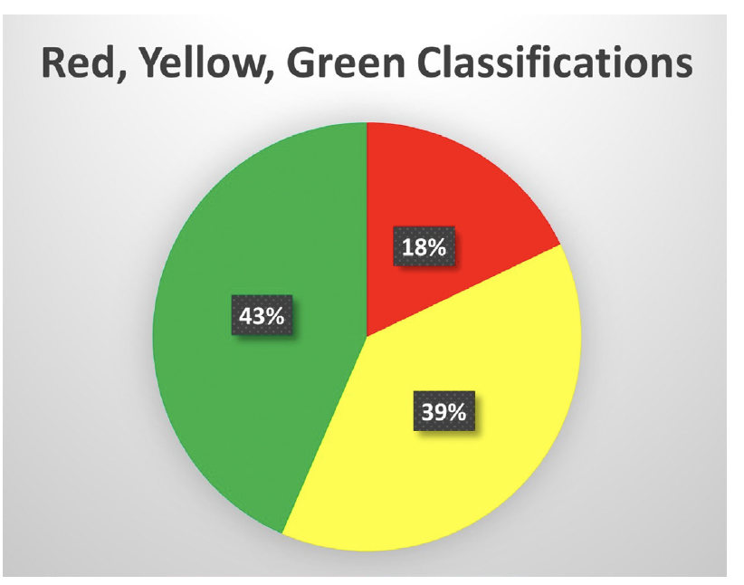
Pray for Struggling Churches
18% in danger
39% plateaued or at risk

Slide 28
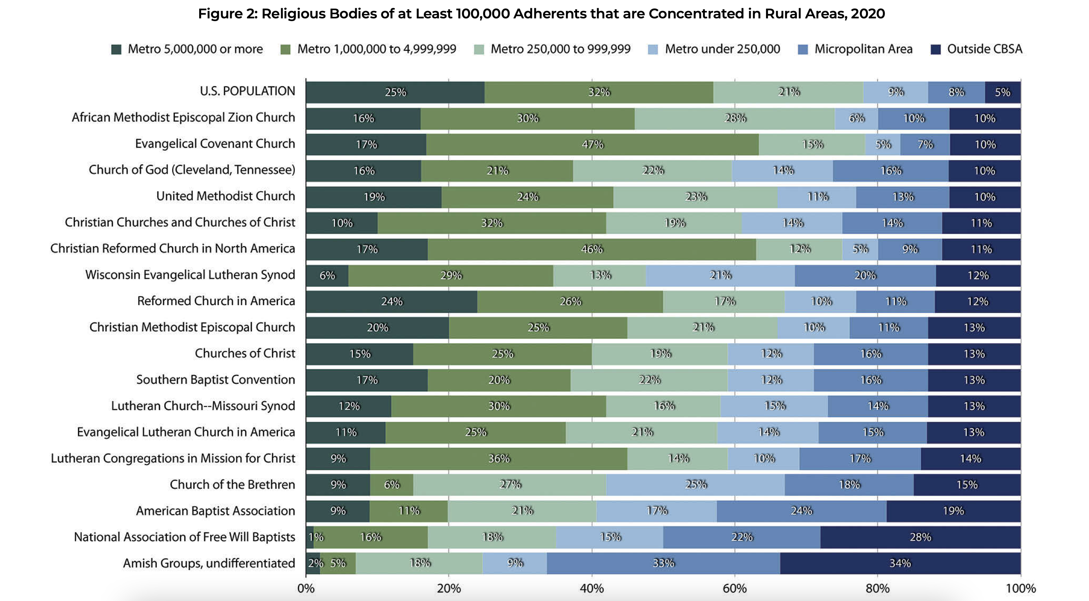

Slide 29
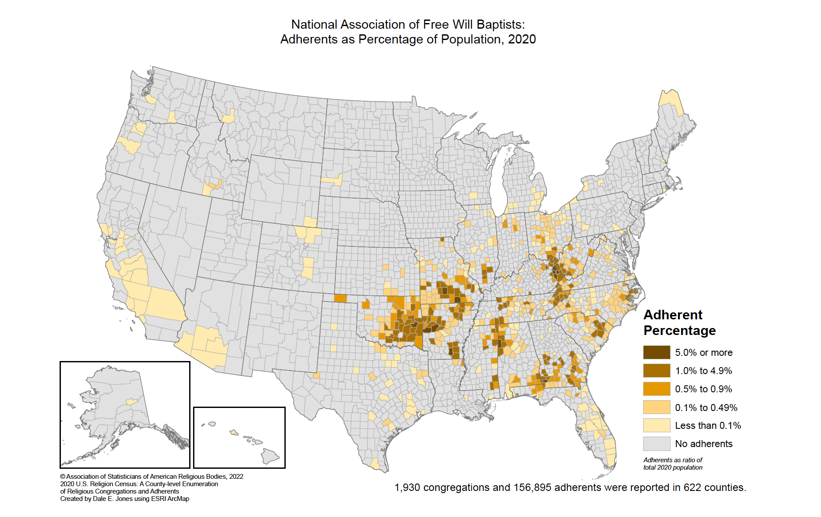

Slide 30
Know Your Community
The Hope Initiative
Rekindle

Slide 31
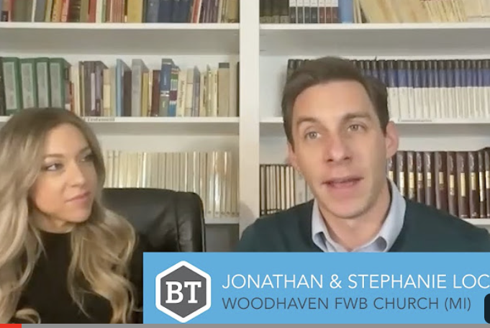
Pray for the Effectiveness of Our Interventions: Know Your Community

Slide 32
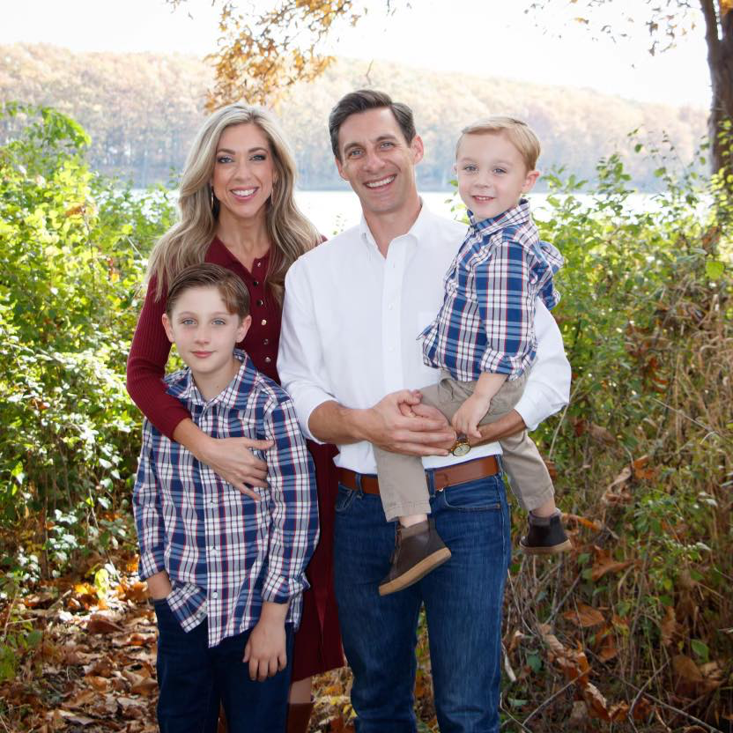
Jonathan and Stephanie Locklear 27684 Wyatt Ave Brownstown TWP MI 48183

Slide 33
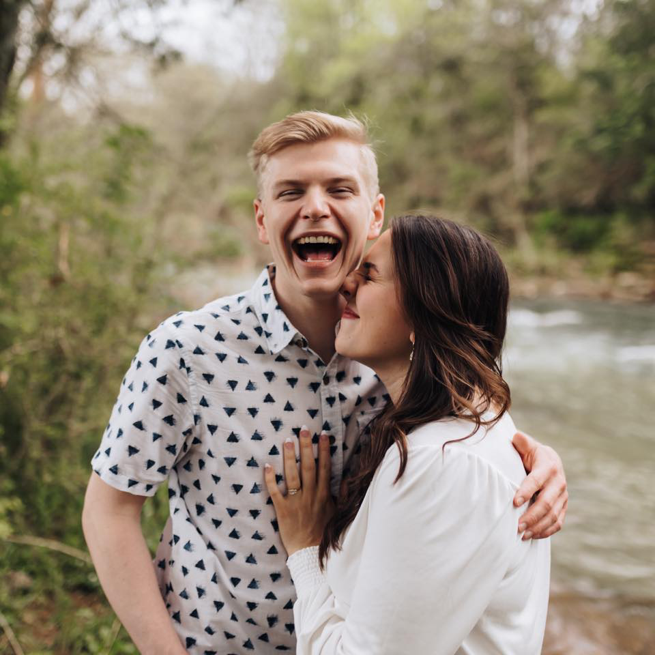
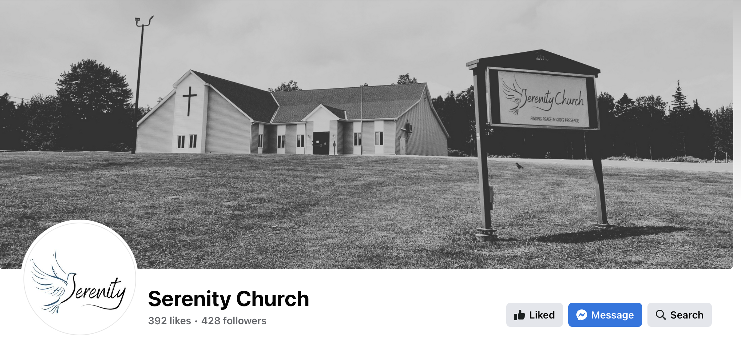
Ben and Tori Barcroft 1238 Lincoln Rd Fredericton NB E3B 7E2 CANADA

Slide 34
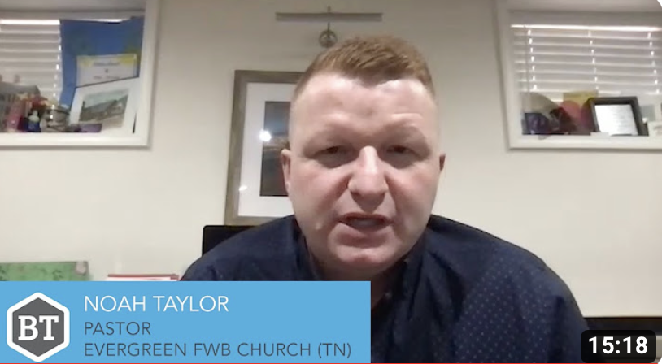
Pray for the Effectiveness of Our Interventions: The Hope Initiative

Slide 35
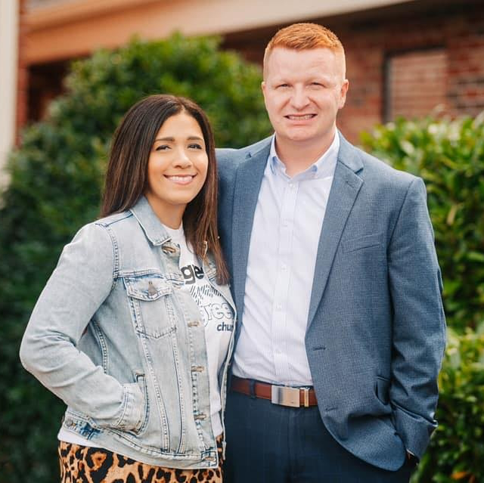
Noah and Alexis Taylor 213 Williams St Erwin TN 37650

Slide 36
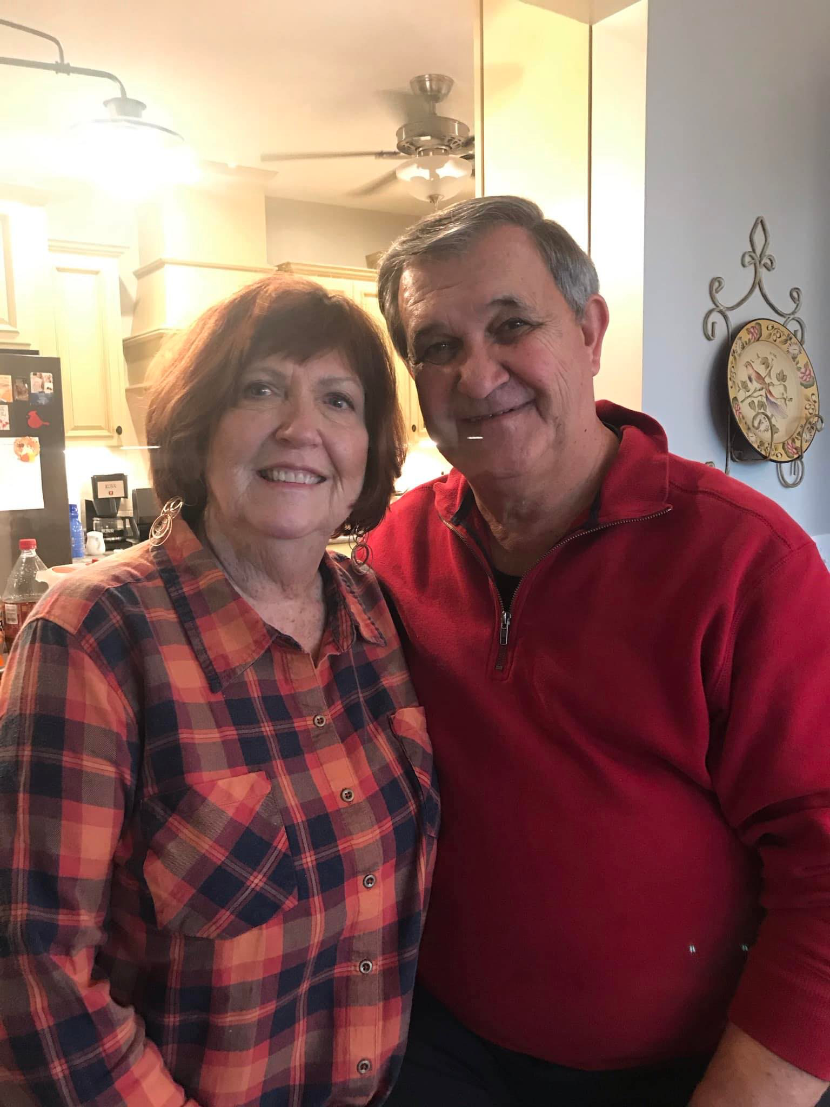
Pray for the Effectiveness of Our Interventions: Rekindle
Dr. Danny and Mrs. Carolyn Dwyer
1037 Dwyer Rd
Ashland City TN 37015

Slide 37
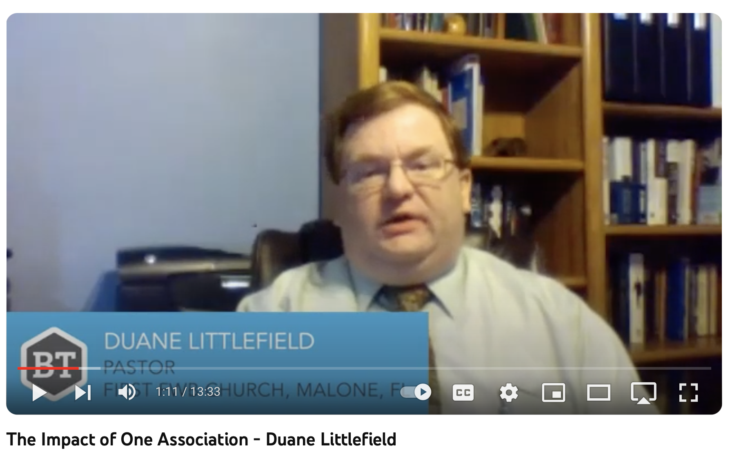
Pray for the Effectiveness of Our Interventions: Operation Restoration
Duane Littlefield 5453 9th St Malone FL 32445

Slide 38
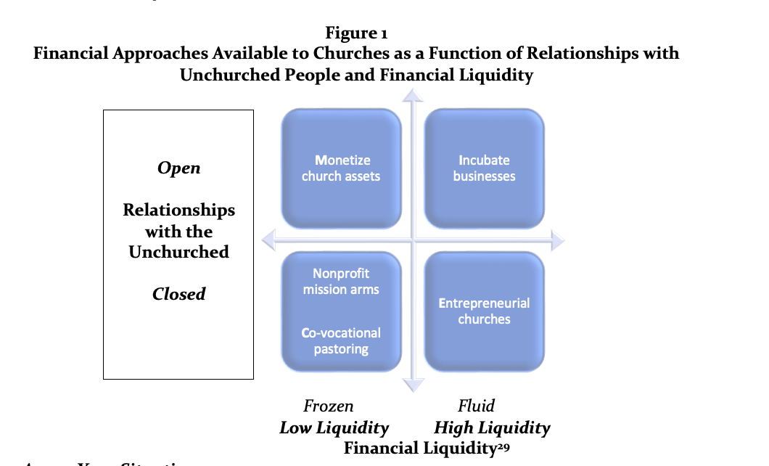
Pray for the Effectiveness of Our Interventions: MINCE
James and Leah Taylor
Church Applied
15226 Boca Chica Dr
La Mirada CA 90638

Slide 39
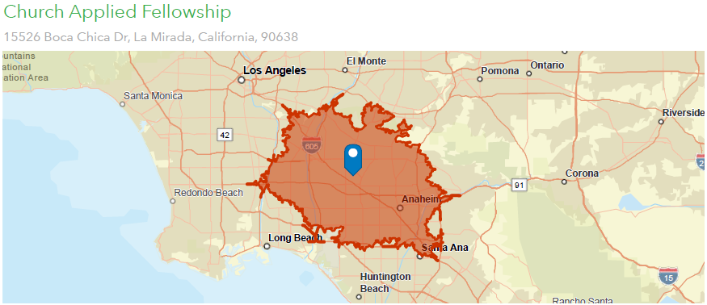
How many neighbors do you have within a 20-minute drive of your church? 1,929,561

Slide 40
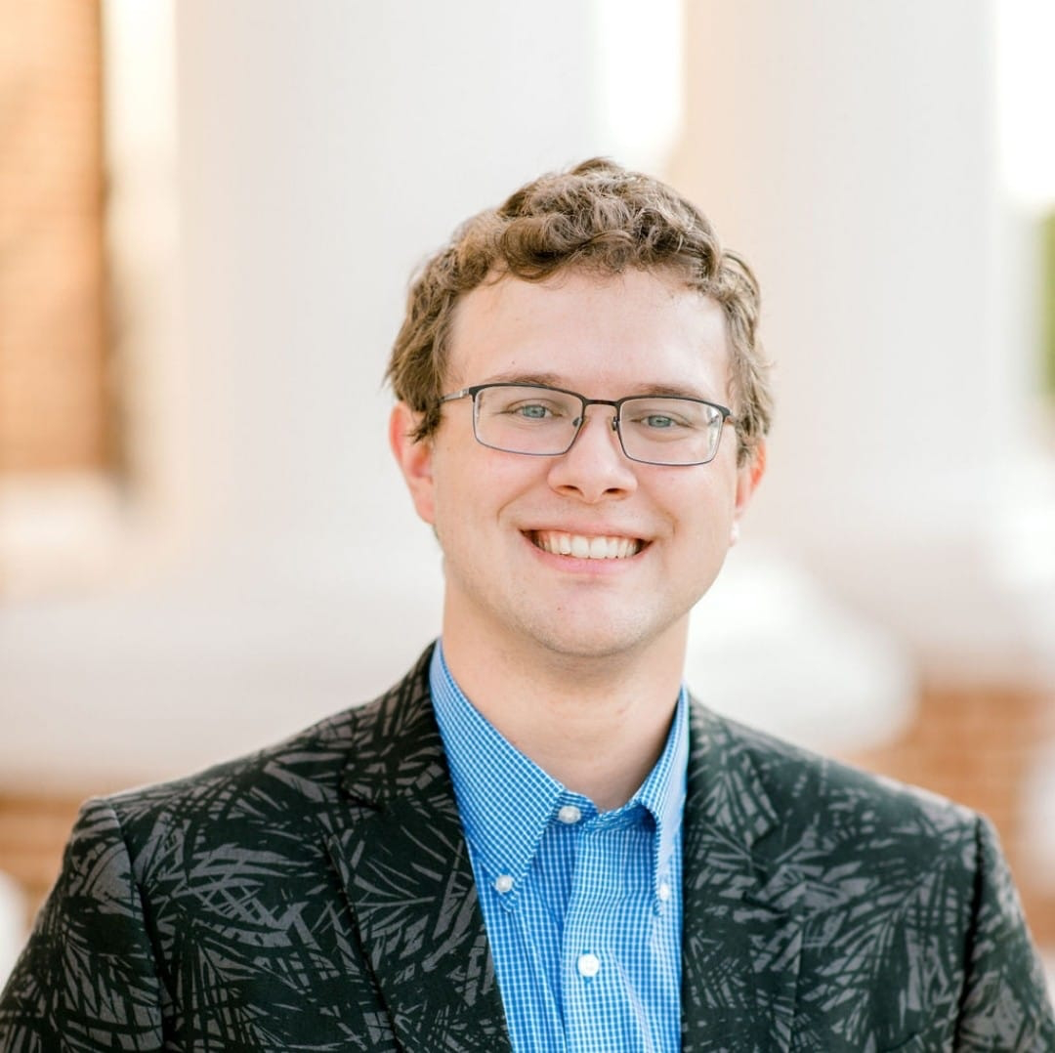
Pray for the Effectiveness of Our Interventions: First Aid Ready
Joshua Hunter First FWB Church of Waverly
PO Box 614
Waverly TN 37185

Slide 41
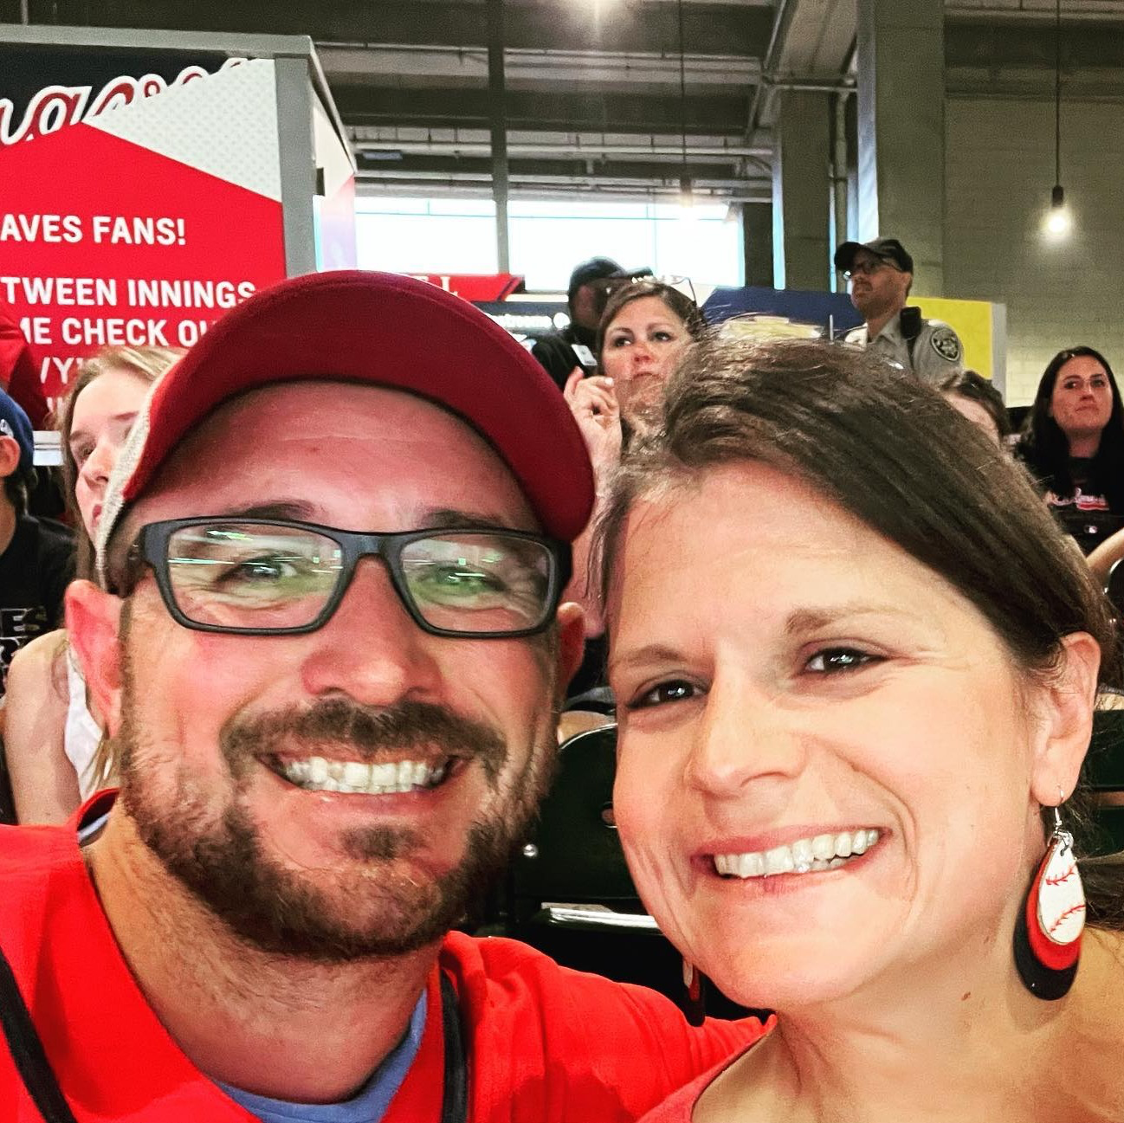
Awaken Church
Josh and Ashley Bennett Tifton, GA

