Slide 1
Surviving Culture Psalm 139
Eddie Moody
emoody@nafwb.org

Slide 2
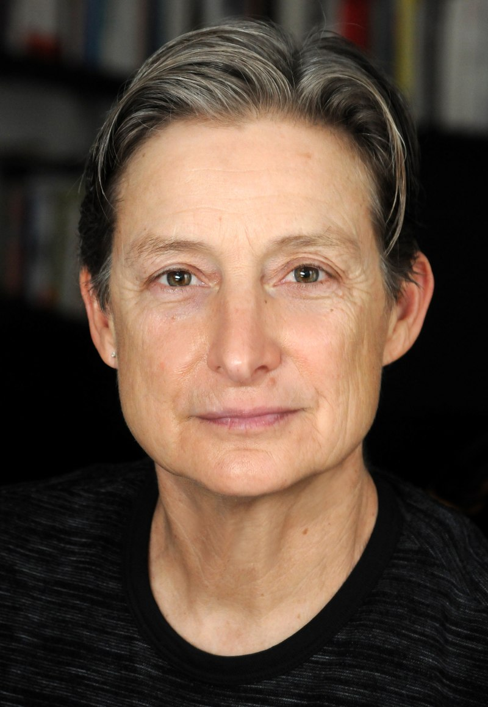
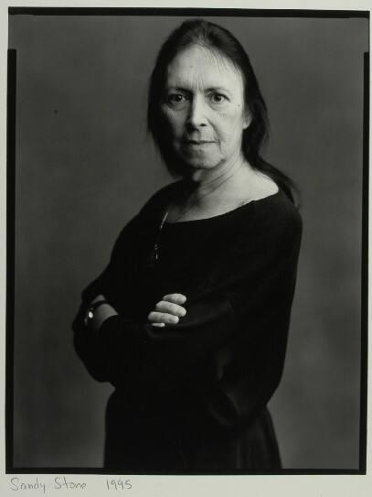
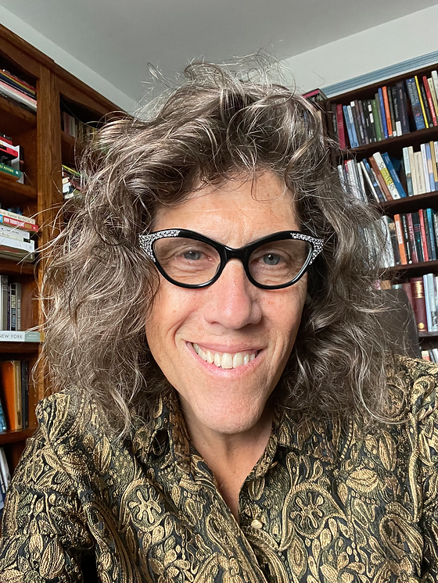
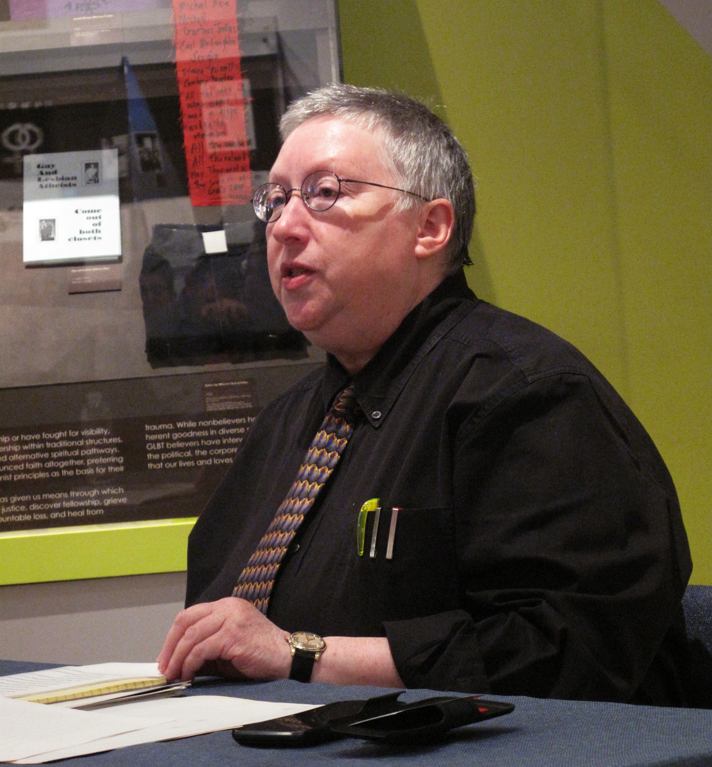
New Challengers
Judith Butler Sandy Stone Susan Stryker Gayle Rubin
Notes:
Judith Butler
Gayle Rubin
Sandy Stone
Susan Stryker

Slide 3
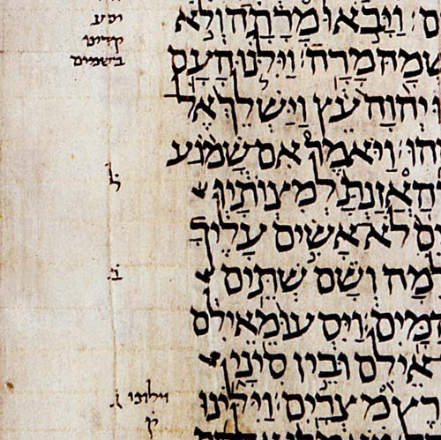
Answers in
Ancient Words
Leningrad Codex A.D. 1008

Slide 4
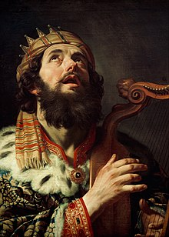
King David
Reigned from 1010-970 B.C.

Slide 5
Now from among those of the sons of Judah were Daniel, Hananiah, Mishael, and Azariah.
Daniel 1:6

Slide 6
Daniel = God is my judge
Judge me, O LORD; for I have walked in mine integrity: I have trusted also in the LORD; therefore I shall not slide.
Psalm 26:1
Notes:
Hananiah>

Slide 7
Hananiah= Yah has been gracious
The LORD is merciful and gracious, slow to anger and abounding in steadfast love.
Psalm 103:8
Notes:
Mishael>

Slide 8
Mishael = Who is what God is?
Who is like the LORD our God, who is seated on high,
Psalm 113:5
Notes:
Azariah>

Slide 9
Azariah =Yah is my help
Behold, God is my helper; the Lord is the upholder of my life.
Psalm 54:4
Notes:
Land of Shinar>

Slide 10
To them the chief of the eunuchs gave names: he gave Daniel the name Belteshazzar; to Hananiah, Shadrach; to Mishael, Meshach; and to Azariah, Abed-Nego.
Daniel 1:7

Slide 11
Get to know God, He knows you
¹ O Lord, You have searched me and known me. ² You know my sitting down and my rising up; You understand my thought afar off. ³ You comprehend my path and my lying down, And are acquainted with all my ways. ⁴ For there is not a word on my tongue, But behold, O Lord, You know it altogether.
Psalm 139:1-4

Slide 12
¹ O Lord, You have searched me and known me. ² You know my sitting down and my rising up; You understand my thought afar off. ³ You comprehend my path and my lying down, And are acquainted with all my ways. ⁴ For there is not a word on my tongue, But behold, O Lord, You know it altogether.
Psalm 139:1-4

Slide 13
When you read the Bible, consider:
What did this passage mean to the original hearers?
What is the timeless principle?
What does it teach me about God?
Based on this passage, how can I apply it?
Notes:
Be solid, Certain in resolve>
When you read a portion of Scripture, consider these questions:
What did this passage mean to the original hearers?
What is the timeless principle?
What does it teach me about God?
Based on this passage, how can I apply it?
God will guide you through this world with His Word and help you stay pure. Say, what is the timeless principle of Daniel 1?
2 Timothy 2:21>

Slide 14
Mishael = Who is what God is?
Who is like the LORD our God, who is seated on high,
Psalm 113:5
Notes:
Azariah>

Slide 15
Let God help you
You have hedged me behind and before, And laid Your hand upon me.
Psalm 139:5

Slide 16
Azariah =Yah is my help
Behold, God is my helper; the Lord is the upholder of my life.
Psalm 54:4
Notes:
Land of Shinar>

Slide 17
Appreciate God
Such knowledge is too wonderful for me; It is high, I cannot attain it.
Psalm 139:6

Slide 18
Remember, God is everywhere
⁷ Where can I go from Your Spirit? Or where can I flee from Your presence? ⁸ If I ascend into heaven, You are there; If I make my bed in hell, behold, You are there. ⁹ If I take the wings of the morning, And dwell in the uttermost parts of the sea, Psalm 139:7-9

Slide 19
Daniel = God is my judge
Judge me, O LORD; for I have walked in mine integrity: I have trusted also in the LORD; therefore I shall not slide.
Psalm 26:1
Notes:
Hananiah>

Slide 20
Remember, God is everywhere, and He helps in all situations
¹⁰ Even there Your hand shall lead me, And Your right hand shall hold me. ¹¹ If I say, “Surely the darkness shall fall on me,” Even the night shall be light about me; ¹² Indeed, the darkness shall not hide from You, But the night shines as the day; The darkness and the light are both alike to You.
Psalm 139:10-12

Slide 21
Why does God know us so well?
¹³ For You formed my inward parts; You covered me in my mother’s womb. ¹⁴ I will praise You, for I am fearfully and wonderfully made; Marvelous are Your works, And that my soul knows very well. ¹⁵ My frame was not hidden from You, When I was made in secret, And skillfully wrought in the lowest parts of the earth.
Psalm 139:13-15

Slide 22
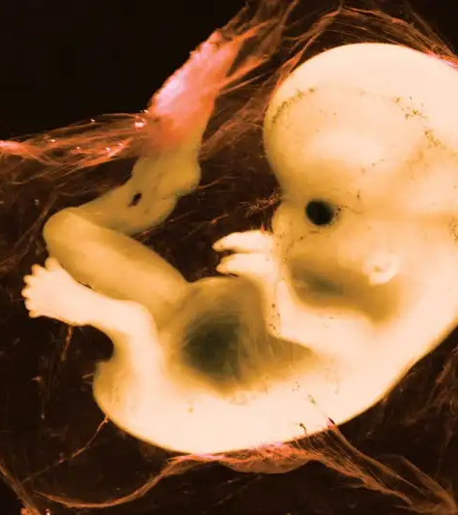
¹³ For You formed my inward parts; You covered me in my mother’s womb. ¹⁴ I will praise You, for I am fearfully and wonderfully made; Marvelous are Your works, And that my soul knows very well. ¹⁵ My frame was not hidden from You, When I was made in secret, And skillfully wrought in the lowest parts of the earth.
Psalm 139:13-15

Slide 23
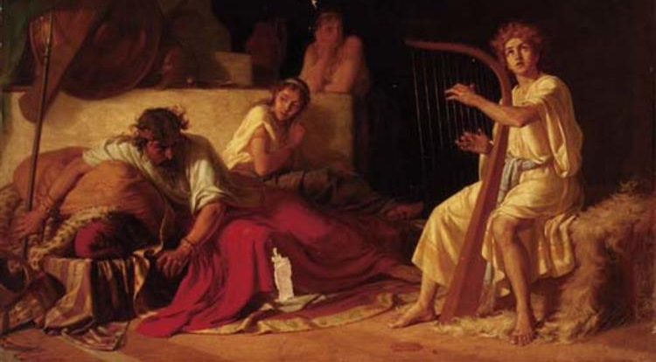
David Playing The Harp Before Saul - Ivan Tvorozhnikov
Notes:
Bernardo Cavallino - David harpspelend voor Saul - St 115 - Museum Boijmans Van Beuningen

Slide 24
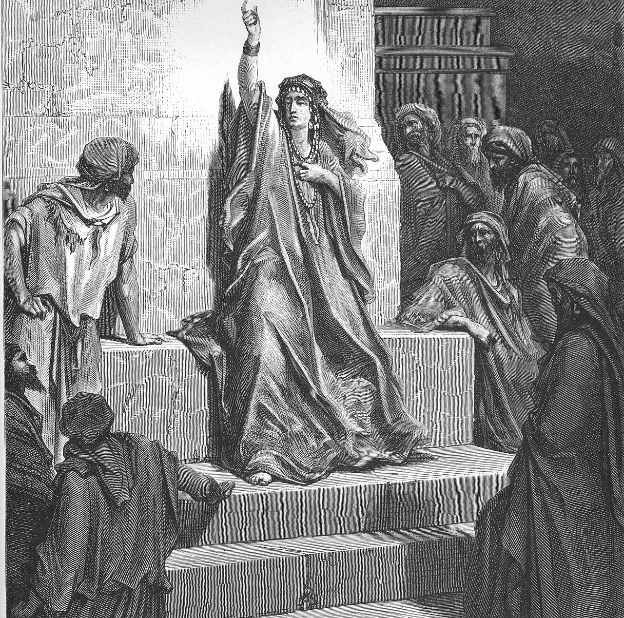
Deborah portrayed in Gustave Doré's illustrations for La Grande Bible de Tours (1865)

Slide 25
Embrace God’s design
¹⁶ Your eyes saw my substance, being yet unformed. And in Your book they all were written, The days fashioned for me, When as yet there were none of them.
Psalm 139:16

Slide 26
How has God designed us?
In His image
²⁶ Then God said, “Let Us make man in Our image, according to Our likeness; let them have dominion over the fish of the sea, over the birds of the air, and over the cattle, over all the earth and over every creeping thing that creeps on the earth.” ²⁷ So God created man in His own image; in the image of God He created him; male and female He created them. ²⁸ Then God blessed them, and God said to them, “Be fruitful and multiply; fill the earth and subdue it; have dominion over the fish of the sea, over the birds of the air, and over every living thing that moves on the earth.”
Genesis 1:26-28

Slide 27
How has God designed us?
In His image
Gender
²⁶ Then God said, “Let Us make man in Our image, according to Our likeness; let them have dominion over the fish of the sea, over the birds of the air, and over the cattle, over all the earth and over every creeping thing that creeps on the earth.” ²⁷ So God created man in His own image; in the image of God He created him; male and female He created them. ²⁸ Then God blessed them, and God said to them, “Be fruitful and multiply; fill the earth and subdue it; have dominion over the fish of the sea, over the birds of the air, and over every living thing that moves on the earth.”
Genesis 1:26-28

Slide 28
How has God designed us?
Gender roles
Marriage
²¹ And the Lord God caused a deep sleep to fall on Adam, and he slept; and He took one of his ribs, and closed up the flesh in its place. ²² Then the rib which the Lord God had taken from man He made into a woman, and He brought her to the man. ²³ And Adam said: “This is now bone of my bones And flesh of my flesh; She shall be called Woman, Because she was taken out of Man.” ²⁴ Therefore a man shall leave his father and mother and be joined to his wife, and they shall become one flesh. ²⁵ And they were both naked, the man and his wife, and were not ashamed.
Genesis 2:21-25

Slide 29
How has God designed us?
Parenthood
²⁶ Then God said, “Let Us make man in Our image, according to Our likeness; let them have dominion over the fish of the sea, over the birds of the air, and over the cattle, over all the earth and over every creeping thing that creeps on the earth.” ²⁷ So God created man in His own image; in the image of God He created him; male and female He created them. ²⁸ Then God blessed them, and God said to them, “Be fruitful and multiply; fill the earth and subdue it; have dominion over the fish of the sea, over the birds of the air, and over every living thing that moves on the earth.”
Genesis 1:26-28

Slide 30
¹⁷ How precious also are Your thoughts to me, O God! How great is the sum of them! ¹⁸ If I should count them, they would be more in number than the sand; When I awake, I am still with You.
Psalm 139:17-18

Slide 31
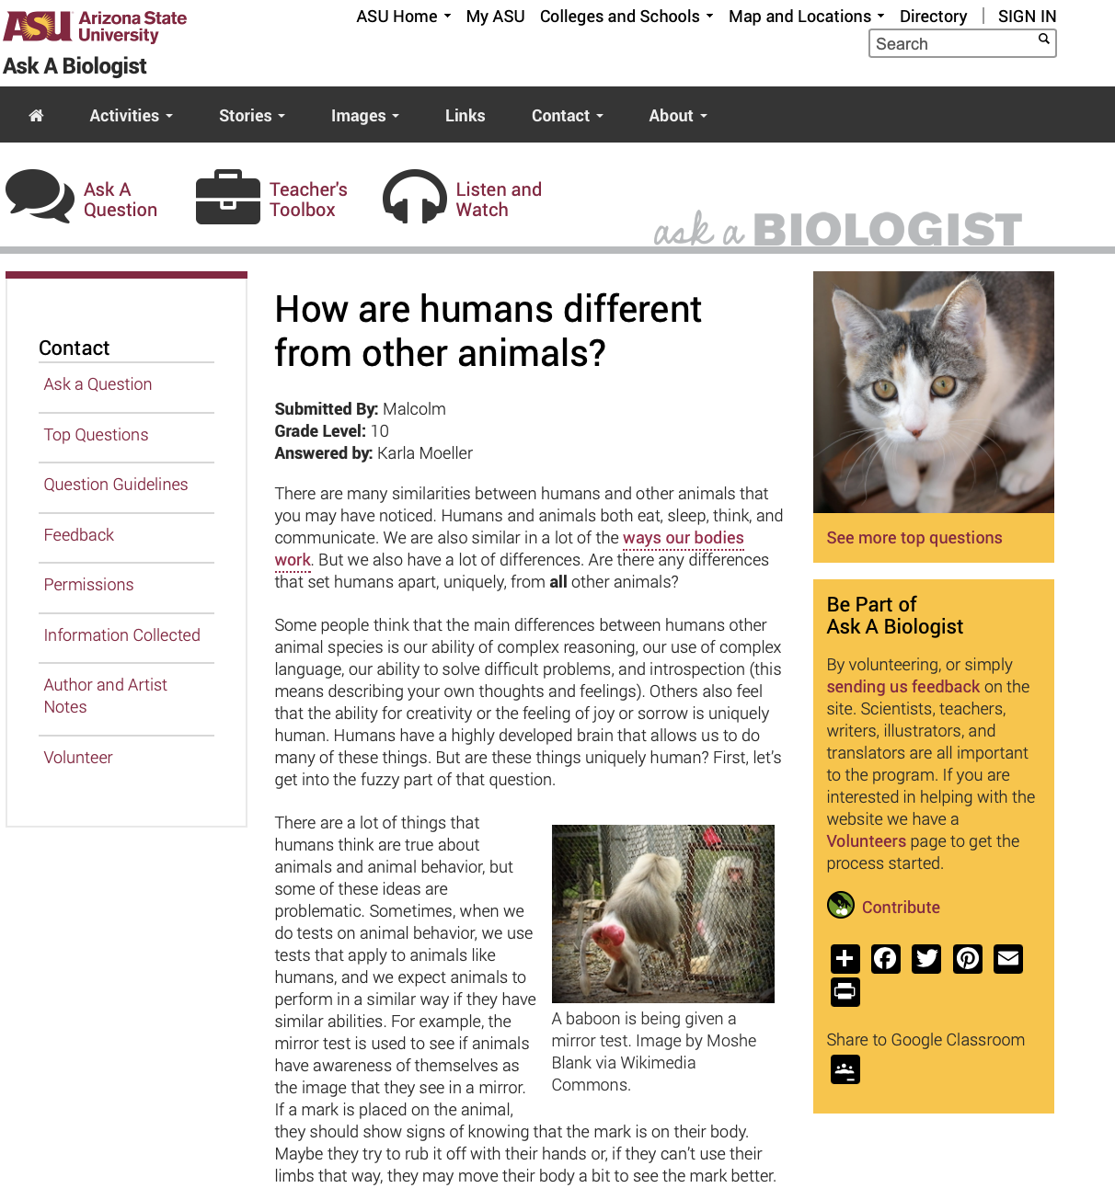
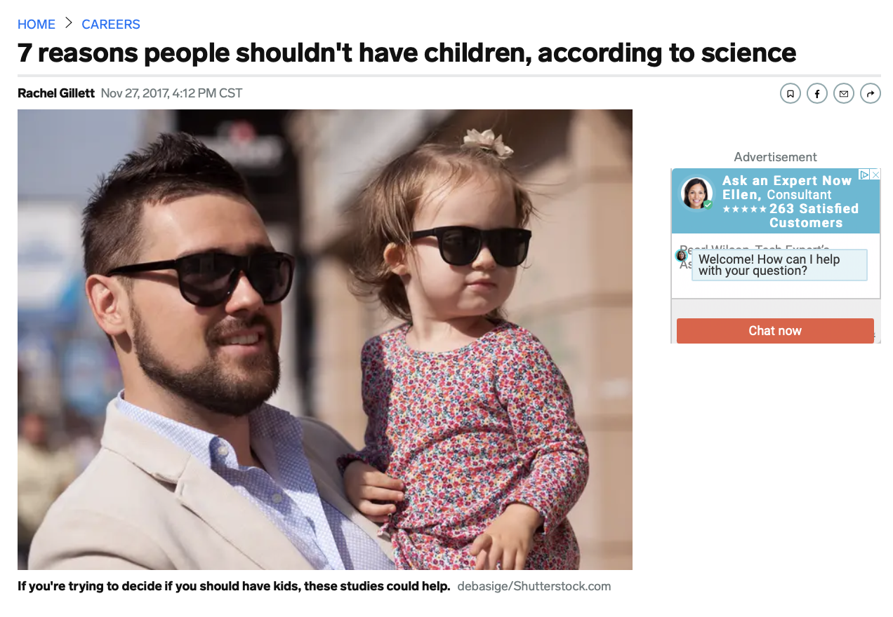
What are the messages of the enemies of God?

Slide 32
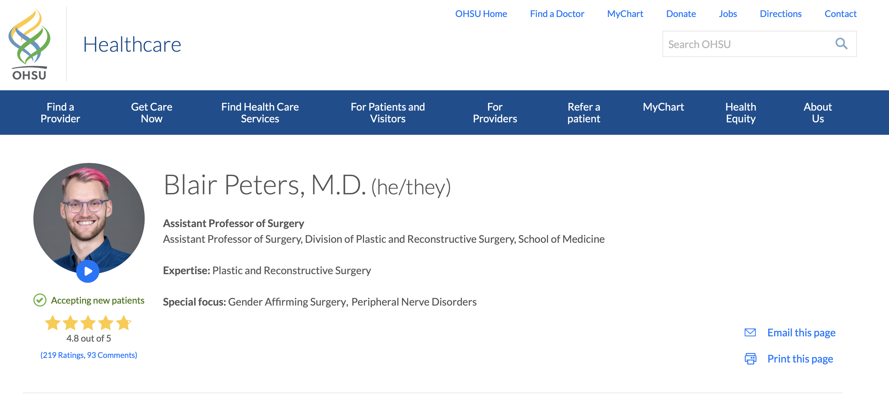

Slide 33
Mark the enemies of God
¹⁹ Oh, that You would slay the wicked, O God! Depart from me, therefore, you bloodthirsty men. ²⁰ For they speak against You wickedly; Your enemies take Your name in vain. ²¹ Do I not hate them, O Lord, who hate You? And do I not loathe those who rise up against You? ²² I hate them with perfect hatred; I count them my enemies.
Psalm 139:19-22

Slide 34
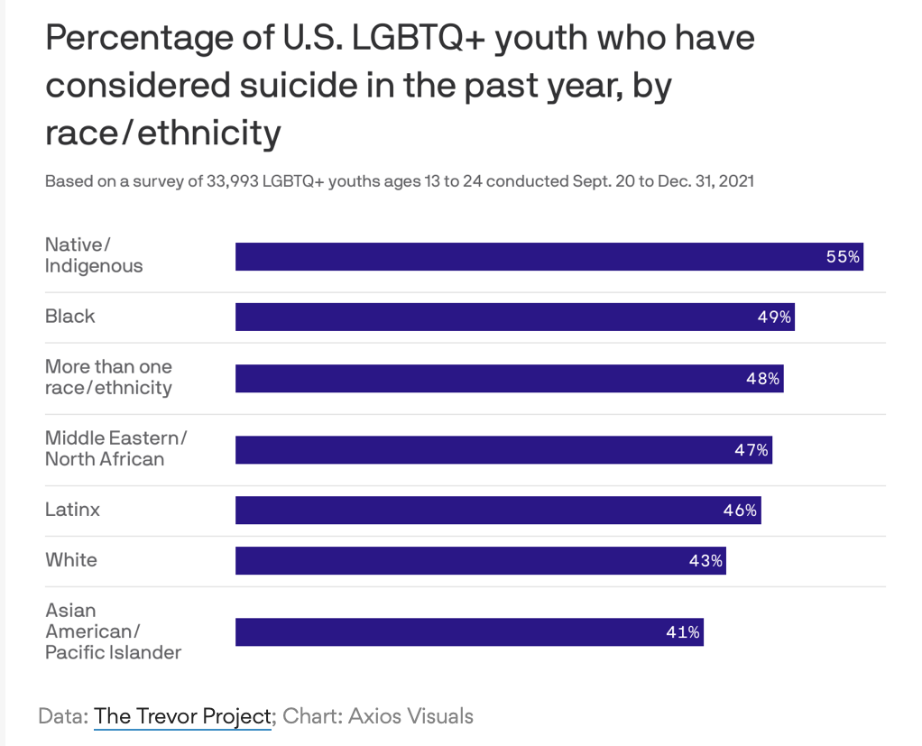

Slide 35
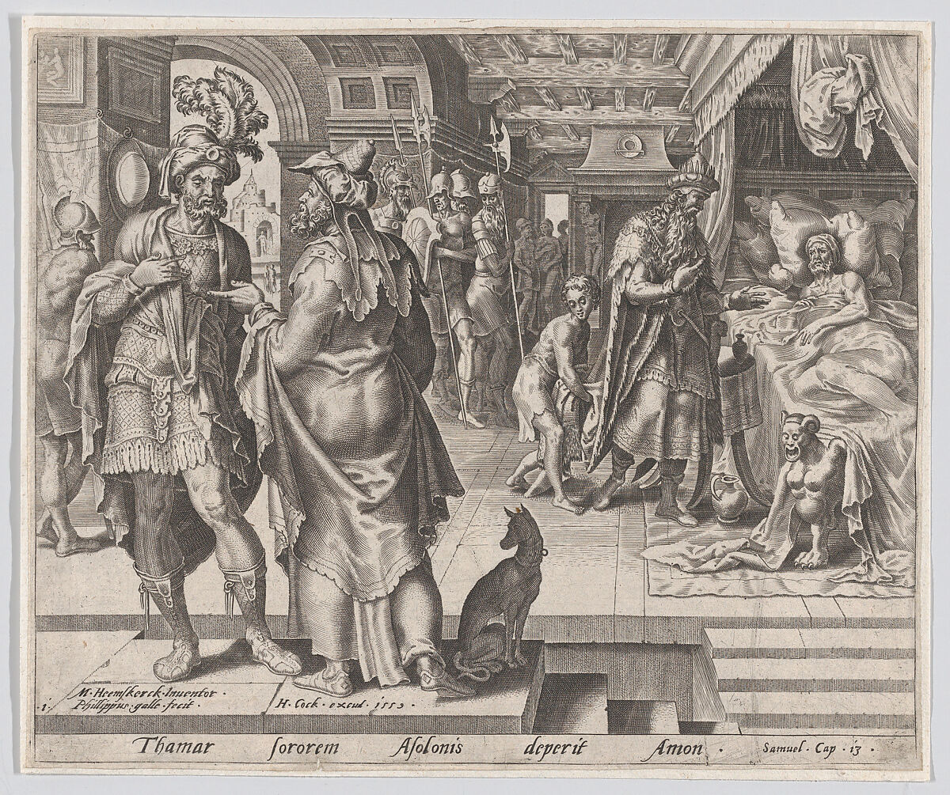
Philips Galle Netherlandish After Maarten van Heemskerck 1559

Slide 36
What is perfect hatred?
¹⁹ Oh, that You would slay the wicked, O God! Depart from me, therefore, you bloodthirsty men. ²⁰ For they speak against You wickedly; Your enemies take Your name in vain. ²¹ Do I not hate them, O Lord, who hate You? And do I not loathe those who rise up against You? ²² I hate them with perfect hatred; I count them my enemies.
Psalm 139:19-22

Slide 37
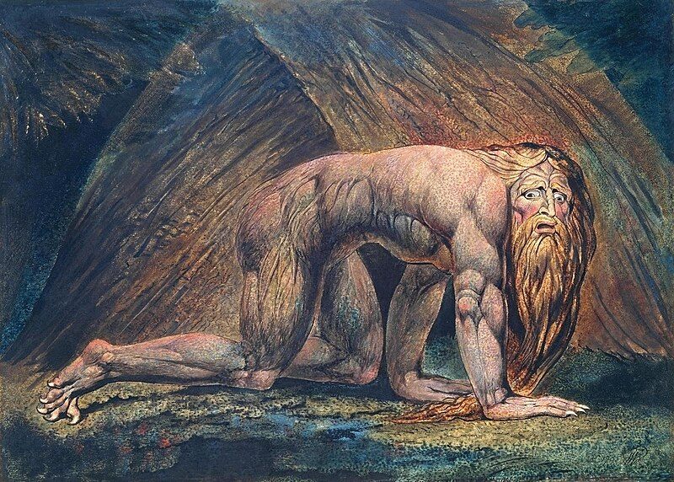
Nebuchadnezzar, William Blake

Slide 38
Hananiah= Yah has been gracious
The LORD is merciful and gracious, slow to anger and abounding in steadfast love.
Psalm 103:8
Notes:
Land of Shinar>

Slide 39
Ask God to show you
²³ Search me, O God, and know my heart; Try me, and know my anxieties; ²⁴ And see if there is any wicked way in me, And lead me in the way everlasting.
Psalm 139:23-24

Slide 40
Surviving Culture Psalm 139
Eddie Moody

