Slide 1
How a Denomination Can Help You and Your Church
emoody@nafwb.org

Slide 3
Notes:
There are a lot of problems with the FWB denomination. I believe I am as acquainted with them as anyone. But if you are a reader of the news or have friends in any other I will say, I will gladly take our problems. I encourage you to utilize our agencies.

Slide 4
Productivity
Two are better than one, because they have a good reward for their toil. Ecclesiastes 4:9

Slide 5
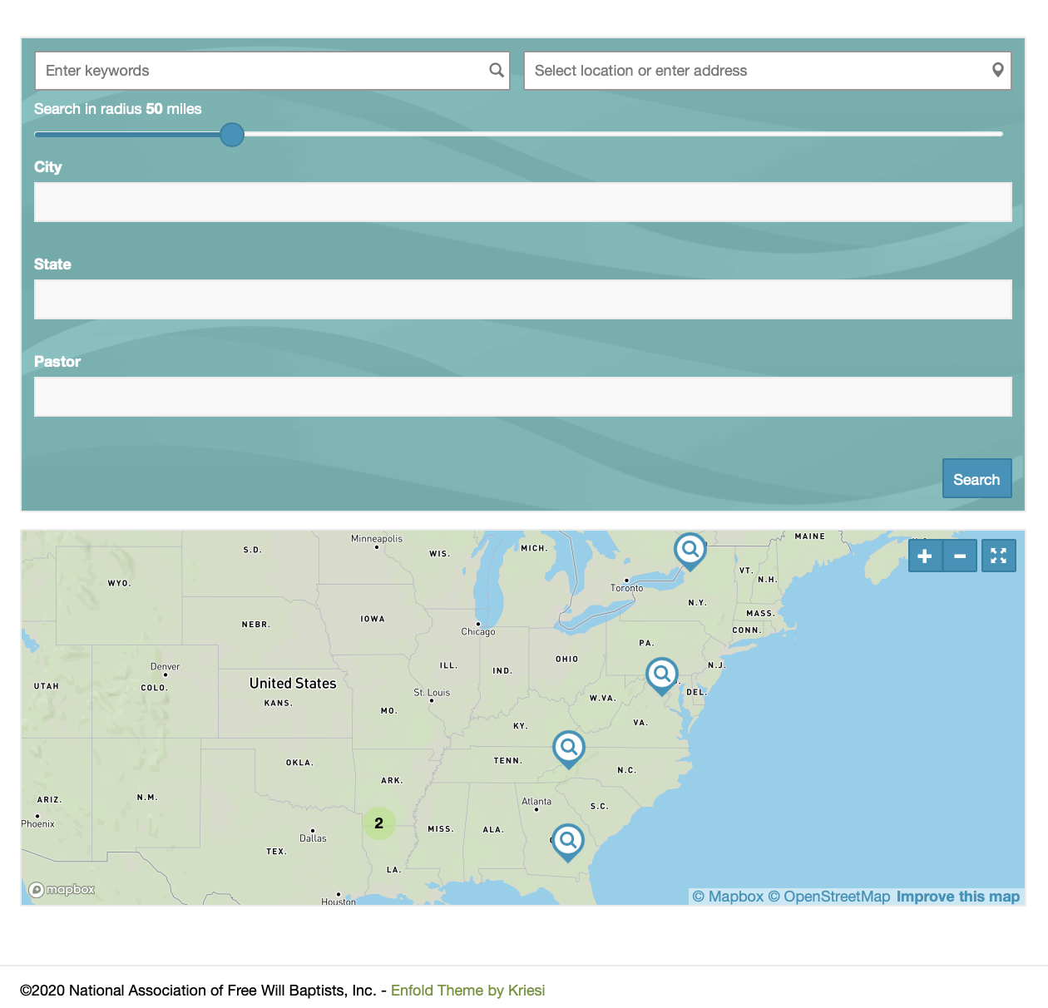
Promotion
anna@nafwb.org
Notes:
Send to Elizabeth>

Slide 6
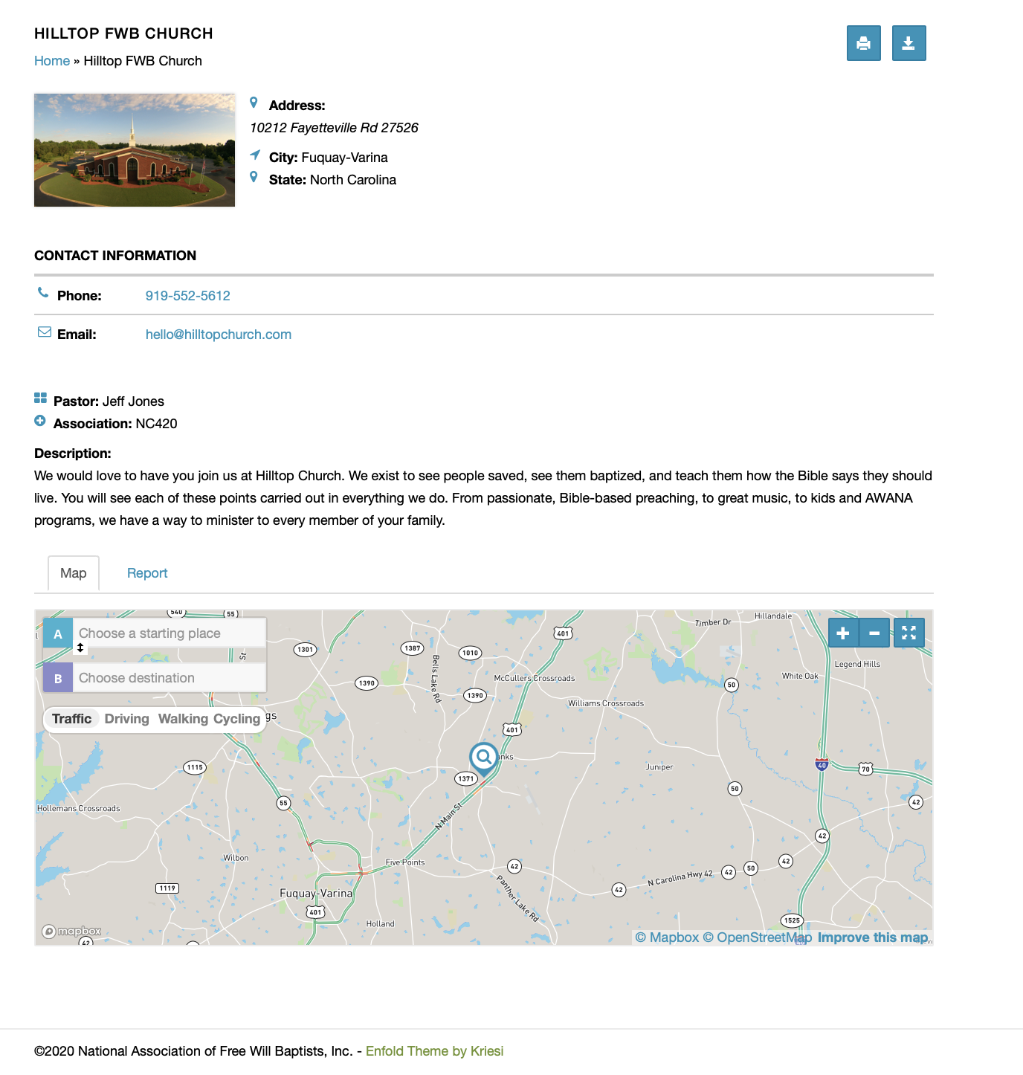
Notes:
Send a video>

Slide 7
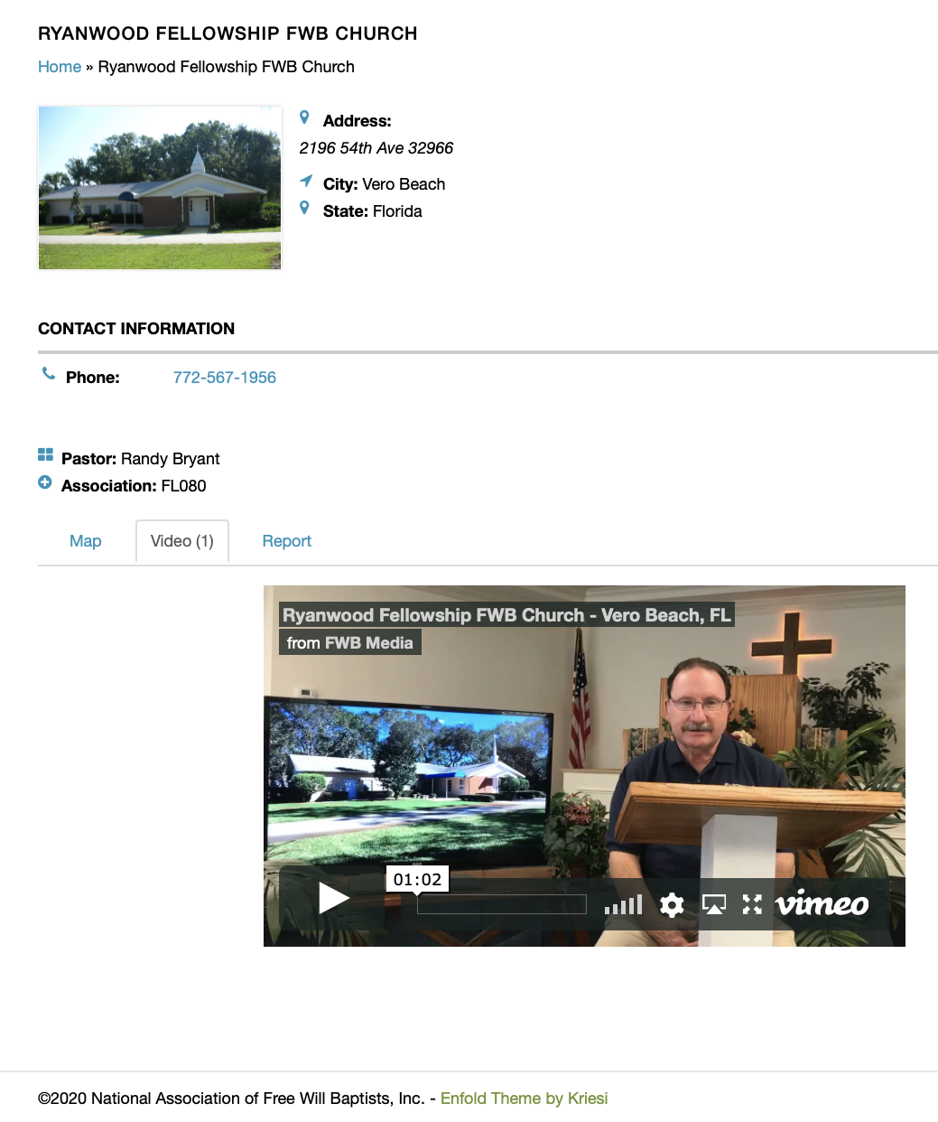
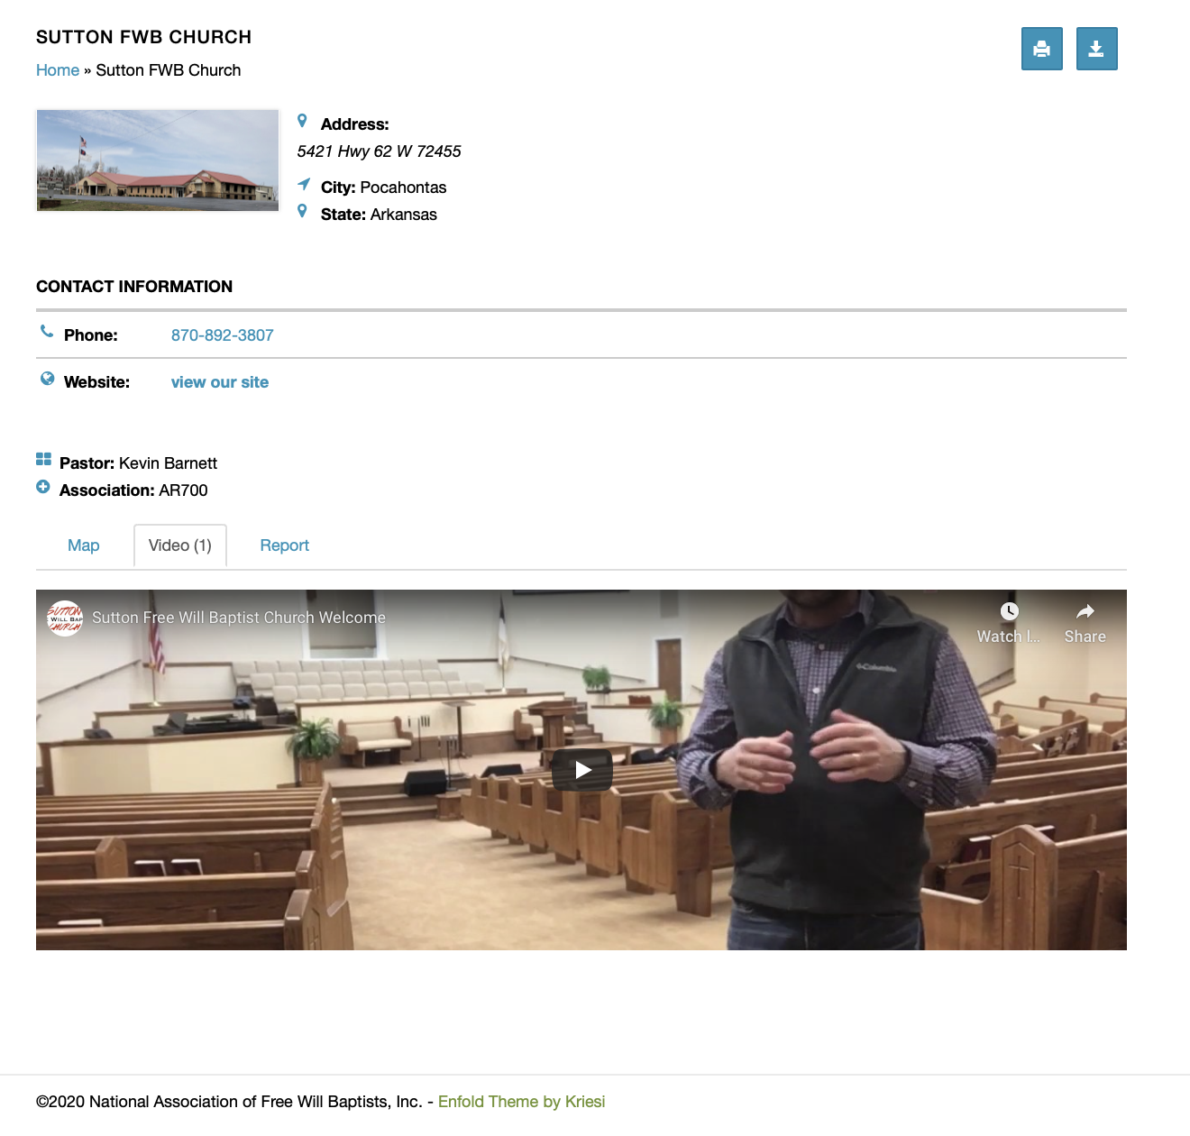
Notes:
3 for 30>

Slide 8
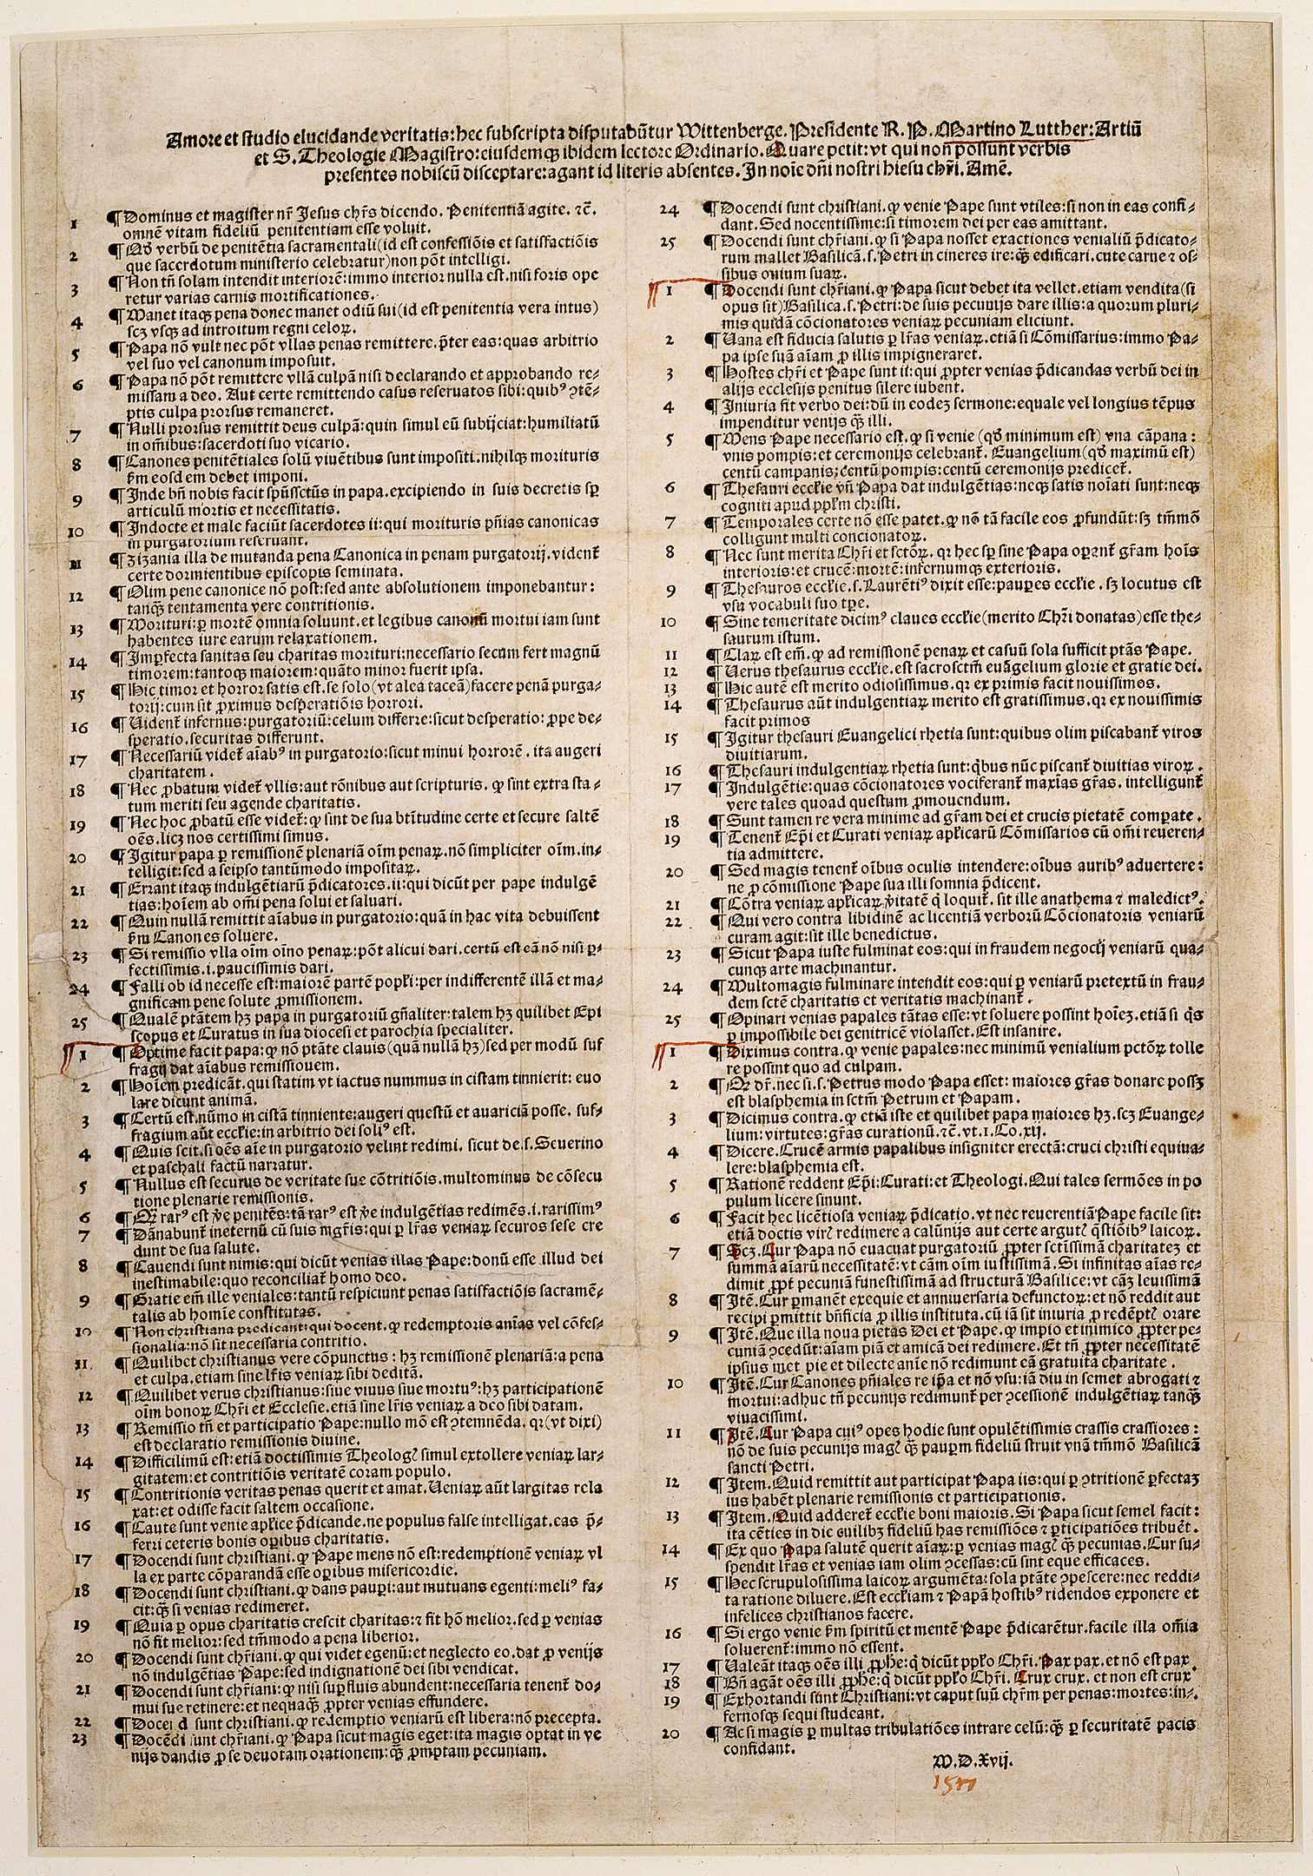
1517 Nuremberg printing of the Ninety-five Theses as a placard, now in the Berlin State Library
Notes:
Take your phones out and like>
By Martin Luther - http://digital.staatsbibliothek-berlin.de/werkansicht/?PPN=PPN644115580&amp;PHYSID=PHYS_0001, Public Domain, https://commons.wikimedia.org/w/index.php?curid=47482515
Andrew Pedigree wrote in his book Brand Luther wisely used the printing press, a new technology which helped him disseminate the message of the reformation. I believe if Luther were alive today and even the apostle Paul they would be using social media to advance the gospel. So I encourage you to think about that phrase be harmless as doves but wise as serpents that Jesus instructed us as you use social media . . .

Slide 9
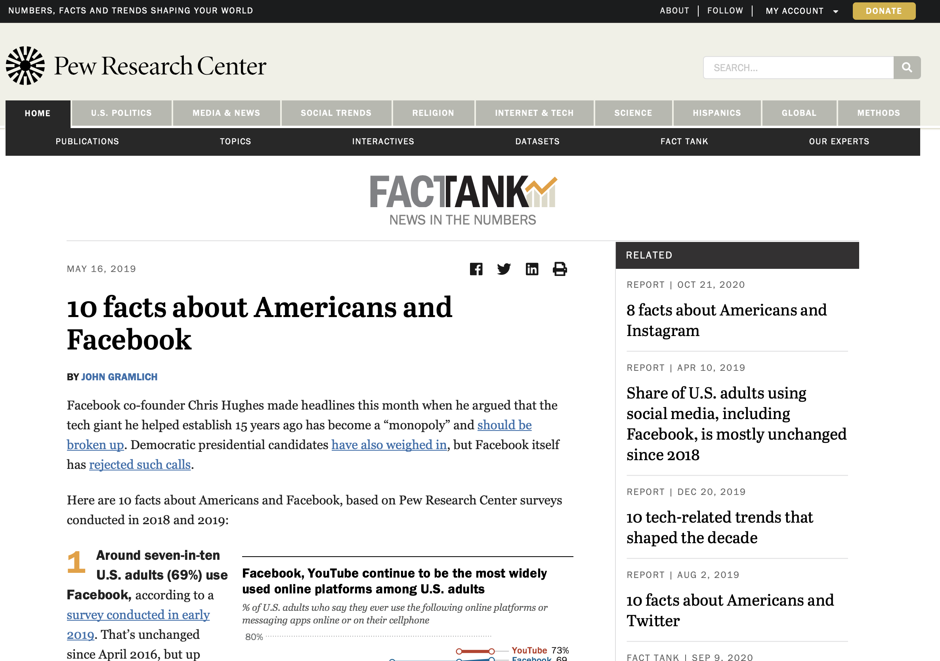

Slide 10
Social Media Plan (all times Central)
Monday, 8:00 AM Better Together Podcast
Tuesday, 8:00 AM Instructional Meme
Thursday, 8:00 AM Verse Meme
Your material (Join us Sunday at 8:30 or 10:30 AM for insert your sermon title here)
Your material (Join us tonight at 7:00 pm when we insert your activity here)

Slide 11
Planning
Two are better than one, because they have a good reward for their toil. Ecclesiastes 4:9

Slide 12
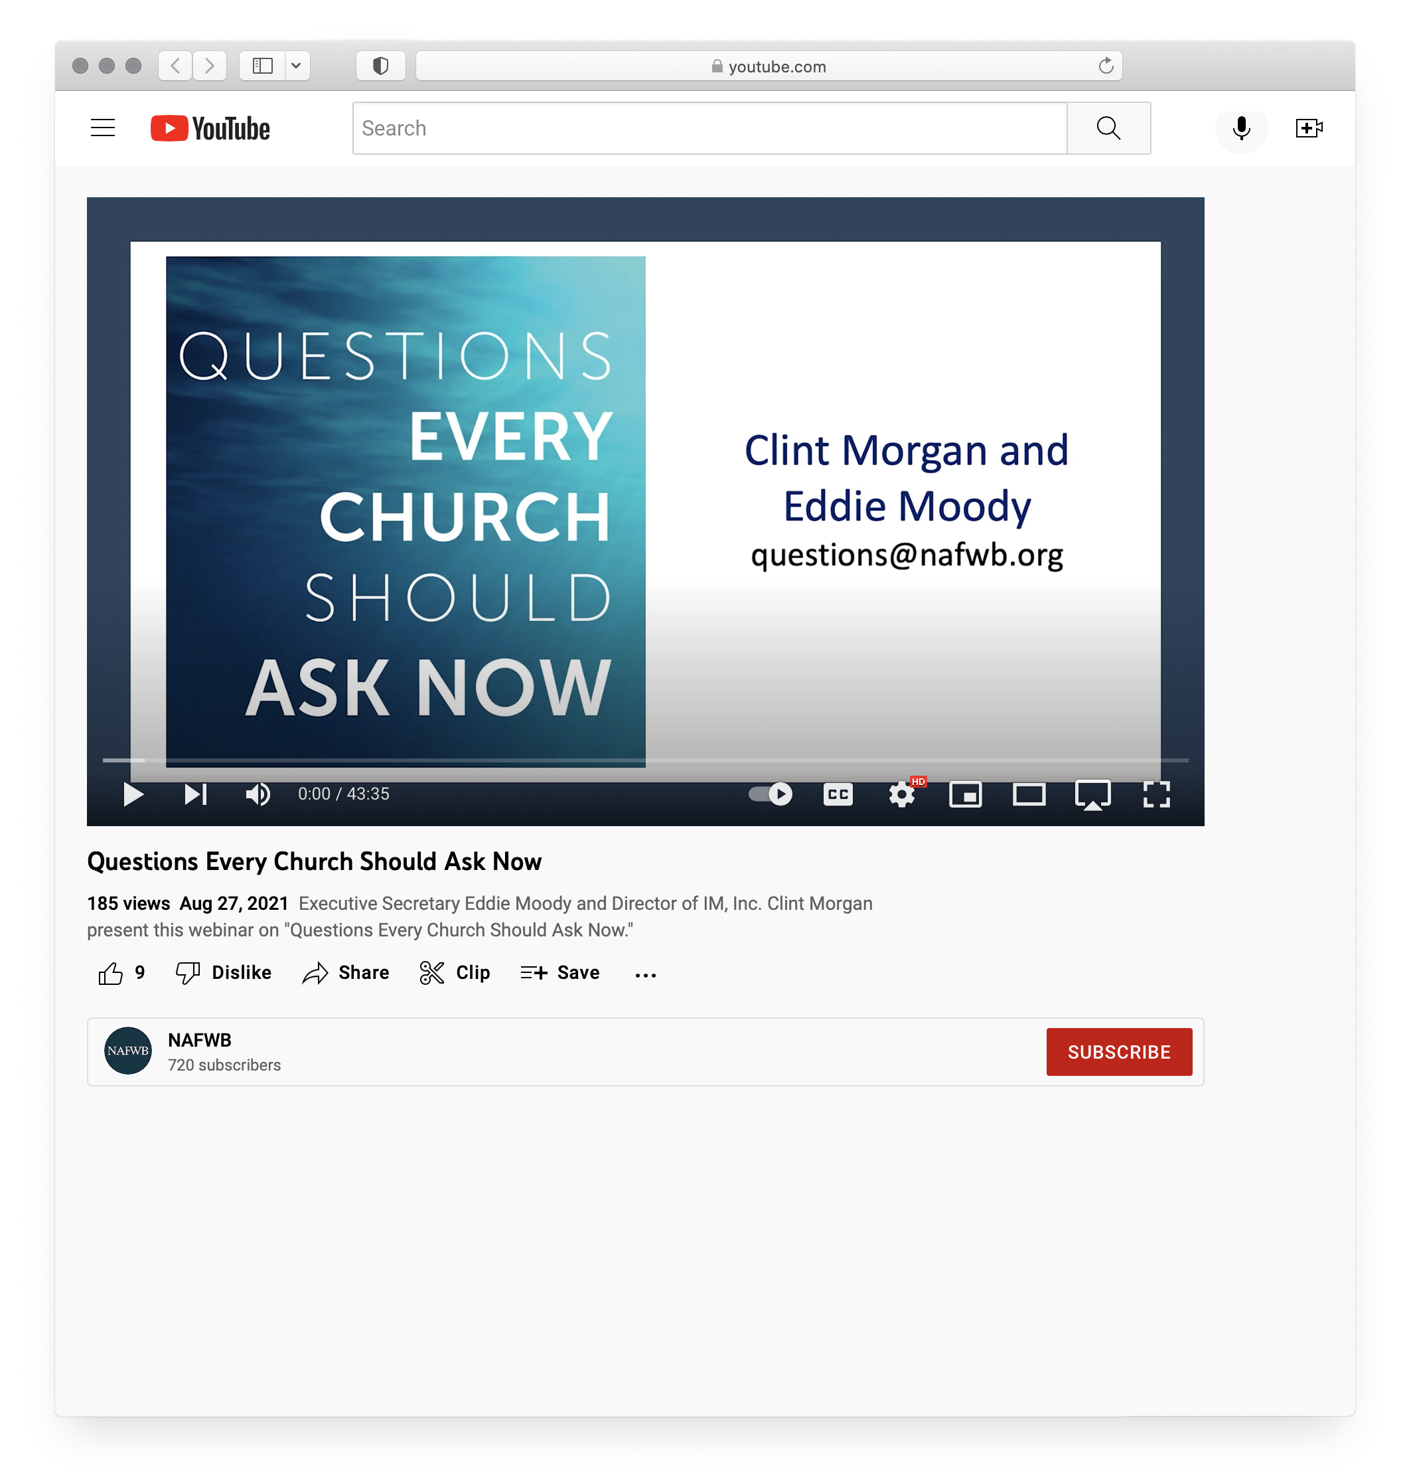

Slide 13
Leadership Development: Planning for Future Growth
Pastors of Growing Churches
Pastors of Plateaued & Declining Churches
50% of pastors serving in plateaued situations have strategy (25% formalized, 75% informal)
60% of pastors serving declining churches have a strategy (17% formalized, 83% informal)
80% have a strategy in place (50% formalized, 50% informal)

Slide 15
Reach
Individual goals: I will reach _______ with the gospel.
And he said to them, “Go into all the world and proclaim the gospel to the whole creation.
Mark 16:15
Notes:
Better together podcast>

Slide 16
Reach
Individual goals: I will reach _______ with the gospel.
Church/Association goals: I will reach _________ (a particular group or segment of the population) with the gospel.
Denominational goals: We will train our people to reach _______ (groups like the nones, or those struggling with mental health issues).
Notes:
Better together podcast>

Slide 17
A Plan to Prepare Your People
Equip
Podcasts
Webinars/Seminars
Written Resources
National Convention, Leadership Conference
Association Meetings
¹¹ And he gave the apostles, the prophets, the evangelists, the shepherds and teachers, ¹² to equip the saints for the work of ministry, for building up the body of Christ,
Ephesians 4:11-12
Notes:
Better Together Podcast>

Slide 18
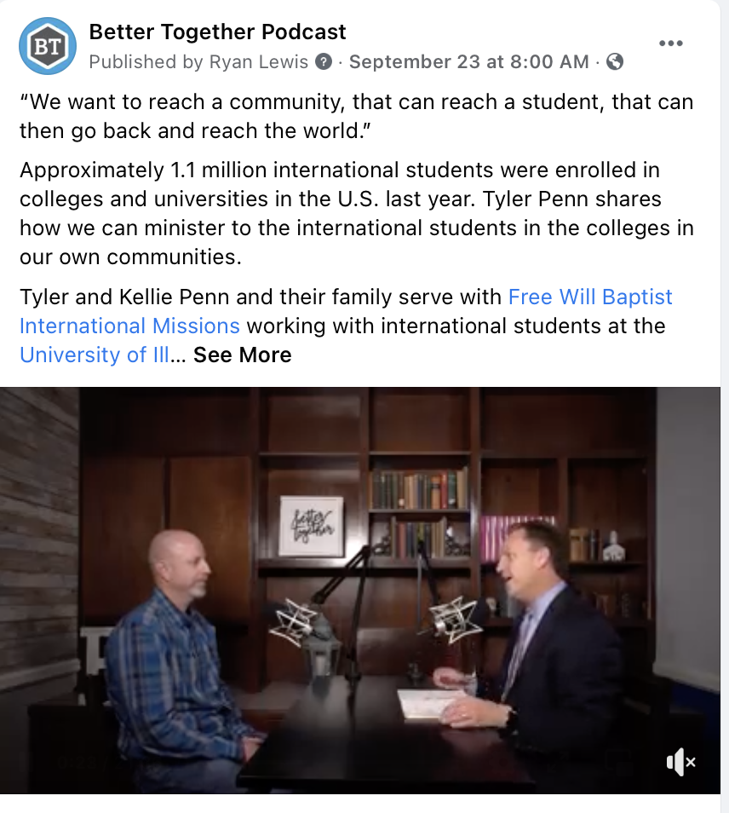
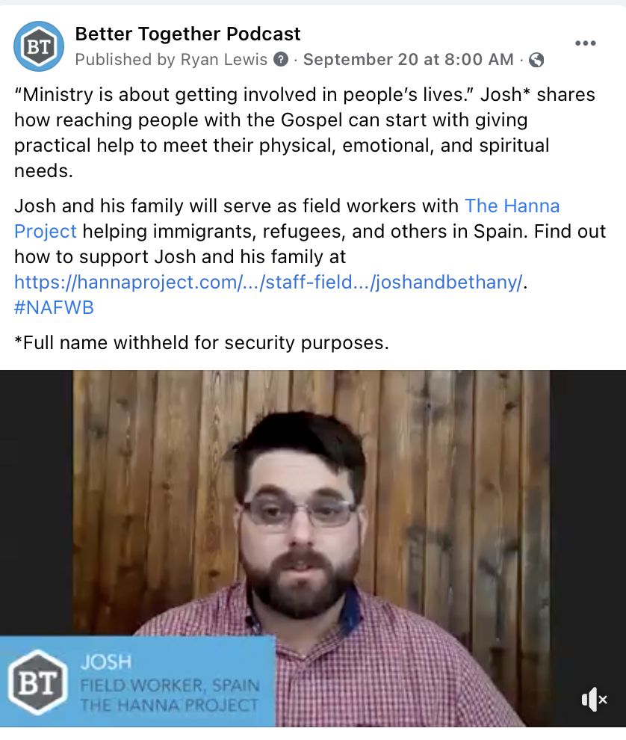
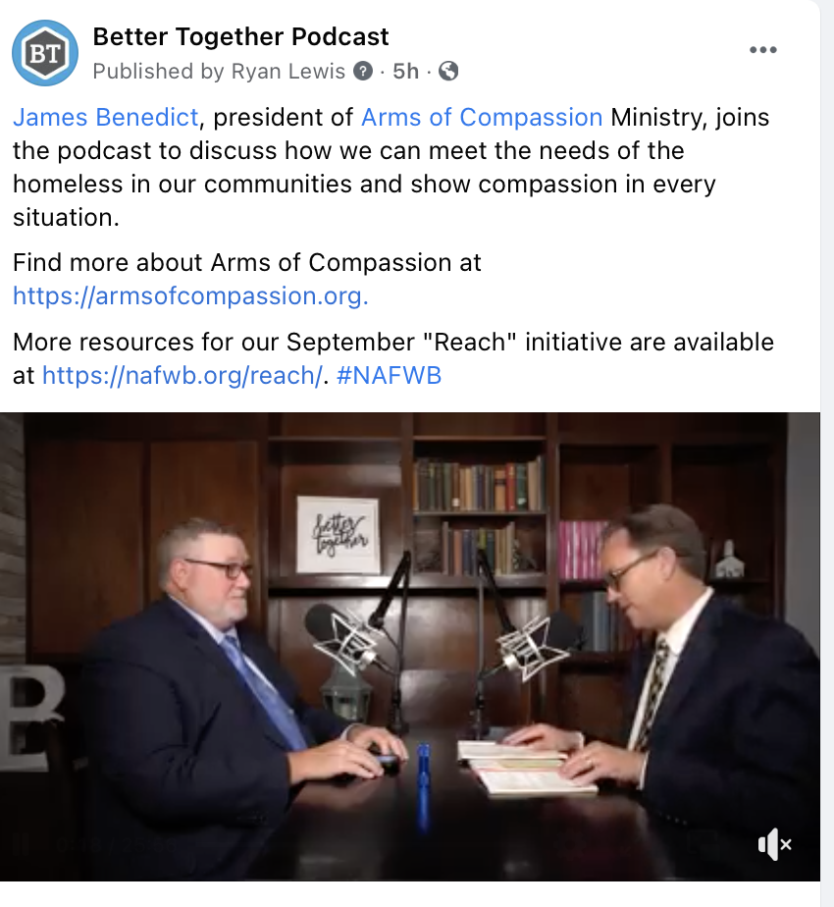
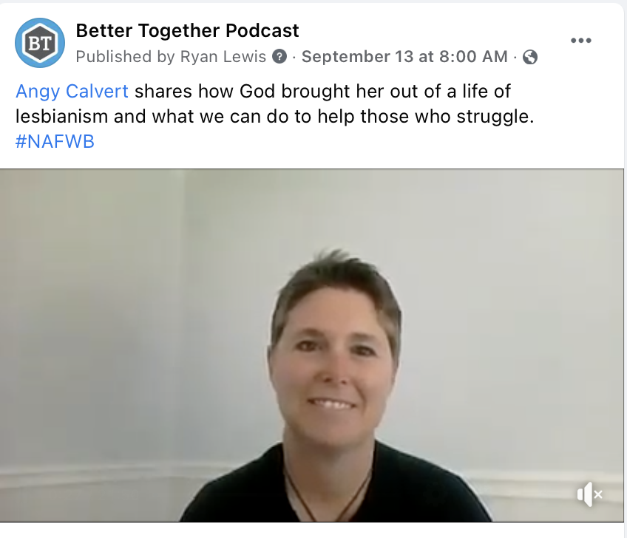
Mondays

Slide 19
Tuesdays

Slide 20
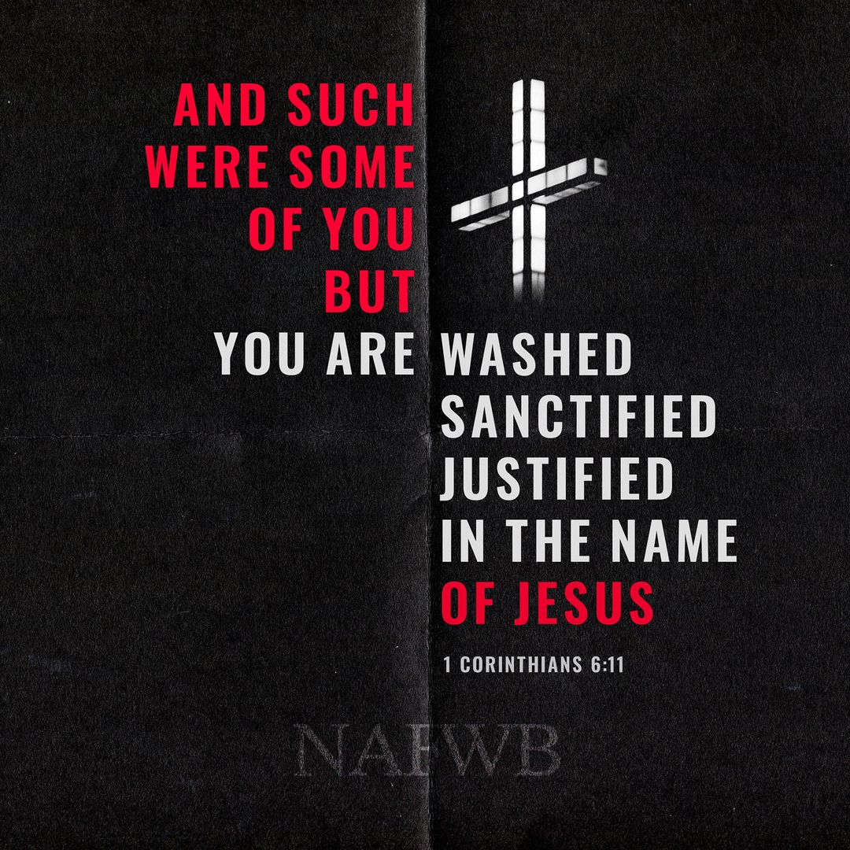
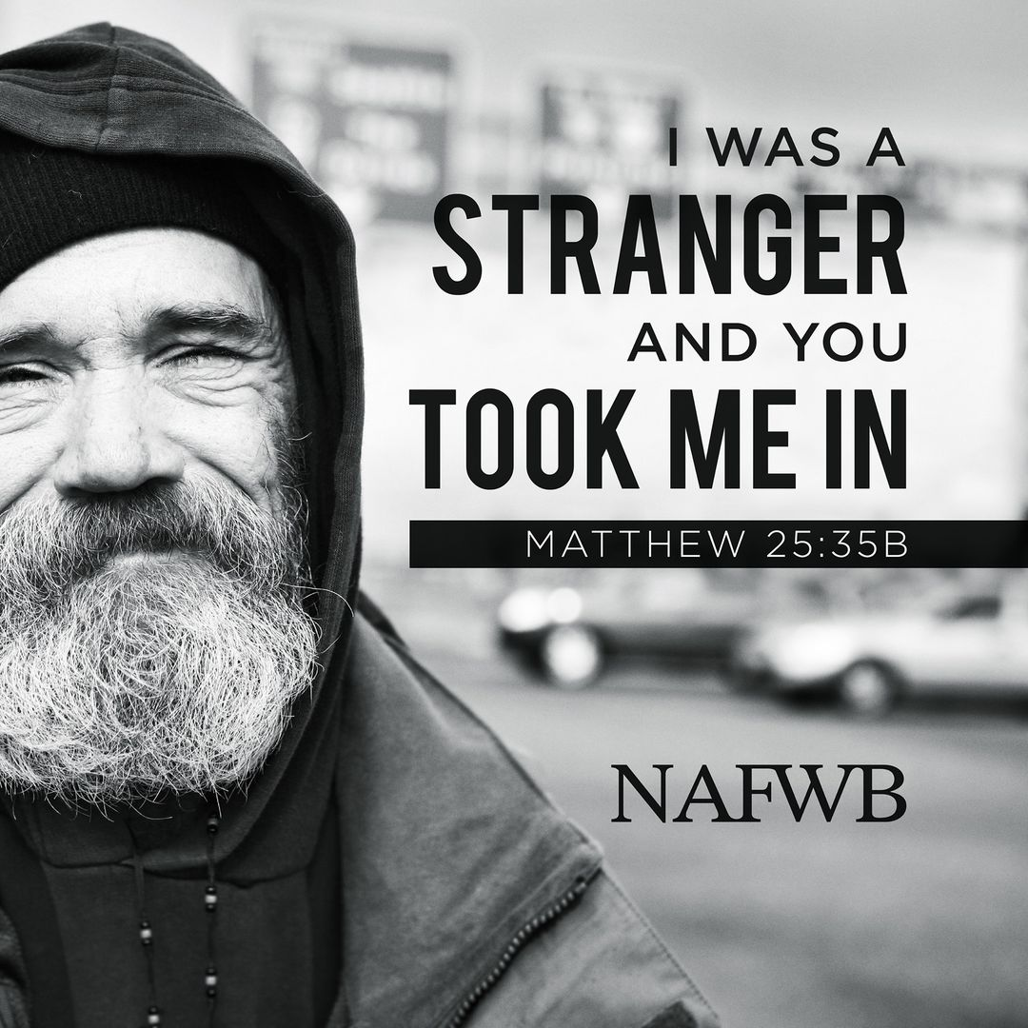
Thursdays

Slide 22
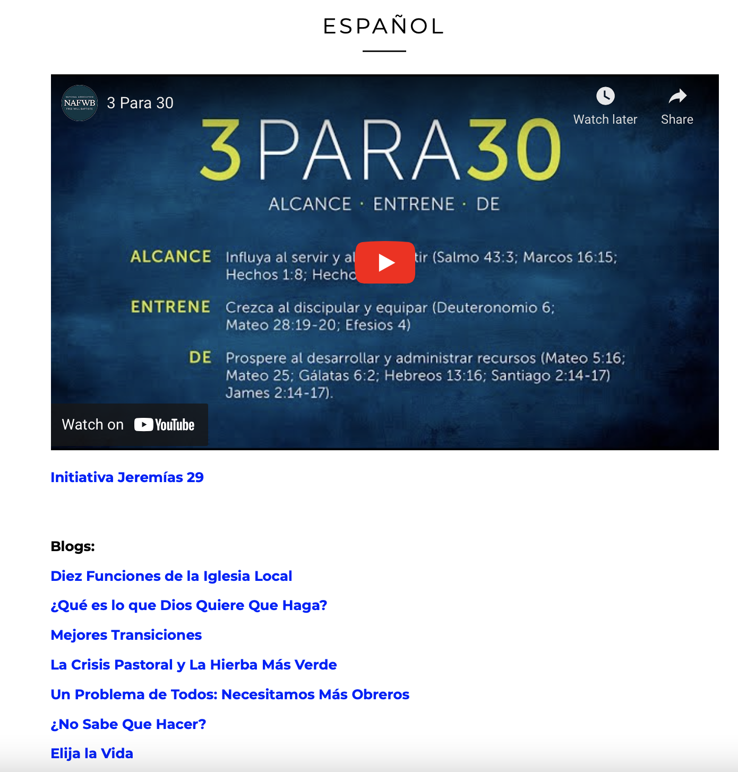

Slide 23
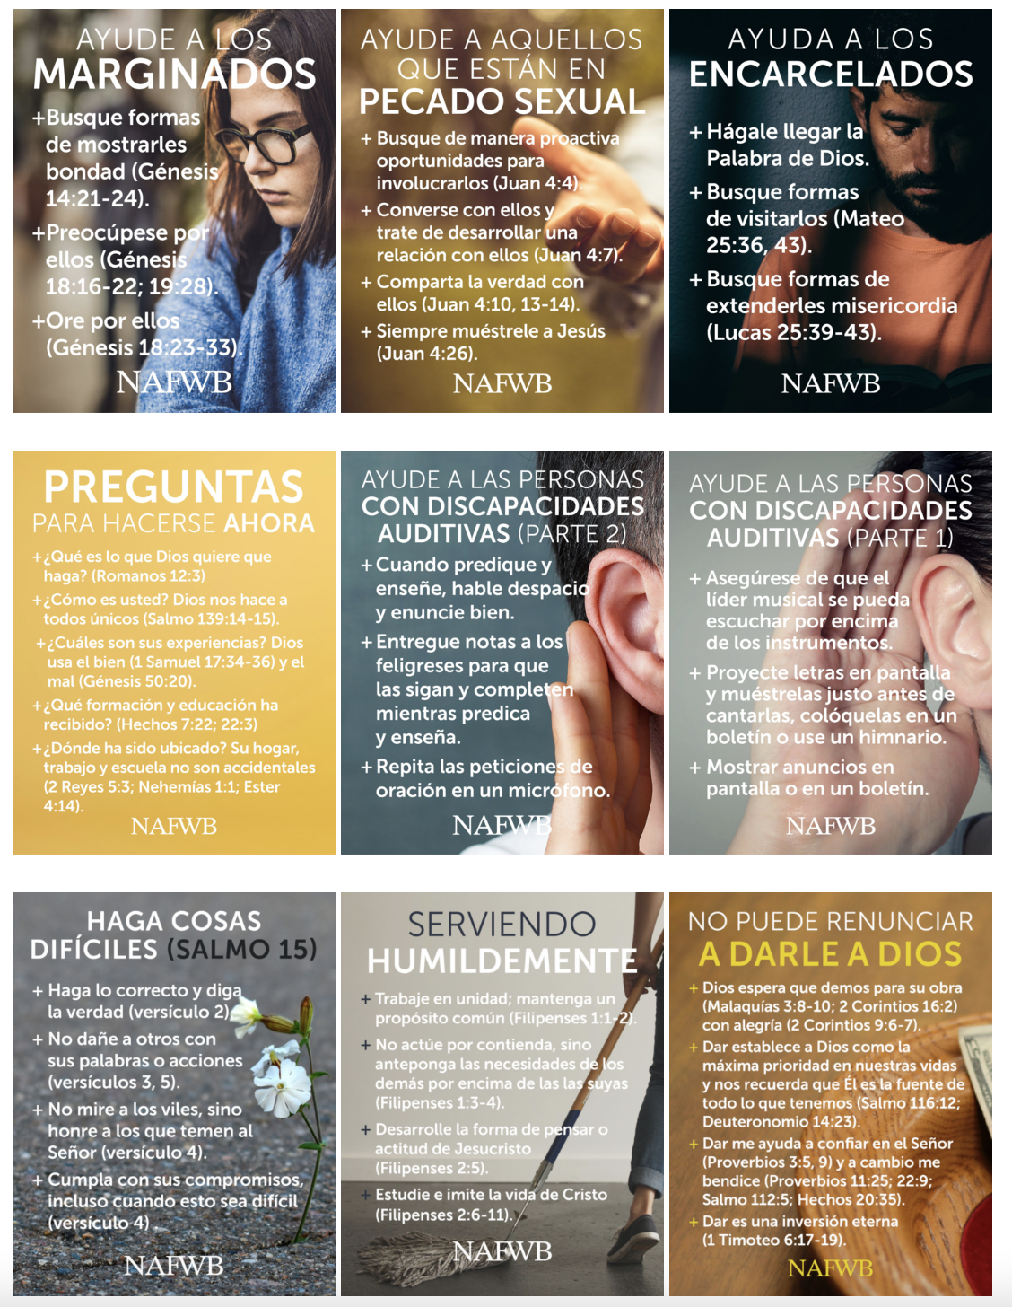

Slide 24
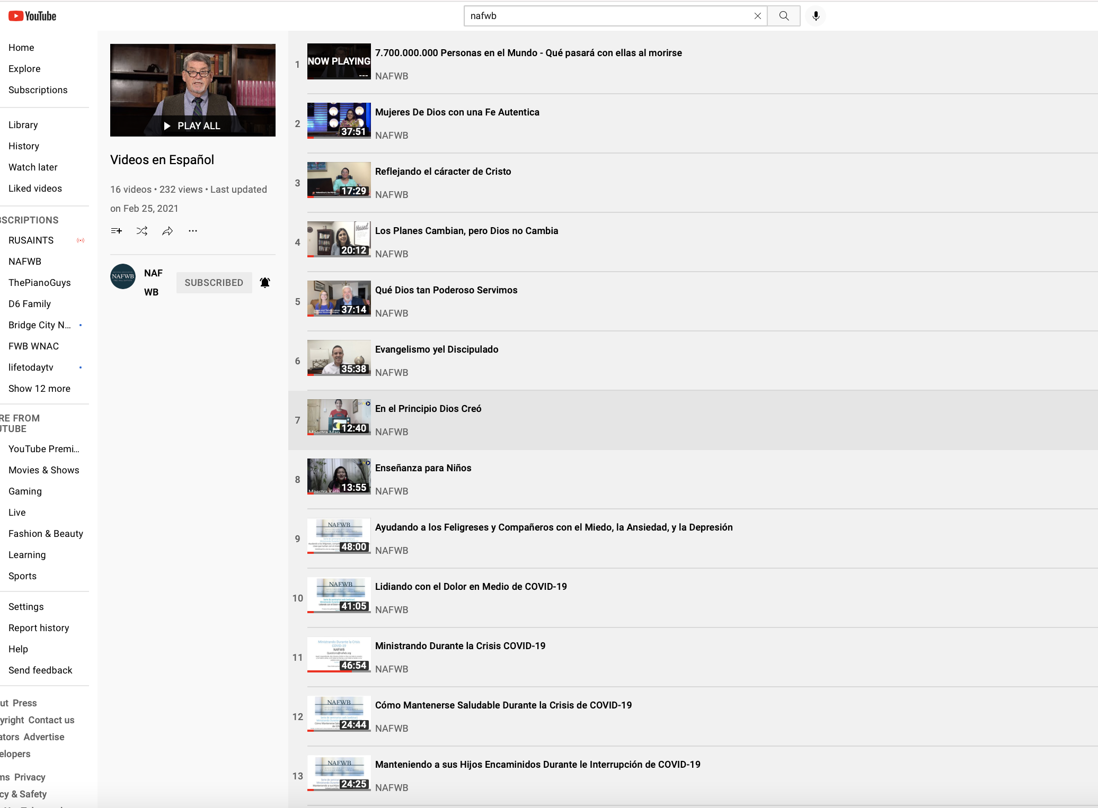

Slide 25
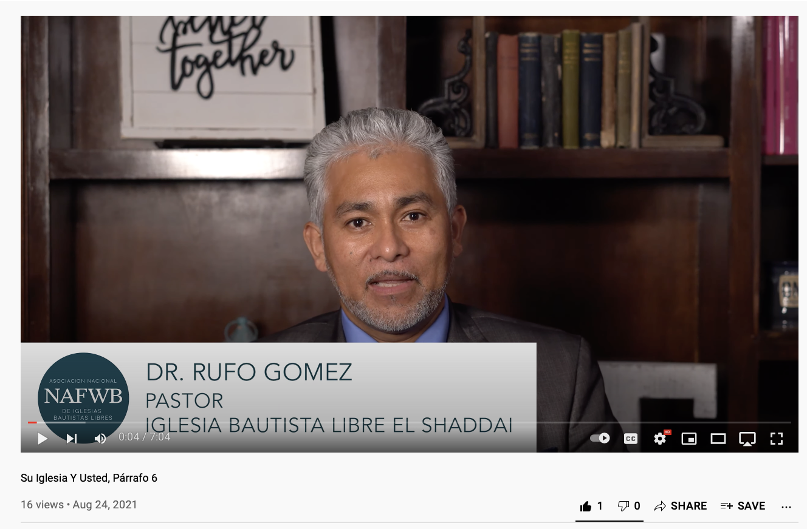

Slide 26
Train
Deuteronomy 6 (family discipleship)
Matthew 28:19-20 (personal discipleship)
Ephesians 4 (Everyone is called.)
Notes:
Go after each generation>

Slide 27
Train
Individual goals: I will train/disciple _______ in the Christian faith.
Go ye therefore, and teach all nations, baptizing them in the name of the Father, and of the Son, and of the Holy Ghost: Teaching them to observe all things whatsoever I have commanded you: and, lo, I am with you always, even unto the end of the world.
Matthew 28:19-20
Notes:
Better together podcast>

Slide 28
Train
Church/Association goals: We will train our people (pastors and laypeople) to utilize their spiritual gifts in ministry.
You shall teach them diligently to your children, and shall talk of them when you sit in your house, and when you walk by the way, and when you lie down, and when you rise. Deuteronomy 6:7
Notes:
More individual>

Slide 29
Train
¹¹ And he gave the apostles, the prophets, the evangelists, the shepherds and teachers, ¹² to equip the saints for the work of ministry, for building up the body of Christ,
Ephesians 4:11-12
Notes:
More individual>

Slide 30
Train
Individual goals: I will train/disciple _______ in the Christian faith.
Church/Association goals: We will train our people (pastors and laypeople) to utilize their spiritual gifts in ministry.
Denominational goals: We will provide assessment centers and training in the identification and utilization of spiritual gifts.
Notes:
More individual>

Slide 31
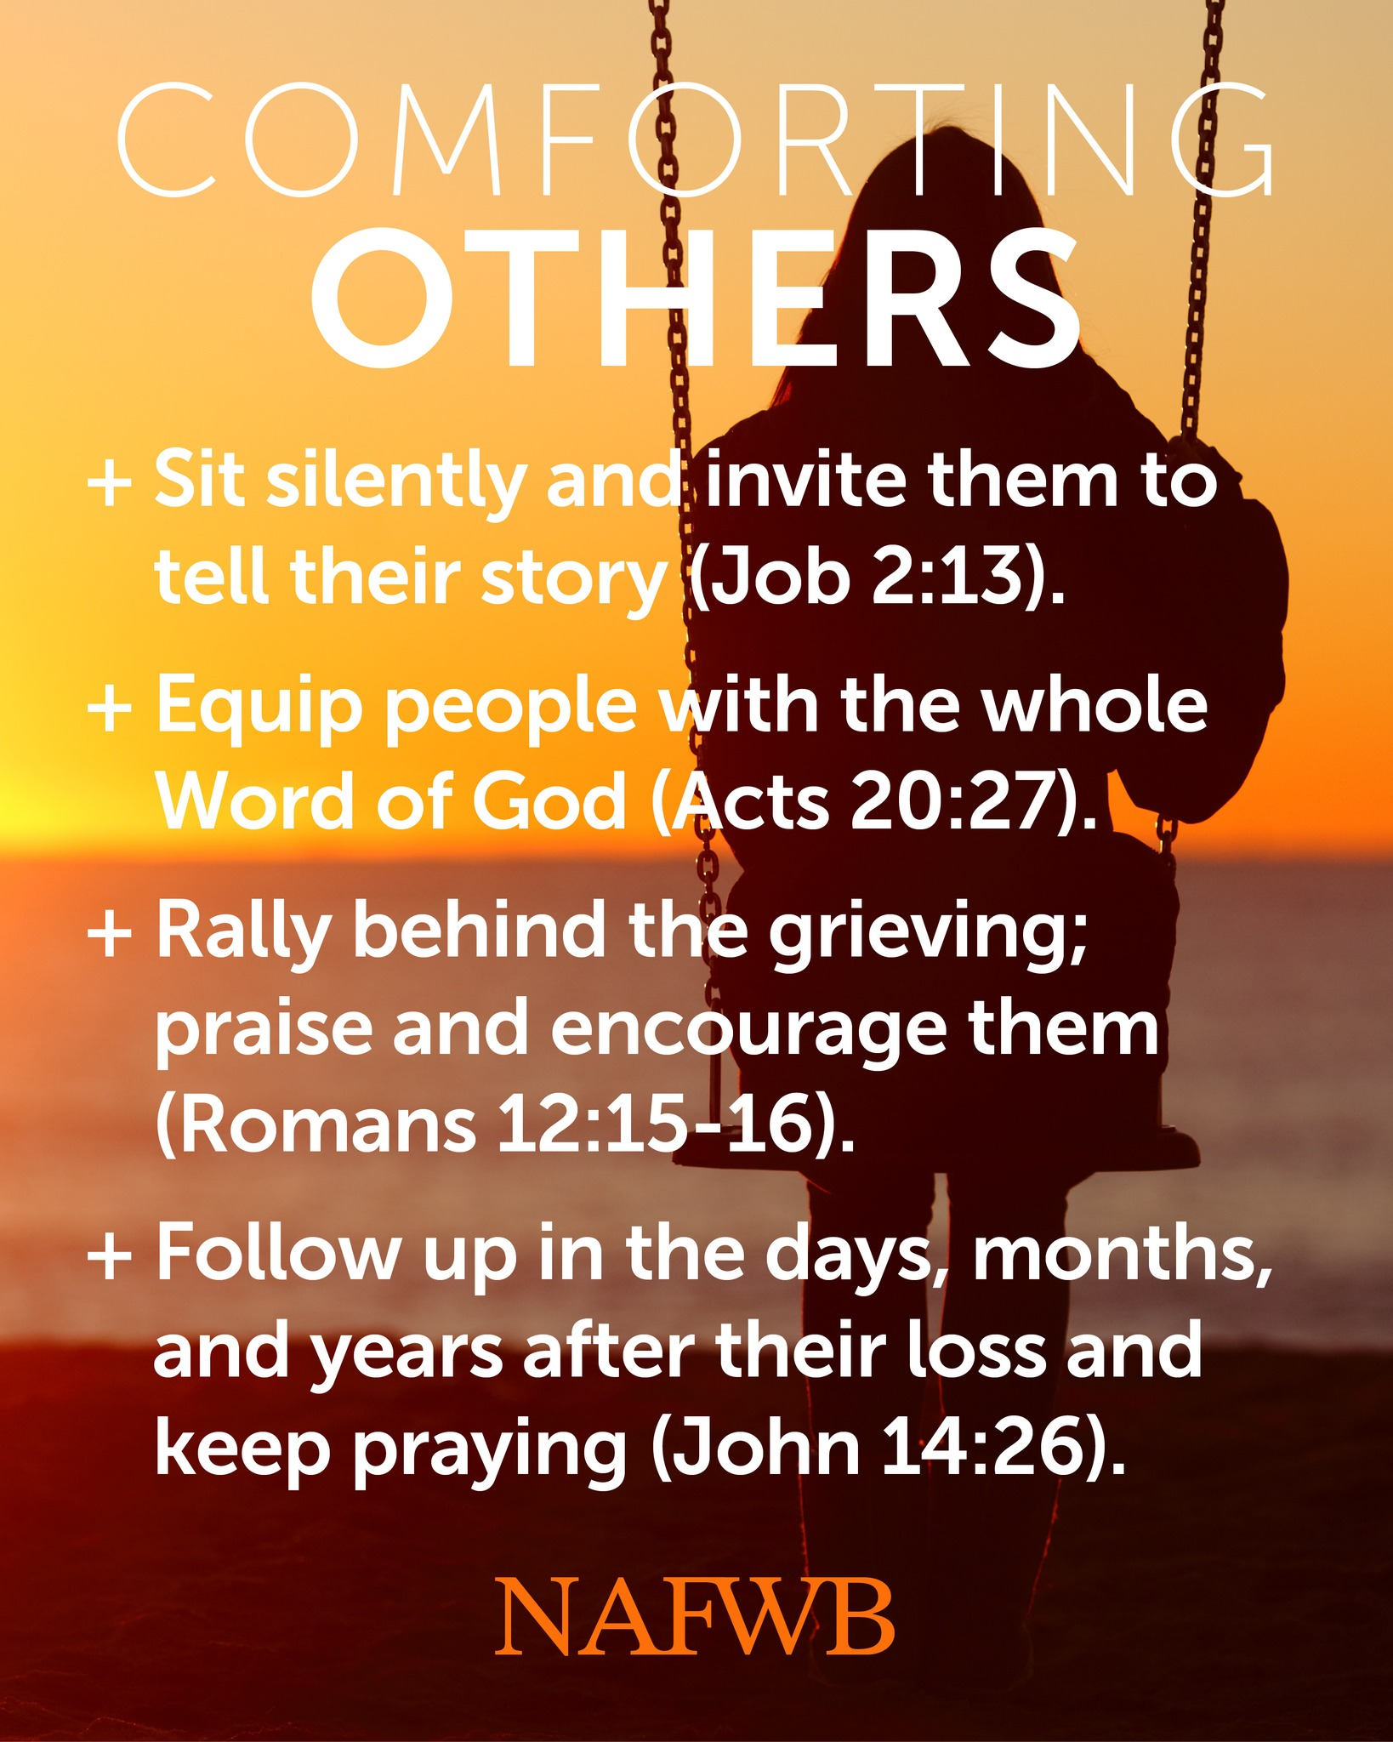

Slide 32
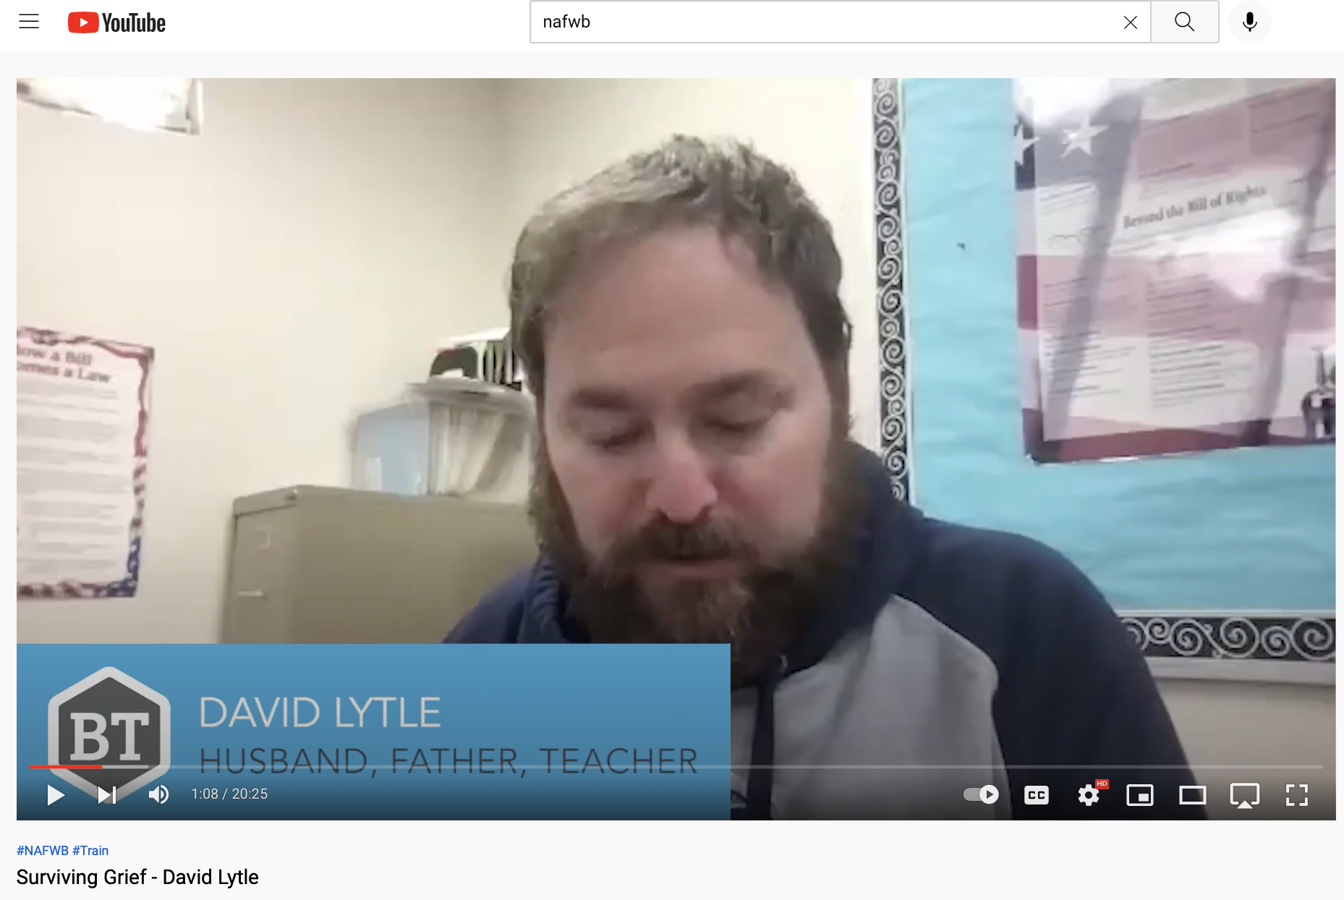
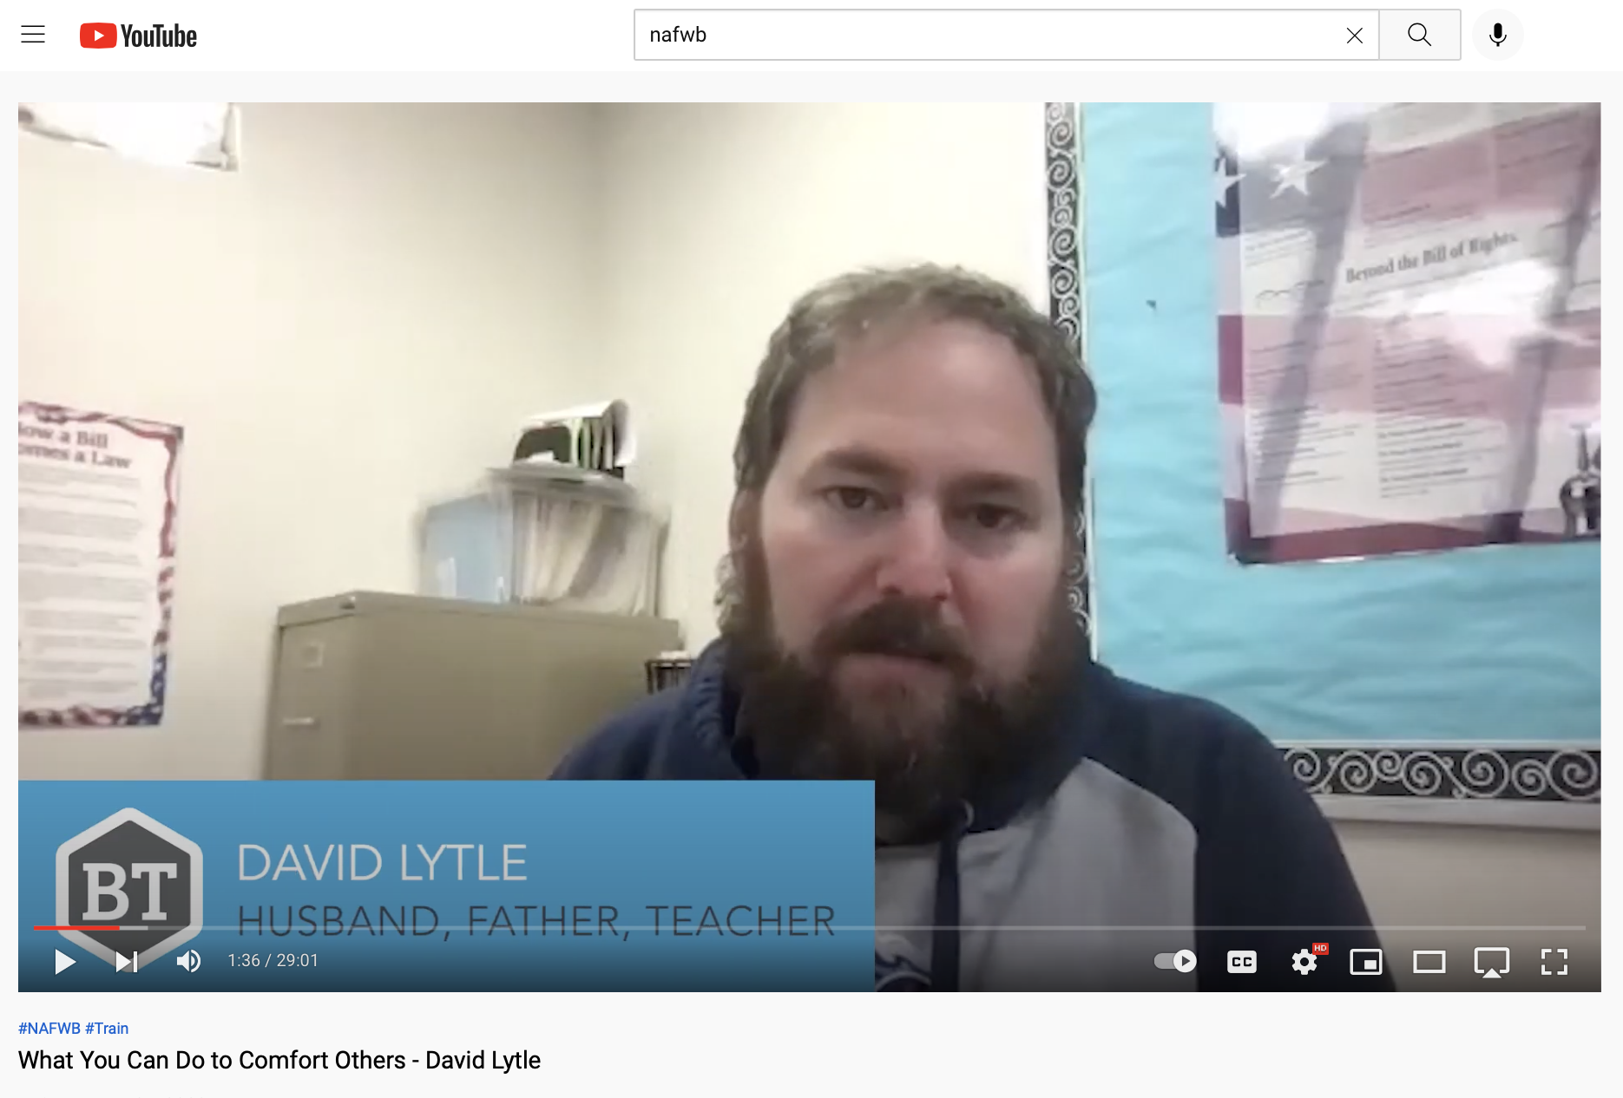

Slide 34
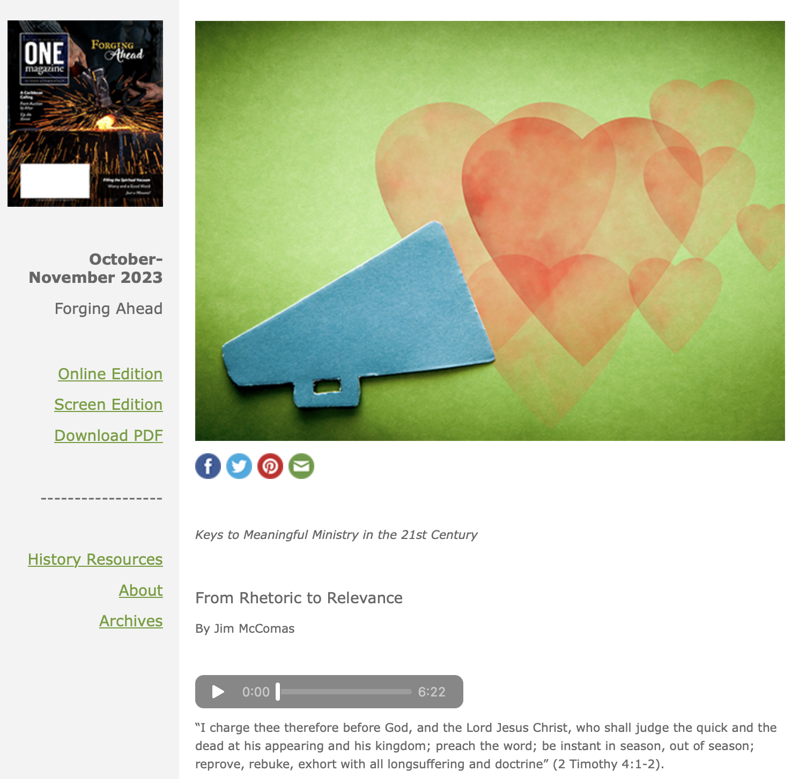

Slide 35
Give
In the same way, let your light shine before others, so that they may see your good works and give glory to your Father who is in heaven.
Matthew 5:16
Notes:
Activist>

Slide 36
Give
Individual goals: I will give myself wholly to the work of God (finances, time, talents).
Now after a long time the master of those servants came and settled accounts with them.
Matthew 25:19
Notes:
Better together podcast>

Slide 37
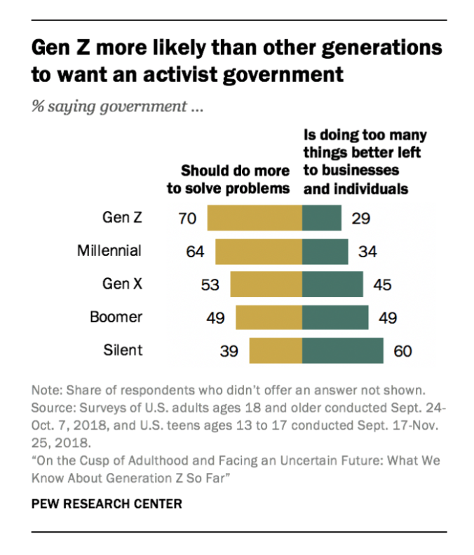
Give
Church/Association goals: We will faithfully serve our community to better reach them (provide meals, engage in service activities).
Notes:
David>

Slide 39
Praying
For if they fall, one will lift up his fellow. But woe to him who is alone when he falls and has not another to lift him up! Ecclesiastes 4:10

Slide 41
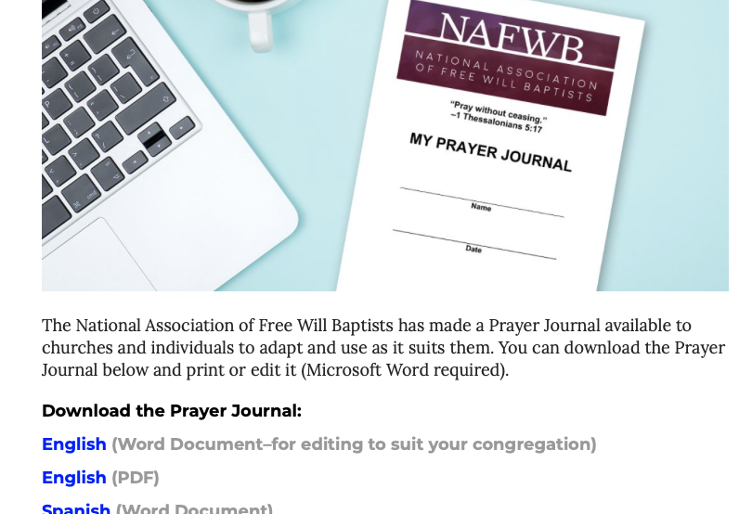

Slide 42
Identify a Person
Pray
Pray for them daily
Follow
Follow their church on social media
Reach out
Reach out to them weekly or biweekly
Breakfast
Breakfast/lunch/coffee once a month
Attend
Attend any open activity (e.g., revivals) they have
Provide
Provide personal invite to any activity you have

Slide 43
Supporting/Coaching
Again, if two lie together, they keep warm, but how can one keep warm alone? Ecclesiastes 4:11

Slide 44
Finding (and Keeping) a Mentor or Coach
Pastors of Growing Churches
Pastors of Plateaued & Declining Churches
60% in first 5 yrs.
89% in the past
Now…
67% currently maintain such relationships
100% initially
Now…
40% of declining
33% of plateaued

Slide 46
Notes:
Coaches>

Slide 48
How?
Show up
Get involved
Learn something, share something, network with someone

Slide 49
Protection
And though a man might prevail against one who is alone, two will withstand him—a threefold cord is not quickly broken. Ecclesiastes 4:12

Slide 50
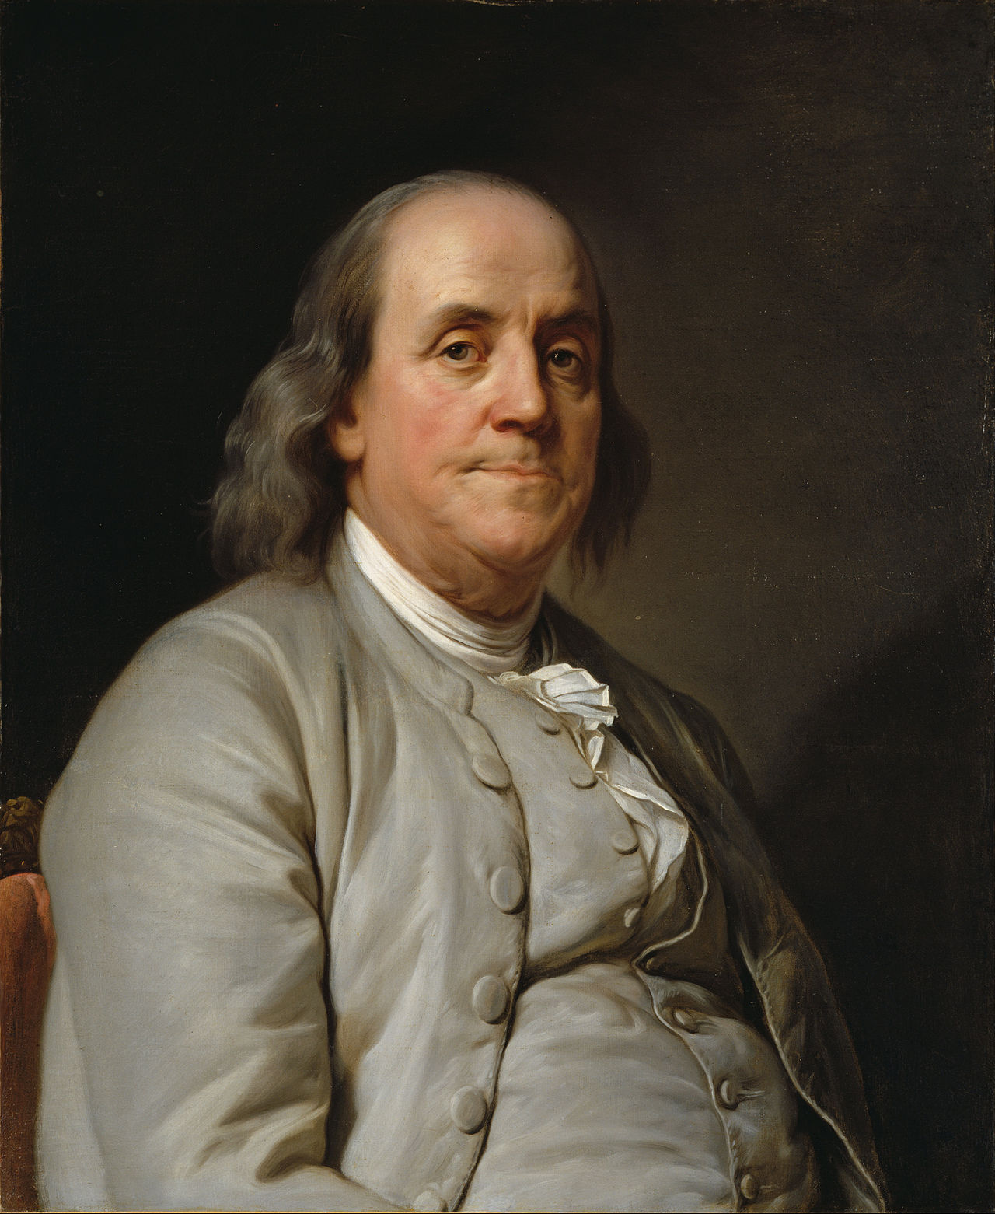
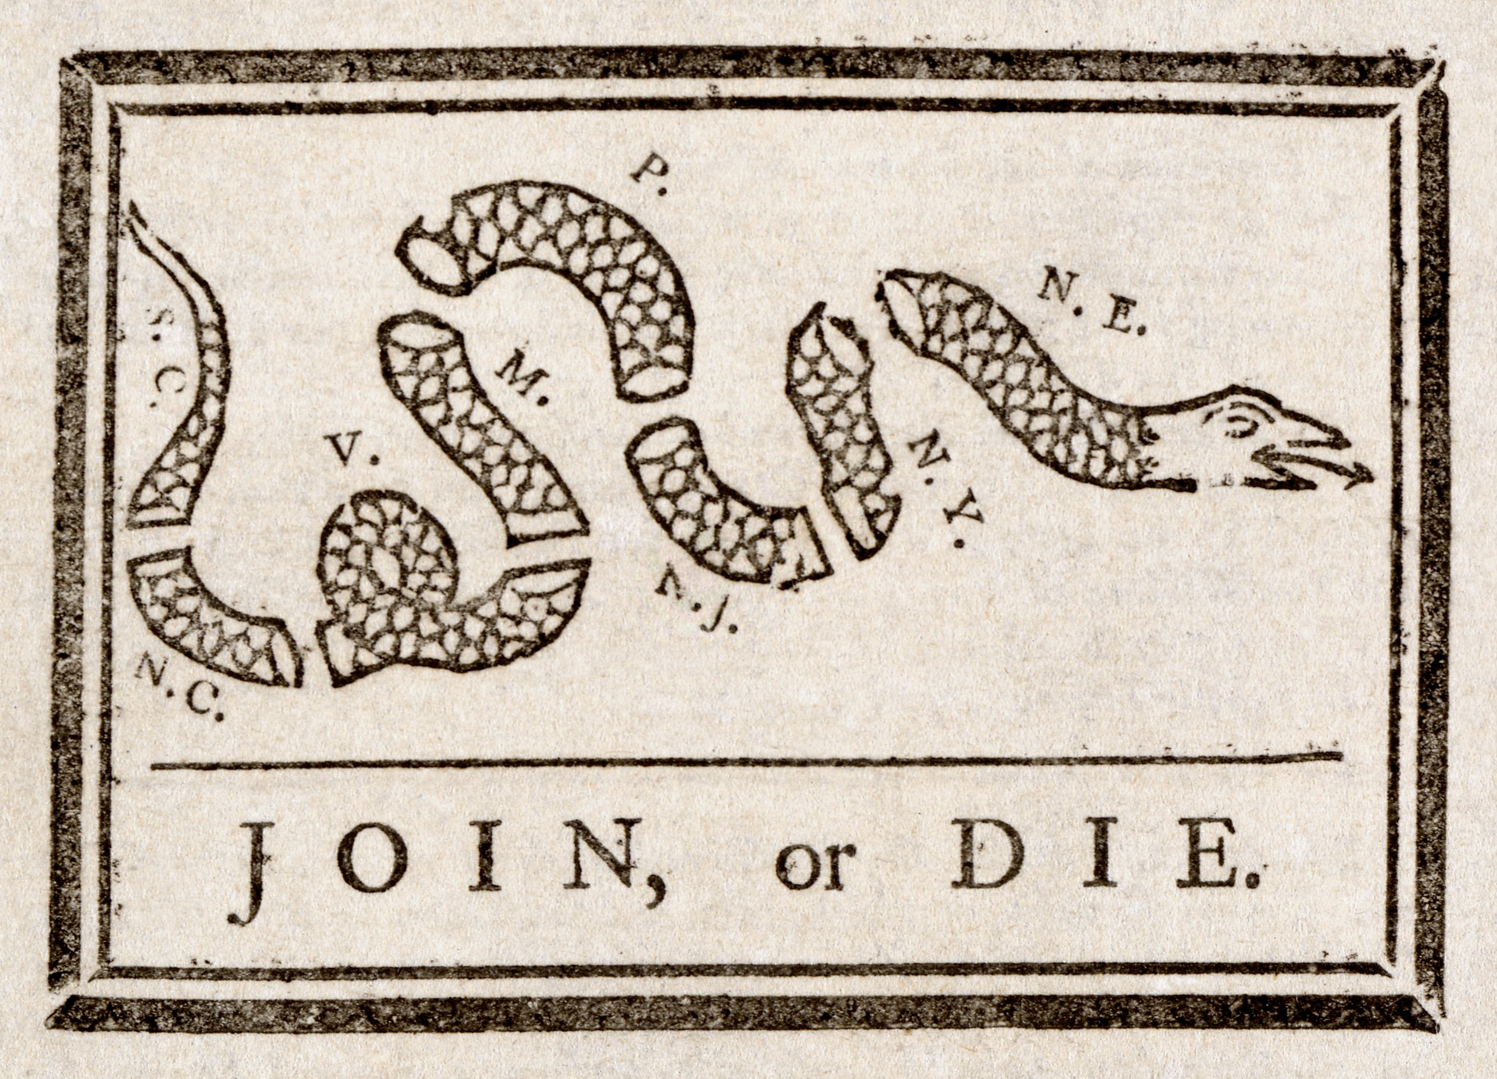
We must, indeed, all hang together, or assuredly we shall all hang separately.
Joseph Siffrein Duplessis –
Benjamin Franklin
Notes:
Join, or Die. is a political cartoon attributed to Benjamin Franklin. The original publication by the Pennsylvania Gazette on May 9, 1754,^{[1]} is the earliest known pictorial representation of colonial union produced by an American colonist in Colonial America.^{[2]} It is a woodcutshowing a snake cut into eighths, with each segment labeled with the initials of one of the American colonies or regions. New England was represented as one segment, rather than the four colonies it was at that time. Delaware was not listed separately as it was part of Pennsylvania. Georgia, however, was omitted completely. Thus, it has eight segments of a snake rather than the traditional 13 colonies.^{[3]} The poster focused solely on the colonies that would go on to make up the present-day United States, due to their shared identities as Americans. The cartoon appeared along with Franklin's editorial about the "disunited state" of the colonies and helped make his point about the importance of colonial unity. It later became a symbol of colonial freedom during the American Revolutionary War.

Slide 51
Notes:
There are a lot of problems with the FWB denomination. I believe I am as acquainted with them as anyone. But if you are a reader of the news or have friends in any other I will say, I will gladly take our problems. I encourage you to utilize our agencies.

Slide 53
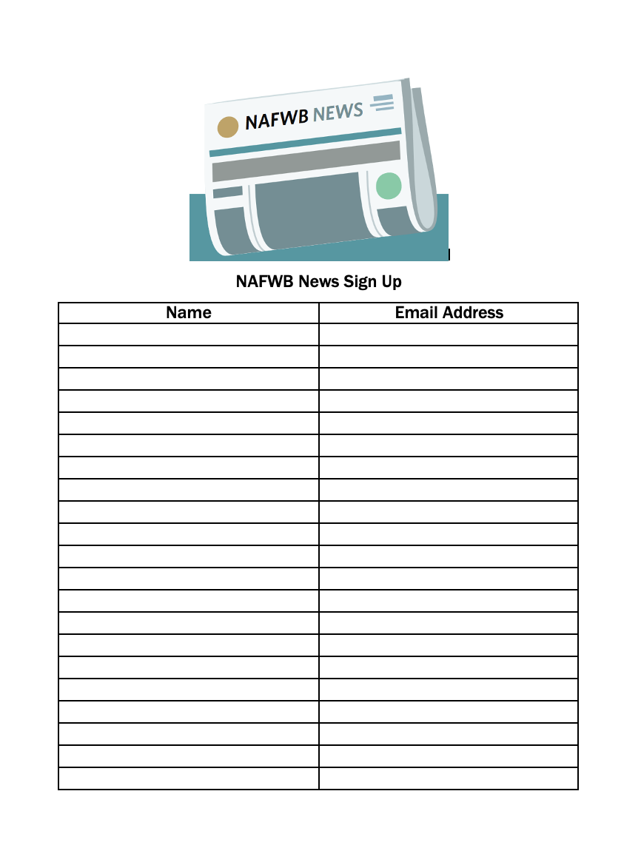

Slide 54
Financial Solutions

Slide 55
FWB Benefits for FWB Employees
403(b)(9)

Slide 56
403(b)(9) Approved Plan
Our 403(b)(9) plan is approved by the IRS for ALL employees of FWB Churches or Church Organizations.
403(b)(9) is simply the section of the Internal Revenue Code that describes church retirement income accounts.
Much like 401(k) is Internal Revenue code for employer plans
Contributions and interest tax deferred. Not to be included in gross “reportable” income
Notes:
A 403(B)(9) is much like a 401(K).
Eligibility – any FWB employee…

Slide 57
Flexible Contributions
Start with as little as $10 per month
Maximum contribution allowable is 100% of taxable income or $66,000, whichever is less. (2023)
Salary Reduction limit $22,500 for 2023
Special “catch-up” provisions are available to certain participants
Over 50 Catch-up $7,500 per year (2023)
Notes:
You can start an account with as little as $10/mth (and then add to it as you go).

Slide 58
Illustration of Possibilities
*Illustration growth potential is based upon monthly deposit at an 6% per annum, compounded annually, on the account balance at the ending of the month and from the date subsequent deposits are made.
Monthly Deposits* | 10 Years | 20 Years | 30 Years | 40 Years
$100 | $16,765 | $46,791 | $100,562 | $196,857
250 | 41,914 | 116,978 | 251,405 | 492,143
500 | 83,829 | 233,956 | 502,810 | 984,286
750 | 125,744 | 350,934 | 754,215 | 1,476,429
1,000 | 167,659 | 467,912 | 1,005,620 | 1,968,572
1,250 | 209,574 | 584,890 | 1,257,430 | 2,460,715
Notes:
This chart demonstrates the power of time and interest. So a little can go a long ways given time.
The more you are able to contribute and the longer you contribute, the more you have in retirement.

Slide 59
$500,000 Starting Point
Age | Yearly Amount | Retirement Age | Number of Years to Save | Total Contribution | Ending Balance
20 | $2,100 | 65 | 46 | $96,600 | $504,207
30 | $3,960 | 65 | 36 | $142,560 | $500,021
40 | $7,980 | 65 | 26 | $207,480 | $500,392
50 | $18,420 | 65 | 16 | $294,720 | $501,261
60 | $67,800 | 65 | 6 | $406,800 | $501,302
Based on 6% annual return

Slide 60
Start ASAP If you start at 25 contributing $3,000 per year for 10 years then stopped. At age 65 you would have more funds than a someone that started at 35 contributing $3,000 per year and contributed until age 65. By almost $35,000 dollars. Also you would have only contributed $30,000 while the 35 year old would need to contribute $90,000.

Slide 61
Contact us
www.boardofretirement.com
Email : boardofretirement@nafwb.org
Phone: 877.767.7738
Mail: Board of Retirement
PO Box 5002
Antioch, TN 37011
Notes:
Also, check out our Instagram and FB page (Like us). We will have all kinds of different helpful financial info as we go along
Thank you!!!

Slide 62
How a Denomination Can Help You and Your Church
emoody@nafwb.org

