Slide 1
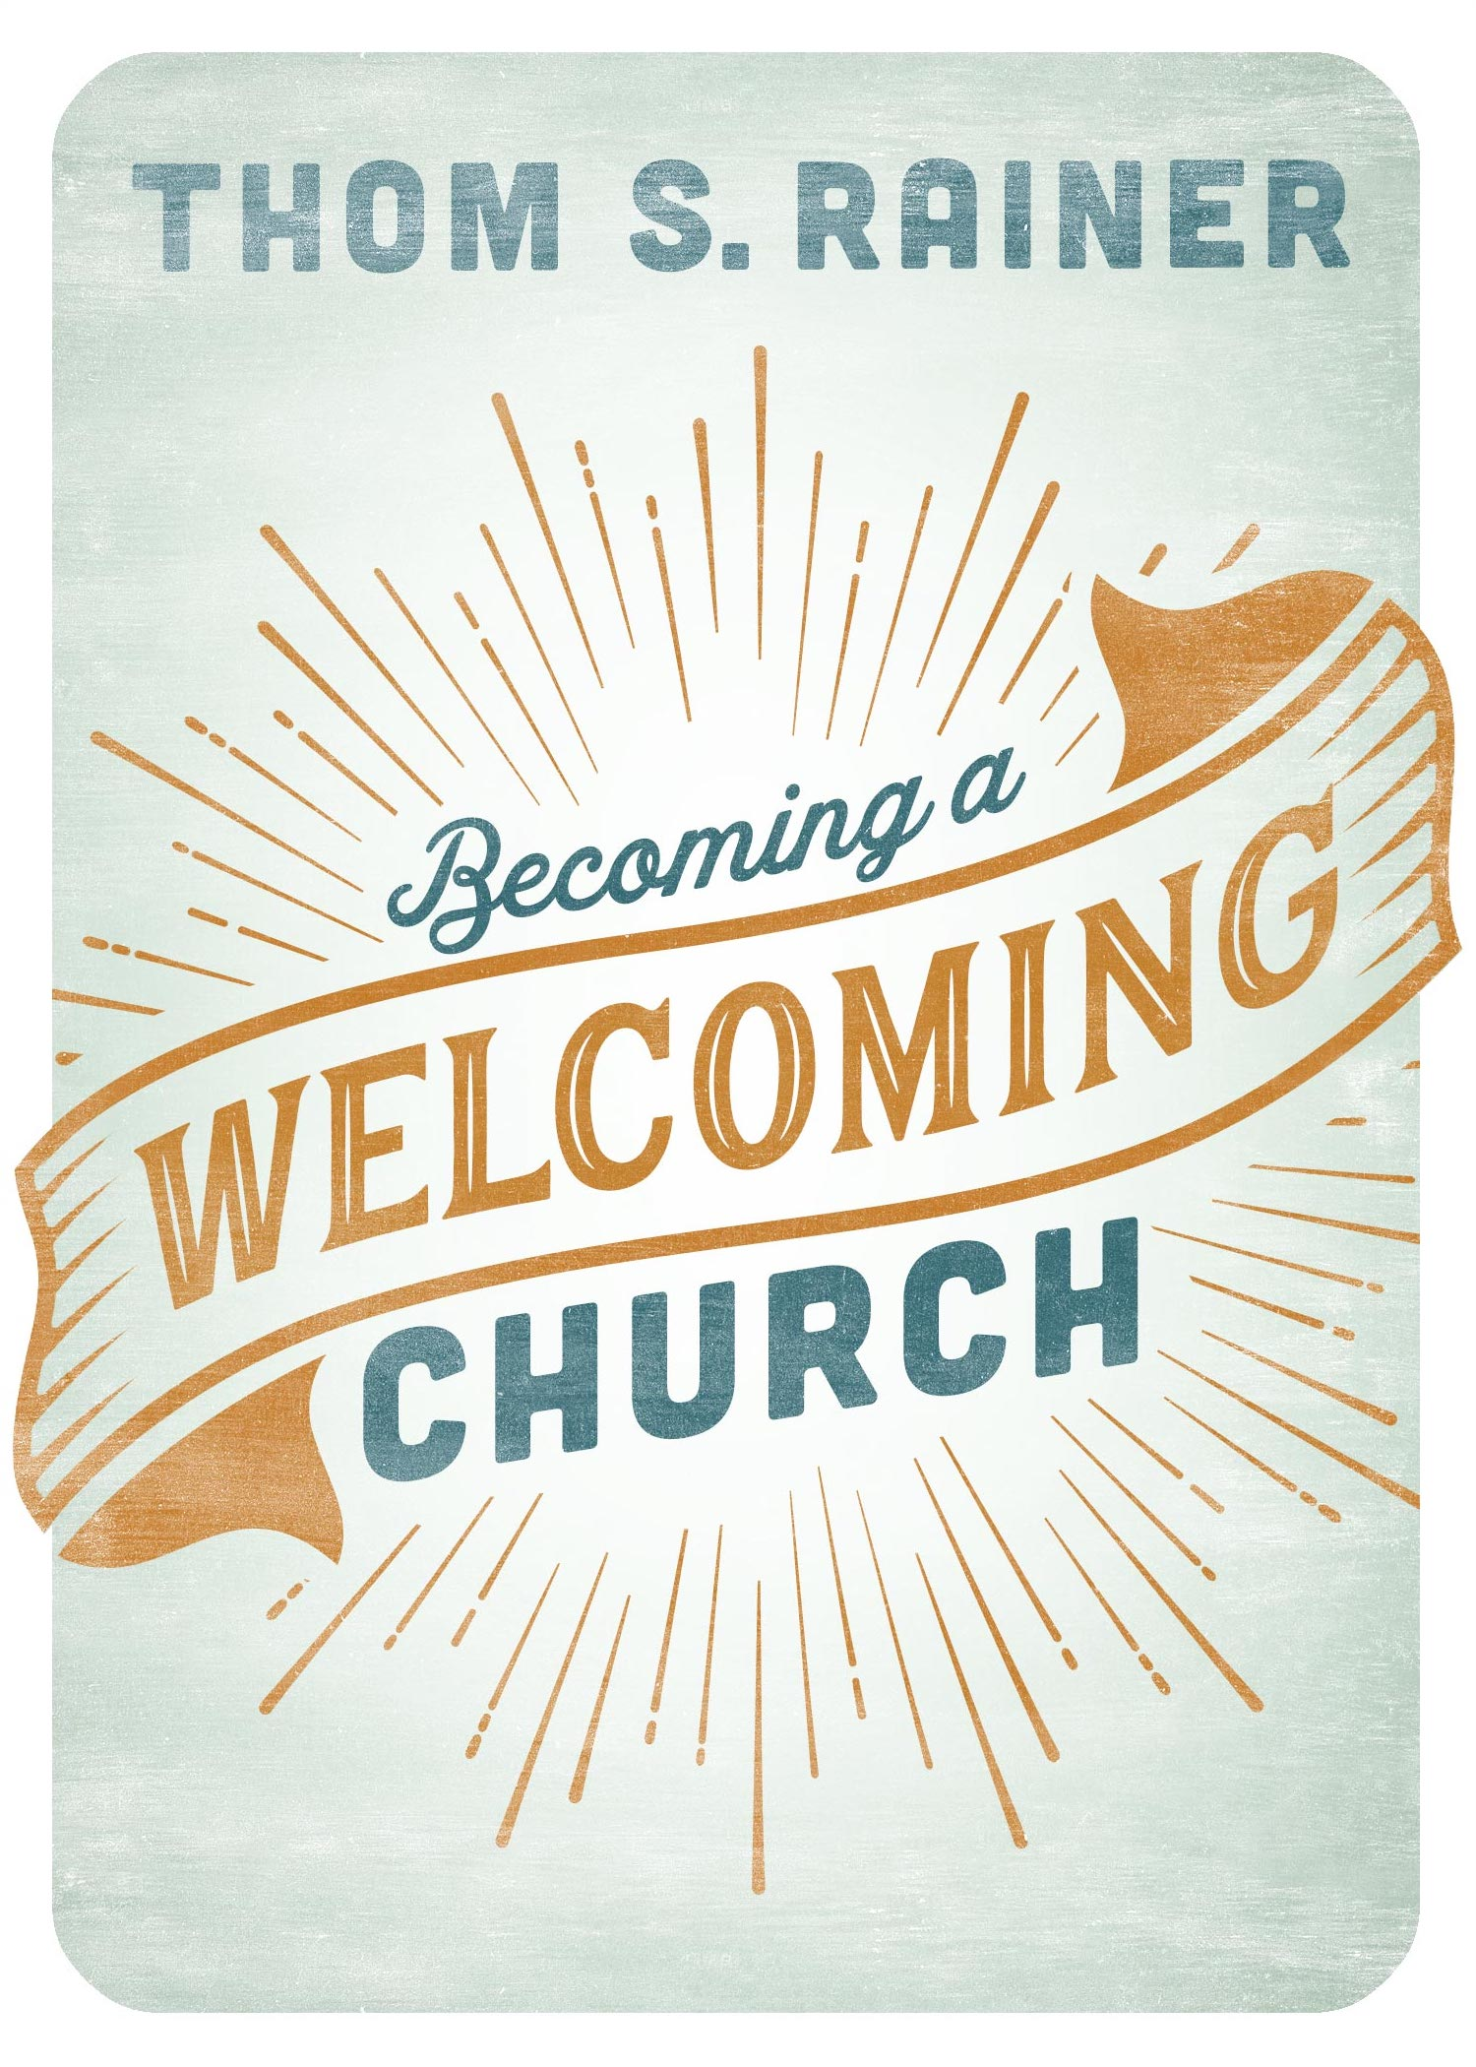

Slide 2
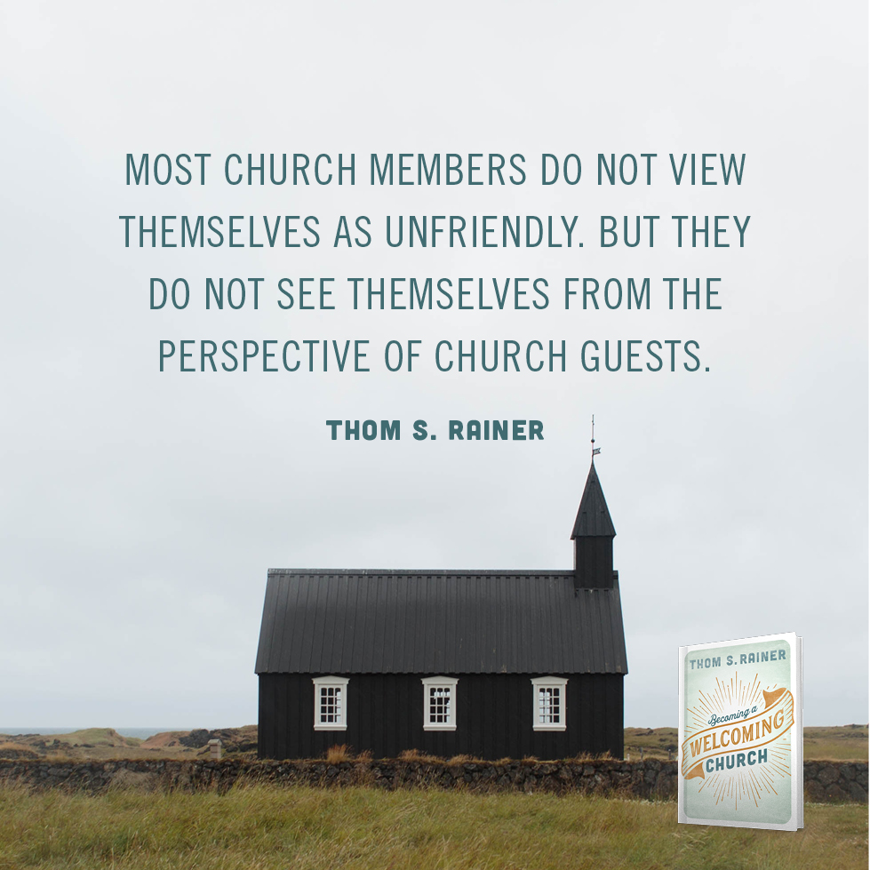

Slide 4
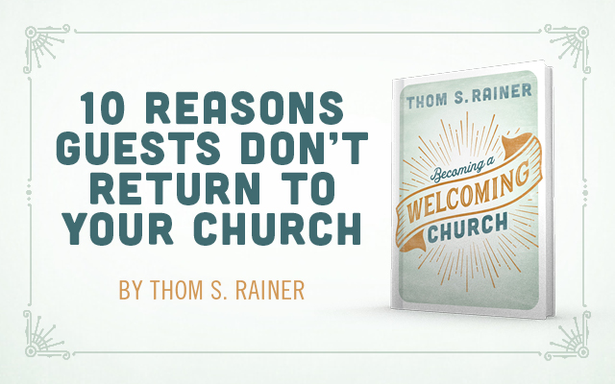

Slide 5
Be not forgetful to entertain strangers: for thereby some have entertained angels unawares.
Hebrews 13:2

Slide 6
Use hospitality one to another without grudging.
1 Peter 4:9

Slide 7
Are we as welcoming as we think we are?

Slide 8
The Myth of the Welcoming Church
The stand-and-greet time in the worship service was unfriendly and awkward.
Unfriendly church members
Unsafe and unclean children’s areas
No place to get information on the church
Bad church website
Poor signage
Insider church language
Boring or bad church services
Members telling guests they are in the wrong pew or chair
Dirty facilities

Slide 9
The Happy Guests
Someone asked the guest to sit with her.
People introduced themselves to the guests.
There was clear signage.
There was a clearly marked welcome center.
The kids loved the children’s area.
The children’s area was secure and sanitary.
Guest parking was clearly visible.
The church did not have a stand-and-greet time.
The members were not pushy.
The guest card was simple to complete.

Slide 10
Confidential Report (For Your Eyes Only)

Slide 11
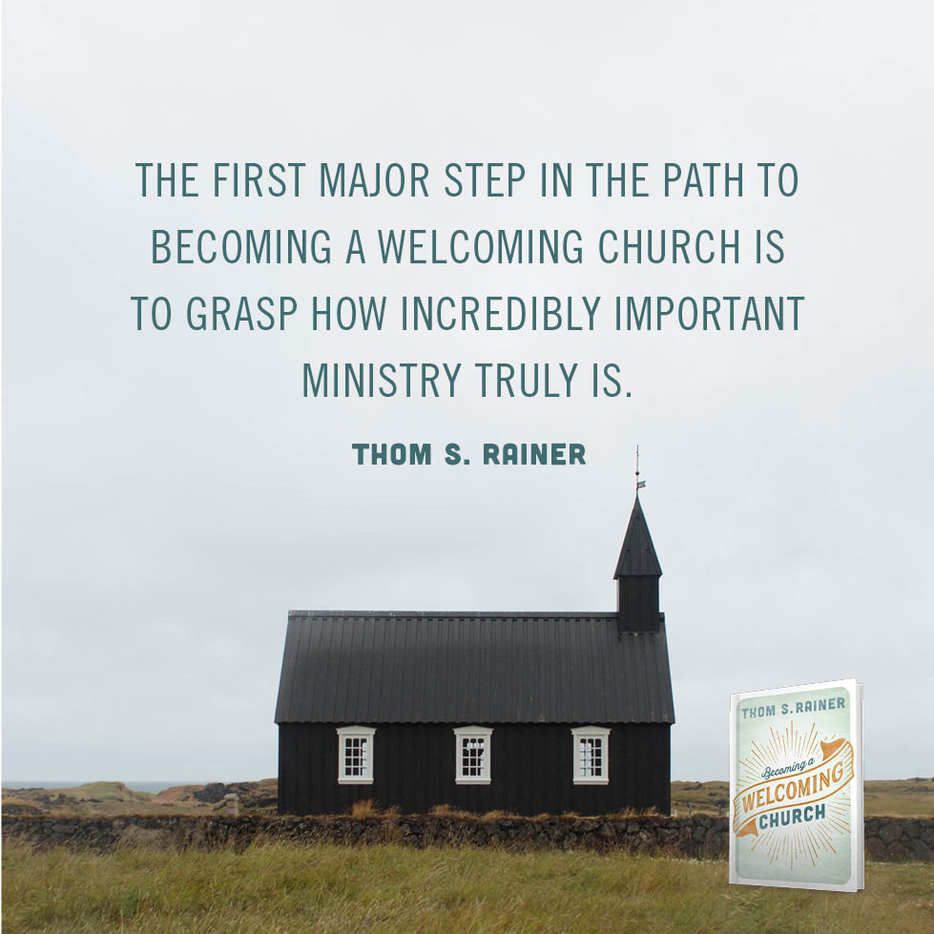

Slide 12
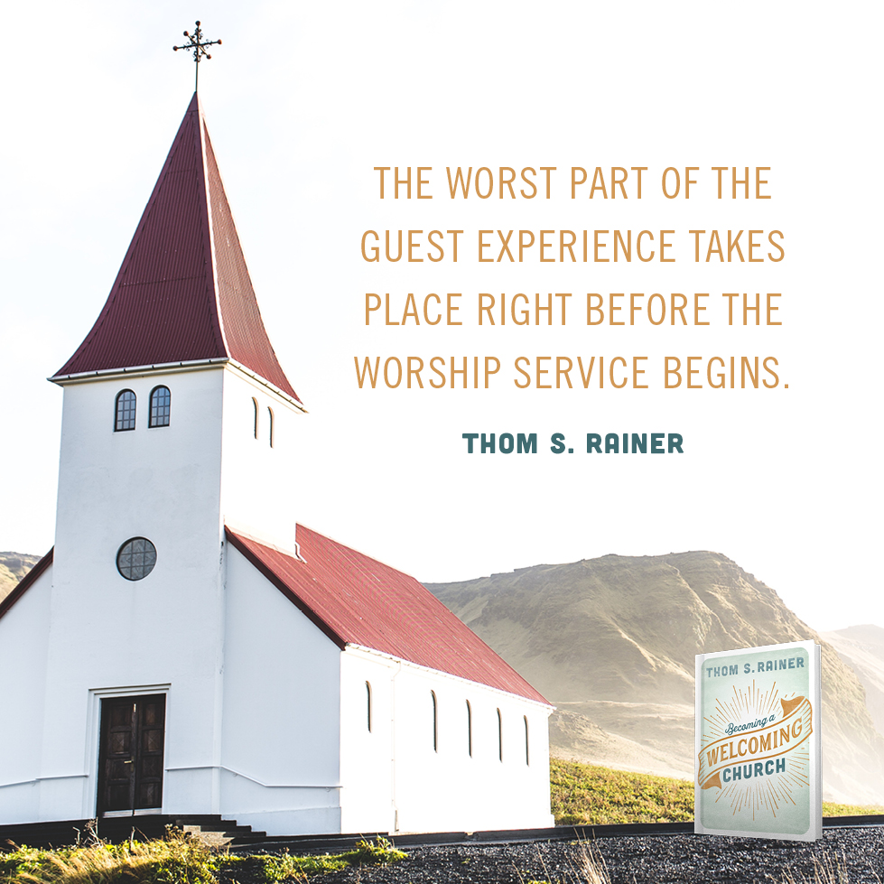
Confidential Report (For Your Eyes Only)

Slide 13
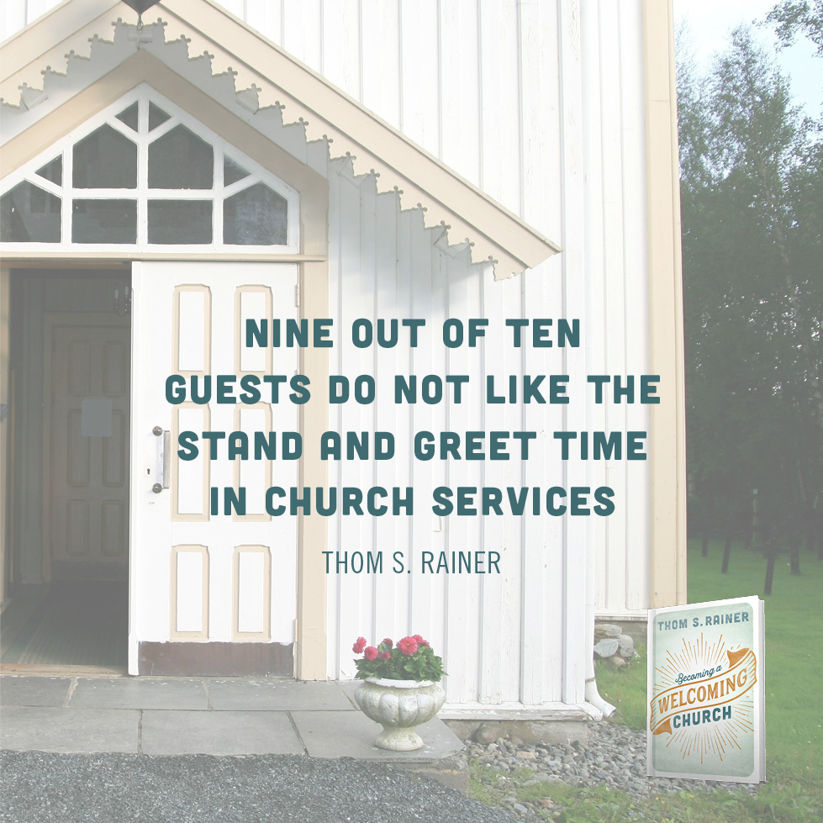
Confidential Report (For Your Eyes Only)
The worst part of the guest experience takes place right before the worship service begins.
Very few churches consider guests during the stand-and-greet.

Slide 14
Confidential Report (For Your Eyes Only)
The worst part of the guest experience takes place right before the worship service begins.
Very few churches consider guests during the stand-and-greet.
Many guests see an abundance of holy huddles in churches.
“Where’s the beef?”

Slide 15
The Silent Killers
Too friendly
What’s next?

Slide 16
Signs and Sites

Slide 17
Five Myths About Church Signage and Websites
Everyone knows where our church is.
Our church is small. We don’t need signs for people to get around.
Church websites are really not that important.
It’s easy to get around in our church.
Signs and websites are human-centered methodologies.

Slide 18
A Primer on Church Signage
Signage is not for members.
Quality signage is very important.
The primary external church sign is also very important.
The parking lot should have clear signage.
There should be clear signage pointing to the entry point or entry points of the church.
The two “must” signs are for handicap and guest parking.
Internal signage must have three basic characteristics: good quality, readable font, and right height.
All signage should be friendly and communicate an attitude of hospitality.
Mobile signage can be very helpful for guests and for the church.
Church leaders should conduct a signage audit at least once a year.

Slide 19
The Front Door We Often Forget
Address and worship times difficult to locate
Outdated information
Lack of clarity about beliefs and doctrine
Incomplete or total lack of information about children’s ministry or student ministry
Poor graphics and copyrighted images
Hardly visible contact information
No photos of pastor, staff, and other leadership

Slide 20
Distributing to the necessity of saints; given to hospitality.
Romans 12:13

Slide 21
² For kings, and for all that are in authority; that we may lead a quiet and peaceable life in all godliness and honesty. ³ For this is good and acceptable in the sight of God our Saviour;
1 Timothy 2:2-3

Slide 22
⁷ That being justified by his grace, we should be made heirs according to the hope of eternal life. ⁸ This is a faithful saying, and these things I will that thou affirm constantly, that they which have believed in God might be careful to maintain good works. These things are good and profitable unto men.
Titus 3:7-8

Slide 23
Safe Church/Clean Church

Slide 24
The Safe Church

Slide 25
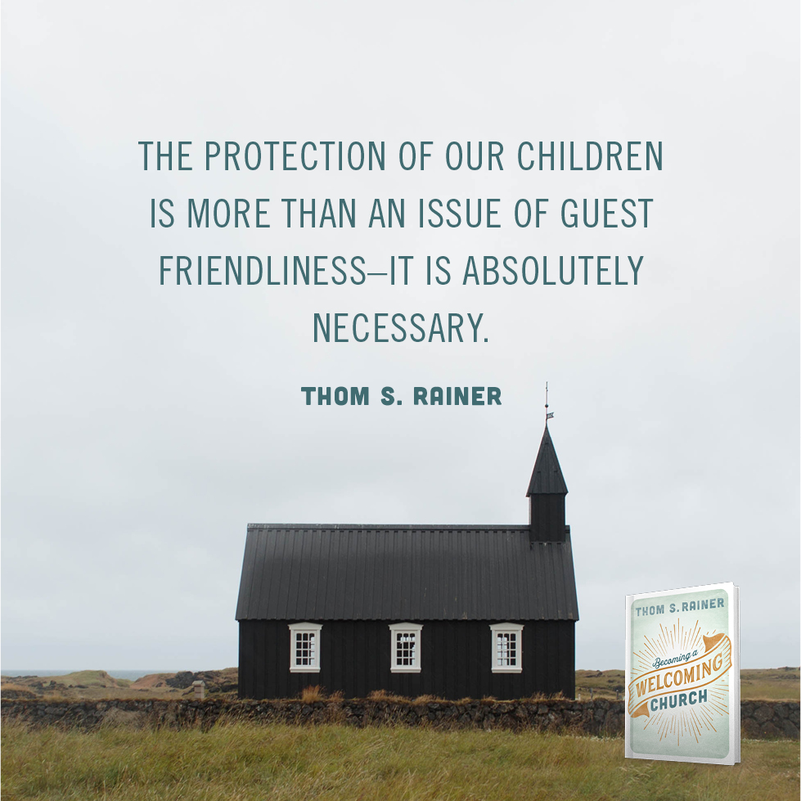

Slide 26
The Sloppy Church

Slide 27
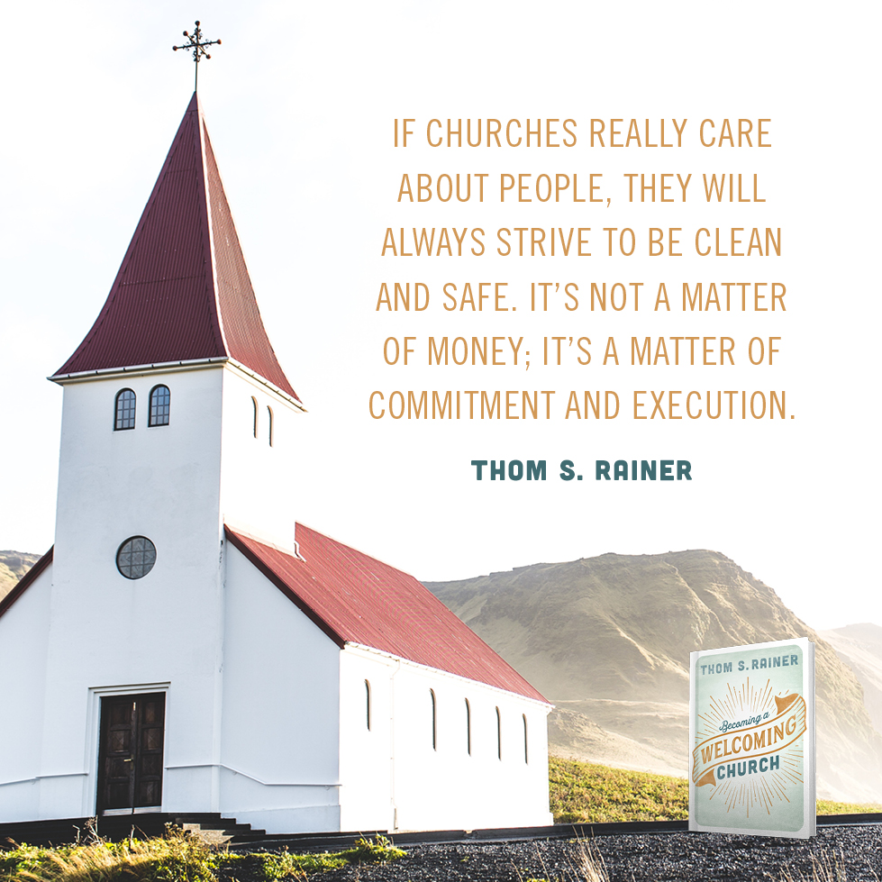

Slide 28
What Safe and Clean Churches Do
They see the issue from a gospel perspective.
They find champions.
They focus on three distinct areas: cleanliness, safety, and security.
They have regularly scheduled check-ups in all three areas.
They listen to a secret guest.
They check out other churches.

Slide 29
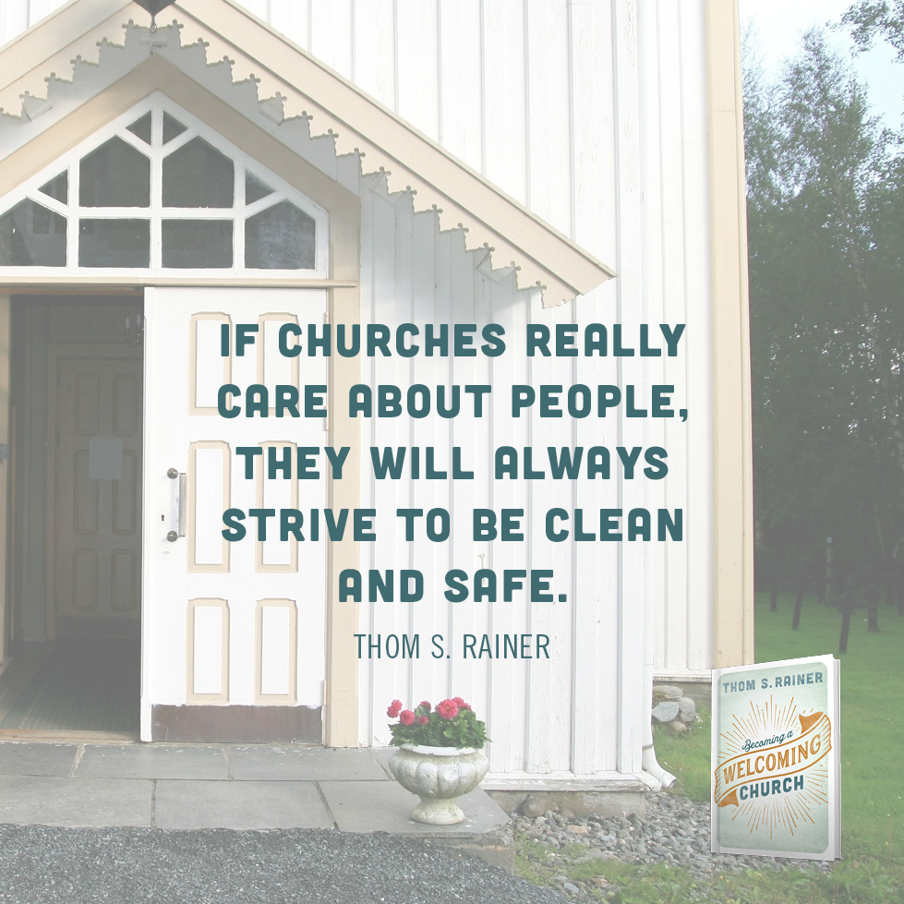

Slide 30
And whatsoever ye do, do it heartily, as to the Lord, and not unto men;
Colossians 3:23

Slide 31
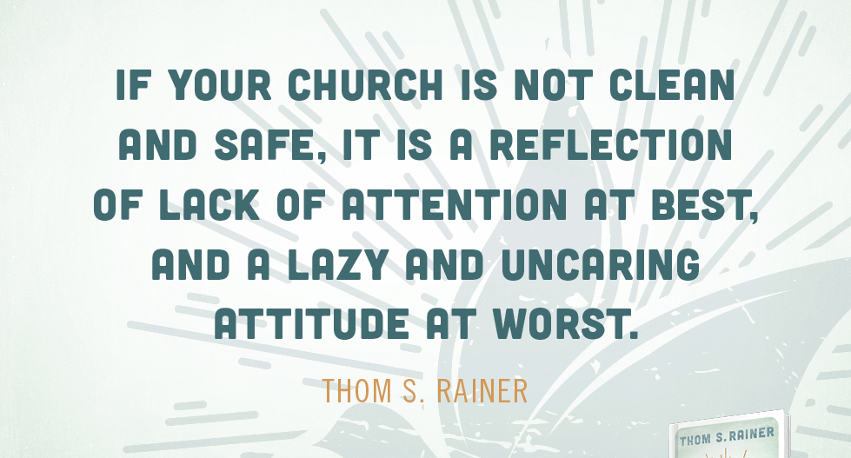

Slide 32
Greeters, Welcome Centers, and the Welcoming Church

Slide 33
Why do we even need greeters?
It’s a focused ministry
It moves people to strategic locations
It commits volunteers to specific times

Slide 34
Strategic Locations for Greeters
The parking lot
The entrances
The roaming greeters
The worship center greeter

Slide 35
Common Mistakes of Greeters
Holy huddles
Arriving too late; leaving too early
Calling the bulletin person a greeter
Failing to introduce yourself

Slide 36
The Welcome Center
It can be simple.
It should be manned when guests are present.
It should have information on the church.
It should have gifts.
It should have pens.
It should have treats.

Slide 37
The First Impression Factor

Slide 38
Greet all the brethren with an holy kiss.
1 Thessalonians 5:26

Slide 39
But we will give ourselves continually to prayer, and to the ministry of the word.
Acts 6:4

Slide 40
Let nothing be done through strife or vainglory; but in lowliness of mind let each esteem other better than themselves.
Philippians 2:3

Slide 41
The Path to Becoming a Welcoming Church
Grasp the importance of becoming a welcoming church.
Make the welcoming church a leadership priority.
Gather a team of passionate servers.
Change something every quarter.
Give guests something to remember the church.
Understand the importance of looking in the mirror.

Slide 42
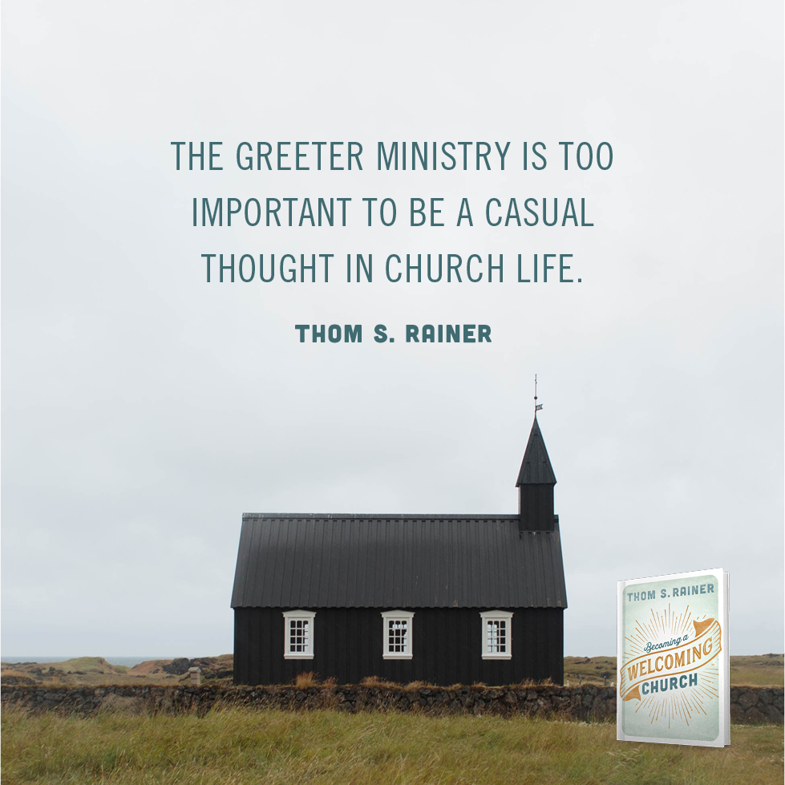

Slide 43
A Postscript of Priority
The millennials and their kids
Cultural frustration
Welcoming means going.

Slide 44
